Slide 1
Understanding Open Source
Sebastian Mancke
Creative Commons BY-SA 3.0

Slide 2
Agenda
History and definition of Open Source Software
Basic knowledge about OSS licenses
Working together

Slide 3
History and definition of
Open Source Software

Slide 4

In the beginning ..
BSD Unix
The first free unixoid software
distribution started.
In 1980 the
  BSD License
Notes:
Open Source IS commercial and non-commercial
The major difference between Open Source and Proprietary Software is not the created value, but how you create it.
Open Source characterises a new Development Model, where different parties contribute to projects that they would not run alone.

Slide 5
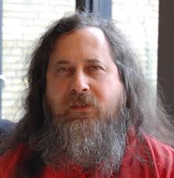

.. and ..
(in contrast to that)
Richard Stallman got the Vision
of free software
In 1983 the
  GNU Projekt and the
  GNU Manifesto
In 1989 the
  GNU General Public License
Notes:
Open Source IS commercial and non-commercial
The major difference between Open Source and Proprietary Software is not the created value, but how you create it.
Open Source characterises a new Development Model, where different parties contribute to projects that they would not run alone.

Slide 6
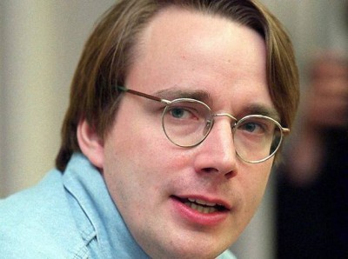

.. and then
In 25 August 1991
Linus Torwalds joined the party
He invented linux and
put it unter GPL
So:
  GNU/Linux was born!
Notes:
Open Source IS commercial and non-commercial
The major difference between Open Source and Proprietary Software is not the created value, but how you create it.
Open Source characterises a new Development Model, where different parties contribute to projects that they would not run alone.

Slide 7
Motivations for doing Open Source
market competition
pragmatism
ideology
costs
availability
velocity
transparency
independence

Slide 8
Why do I do Open Source?
pragmatism
As an engineer I always wanted to have the full power in my hands:
  Looking inside the engine
  Build new systems without limitations

Slide 9
Why do I do Open Source?
ideology
After some years of doing so,
I decided, that this is the right way for me and I don't want to use proprietary software any more.

Slide 10
Why do I do Open Source?
earning money
Open Source helps you being a good software developer and that's a perfect foundation for earning money!

Slide 11
Open Source Software hast many aspects and flavours ..
Free of charge?
Public available?
..?
Copyleft <-> proprietary extensions?

Slide 12

Definition: Open Source Software
Free redistribution
Availability of source code
Derived Works
Integrity of 'The Author's Source Code'
No Discrimination
Distribution of License
Not Be Specific to a Product
Not Restrict Other Software
Technology-Neutral License
(http://www.opensource.org/osd)

Slide 13
Basic knowledge about
OSS licenses

Slide 14
Software licenses are always a bisg issue.
OSS Licenses are standardized and therefore give you an easy understandable framework.
Even if a lot of different licenses exist, they can be clustered in a few license types (apart to proprietary licenses)
It's hard to build software without OSS parts, today
  => OSS Licenses are very relevant

Slide 15
Definition: Open Source Software
The
Open Source Initiative
lists all approved licenses:
http://opensource.org/licenses

Slide 16
Most Popular
MIT
Apache License
GPL
BSD
LGPL
Eclipse Public License
Mozilla Public License

Slide 17
Consequences of OSS license
Depending on the individual license
  strong copyleft
  weak copyleft
  non copyleft
Depending on the usage type
  Internal usage (e.g. build toolchain)
  Network services
  Unmodified delivery
  Modified delivery
  Dependencies in own components

Slide 18
Copyleft
All derivative work of code under a copyleft license must themselve be under the same or at least comparable license.

Slide 19
Copyleft
When is a work 'derived'?
  Modification of the base project
  Substantially dependency to the base project
  Statically linked
What's about dynamic linking?
  Borderline case!
  Depends on the type of dependency
  Conservative approach: derived work!

Slide 20
Copyleft
Weak copyleft:
  Modifications of the code themselves has to be the same license
  Components who use the software are free to get another license (e.g. linking libraries)
No copyleft:
  Derived work can be released under a different license
  Even proprietary software based on those software is possible.

Slide 21
Usage: Internal
Usage example: build tools, compiler, ...
Normally: No consequences
Exception: Tools which produce source code (e.g. MDA processors). If the created source is more then a simple template, it's library has to be considered.

Slide 22
Usage: Unmodified Delivery
Usage example: E.g. delivering OSS software packages.
Non copyleft licenses
  Attributation has to be preserved
Copyleft licenses
  Detailed inclusion of license information
  Provision of the source code has to be ensured

Slide 23
Usage: Modified Delivery
Usage example: Modified open source software
Non copyleft licenses
  No or small consequences
  Attributation has to be preserved
Copyleft licenses
  Releasing the whole work under the free license
  Detailed inclusion of license information
  Provision of the complete modified source code

Slide 24
Usage:
Dependencies in own components
Usage example: Using libraries in your software
Weak or non copyleft licenses
  Free to choose a license
  Attributation has to be preserved
Licenses with strong copyleft & derived work
  Releasing the whole work under the free license
  Inclusion of license information
  Provision of the complete source code of all parts of the component

Slide 25
BSD-Style & MIT License
Free distribution
No copyleft
Free choice of the license for a derived work
No duty to publish source code
Obligations:
Preservation of copyright information
For source redistribution of modified work:
  License information
  Marking of modifications
  Changing the project name

Slide 26
Apache License v2
Free distribution
No copyleft
Free choice of the license for a derived work
No duty to publish source code
Patent clause
Obligations:
Preservation of copyright information
For source redistribution of modified work:
  License information
  Marking of modifications
  Changing the project name

Slide 27
GPLv2
Free distribution
Strong copyleft
Obligations:
Preservation of copyright information
Provision of the complete source code
Changing the project name (e.g. trademark issues)

Slide 28
GPLv3
Similar to GPLv2
Saves the users of a software against patents from the originator
Anti DRM Clause
Compatibility with the Apache License V2
Problems:
Through the copy left, the GPLv2 and GPLv3 are not combinable. So better publish GPL software as
'GPLv2 or any later'

Slide 29
LGPLv2
Free distribution
Weak copyleft:
  Full copyleft for modifications on the software
  No copyleft for software that „uses“ the library or component. (e.g. static and dynamic linking is allowed)
Obligations for „usage“:
For the LGPL library, same as with GPL
For the dependent software: providing possibilities to modify the original library (e.g. object code for re-linking).

Slide 30
Afero GPL (AGPL)
Similar to GPL, but
Expand the copyleft also to users of the software within the same network.
Obligations:
The source code has to be available for every user of a services
Effective protection against proprietary usage

Slide 31
Eclipse Public License
Free distribution
Strong copyleft
No derivative works through usage or linking.
No derivative works through addition.
Obligations:
Preservation of copyright information
Provision of the complete source code
Patent grants for contributions
Changing the project name (e.g. trademark issues)

Slide 32
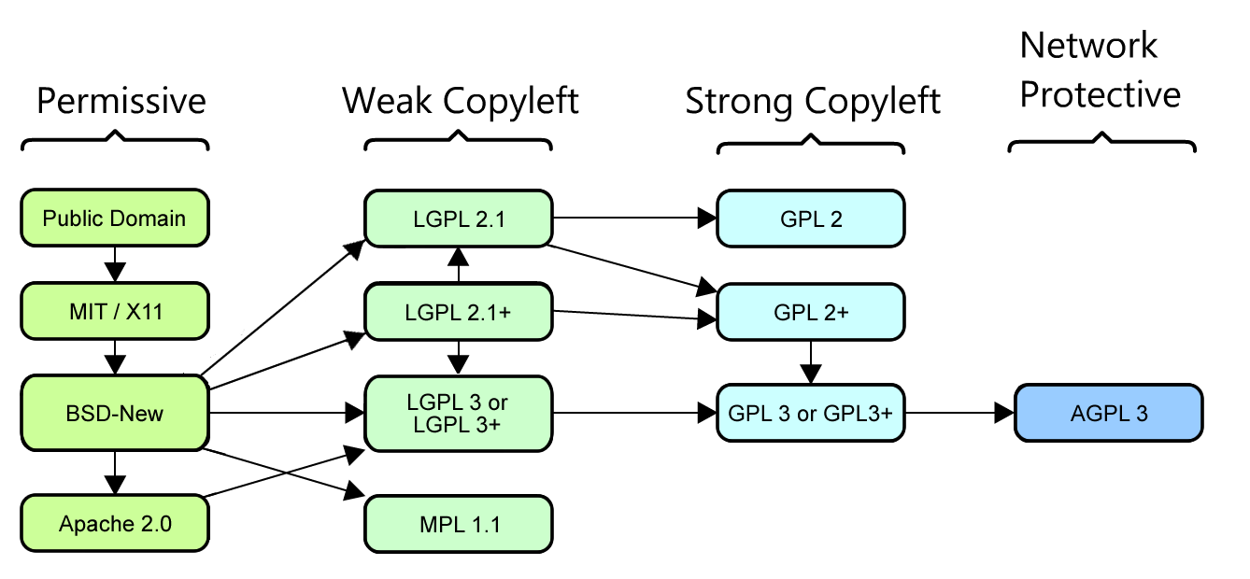
Overview and compatibility
© by David A. Wheeler

Slide 33
Providing source code
Which parts have to be provided?
  Depending on the license: all parts with copyleft
  The exact version for the binary!
  All special tools which are necessary to build the binary (e.g. build script, special compiler, ..)
To whom?
  Often misunderstood: To the person, which has obtained the binary, only.
  No duty to publish the source to the whole world if you build an application for a customer!

Slide 34
Working together ..

Slide 35
GitHub
GitHub has become the main platform for open source collaboration:
Git as foundation
Forking as default cooperation model
Markdown for documentation
Issue tracker
Hosting of static pages
Open api for integration (e.g. in build services)

Slide 36
Public build services
Services, which offer build systems for open source projects: e.g. travis-ci.org
Configuration by travis.yml
Integration with GitHub
Public viewable build status

Slide 37
Collaboration on systems
Container technologies bring collaboration to the next level:
People are able to exchange whole software systems in an easy way.
Other than linux distributions, they may be preconfigured for special usecases.

Slide 38
.. and what's next?

Slide 39
What has happened since 2005?
The (software) world has changed:
Workstations and desktop software don't
play a role anymore.
Web based services have made the race!

Slide 40
Open Source has changed
In the beginning
Individuals
Applications
User focussed
GPL
Today
Big Companies
Libraries, tools
Developer focussed
MIT

Slide 41
Open Source has changed
On the good side:
Today no company can compete without using open source!
On the bad side:
The evolution to use cloud based services makes it easy to ..
.. use open source without contribution
.. lock users

Slide 42
Questions for the future
How to avoid vendor logins:
Open standards!
Open APIs!
The freedom to stay owner of your data!

Slide 43
Thank you!

