Slide 1
mobile development platforms

Slide 2

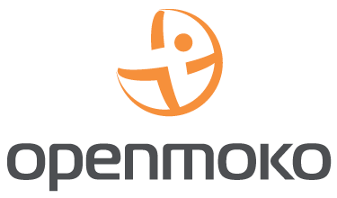




Mobile platforms

Slide 3
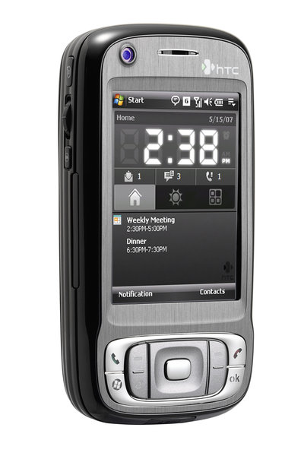
Windows Mobile
Very Closed
Main language: Visual C++
Supported developing:
  Visual Basic
  .NET
  ASP.NET
Supported devices: many phones
Company behind: Microsoft

Slide 4
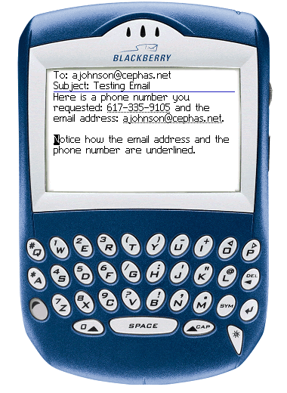
BlackBerry
Very Closed
Main language: Java (J2ME) + proprietary extensions
Supported devices: BlackBerry
Company behind: RIM

Slide 5
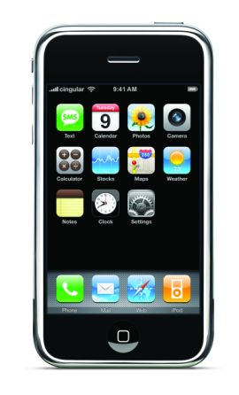
iPhone
Very Closed
Proprietary marketing model
Based on BSD + iPhone Framework
Main language: Objective C
Device: iPhone (1 model)
Company behind: Apple
Unofficial gcc based SDK available
You have to hack the phone

Slide 6
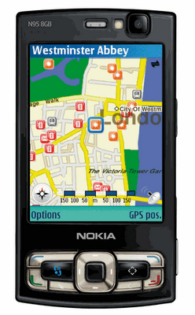
Symbian S60
Proprietary, but open for development
Based on Symbian
Main language: Symbian C++
Supported frameworks:
  Open C (Posix porting layer)
  Java (J2ME)
  Python
  Adobe Flash Lite / Web Runtime
Supported devices: many phones
Company behind: Nokia

Slide 7
Symbian Foundation
New initiative of symbian companies
Conflation of different symbian flavors
  S60
  UIQ
  MOAP(S)
Goal is to OpenSource Symbian until 2010
Planed License: Eclipse Public License (EPL)

Slide 8
Android
Free & Open? Not known yet!
Based on Linux + Android runtime
GUI Toolkits: Android
Language: Java subset only
Written from scratch
Supported devices: emulator + HTC (announced)
Company behind: Google + Open Handset Alliance

Slide 9
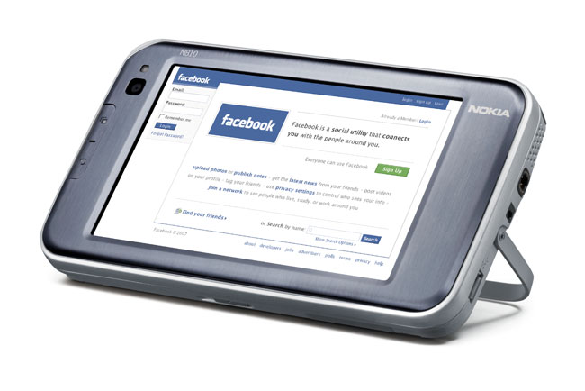
Maemo/ITOS
95 % Free & Open
Based on Linux, DBus and X11
GUI Toolkits: GTK/hildon, QT (soon)
Main languages: C, Python, C++
Based on Debian (forked)
.deb based packaging
Supported device: n810 (1 model)
Company behind: Nokia

Slide 10

OpenMoko
100 % Free & Open
Based on Linux, DBus and X11
GUI Toolkits: GTK, QT, EFL
Main languages: C, Python
Based on OpenEmbedded
.ipk based packaging
Device: Neo freerunner (1 model)
Company behind: FIC/OpenMoko

Slide 11
Biggest problems in mobile development

Slide 12
Problem 1: Too many restrictions
Free platforms change this:
Only small control over the system
Often only limited APIs are available
Features are locked, signing processes are forced
The core components are not replaceable

Slide 13
Problem 2: Too many platforms
solution:
Large number of different platforms
Few standards for cross platform development
  J2ME
  HTML/Web Applications
J2ME often relies on proprietary extensions
Some platforms cover only one device
Cross platform development standards
Or: Focus on widespreaded platforms

Slide 14
Problem 3: Different development approach
Solved by:
Experienced developers want to reuse their knowledge
Companies don't want to hire additional staff for mobile development
Development Environments should be the same in mobile and desktop development
Applications/frameworks should be reused
Multi tier applications should use a homogeneous software stack if possible

Slide 15
Problem 3: Different development approach
Solved by:
Experienced developers want to reuse their knowledge
Companies don't want to hire additional staff for mobile development
Development Environments should be the same in mobile and desktop development
Applications/frameworks should be reused
Multi tier applications should use a homogeneous software stack if possible
For a small group
of target developers, only!

Slide 16

What's wrong with J2ME?
Targets much of the problems, but ..
Has too much restrictions
Differs to much from usual Java
  Completely different APIs
  No code reuse
Even if it is standardized:
  Every manufacturer has different implementations
  Applications have to be device specific
Not powerful enough for much application types

Slide 17
What's about Android?
Targets much of the problems ...
has only few restrictions
uses real Java
promises wide availability
... but ...
  still differs from usual Java
    special APIs
    code reuse only below the GUI
  is not standardized
    is not designed for integration in other platforms
    does not integrate other approaches

Slide 18
What's about Maemo & OpenMoko?
They do a lot of things right ...
eliminate restrictions
use real desktop toolkits
... but ...
  each platform has only one device
  no API standardization (between those platforms)
  focus only on a very special developer community

Slide 19
Cross platform solutions
Cross platform development is not a language problem,
but a problem of cross platforms the libraries and toolkits.
Upcoming solutions
QT
FreeSmartPhone.org standards
LWUIT
Jalimo
OpenEmbedded

Slide 20
What's about QT?
QT has the chance to become a solution!
Good, powerful Toolkit
Wide availability
  Windows, Windows Mobile
  Linux, OpenMoko
Good Java bindings: Jambi
Acquired by Nokia
Soon supported on Symbian and Maemo

Slide 21
FreeSmartPhone.org standards
Origin
OpenMoko framework initiative
Most work founded by OpenMoko
Independent Project
Standardisation of Smartphone APIs
DBus API design
Reference implementation of services
Base for any interaction of applications with the platform

Slide 22
LWUIT
GUI Library for J2ME
Similar to Swing
Small but powerful
Released as GPL from Sun, just now
Benefits of LWUIT
Usable on all J2ME phones
Easy portable backend
Ports in work
  Java AWT (CDC)
  Microbackend (X, SWT, AWT, ...)
Sun's way to unify mobile and desktop development?

Slide 23
jalimo
What is jalimo not:
Project to bring free full Java to mobile and embedded platforms
Support for the development lifecycle to target mobile devices with java
Integrative project, doing most work in upstream projects
Current targets: maemo, OpenMoko, BugLabs, BeagleBoard, Irex Iliad
No additional mobile platform!
No additional JVM!

Slide 24
Who is behind jalimo?
Why is tarent doing jalimo?
Initiated by Tarent
Active members from: Bug Labs & MIDPath
  Tarent has employed 60 people (~40 Java developer)
  Most of tarent's projects use java on the server side
One technology among the applications!
Use the same staff for mobile and server side development!

Slide 25
Parts of jalimo
GUI
Libraries
Runtime
Build
Plattform
J2SE 1.5 focused
Different alternatives for different requirements
SWT
AWT/Swing
java-gnome
MIDPath
dbus-java
scio
fso.org-java
...
GNU Classpath
Sun PhoneME
Cacao JVM
JamVM
maven packaging plugin
Eclipse
OpenEmbedded
...?...
maemo
openmoko
......

Slide 26
OpenEmbedded
cross-compile environment
generation of complete distributions
support for 1000's packages
builds the base for
  OpenMoko
  Angstroem
  Jalimo
  Buglabs
  Irex Iliad
  ...
Nice solution for multi platform development

Slide 27
Different level of openness
Closed
usual mobile, iPhone
Open for application development
Symbian, Android, J2ME phones, Windows Mobile, BlackBerry
Open and customizable
maemo
Free and open
OpenMoko, OpenEmbedded
Free, open and standardized
Nothing yet! (FSO has a chance!)
GPL

Slide 28
Thank you!
Mobile@FrosCon:
Freie Software für das iPhone
  Ralph Pöllath
  11:15 Uhr, HS 4
Openmoko 2008
  Michael Lauer
  14:00 Uhr, HS 1
CC-BY-SA 3.0 or GNU FDL 1.2 or, at your option, any later version.

