Slide 1
Unifying mobile development

Slide 2






Mobile platforms

Slide 3
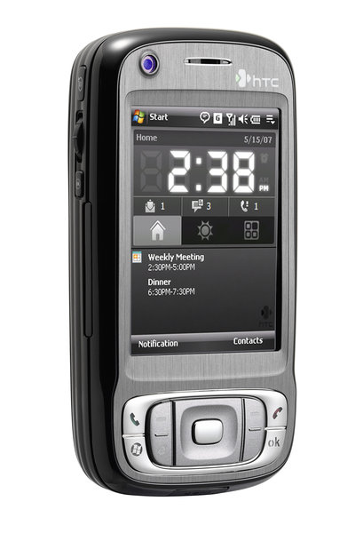
Windows Mobile
Very Closed
Main language: Visual C++
Supported developing:
  Visual Basic
  .NET
  ASP.NET
Supported devices: many phones
Company behind: Microsoft

Slide 4
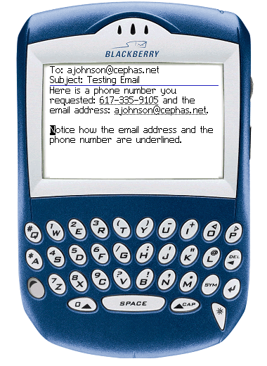
BlackBerry
Very Closed
Main language: Java (J2ME) + proprietary extensions
Supported devices: BlackBerry
Company behind: RIM

Slide 5
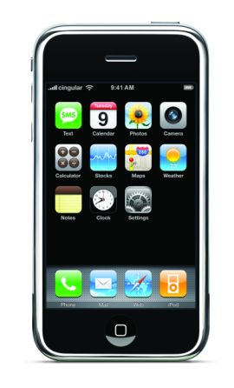
iPhone
Very Closed
Proprietary marketing model
Based on BSD + iPhone Framework
Main language: Objective C
Unofficial gcc based SDK available
Device: iPhone (1 model)
Company behind: Apple

Slide 6
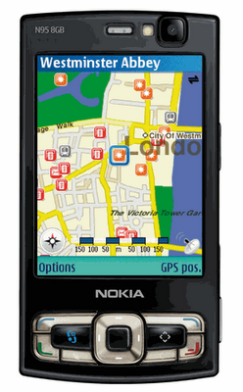
Symbian S60
Proprietary, but open for development
Based on Symbian
Main language: Symbian C++
Supported frameworks:
  Open C (Posix porting layer)
  Java (J2ME)
  Python
  Adobe Flash Lite / Web Runtime
Supported devices: many phones
Company behind: Nokia

Slide 7
Android
Free & Open? Not known jet!
Based on Linux + Android runtime
GUI Toolkits: Android
Language: Java only
Written from scratch
Supported devices: emulator + HTC (announced)
Company behind: Google + Open Handset Alliance

Slide 8
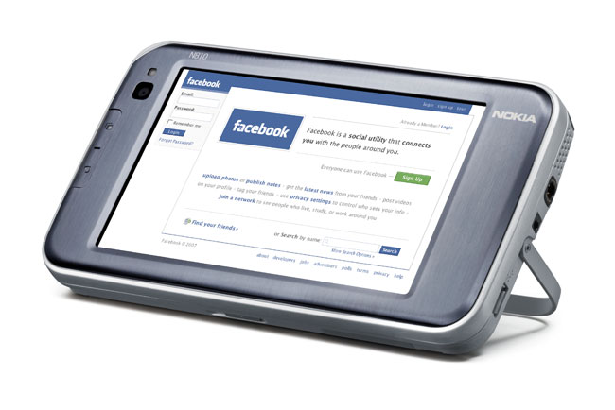
Maemo/ITOS
98 % Free & Open
Based on Linux, DBus and X11
GUI Toolkits: GTK/hildon, QT (soon)
Main languages: C, Python, C++
Based on Debian (forked)
.deb based packaging
Supported device: n810 (1 model)
Company behind: Nokia

Slide 9

OpenMoko
100 % Free & Open
Based on Linux, DBus and X11
GUI Toolkits: GTK, QT, EFL
Main languages: C, Python
Based on OpenEmbedded
.ipk based packaging
Device: Neo freerunner (1 model)
Company behind: FIC/OpenMoko

Slide 10
Biggest problems in mobile development

Slide 11
Problem 1: Too many restrictions
Free platforms change this:
Only small control over the system
Often only limited APIs are available
Features are locked, signing processes are forced
The core components are not replaceable

Slide 12
Problem 2: Too many platforms
solution:
Large number of different platforms
Few standards for cross platform development
  J2ME
  HTML/Web Applications
J2ME often relies on proprietary extensions
Some platforms cover only one device
Cross platform development standards
Or: Focus on widespreaded platforms

Slide 13
Problem 3: Different development approach
Solved by:
Experienced developers want to reuse their knowledge
Companies don't want to hire additional staff for mobile development
Development Environments should be the same in mobile and desktop development
Applications/frameworks should be reused
Multi tier applications should use a homogeneous software stack if possible

Slide 14
Problem 3: Different development approach
Solved by:
Experienced developers want to reuse their knowledge
Companies don't want to hire additional staff for mobile development
Development Environments should be the same in mobile and desktop development
Applications/frameworks should be reused
Multi tier applications should use a homogeneous software stack if possible
For a small group
of target developers, only!

Slide 15

What's wrong with J2ME?
Targets much of the problems, but ..
Has too much restrictions
Differs to much from usual Java
  Completely different APIs
  No code reuse
Even if it is standardized:
  Every manufacturer has different implementations
  Applications have to be device specific
Not powerful enough for much application types

Slide 16
What's about Android?
Targets much of the problems ...
has only few restrictions
uses real Java
promises wide availability
... but ...
  still differs from usual Java
    special APIs
    code reuse only below the GUI
  is not standardized
    is not designed for integration in other platforms
    does not integrate other approaches

Slide 17
What's about Maemo & OpenMoko?
They do a lot of things right ...
eliminate restrictions
use real desktop toolkits
... but ...
  each platform has only one device
  no API standardization (between those platforms)
  focus only on a very special developer community

Slide 18
What's about QT?
QT has the chance to become the solution!
Good, powerful Toolkit
Wide availability
  Windows, Windows Mobile
  Linux, OpenMoko
Good Java bindings: Jambi
Acquired by Nokia
Soon supported on Symbian and Maemo

Slide 19
What is jalimo?
What is jalimo not:
Project to bring free full Java to mobile and embedded platforms.
Composition and maintainment of a complete solution stack for its target platforms.
Support for the development lifecycle to target mobile devices.
Current targets: maemo, OpenMoko
No additional mobile platform!
No additional JVM!

Slide 20
Why we are doing jalimo?
Small devices have special Java requirements
Integration in mobile windowing systems
Most free linux mobile distributions are not aware of Java
Java developers need special support when they target Linux mobile devices
Java developers need a maintained platform to rely on – especially commercial ones

Slide 21
Why we are doing jalimo?
Tarent has employed 56 people (~40 Java developer)
Most of our projects use java on the server side
We want:
One technology among our applications!
Use the same staff for mobile and server side development!

Slide 22
Why we are doing jalimo?
FREEDOM
and
FUN!

Slide 23
Components we use
Mostly J2SE 1.5 focused
Different alternatives for different requirements
The goal is to add more alternatives
Focus: CacaoJVM, GNU Classpath, Eclipse SWT
Also: jamvm, swing, java-gnome, midpath
Also: Mysaifu JVM + eSWT on Windows Mobile
Additional libraries: java-dbus, scio (more coming)
Toolchain support: OpenEmbedded, maven-pkg-plugin

Slide 24
Parts
GUI
Runtime
Build
Plattform
SWT
AWT/Swing
java-gnome
MIDPath
GNU Classpath
OpenJDK
Cacao JVM
JamVM
maven packaging plugin
Eclipse
OpenEmbedded
...?...
maemo
openmoko
......

Slide 25
So, what is possible?
Run nearly all Java 1.5 applications on maemo and OpenMoko
Choose between SWT, Swing or java-gnome GUI
Run J2ME applications
Integrate into the target system, using dbus
Consume web services using scio
Package your application as .deb or .ipk using maven
Porting our stack to every Linux Embedded platform, very fast

Slide 26
OpenEmbedded Toolchain
OpenEmbedded infrastructure
  self-hosting toolchain
  builds jalimo packages for arbitrary distributions and hardware. From a single source!
OpenEmbedded build recipes
  „swt“, „dbus-java“, ...
  in OpenEmbedded upstream
  and Jalimo svn-overlay
Repositories
  public repositories for maemo and OpenMoko
  Integration in OpenMoko, Angstroem, ...

Slide 27
maven packaging plugin
Maven2 is currently the mainstream build tool for Java
Maven allows dependency definition at artifact (.jar-file) level
Packages Maven2 projects for specific distributions
On the fly dependency translation
  maven dependencies => platform dependencies
Supported Platforms
  Maemo Chinook (.deb)
  OpenMoko (.ipk)
  Debian (.deb)

Slide 28
What we are missing most?
A VM which is as fast as cacao with the startup of jamvm
Debugging support (JVMTI)
Really fast Swing implementation for OpenMoko
More free phones!

Slide 29
What we are missing most?
A VM which is as fast as cacao with the startup of jamvm
Debugging support (JVMTI)
Really fast Swing implementation for OpenMoko
More free phones!

Slide 30
JIT-Cache
Robert Schuster implemented caching of native code for the CacaoJVM (will be released soon)
Allows fast startup of applications
Integration into the build process using Qemu: precompiled binaries

Slide 31
Small goals
Big goals (whishes)
More library code and integration
Integrate SUN's Swing implementation
Attract more developers
Package the complete Eclipse RCP/eRCP
Support QT-Jambi
More applications
Port Android APIs to other platforms
SWT implementations for Android, iPhone
Get additional VMs e.g. for Symbian S60

Slide 32
Resources
jalimo.org
Documentation of how to install binary packages for Maemo & OpenMoko
Simple development & packaging tutorial
  mvn-pkg-plugin.evolvis.org:
  Project site and documentation (examples!) for packaging plugin

Slide 33
Thank you!
CC-BY-SA 3.0 or GNU FDL 1.2 or, at your option, any later version.

