Slide 1
Micro Services
Sebastian Mancke
Creative Commons BY-SA 3.0

Slide 2

Monolythic Software
Why are monolythic systems 'evil' ?
Because of their dependencies:
Software is not easy to test
And hard to refactor
Effects of changes can not be isolated
Working with multiple developers/teams is challenging
No reuse of functionality
Runtime and deployment dependencies:
  Performance and scaling
  Deployment of features and releases

Slide 3
Avoid a Monolyth
Monolyths arise from bad design,
independent of the technology!
You can build a monolyth with every software framework.
Even distributed systems with a lot of services can be monolythic.
And even software with monolythic builds and deployments may have a good internal structure.
So, chosing a popular micro services framework is not enough!

Slide 4
Think Vertical!
Split the application in functional modules
Maximal reduction of dependencies between different functional parts
Vertical teams (End-to-End)

Slide 5
Classical Approach
GUI -Layer
Services
Database/Persistance

Slide 6
SOA Approach
GUI -Layer
Business
Service
Business Service
Business
Service
Persistence Service
Persistence Service
Persistence Service
Persistence Service
Persistence Service
DB
DB
DB
DB
DB

Slide 7
The Micro Services Way...
GUI
GUI
GUI
GUI
Service
Service
Service
Service
DB
DB
DB
DB

Slide 8
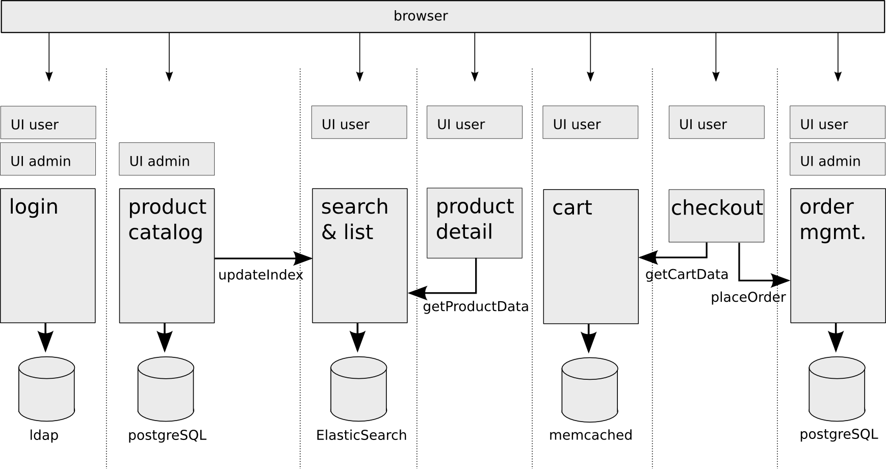
Shop Example

Slide 9
Micro Services

Slide 10
Micro Services Principles 1/2
by James Lewis:
Small with a single responsibility
Each application only does one thing
Small enough to fit in your head
  “If a service is bigger than your head, than it is too big”
Small enough that you can throw them away
  Rewrite or Maintain

Slide 11
Micro Services Principles 2/2
by James Lewis:
Located in different VCS roots
Each application is completely seperate
Domain Driven Design / Conway’s law
  Domains in different bounded contexts shoud be distinct - and it is ok to have duplication
  Use physical separation to enforce this
There will be common code, but it should be library and infrastructure code
  Treat it as you would any other open source library
  Stick it in a nexus repo somewhere and treat it as a binary dependency

Slide 12
Implementation
No application servers
Every service runs in it's own process
Every service brings it's own environment
Choose the right stack for the requirements
1 monolyth → 1 stack, 100 Micro Services → flexibility
Free choice of: OS, language, framework, database, ..
But: Be careful!
New feature, new service?
At first check, if a feature should build a new functional module
Only in the second step extend an existing service
Rule: Merging services is easy, splitting is hard!

Slide 13
Java Frameworks
Spring Boot
Dropwizard
Vert.x

Slide 14
Database
Design goal:
Every service should have it's own exclusive database
Strategies
NoSQL / document oriented design
Treat foreign keys as REST URI references
When a service needs external data: Call a service
Don't fear data redundancy
Replication of data: Pulling feeds with changelogs
Tradeoff solutions
Multiple schemas within the same database
Read-only views for data of other services
Use DB features for replication (e.g. database link)

Slide 15
UI
Design goal:
Services should provide their UI themselves
Strategies
Every service serves the full page, including layout and menu bar
Commitment on one CSS naming schema
Central asset service (menu, styles, common resources)
Single page apps only within one service
GUI composition only on the client (in the browser)
Use UI fragments / widgets when embedding data of another service

Slide 16
Security
Problem: The security context is spread over 100 services
Solution: Identity Management System
Identity Management is also a service module (or even multiple)
    Service for management of identities
    Service for login/logout
    Service for self administration
  OAuth2 allows distribution of the login to different services

Slide 17
Login implementations
Variant a: Shared Cookie
All services are available under the same domain
The login service creates a cookie available to all others
      Username, timestamp, rolles/permissions
      Crypted and signed
  All services can verify the cookie by checking the signature
Variant b: Independent Applications
Every service maintains it's own session
Login is done by OAuth2
        Double redirect
        Token exchange
  The login service maintains a sessions as well
  Multiple logins are done transparent to the user

Slide 18
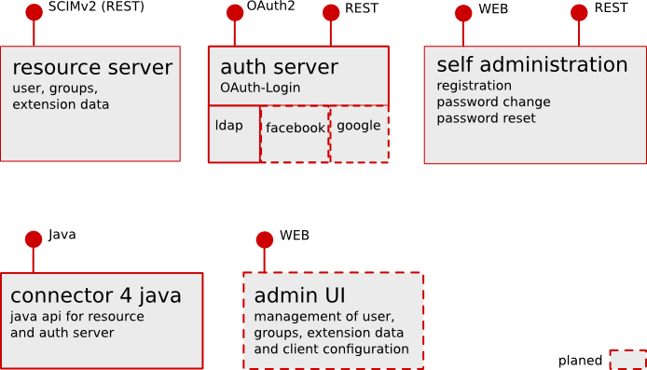
OSIAM
https://github.com/osiam/

Slide 19
Communication
Everything is allowed
But: You should establish one standard for your platform.
Principles
Loose coupling – services should not know about each other
Smart endpoints, dump pipes
    No intelligence in the communication channel
    No ESB
REST is a good choice for many scenarios
Easy consumable with all languages
Interfaces are maintainable towards compatibility
URI references are helpful for navigation to different services and abstraction of the physical location of resources.

Slide 20
Communication– further principles
Asynchronous Messaging
Reliable event distribution
High performance
Load protection of critical services
Resilience
Tolerance against failures
Error recovery
Avoid error cascades
API Versioning
Don't do it for internal APIs!

Slide 21
Testing
Unit Tests
Integration tests suffice in many cases because the services are small
Test the isolated service (Other services should be mocked)
Consumer Driven Tests
Idea: The integration tests of a service will be defined and implemented by the consumer (not by the service provider).
No release before the service passes all consumer's tests
Test with the real expectations, not with the service specification
Very smart concept, but hard to maintain
Has the risk of high test-redundancy for common APIs

Slide 22
Deployment
Contiuous Delivery
Create a deployment pipeline
Need to automate everything
One monolyth may be easy to deploy, 100 Micro Services may not!
Packaging & Provisioning
Usage of established standards: DEB, RPM, …
Robust init scripts
Configuration management: Puppet, Chef, ...

Slide 23
Deployment as platform
1 Micro Service : 1 Linux System
Docker
LXC based virtualisation
Similar to changeroot (but a lot better!)
Slim and fast
Based on git, so changes of the images can be tracked
For Hardliners
Install the Micro Service by shipping and starting the system image
No packaging
No init scripts

Slide 24
Monitoring
Realtime metrics
Monitor, what currently happens
Fast reaction to problems
Do monitoring inside the application, not outside
Tools: Metrics, Spring Boot Actuator
Logging
Manual search in logs of 100 services is not possible
Central log aggregation
Filtering and analyses in realtime
Tools: Logstash, Graylog2, Kibana, Apache Flume, fluentd

Slide 25
Risks
Micro Services are a promising paradigm
  But, you should always be careful with new paradigms!
Inventarisation of many services
Challenging for operations
High network load (if not done right)
New way of thinking
The freedom of technology selection may lead to chaos,
  if it is no governance

Slide 26
Thank You!

