Slide 1
Shell Bootcamp 2024 3 Reflections for Week #2
Siddharth Mandal
Date : 6-Sept-2024

Slide 2

My learnings from this week!

Slide 3
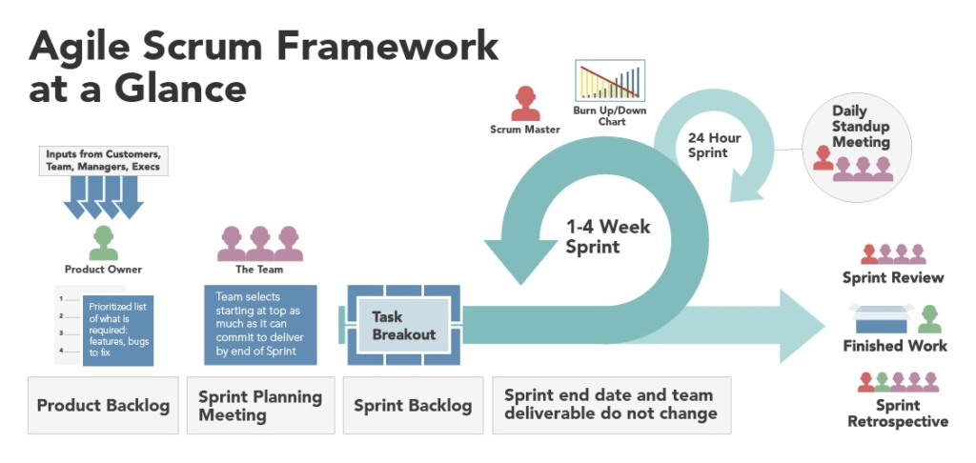
Learning 1 - Agile | My takeaways
Introduction to Agile:
Definition of Agile methodology.
History and evolution of Agile.
Comparison with traditional project management methods (e.g., Waterfall).
Agile Principles:
The 12 principles behind the Agile Manifesto.
Emphasis on customer collaboration, responding to change, and delivering working software frequently.
Agile Frameworks:
Overview of popular Agile frameworks like Scrum, Kanban, and Extreme Programming (XP).
Key differences and when to use each framework.

Slide 4
Learning 1 – Agile | My takeaways
Scrum Framework:
Roles: Product Owner, Scrum Master, Development Team.
Artifacts: Product Backlog, Sprint Backlog, Increment.
Events: Sprint Planning, Daily Stand-up, Sprint Review, Sprint Retrospective.
Kanban Framework:
Principles of Kanban: Visualize work, limit work in progress, manage flow.
Kanban board and its components (To Do, In Progress, Done).
Benefits of Agile:
Increased flexibility and adaptability.
Improved customer satisfaction.
Faster delivery of products.
Enhanced team collaboration and morale.

Slide 5
Learning 1 – Agile | My takeaways
Challenges of Agile:
Resistance to change.
Need for continuous stakeholder engagement.
Potential for scope creep.
Agile Tools and Software:
Popular Agile tools like Jira, Trello, and Asana.
How these tools facilitate Agile practices.
Case Studies:
Examples of successful Agile implementations in various industries.
Lessons learned from these case studies.
Conclusion:
Recap of key points.
Future trends in Agile methodology.
Q&A session.

Slide 6
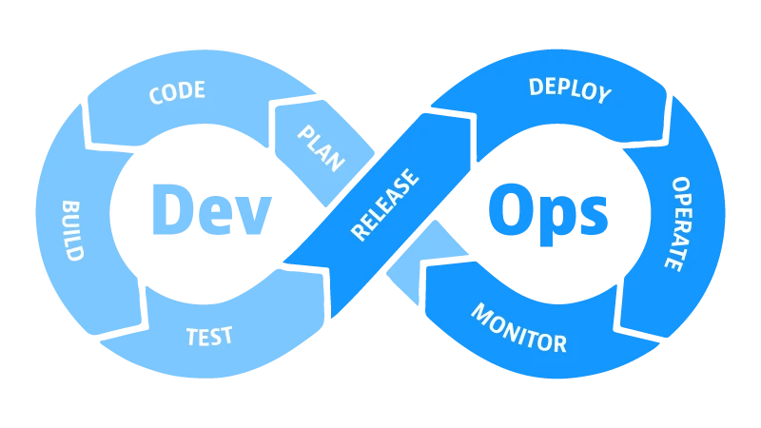
Learning 2 - devops| My takeaways
Introduction to DevOps:
Definition of DevOps.
History and evolution of DevOps.
Comparison with traditional IT operations and development practices.
DevOps Principles:
The core principles of DevOps: Culture, Automation, Lean, Measurement, and Sharing (CALMS).
Emphasis on collaboration between development and operations teams.
DevOps Practices:
Continuous Integration (CI) and Continuous Deployment (CD).
Infrastructure as Code (IaC).
Monitoring and Logging.
Microservices and Containerization.
DevOps Tools:
Overview of popular DevOps tools like Jenkins, Docker, Kubernetes, Ansible, and Terraform.
How these tools facilitate DevOps practices.

Slide 7
Learning 2 - devops| My takeaways
CI/CD Pipeline:
Explanation of the CI/CD pipeline.
Stages of the pipeline: Source, Build, Test, Deploy, and Monitor.
Benefits of implementing a CI/CD pipeline.
Infrastructure as Code (IaC):
Definition and importance of IaC.
Tools for IaC: Terraform, Ansible, Puppet, and Chef.
Benefits of IaC: Consistency, version control, and automation.
Monitoring and Logging:
Importance of monitoring and logging in DevOps.
Tools for monitoring and logging: Prometheus, Grafana, ELK Stack (Elasticsearch, Logstash, Kibana).
Benefits of DevOps:
Faster time to market.
Increased efficiency and reduced costs.
Enhanced quality and reliability of software.

Slide 8
Learning 2 - devops| My takeaways
Challenges of DevOps:
Cultural shift and resistance to change.
Complexity of tool integration.
Security concerns in automated environments.
Case Studies:
Examples of successful DevOps implementations in various industries.
Lessons learned from these case studies.
Conclusion:
Recap of key points.
Future trends in DevOps.
Q&A session.

Slide 9

Learning 3 – postgresql | My takeaways
Introduction to PostgreSQL:
Definition and overview of PostgreSQL.
History and evolution of PostgreSQL.
Comparison with other database management systems (DBMS).
Features of PostgreSQL:
ACID compliance (Atomicity, Consistency, Isolation, Durability).
Support for advanced data types (JSON, XML, Hstore).
Extensibility (custom data types, functions, operators).
Full-text search capabilities.

Slide 10
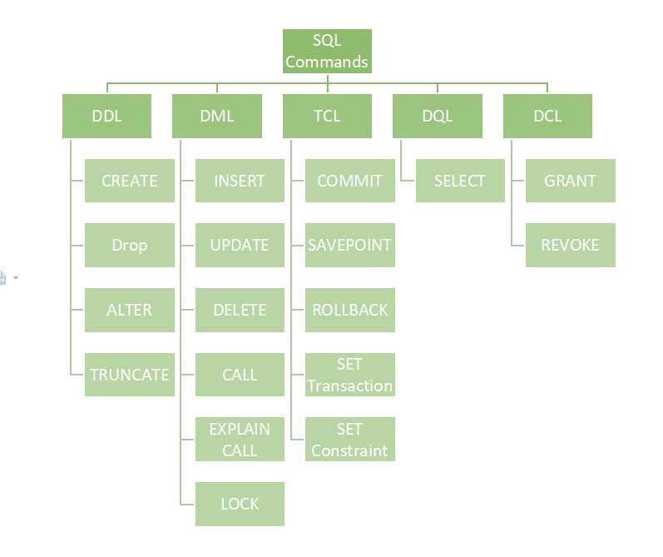
Learning 3 – DBMS | My takeaways
Introduction to DBMS:
Definition and overview of DBMS.
History and evolution of DBMS.
Comparison with traditional file systems.
Types of DBMS:
Hierarchical DBMS.
Network DBMS.
Relational DBMS (RDBMS).
NoSQL DBMS.
Components of DBMS:
Database Engine.
Database Schema.
Query Processor.
Transaction Management.
Storage Management.

Slide 11
Learning 3 – DBMS | My takeaways
DBMS Architecture:
Single-tier architecture.
Two-tier architecture.
Three-tier architecture.
Client-server architecture.
Data Models:
Hierarchical data model.
Network data model.
Relational data model.
Entity-relationship model.
Object-oriented data model.
SQL and Query Languages:
Introduction to SQL (Structured Query Language).
Basic SQL commands (SELECT, INSERT, UPDATE, DELETE).
Advanced SQL features (joins, subqueries, triggers).

Slide 12
Learning 3 – DBMS | My takeaways
Database Design:
Normalization and denormalization.
Entity-Relationship (ER) diagrams.
Indexing and performance optimization.
Transaction Management:
ACID properties (Atomicity, Consistency, Isolation, Durability).
Concurrency control.
Locking mechanisms.
Security in DBMS:
Authentication and authorization.
Role-based access control.
Data encryption and integrity.

Slide 13

Relevance of learnings for my organization

Slide 14
Learning Agile | Relevance for Shell
Enhanced Flexibility and Speed:
Shell uses Agile to increase flexibility and speed in project delivery. By breaking projects into smaller, manageable iterations, they can adapt quickly to changes and deliver results faster.
Improved Collaboration:
Agile promotes better collaboration between teams. At Shell, this has led to more effective communication and teamwork, which is crucial for complex projects.
Cost Efficiency:
Implementing Agile practices has helped Shell reduce costs by streamlining processes and eliminating inefficiencies. This is particularly important in the energy sector, where cost management is critical.
Innovation and Continuous Improvement:
Agile encourages continuous improvement and innovation. Shell has leveraged this to stay competitive and drive technological advancements in their operations.

Slide 15
Learning Devops | Relevance for Shell
Automation and Efficiency:
DevOps practices have enabled Shell to automate repetitive tasks, streamline workflows, and improve overall efficiency. This includes automating software builds, deployments, and testing processes.
Improved Collaboration:
By fostering a culture of collaboration between development and operations teams, DevOps has helped Shell enhance communication and teamwork, leading to more cohesive and efficient project execution.
Faster Time to Market:
DevOps practices, such as Continuous Integration (CI) and Continuous Deployment (CD), have allowed Shell to reduce the time it takes to bring new features and products to market. This agility is crucial in the competitive energy sector.
Enhanced Reliability and Stability:
Through continuous monitoring and automated testing, DevOps has improved the reliability and stability of Shell’s IT systems. This ensures that services are consistently available and performant.

Slide 16
Learning postgresql | Relevance for Shell
Robust Data Management:
PostgreSQL provides a reliable and robust platform for managing large volumes of data, which is crucial for Shell’s complex operations and data-intensive processes.
Advanced Features:
With support for advanced data types, full-text search, and powerful indexing, PostgreSQL allows Shell to handle diverse and complex data requirements efficiently.
Scalability:
PostgreSQL’s ability to scale both vertically and horizontally makes it suitable for Shell’s growing data needs. This ensures that the database can handle increased loads without compromising performance.
Extensibility:
PostgreSQL’s extensibility allows Shell to customize the database to meet specific needs. This includes creating custom functions, data types, and operators, which can enhance the functionality of their applications.

Slide 17

Challenges in implementing learning

Slide 18
Challenge faced while implementing Learning agile
Understanding Agile Principles:
Grasping the core principles and values of Agile, such as customer collaboration, responding to change, and delivering working software frequently, can take time and practice.
Adapting to New Roles:
Agile introduces new roles like Scrum Master, Product Owner, and Development Team members. Understanding and adapting to these roles can be challenging.
Learning New Practices:
Agile involves various practices like daily stand-ups, sprint planning, retrospectives, and continuous integration. Mastering these practices requires time and effort.
Balancing Flexibility and Discipline:
Agile promotes flexibility, but it also requires discipline to follow processes and maintain consistency. Striking the right balance can be difficult.

Slide 19
Challenge faced while implementing Learning devops
Skill Set:
DevOps demands a broad skill set, including knowledge of coding, scripting, automation tools, and infrastructure management. Acquiring and mastering these skills can be time-consuming.
Tool Integration:
DevOps involves using various tools for continuous integration, continuous deployment, monitoring, and more. Integrating these tools into a seamless workflow can be complex.
Automation:
Automating processes like testing, deployment, and monitoring is a core aspect of DevOps. Setting up and maintaining automation pipelines requires expertise and can be challenging.
Security:
Ensuring security in a DevOps environment, especially with automated processes, can be tricky. Implementing DevSecOps practices to integrate security into the DevOps pipeline is essential but challenging.

Slide 20
Challenge faced while implementing Learning postgresql
Performance Tuning:
Optimizing PostgreSQL for performance can be challenging. It involves configuring various parameters, indexing strategies, and query optimization techniques.
Replication and High Availability:
Setting up and managing replication and high availability solutions can be complex. Ensuring data consistency and failover mechanisms requires careful planning and execution.
Backup and Recovery:
Implementing effective backup and recovery strategies is crucial but can be difficult. Ensuring that backups are consistent and can be restored quickly is essential for data integrity.
Security:
Configuring PostgreSQL for robust security involves setting up authentication, authorization, and encryption. Keeping up with security best practices and updates is necessary but challenging.

Slide 21

Action Plan

Slide 22
My Action Plan for this Week
Actions
Timeline
Status
I took one topic at a time and followed the hands on in the class and was very helpful for understanding the core of the technologies.
Use the weekend to learn the concepts of agile and devops in depth. Revise the concepts of DBMS
Case study helped understand the concepts of agile, and devops a lot. Only now DBMS revision is left.

Slide 23

Learning is also Fun!

Slide 24
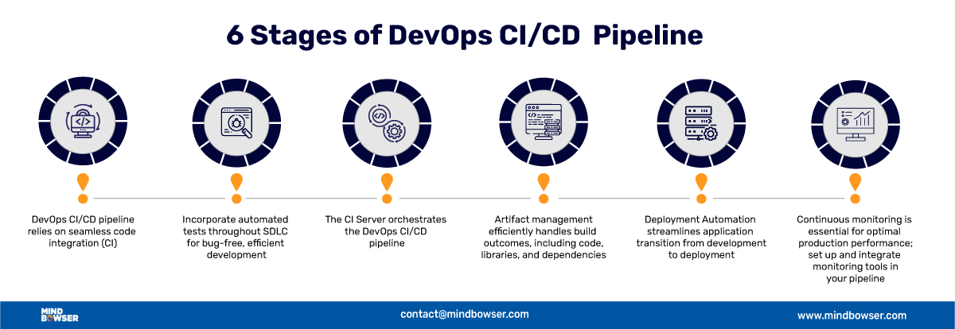
Learning is also Fun!
The case study was the most important thing this week. Complete hands on experience of agile, devops, ci/cd pipeline of github actions was the highlight of the week.

Slide 25

Summary
Devops, Agile, DBMS, Postgresql, CI/CD pipeline, github actions. We learnt all of these technologies this week which will be very helpful for my upcoming projects and life of a software engineer.

Slide 26
Thank You

