Slide 1
D Adoption Case Study
Andy Smith

Slide 2
Outline
Business overview
Software requirement
Where D addresses these + where its used

Slide 3
Business Overview
Group with Fund management firm
  Regulated at Firm + Regulatory auth level
  Fiduciary Responsibility
Technology function to support business
  Market Data Recording
  Trading Frameworks
    Interact directly with brokers
  Introduce new data sources
  Simulation / Analysis tools
  Competitive / Time pressure environment

Slide 4
A 'Perfect Storm' of Requirements
Correctness
Testability
Reliability
Modifiable
Productive
Performant

Slide 5
What makes D a good citizen
Fast development iterations (DMD)
Built-in unit-tests
C Syntax
Posix Availability
Good Standard Library
(So far) no nasty language surprises

Slide 6
D Adoption History

Slide 7
Phobos Goodness
Time savers
  Commandline option parsing
  JSON Parsing
  DateTime module

Slide 8
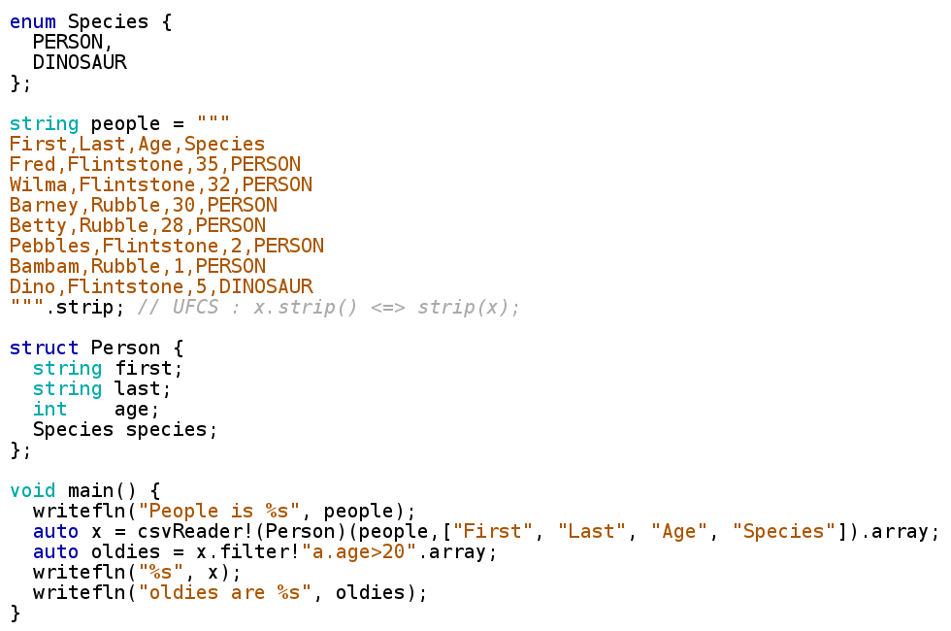
Phobos goodness - CSV

Slide 9
Event Sourcing

Slide 10
Event Sourcing
Represent Everything as stream of events
  Ordered
  Persisted
Examples of Events
  Orders
  Executions
  User actions
    Button Press
    Numeric Field change
  Heartbeats

Slide 11
State Function

Slide 12
Pure State Function
Inputs (State,Input Event) 2-tuple
Outputs (State,Output Event) 2-tuple

Slide 13
System is a 'fold-left' over events
i.e. a pure function of initial +input events

Slide 14
Purity?

Slide 15
If we are 'pure' we get …
Determinism
  Same result every time. Repeatable behaviour
  Auditable
  Analysis
  Regression testing
  Post-Trade analysis
Resilience
  Copy events off to another box for standby system
Debugging
  Breakpoint at a certain event
Parallelizable

Slide 16
But ...

Slide 17
But ... lied a bit :-(
Pure functional version performs badly
  Allocate new state for every event
  Even with persistent structures not good enough
Imperative code with state mutation faster
  That's what we ACTUALLY have
However ...
  Same input still produces same outputs
  Mutation still okay
  c.f. Clojure 'transients'
  Lose ability to cache intermediate state objects

Slide 18
Architecture

Slide 19
Layered Separation of Concerns
Concurrency
Persistence
Event Dispatch
Business
Logic

Slide 20
Inner layer – Business Logic
Simple vanilla callback code
Can send orders in response to events
Can itself be layered
  Process Raw Events OR
  Compose other structures
    Order Handling
    Stats calculations
    Profit/Loss calculation
Single threaded
  Cache friendly

Slide 21
Outer Layer (the D parts!)
Handles
  Concurrency
  Persistence
  Event Delivery
Implemented in terms of
  Streams
  Event Loop ( Live or Simulation )
    Decided ordering of callback
    Simulation plays straight through historic file
    Live busy-spins on queues still being written to

Slide 22
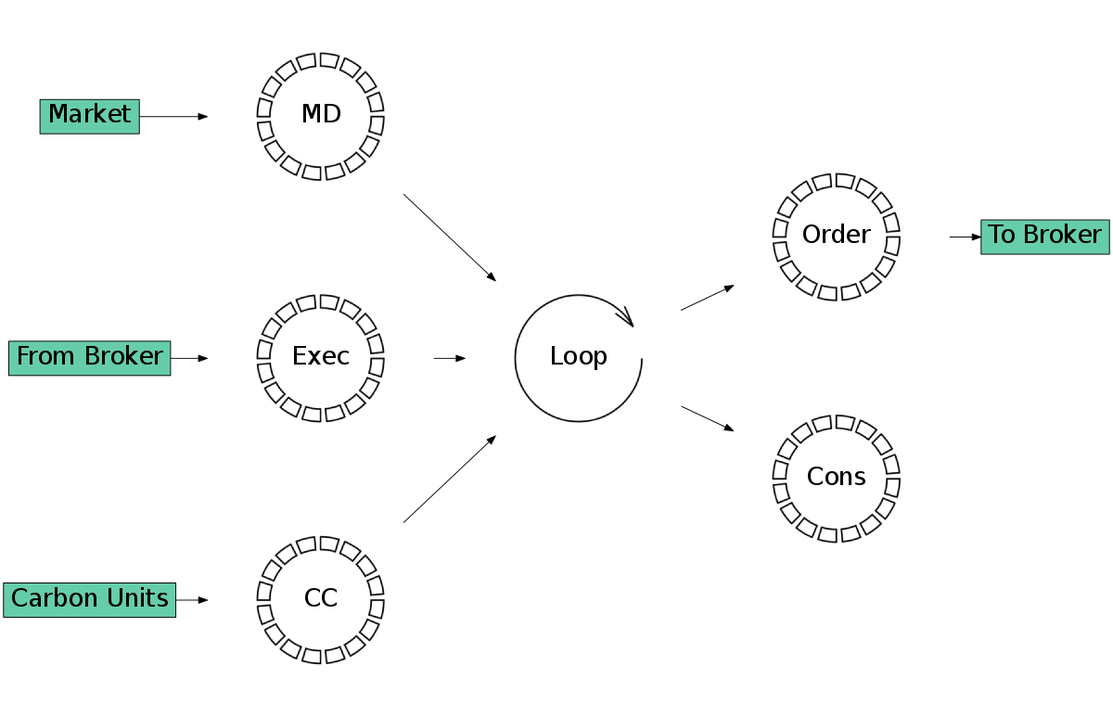
Live Event Sources
MD Index | Source
12321 | 1
12432 | 1
12543 | 2

Slide 23
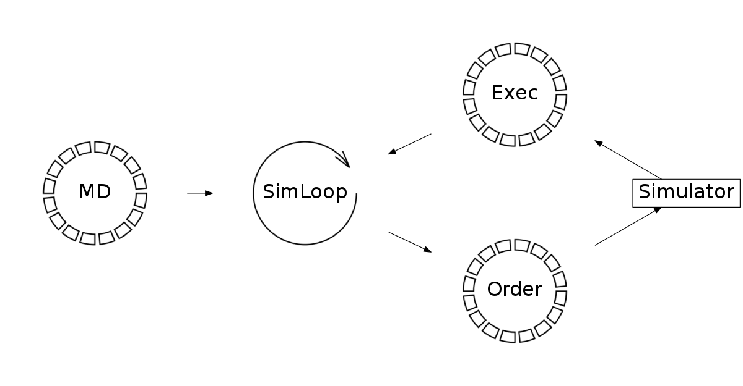
Simulation
Single Threaded
Streams are 'delay lines' not concurrency
Only one 'fundamental' source, the Market Data

Slide 24
Where is D used?

Slide 25
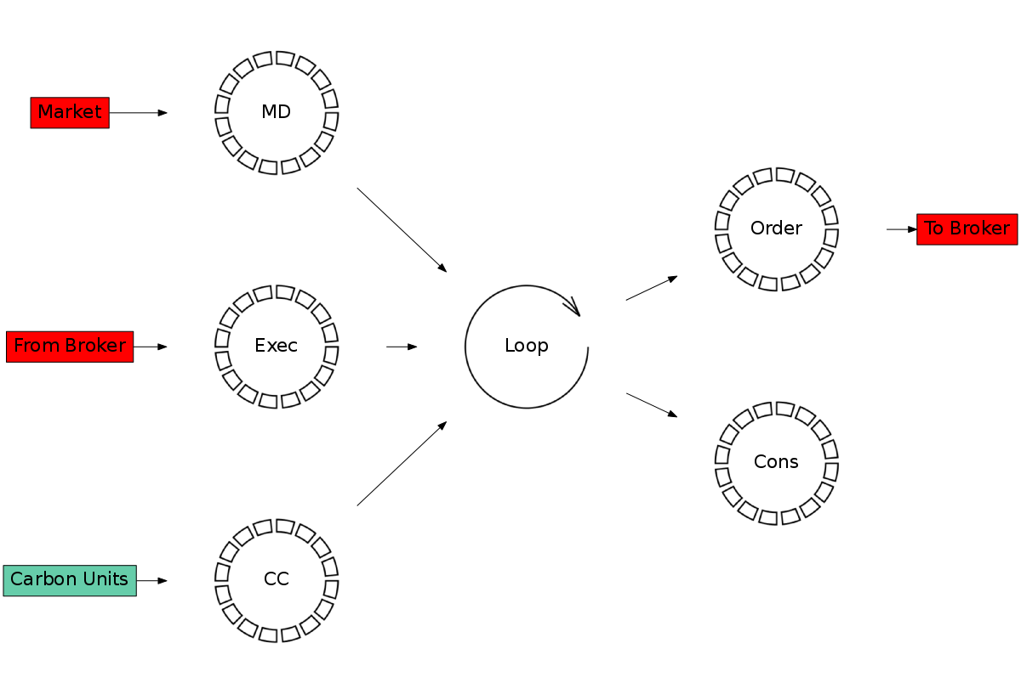
Where is D used?

Slide 26
Why there?
Require C-linkage for optimal API usage
Alternatives?
  JNI ( homegrown )
  JNI ( vendor )
  JNA ( maybe )
  C / C++
D with C-linkage + SHM kills two birds with one stone
Intention was to rewrite in C/C++ ( probably C++11)
  But stuck with D

Slide 27
Stream == ???

Slide 28
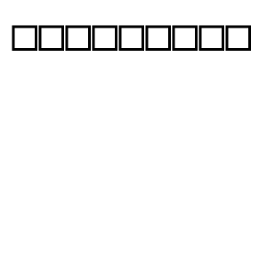

Stream Candidates
( Contiguous vs Ring-buffer)
Contiguous
  Simple, mmap required memory segment
  Not so simple in Java-land mmap takes integer :-(
  Numpy friendly
  Page Faults
  Bounded, can run out!!
Ring Buffer
  Less simple
  Cache friendly
  Need journal of retired entries

Slide 29
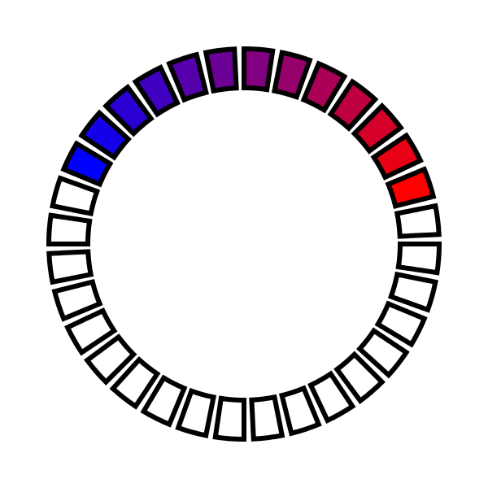
Stream Implementation with circular array
Head
(readers)
Tail
(writers)

Slide 30
Atomic Weapons
We need 'LOCK XADD' ASM instruction on X86_64 for wait free operation in a MPMC queue
AKA 'UNSAFE.addAndIncrement' in Java 7+ land
Unavailable in Phobos (as of writing) :-(
Not a problem :-)

Slide 31
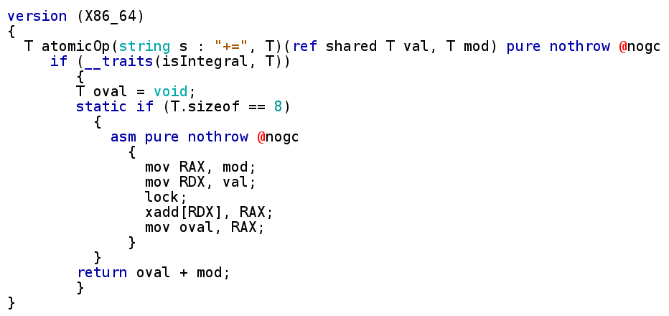
Atomic 'addAndIncrement'
(courtesy of mnovak)

Slide 32
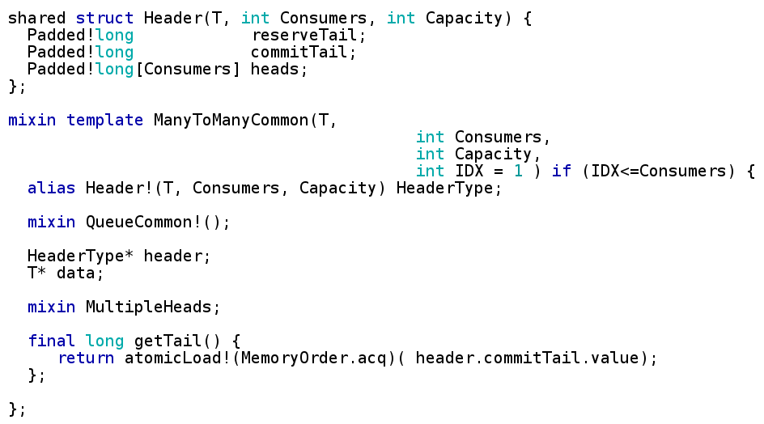
MPMC Common

Slide 33
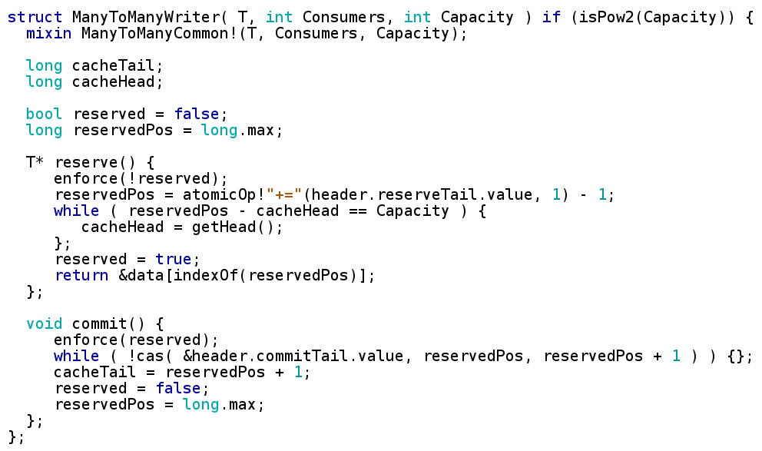
Writer

Slide 34
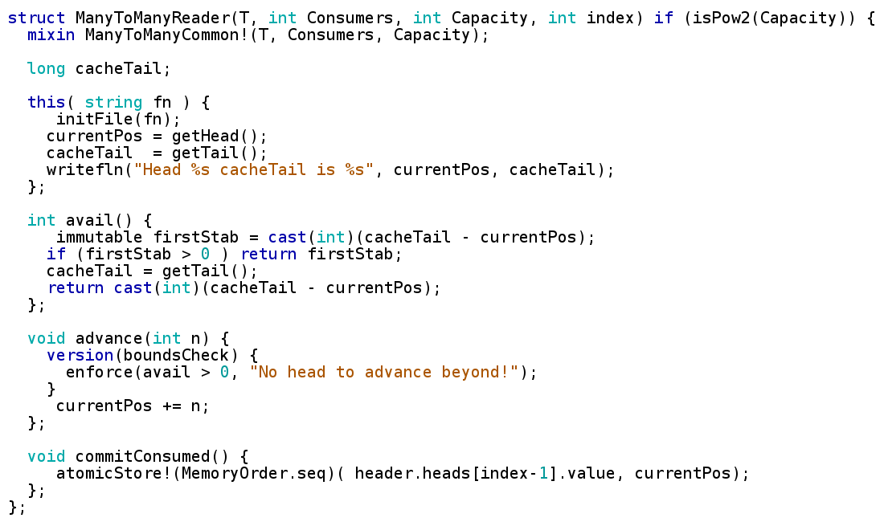
Readers

Slide 35
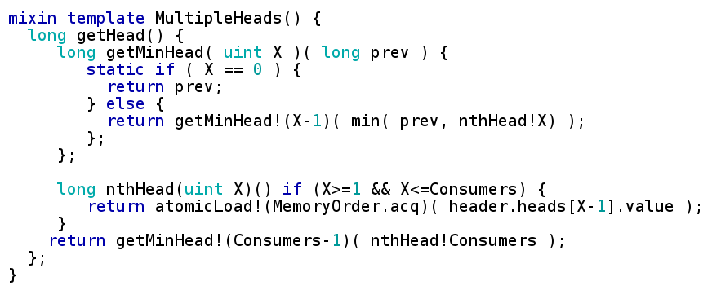
Multiple Heads

Slide 36
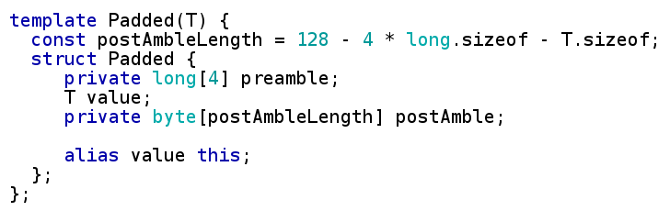
A D solution to false sharing
Java alternatives not very attractive

Slide 37
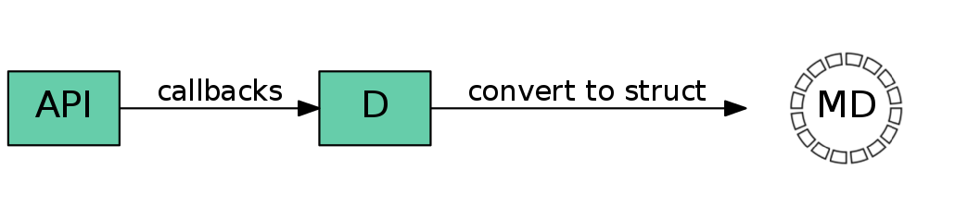
Market Data Consumption

Slide 38
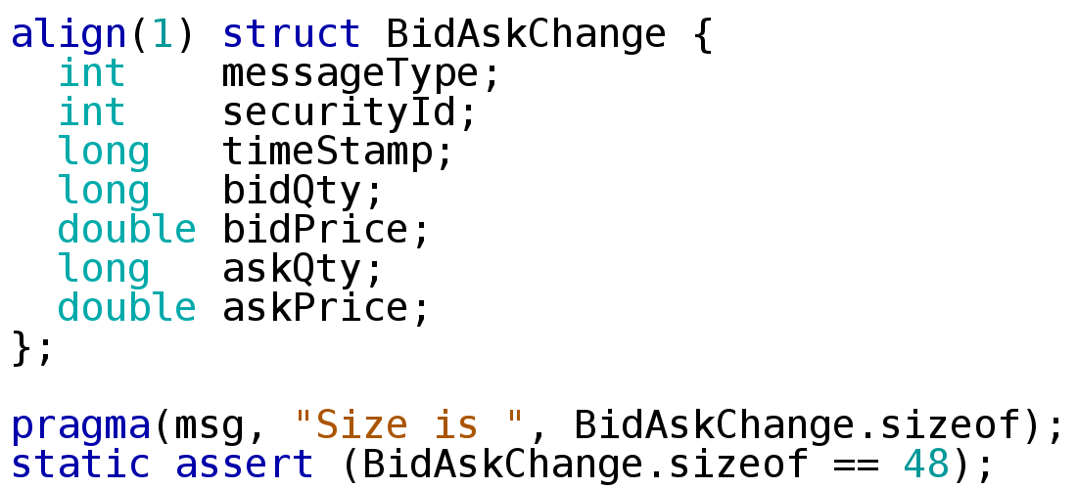
D Market Data Message

Slide 39
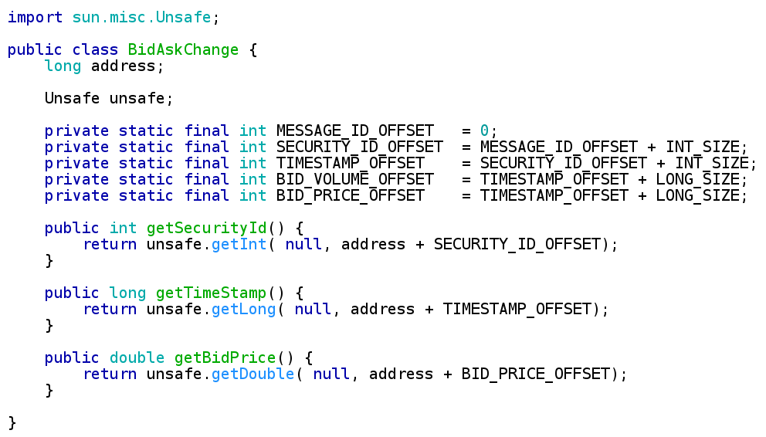
Reading Structs in Java

Slide 40
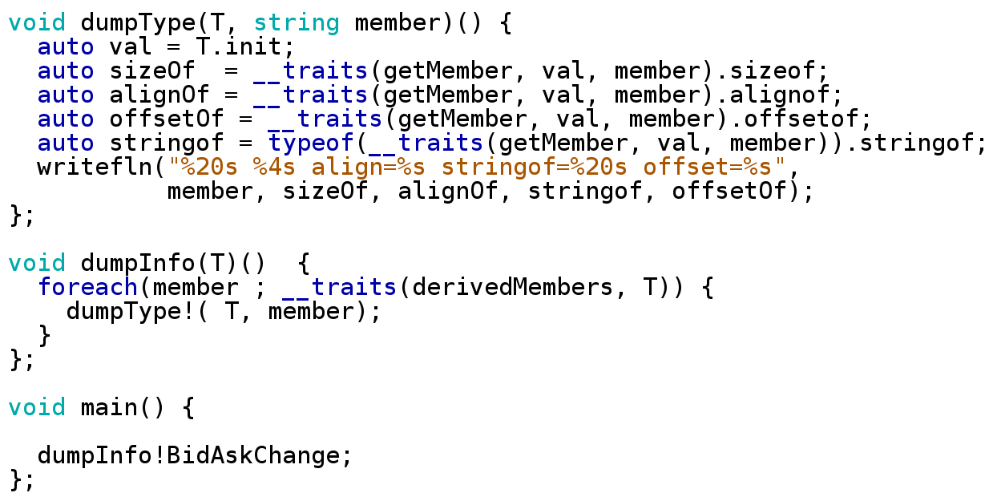
Compile time introspection

Slide 41
Output...
Size is 48LU
Size is 48LU
messageType 4 align=4 stringof= int offset=0
securityId 4 align=4 stringof= int offset=4
timeStamp 8 align=8 stringof= long offset=8
bidQty 8 align=8 stringof= long offset=16
bidPrice 8 align=8 stringof= double offset=24
askQty 8 align=8 stringof= long offset=32
askPrice 8 align=8 stringof= double offset=40
Enough info to generate the java reader code at compile time
Already paid for itself in time-save
D can't read java so compile time utility limited
Show possibilities for further work
Market data protocols (xml, csv specs ).

Slide 42
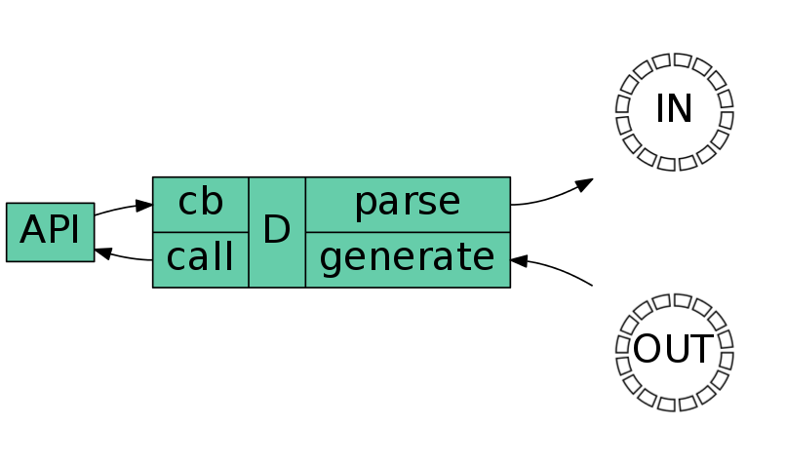
Trading

Slide 43
Trading API
Relatively straightforward
Process performs two tasks
  Convert outbound structs to strings (main thread)
  Convert inbound strings to structs (cb thread)
One thread dedicated to each task
  No contention/locking

Slide 44
FIX ...

Slide 45
FIX Protocol
'Human Readable ?'
8=FIX.4.29=17835=849=PHLX56=PERS52=20071123-05:30:00.00011=ATOMNOCCC999090020=3150=E39=E55=MSFT167=CS54=138=1540=244=1558=PHLX EQUITY TESTING59=047=C32=031=0151=1514=06=010=128
Warty Protocol
  Conflates session + transport in ugly ways
  Compare with
    MIDI
    Military Protocols
    Native exchange
Parsing / Generation done with old school C-style string processing

