Slide 1
Run UNIX and Python on the cloud
Serghei Mangul, Ph.D.
University of California, Los Angeles

Slide 2

Why?
In certain cases, installing UNIX (Ubuntu) on Windows might be challenging
Cloud is an alternative allowing to run UNIX and Python on any computer regardless of the operating system

Slide 3
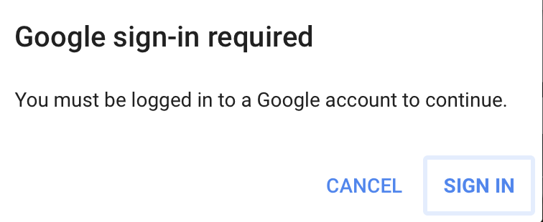
Steps
Open google/gmail account if you don’t have one
Go to https://colab.research.google.com/

Slide 4
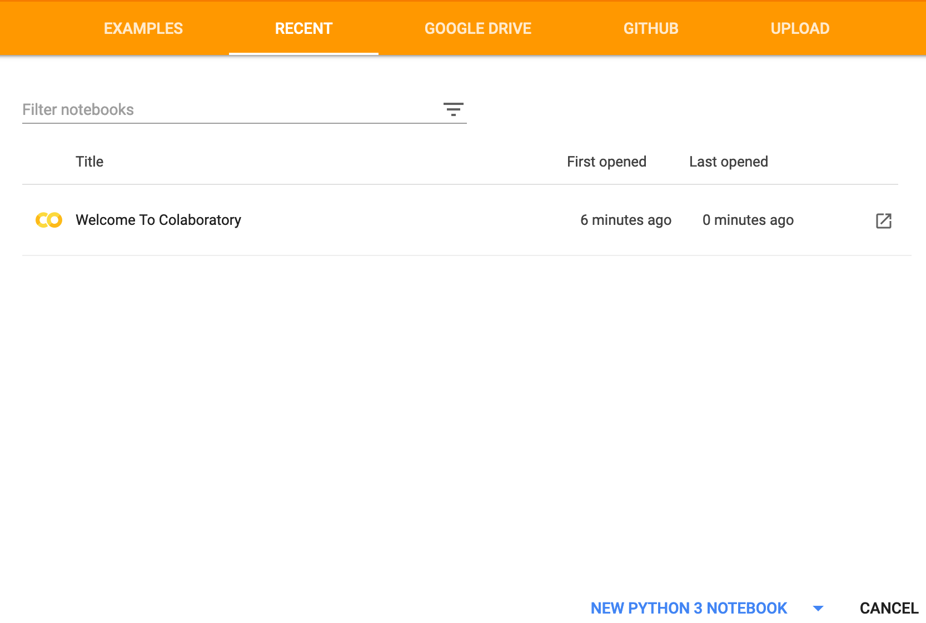
Colaboratory - Google
Allows to use UNIX and Python with no prior installation
Using Jupyter notebooks
https://colab.research.google.com/

Slide 5
Run jupyter notebook
test

Slide 6
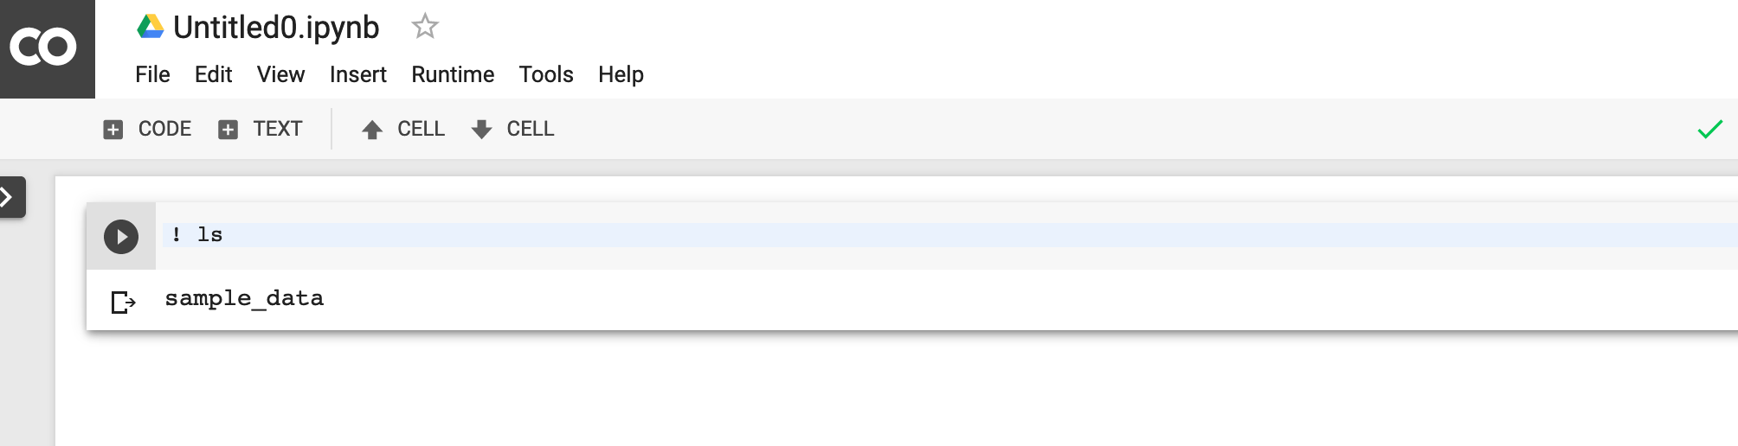
Run UNIX command in notebook

Slide 7
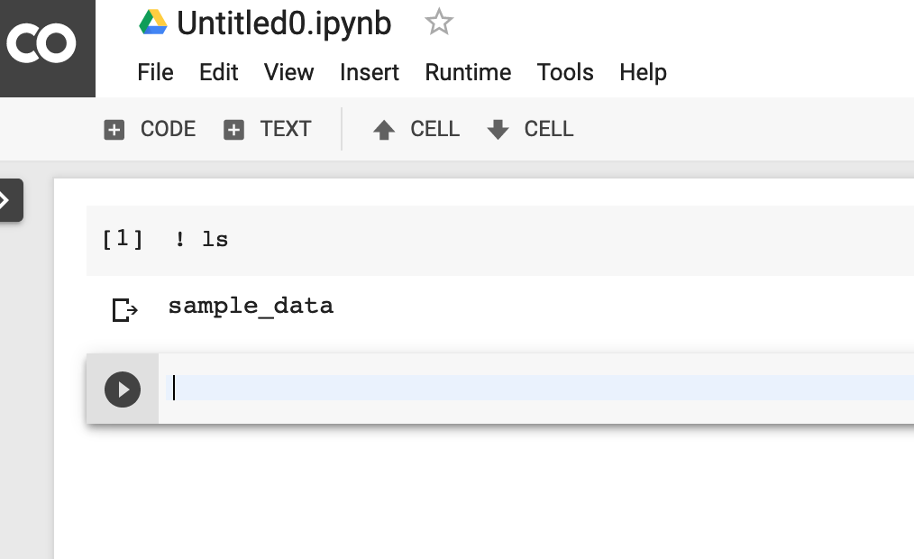
Add new code cell

Slide 8
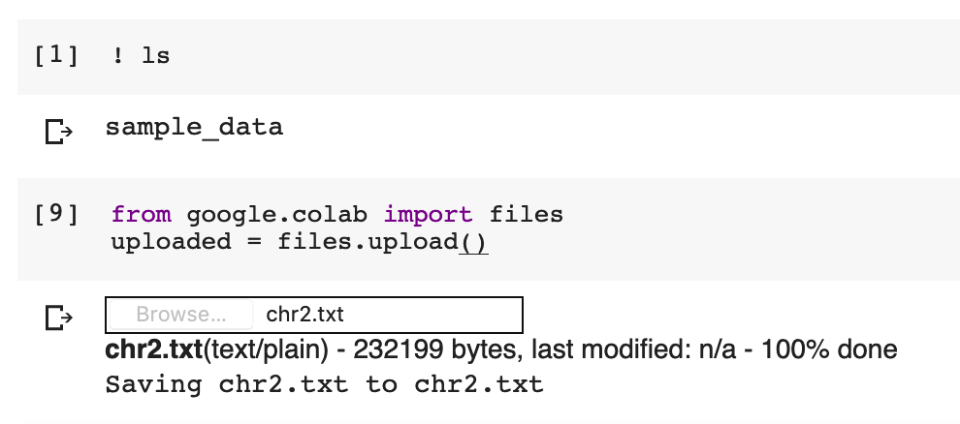
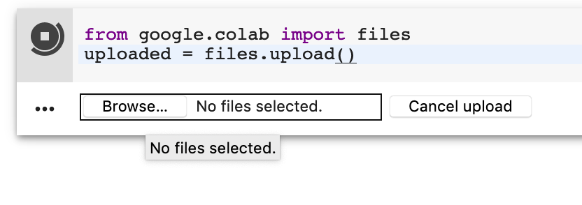
Upload files
from google.colab import filesuploaded = files.upload()
Select file you want to upload
Confirmation that the file was successfully uploaded

Slide 9
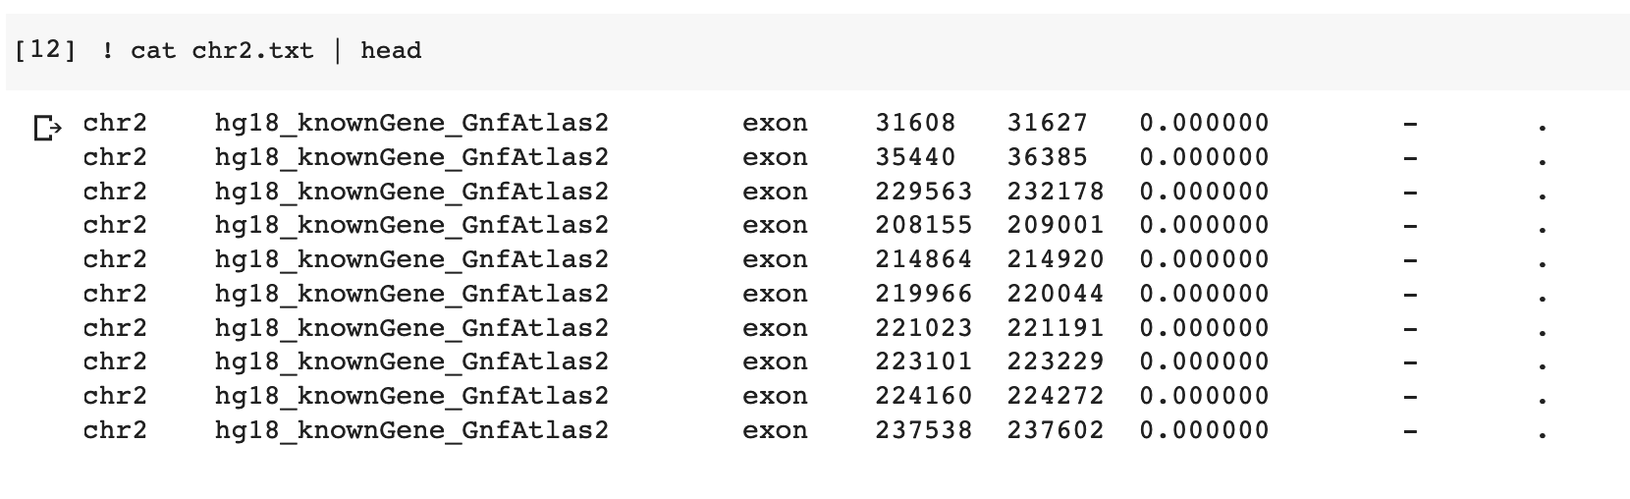
You can use any UNIX command

