Slide 1
Data visualization using python
Serghei Mangul

Slide 2
Visualization via python
Pandas
Seaborn

Slide 3
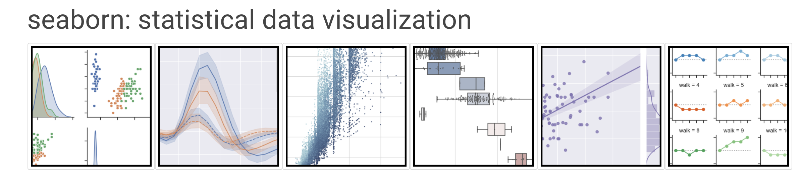
Seaborn
Seaborn is a Python data visualization library. It provides a high-level interface for drawing attractive and informative statistical graphics
Allow to generate publication quality figures using few commands

Slide 4
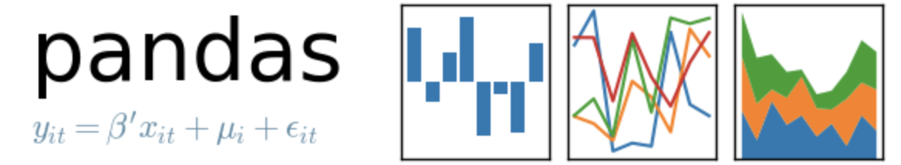
Pandas
Pandas is a software library written for the Python programming language for data manipulation and analysis
Particularly useful for .csv files
Any .xls file can be converted to .csv by using ‘Save as’ option

Slide 5
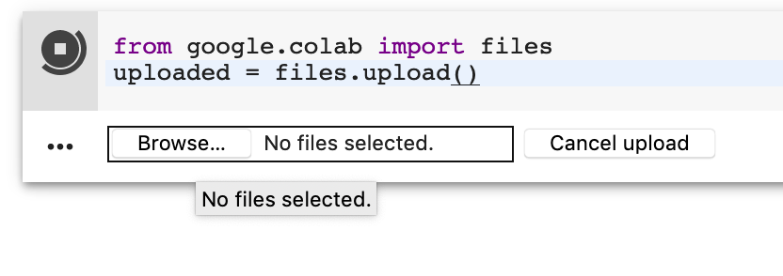
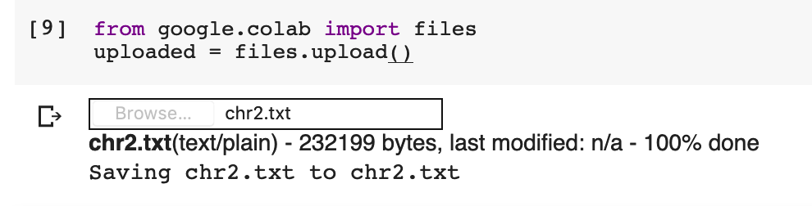
Upload files
from google.colab import files
uploaded = files.upload()
Select file you want to upload
Confirmation that the file was successfully uploaded

Slide 6
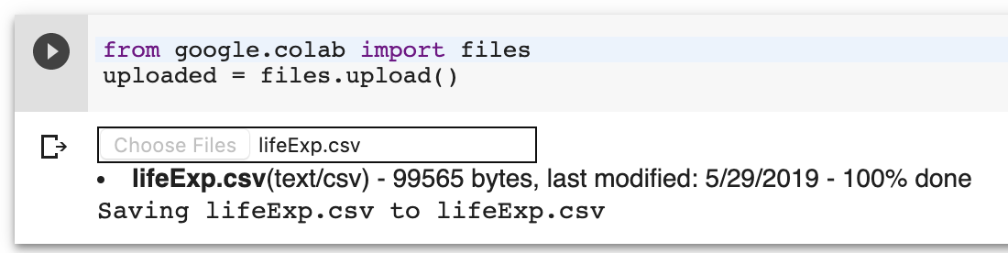
Upload file to Colaboratory - Google
from google.colab import files
uploaded = files.upload()

Slide 7
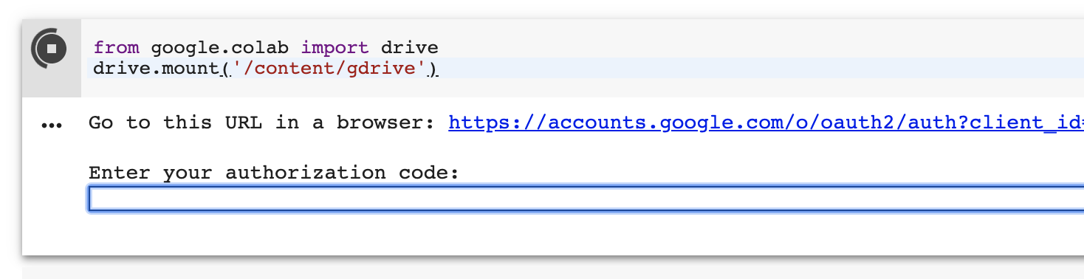
Download files
from google.colab import drive
drive.mount('/content/gdrive')
Click

Slide 8
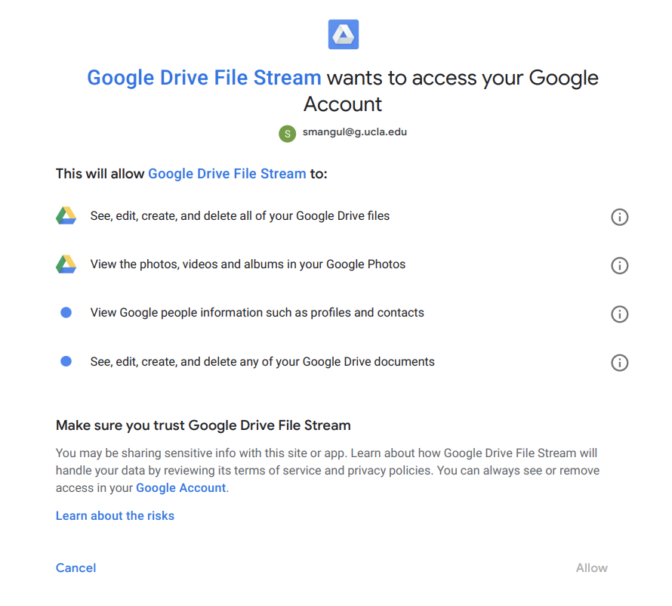
Click

Slide 9
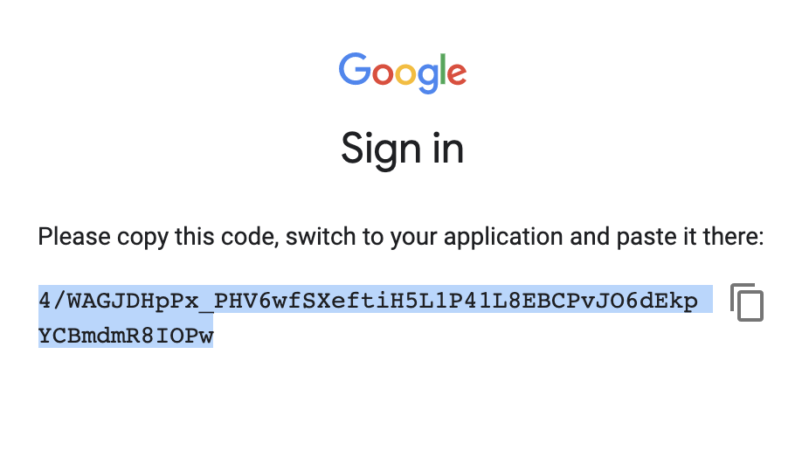
Click to copy text

Slide 10
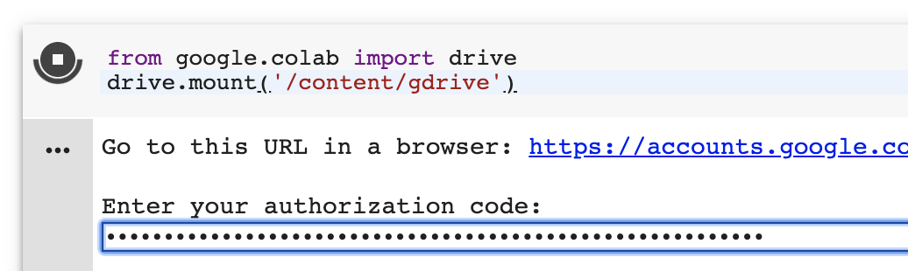
Connect notebook with Google Drive
Paste and click ENTER/RETURN

Slide 11
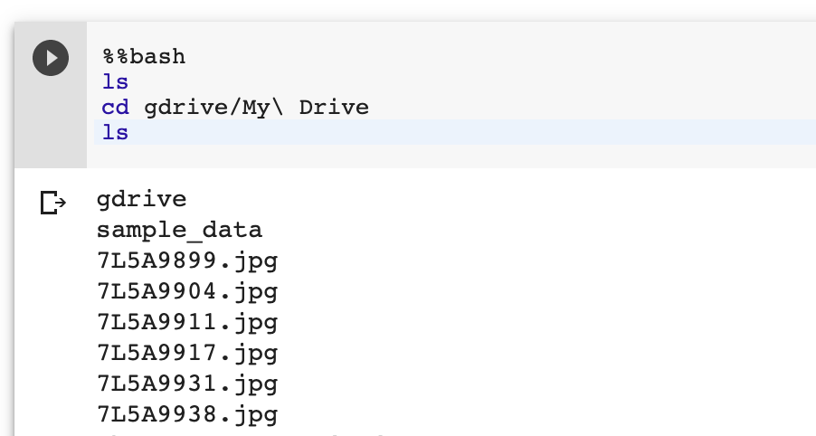
Access Google drive from notebook

Slide 12
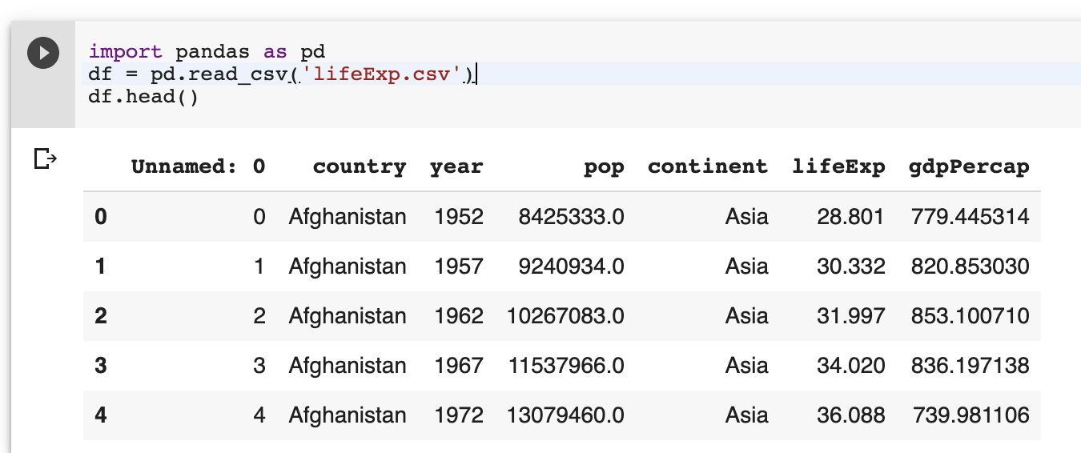
Read csv file using pandas
import pandas as pd
df = pd.read_csv('lifeExp.csv’)
df.head()

Slide 13
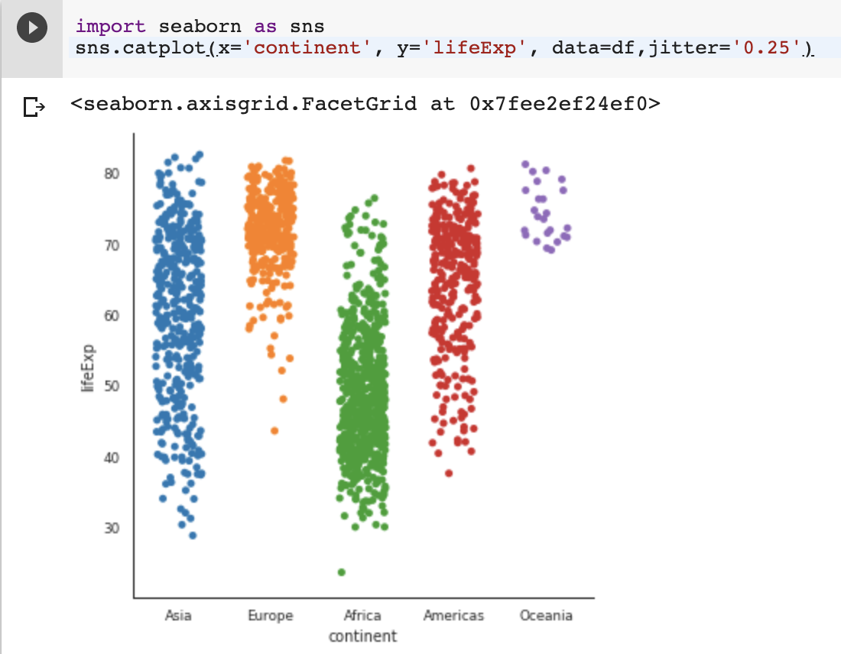
Visualize data as Stripplot
import seaborn as sns
sns.catplot(x='continent', y='lifeExp', data=df,jitter='0.25')

Slide 14
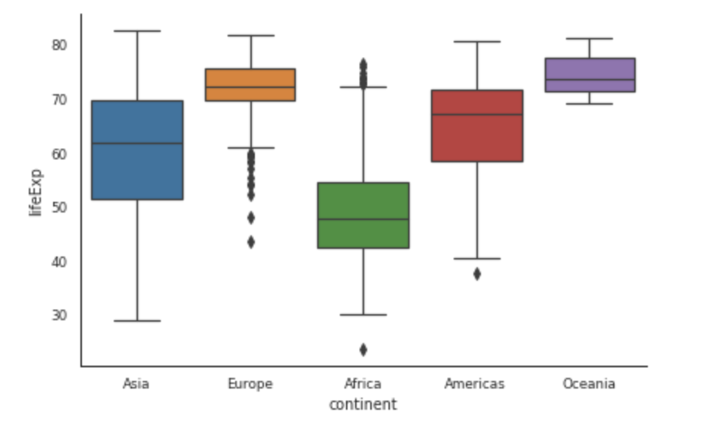
Visualize data as Boxplot
import seaborn as sns
sns.catplot(x='continent', y='lifeExp', data=df,kind='box',height=4, aspect=1.5)

Slide 15
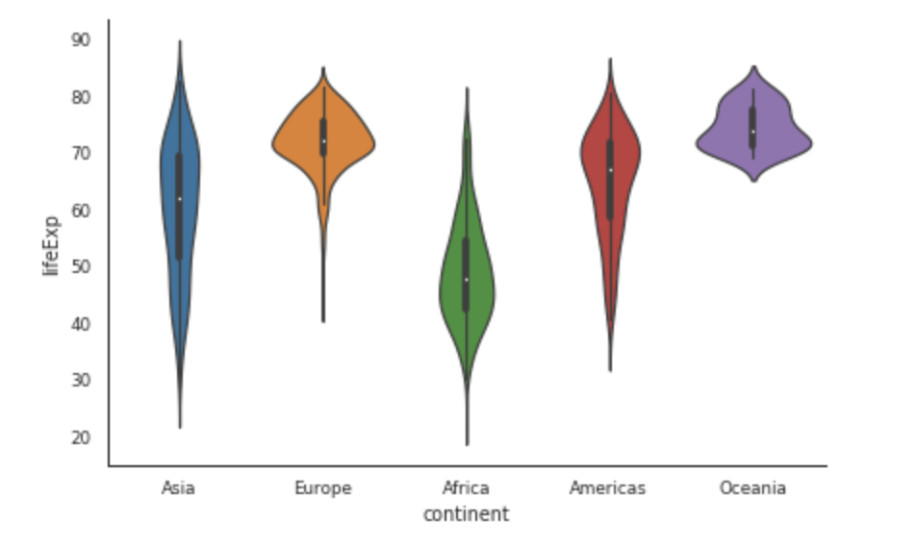
Visualize data as violin plot
import seaborn as sns
sns.catplot(x='continent', y='lifeExp', data=df,height=4,aspect=1.5,kind='violin')

Slide 16
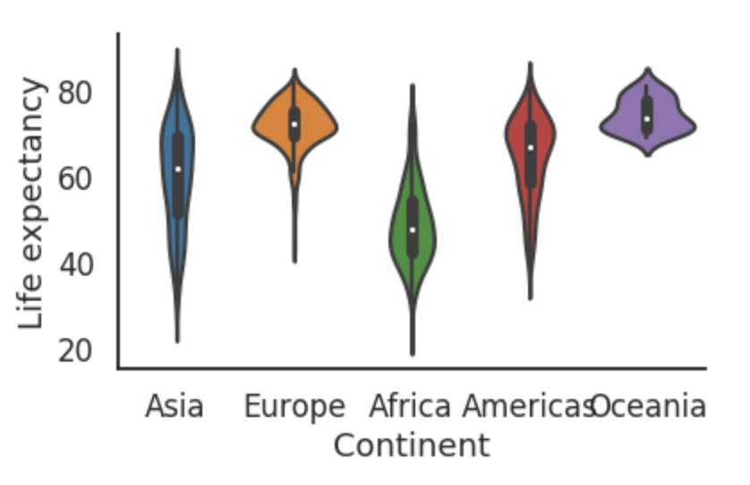
Save as .png or .pdf file
import matplotlib.pyplot as plt
import seaborn as sns
g=sns.set_style("white")
g=sns.set_context("paper")
g=sns.catplot(x='continent', y='lifeExp', data=df,height=4,aspect=1.5,kind='violin')
g.set(xlabel='Continent', ylabel='Life expectancy')
g=sns.despine()
plt.savefig("./gdrive/My Drive/lifeExp.png ")

Slide 17
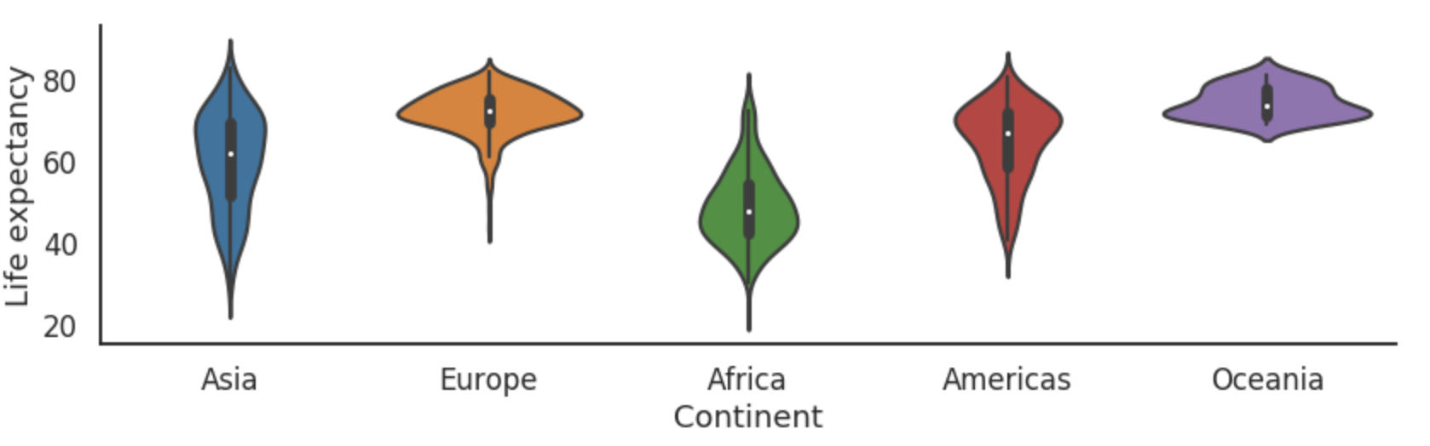
Adjust size of the figure
import matplotlib.pyplot as plt
import seaborn as sns
g=sns.set_style("white")
g=sns.set_context("talk")
g=sns.catplot(x='continent', y='lifeExp', data=df,height=4,aspect=3,kind='violin')
g.set(xlabel='Continent', ylabel='Life expectancy')
g=sns.despine()
plt.savefig("./gdrive/My Drive/lifeExp.png")

Slide 18
I have used this great blog
https://cmdlinetips.com/2019/03/catplot-in-seaborn-python/

