Slide 1

Analysis of the usability and archival stability of omics computational tools and resources
Serghei Mangul
University of California, Los Angeles
@serghei_mangul

Slide 2
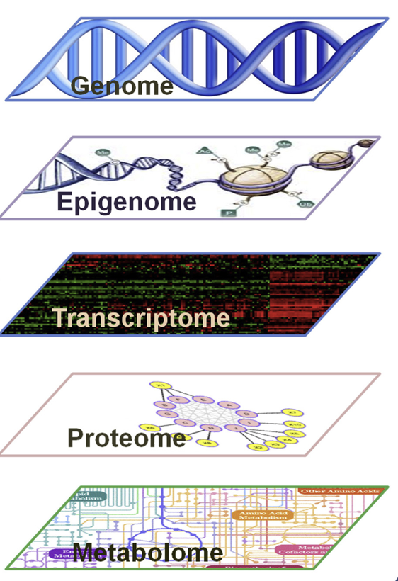
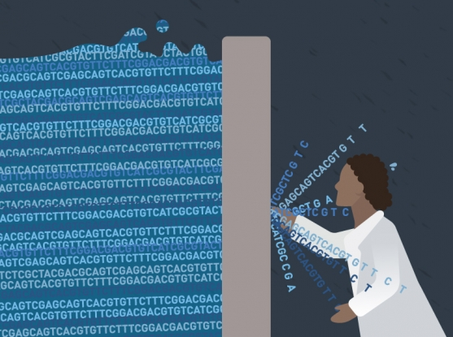
Flood of omics software tools
Bioinformatics tools
S. Mangul, Interpreting and integrating big data in the life sciences, preprint -- https://doi.org/10.7287/peerj.preprints.27603v1

Slide 3
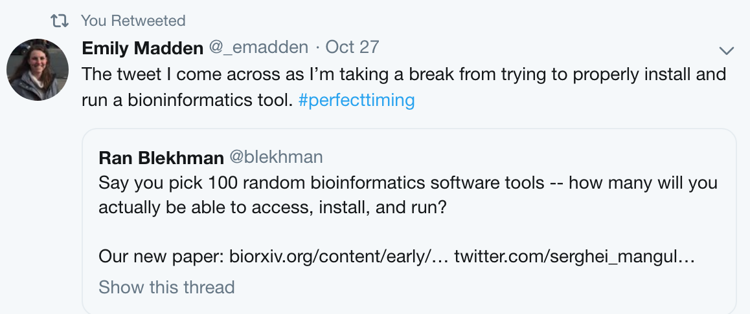
Many bioinformatics tools are hard to install

Slide 4
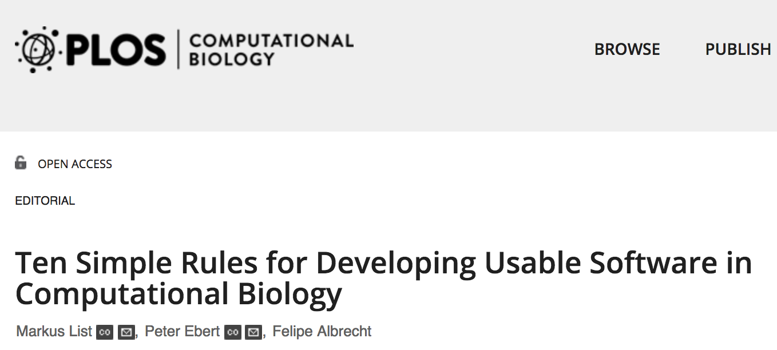
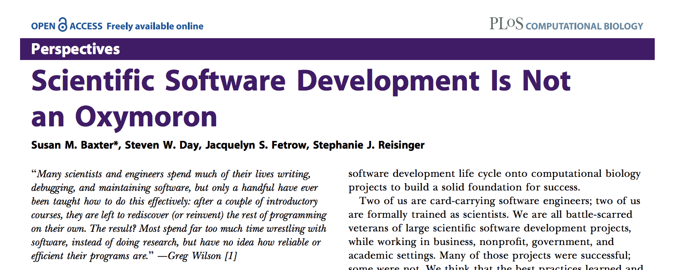
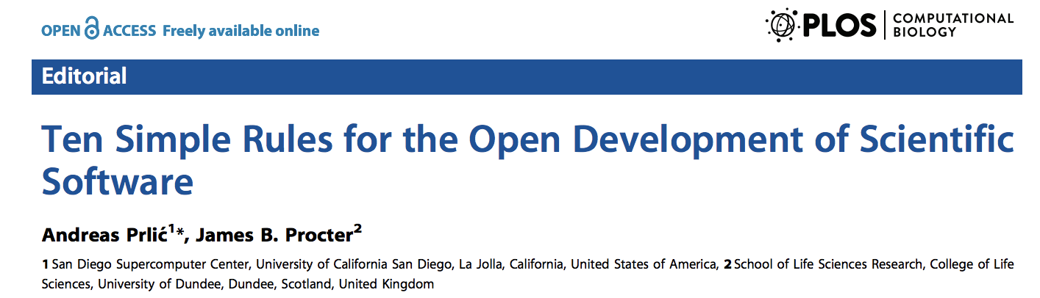

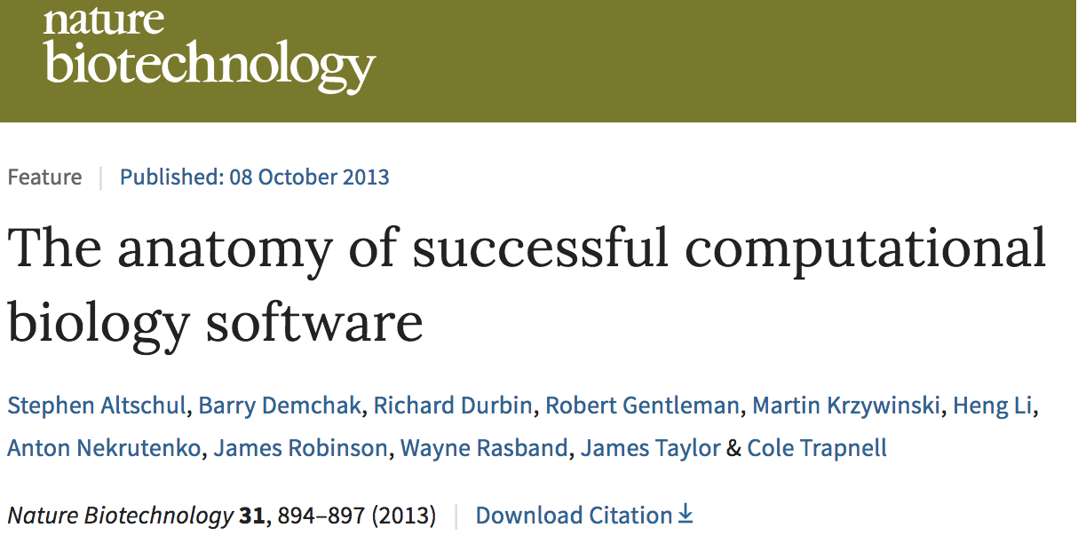
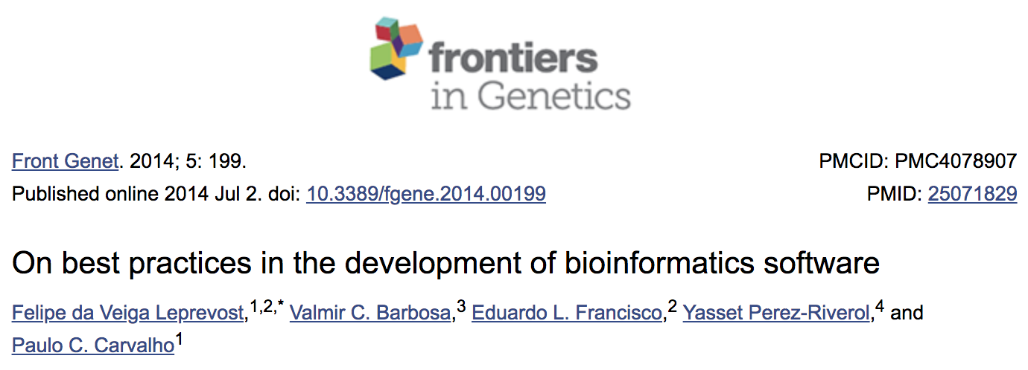
Is user-friendly scientific software an oxymoron?

Slide 5
Challenges to effective software development and distribution in academia
Software written by researchers tends to be written with the idea that all users will know as much about the code as its original authors
Incentives in academia heavily favor the publication of new software, not the maintenance of existing tools
There is lack of protocols to check insatiability of published software tools in academia

Slide 6
Software development in academia versus industry
Industry receive considerably more resources for developing user-friendly tools
Companies efficiently distribute industry-produced software using dedicated company units or contractors
There is little reward for continuous, long-term development and maintenance of tools in academia

Slide 7
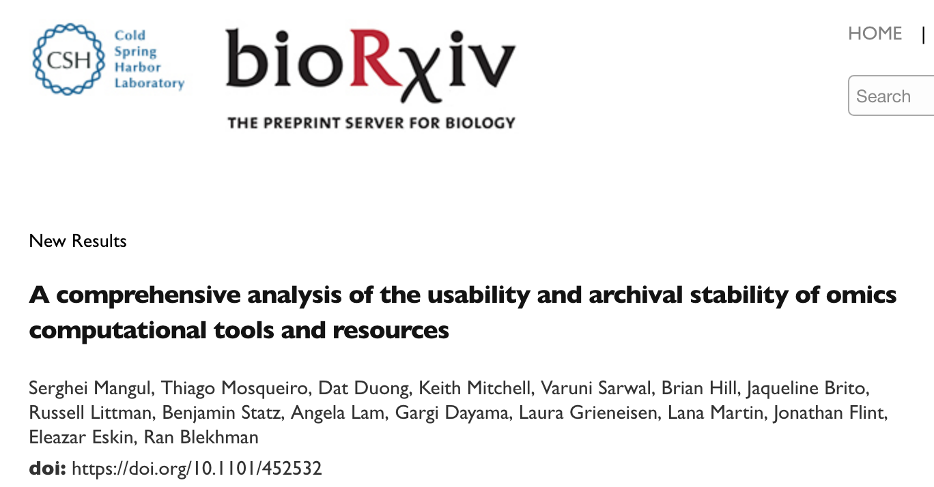
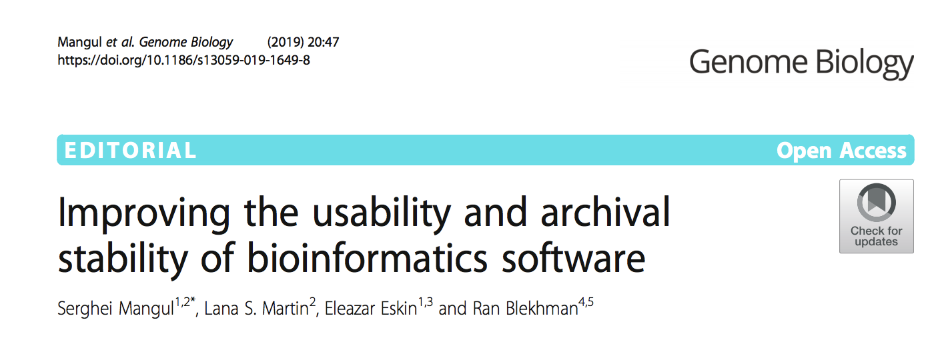
Poorly implemented tools will ultimately hinder progress in big data-driven fields

Slide 8
Software crisis is a reproducibility crisis
Limited software usability and archival stability of computational tools leads to (computational) reproducibility crisis
Computational reproducibility is the ability to replicate published findings by running the same computational tool on the data generated by the published study

Slide 9
Data: archival stability of omics computational tools and resources
51,236 biomedical papers from PubMed
99 randomly selected bioinformatics tools
Journal name | Number of URLs
Nature Biotechnol | 180
Genome Medicine | 352
Nature Methods | 403
Genome Biology | 904
BMC Systems Biology | 912
Bioinformatics | 3131
PLoS Comp. Biology | 3226
BMC Bioinformatics | 6840
BMC Genomics | 7651
Nucleic Acids Research | 13103

Slide 10
Analysis of archival stability
We downloaded 51,236 open access papers via PubMed from 10 systems and computational biology journals (Raw data in XML format)
We developed an approach to extract 36,702 software links from the downloaded papers and verify the archival stability of links
Timeout links were manually verified

Slide 11
Archival stability of abstract URLs

Slide 12
Effect of social media

Slide 13
GitHub is the most popular platform to host scientific code

Slide 14
Tools hosted on GitHub have <3% of unreachable links

Slide 15
Analysis of the software usability
We have randomly selected 99 tools across various domains of computational biology.
Assign one undergraduate student to install 10 tools or more
Record total time, number of commands to install the tools
Total human time to install 99 tools -- 72 hours
S. Mangul, et. al , Involving undergraduates in genomics research to narrow the education–research gap, Nature biotechnology 36.4 (2018): 369.

Slide 16
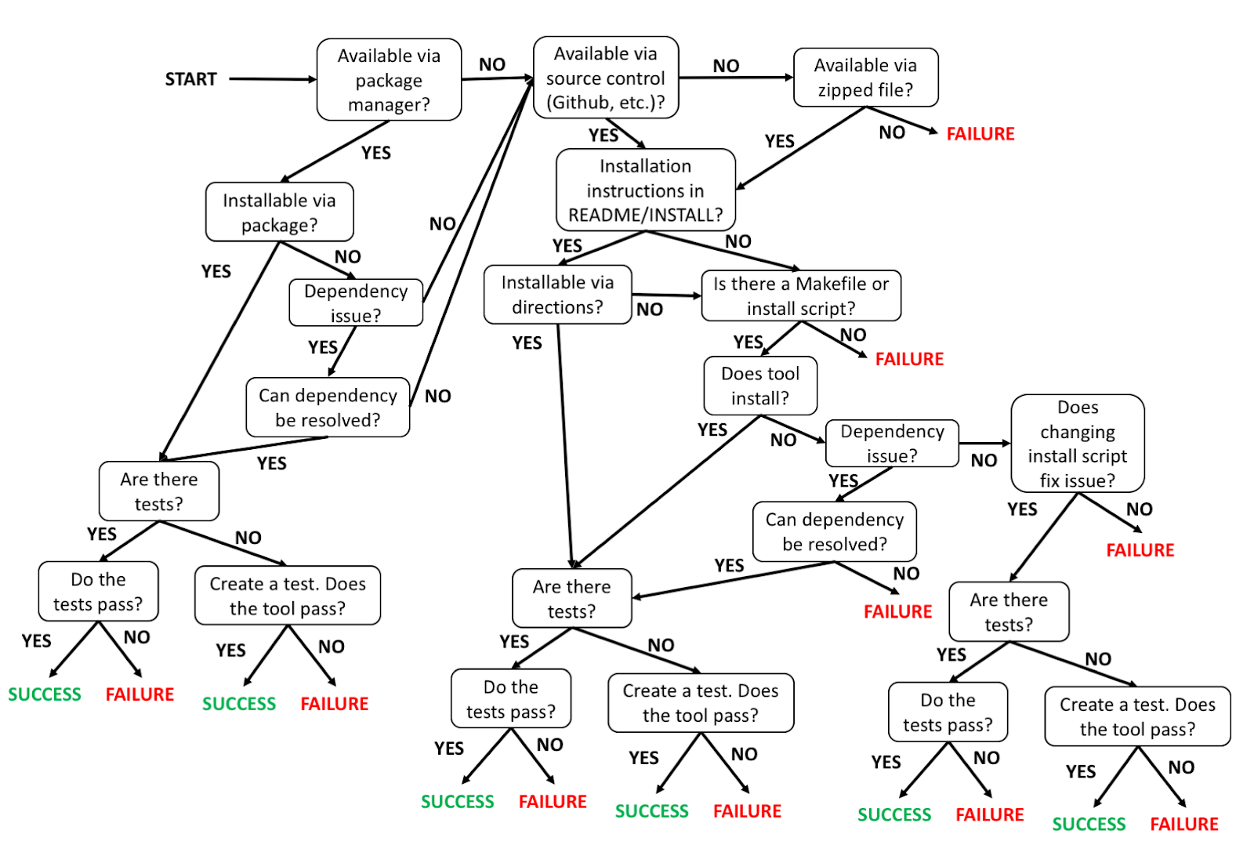
Protocol to check the insatiability of the tool

Slide 17
Many tools are hard or impossible to install
(15 minutes or less)

Slide 18
Automatic installation test
Passed: no manual intervention

Slide 19
Manual interventions are time consuming

Slide 20
Easy-to-install* tools have fewer undocumented commands
*<15min

Slide 21
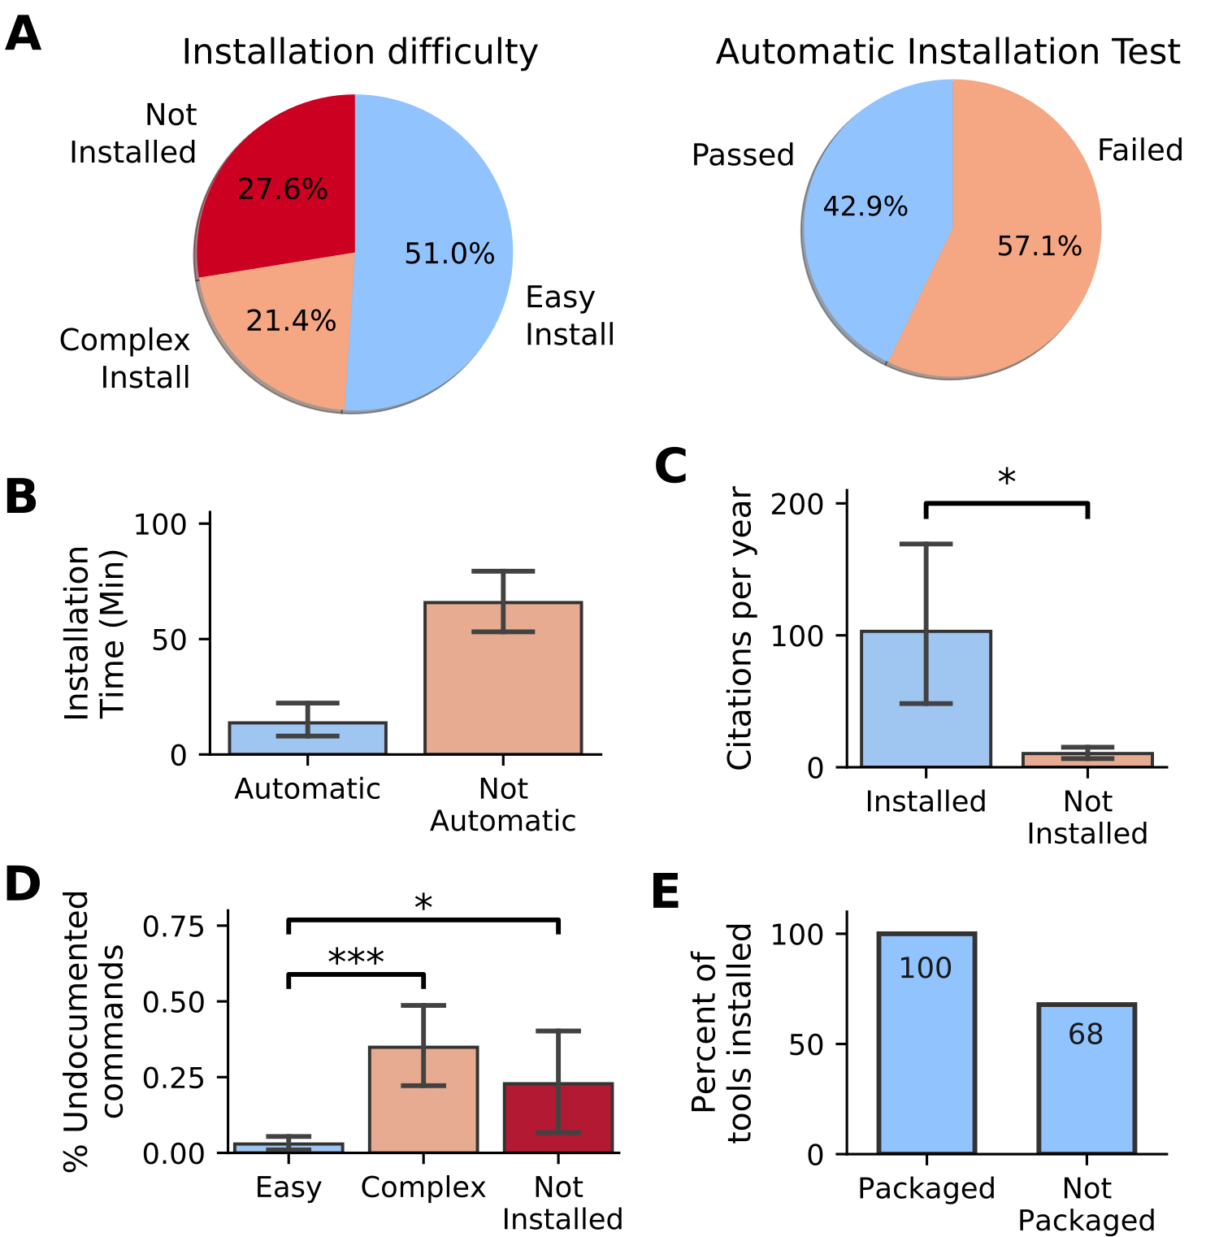
Bioconda tools were always installable

Slide 22
Installable tools have more citations

Slide 23
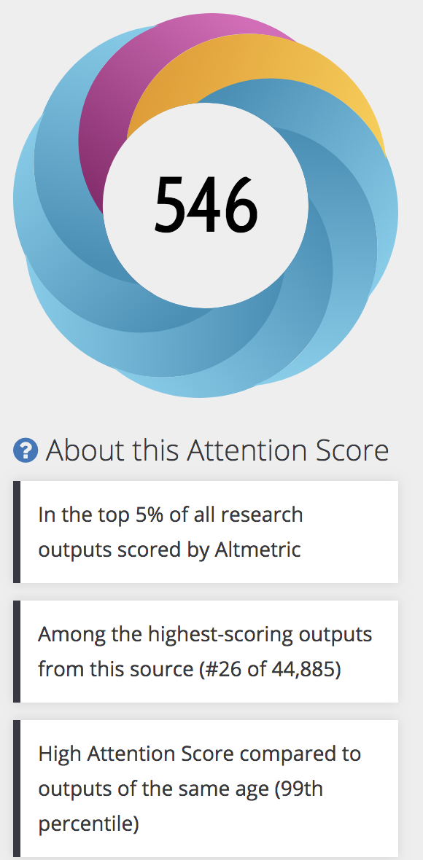
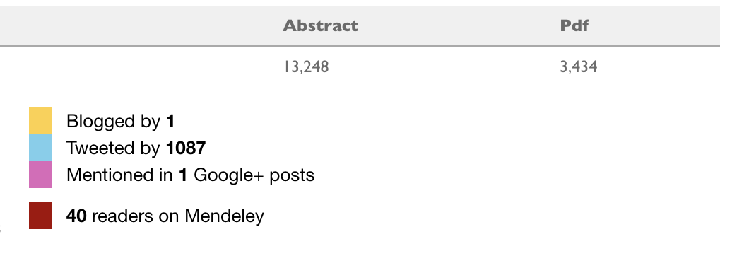
Conclusions
Host software on archaically stable services e.g. GitHub
Provide easy-to-use installation interface and get more citations
Tools wrapped in package managers (e.g. Bioconda) are 100% installable!
Editorial (Genome Biology) is available at https://genomebiology.biomedcentral.com/articles/10.1186/s13059-019-1649-8
Preprint is available at https://www.biorxiv.org/content/early/2018/10/25/452532

Slide 24
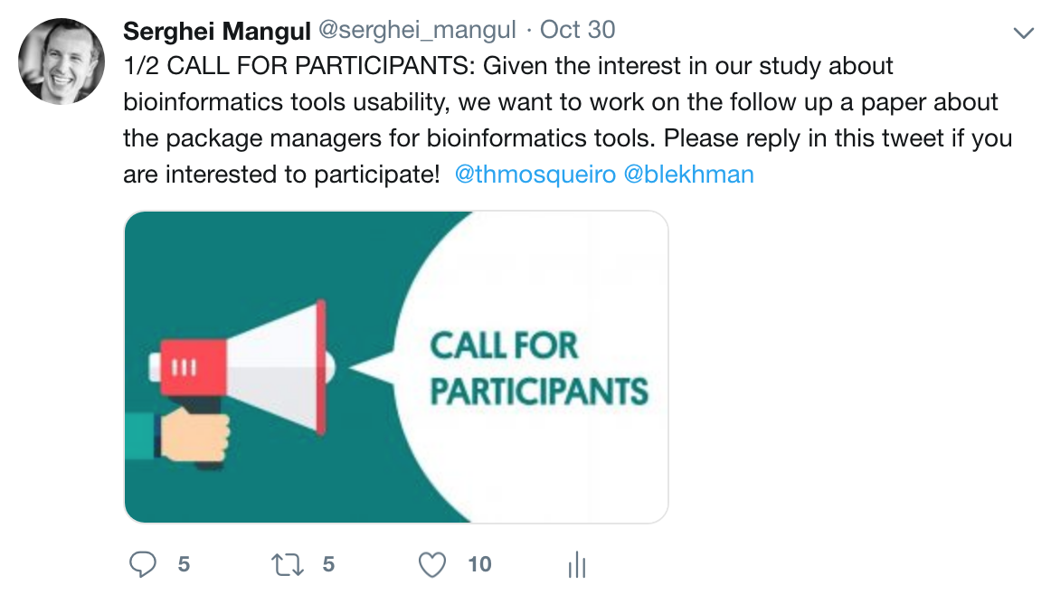
Future work

Slide 25
Acknowledgment
Thiago Mosqueiro, Dat Duong, Keith Mitchell, Varuni Sarwal, Brian Hill, Jaqueline Brito, Russell Littman, Benjamin Statz, Angela Lam, Gargi Dayama, Laura Grieneisen, Lana Martin, Jonathan Flint, Eleazar Eskin, Ran Blekhman

Slide 26
Thank you.
We have prepared Jupyter Notebooks that utilize the raw data described above to reproduce the results and figures presented in our paper
https://github.com/smangul1/good.software
smangul@ucla.edu
http://www.sergheimangul.com/

