Slide 1

Part 2: Elementary Data Structures
Assignment 6 Presentation
Arrays, Stacks, Queues, Linked Lists, and Rooted Trees
Sai Mohan Manukonda | UC Student ID: 005046992 | Algorithms and Data Structures | April 2026
Notes:
This presentation summarizes Part 2 of Assignment 6.
I implemented and analyzed five elementary data structures in Python.
I will cover design decisions, complexity, empirical measurements, and practical applications.

Slide 2
Objective and Scope
Implement core data structures from scratch in Python
Analyze time/space complexity for core operations
Measure empirical performance at multiple input sizes
Compare trade-offs: speed, memory, and implementation simplicity
Map each structure to real-world application scenarios
Notes:
The scope is practical and analytical.
I focused on operations that matter most in real systems: insert, delete, access, and search.
This helped connect theory to observable performance behavior.

Slide 3
Implemented Data Structures
Dynamic Array: append, indexed access, insert, delete
Stack (array-based): push, pop, peek, is_empty
Queue (circular array): enqueue, dequeue, front, is_empty
Singly Linked List: insert_front, insert_end, delete, traverse, search
Rooted Tree: node relationships, traversal, and hierarchy operations
Notes:
All implementations were done manually without built-in collection shortcuts for key logic.
For queue, circular indexing was used to preserve O(1) enqueue and dequeue.
For linked list, head and tail pointers were used to improve end insertion.

Slide 4
Complexity Summary
Dynamic Array: O(1) amortized append, O(n) insert/delete/search
Stack/Queue: O(1) push-pop and enqueue-dequeue operations
Linked List: O(1) front insert/delete, O(n) search and indexed access
Rooted Tree: O(1) add_child, O(n) traversal and general search
Main trade-off: random access efficiency vs update flexibility
Notes:
Arrays are excellent for random access due to contiguous memory.
Linked structures handle updates well but lose cache locality and fast indexing.
Specialized structures like stack and queue are ideal when access pattern is fixed.

Slide 5
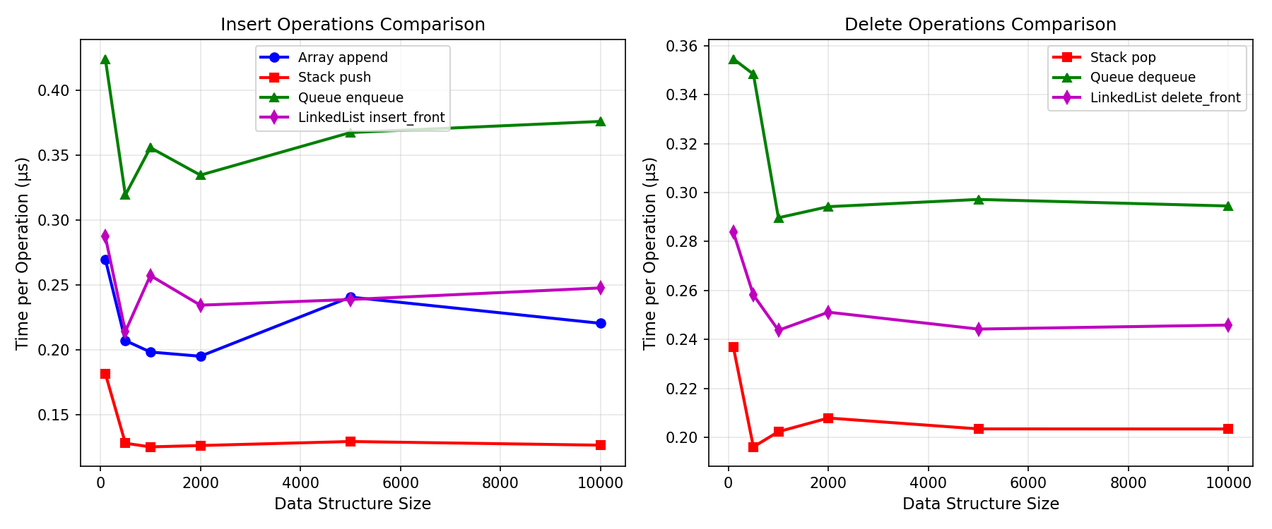
Empirical Results: Insert/Delete Operations
Notes:
This plot compares operation time per operation in microseconds.
Stack push and pop remain very stable and fast across scales.
Queue and linked list operations are also consistent, with small constant-factor differences.
The dynamic array append remains near-constant due to amortized resizing.

Slide 6
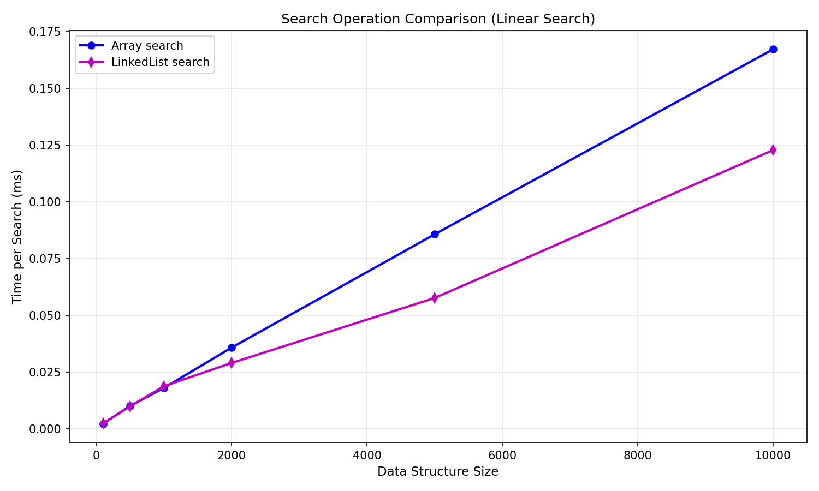
Empirical Results: Search Performance
Notes:
Search performance grows roughly linearly with size for both arrays and linked lists.
Array search is generally faster due to contiguous memory and cache efficiency.
Linked list search incurs pointer traversal overhead.
This validates the expected O(n) complexity while showing constant-factor impact.

Slide 7
Practical Applications
Dynamic Arrays: buffers, analytics tables, and indexed datasets
Stacks: function call stacks, undo/redo features, expression parsing
Queues: scheduling, message pipelines, breadth-first traversal
Linked Lists: frequent front insertions, memory-constrained dynamic records
Rooted Trees: file systems, DOM trees, organizational hierarchies
Notes:
No single structure is universally best.
The best selection is workload-driven: access pattern, mutation frequency, and memory behavior.
In production systems, this choice directly impacts latency and scalability.

Slide 8
Conclusion and Lessons Learned
Theoretical complexity matched empirical trends across all tested operations
Constant factors and memory locality strongly influenced practical speed
Arrays are best for indexed access; linked lists for localized updates
Stacks and queues remain efficient, purpose-built structures
Future work: larger datasets, memory profiling, and concurrency-aware variants
Notes:
The key takeaway is that data structure choice is a performance decision.
Combining asymptotic analysis with benchmarks gives a reliable basis for design choices.
This assignment reinforced how foundational structures shape higher-level algorithm performance.

Slide 9
References
Blum, M., Floyd, R. W., Pratt, V., Rivest, R. L., & Tarjan, R. E. (1973). Time bounds for selection.
Cormen, T. H., Leiserson, C. E., Rivest, R. L., & Stein, C. (2022). Introduction to Algorithms (4th ed.).
Goodrich, M. T., Tamassia, R., & Goldwasser, M. H. (2014). Data Structures and Algorithms in Python.
Sedgewick, R., & Wayne, K. (2011). Algorithms (4th ed.).
Project empirical outputs: medians_order_tatistics_and_elementary_data_structures_6/results/plots.
Notes:
These references support algorithmic analysis and implementation choices.
The final reference points to the empirical measurements generated in this project repository.

