Slide 1

Cloud Security
Smaran Chand

Slide 2
About Me
Smaran Chand
AppSec Pentester/Engineer @Eminence Ways Pvt Ltd
Microsoft Azure Security Engineer, AWS Security Specialist
Synack Red Team member, Occasional Bug Bounty Hunter
Noob Programmer, Tech explorer
Twitter: @smaranchand
Creator of security tools like Bucky, ***ci
https://smaranchand.com.np

Slide 3

What is Cloud?
Cloud is nothing but a someone else’s computer which we rent for the specific period of a time to store our data.
Cloud model consists up of Iaas, PaaS and SaaS.
Cloud services usage is increasing gianormous way, almost every organization use cloud services directly or indirectly.

Slide 4
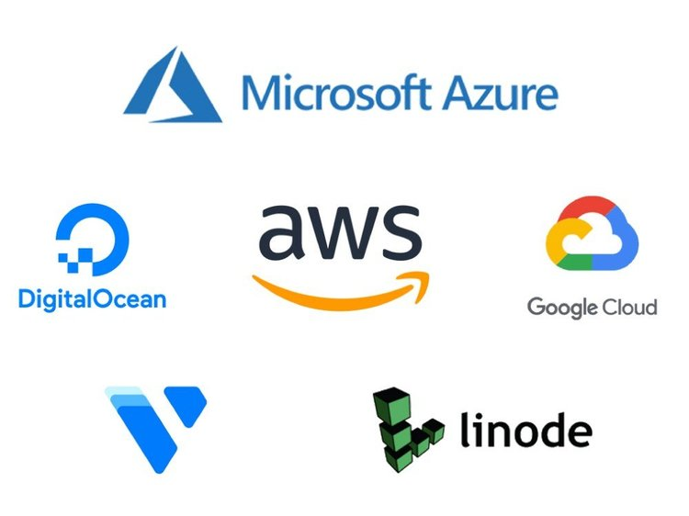
Major Cloud Service Provider(IaaS)
Google Cloud Platform (GCP)
Amazon Web Services(AWS)
Microsoft Azure
Digitalocean
Linode
Oracle Cloud
Alibaba Cloud
Vultr etc.

Slide 5

What is Cloud Security?

Slide 6
Cloud Security
Cloud Security is a process of protecting the cloud environment by implementing the security measures designed to protect cloud-based infrastructure, applications, data and handle incidences and react accordingly.

Slide 7
Factual things about the cloud
Everything is naked on the Cloud in default.
Misconfigurations make things worst.
Inheritence of “IF IT WORKS DON’T TOUCH IT” is everywhere.
Cloud Security Assessment doesnot exist until there is a breach.

Slide 8

How to secure cloud?
A secure cloud environment comprises of a prime Architecture from the design level with the use of correct set of tools, resources and technologies available.
Securing cloud resources using the available resources in the cloud is preferebly the most splendid way to secure cloud environment.

Slide 9
Tools In Cloud Platforms
Logging, Monitoring and Automation
Compliance
Identity Access Management(IAM)
Infrastructure and Network Security
Data Protection Tools

Slide 10
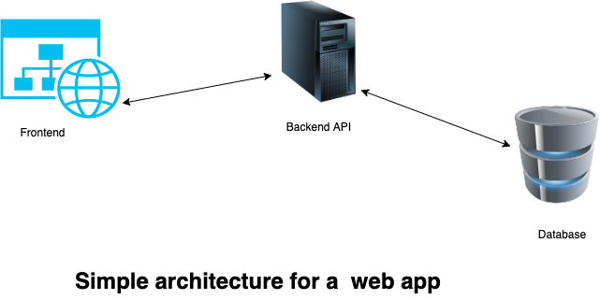
Traditional Web App Architecture

Slide 11
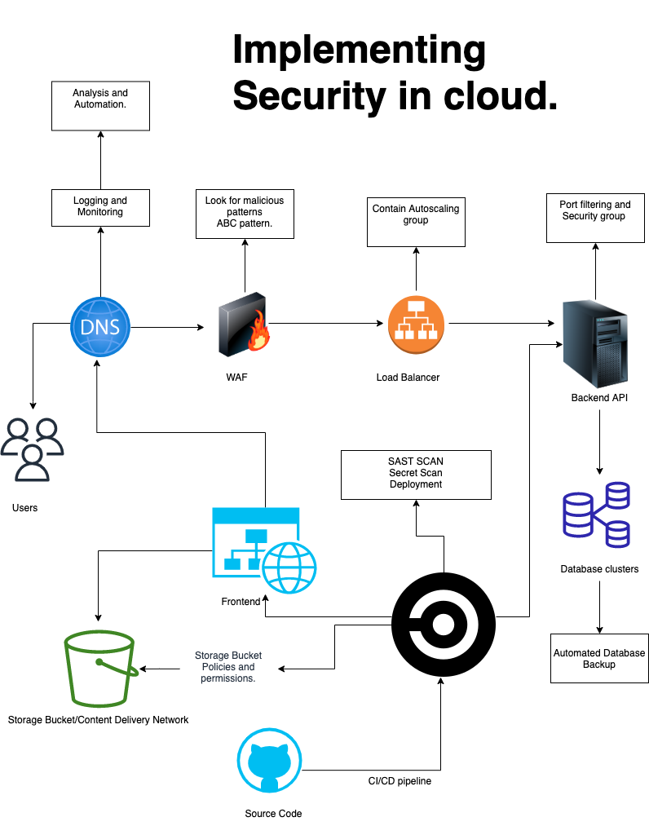

Slide 12
Vulnerabilities in Cloud resources
Misconfigured storage container/bucket takeover
DNS Zone/Subdomain takeover.
Privilege Escalation
SSRF in webapp/API leading cloud environment compromise.
Insecure API’s and components.
Exposed services, ports, data.
Poor Encryption.

Slide 13
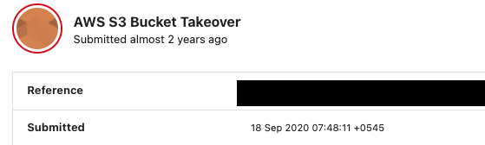
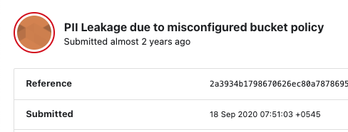

BUGBOUNTY
https://github.com/smaranchand/bucky

Slide 14
Why should we learn about cloud security?

Slide 15

Cloud Security concept is important for everyone working in Offensive as well as Defensive field. It opens a way to think, analyse, plan, strategize and protect the cloud environment.

Slide 16


Learning Resources
Microsoft Azure Cloud (MS Learn)
https://docs.microsoft.com/en-us/learn/browse/
For exploring and learning AWS Cloud
https://explore.skillbuilder.aws/

Slide 17
Careerer in Cloud Computing
The jobs roles in the cloud computing field are responsible for designing, planning, deploying, managing and securing the cloud infrastructure.
High earning potential.
Overwhelming demand of Expertise.
Concept is same amongs Cloud platforms.
Easy to learn and its real fun.
Remote Positions available.

Slide 18

Job Opportunities/ Roles
Cloud Solutions Architect
Devops Engineer
DevSecOps Engineer
Cloud Security Engineer
Cloud Support Engineer
Cloud Administrator

Slide 19
Cloud Certification for Beginners
AWS Cloud Practitioner (CLF-C01)
Microsoft Azure Fundamentals (AZ-900)
CompTIA Cloud+

Slide 20
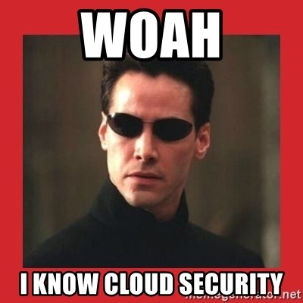
Ready to face challenges?

Slide 21

Thankyou Everyone RIP Internet Hero Binit Ghimire

Slide 22

Any Questions?
Feel Free to contact me via twitter/email.
Keep learning everyday, Support everyone.
smaranchand@gmail.com
https://twitter.com/smaranchand

