Slide 1

DigitalOcean Cloud Security Practices
Smaran Chand
@smaranchand

Slide 2
DO Resources
Droplets
Databases
Spaces
Firewall
dns
VPC

Slide 3
Droplet Security
Disable root login via SSH
System Hardening
Firewall and custom VPC networking.
Backup
OS Updates
Reserved IP address/Floating IP
Isolated Execution Environment
Service Auditing

Slide 4
References
https://github.com/konstruktoid/hardening
https://docs.digitalocean.com/tutorials/recommended-droplet-setup/

Slide 5
Database Security
Firewall in place
System Hardening If applicable
Use of Private VPC network connection string
Logging and Monitoring
Use of Alert Policies

Slide 6
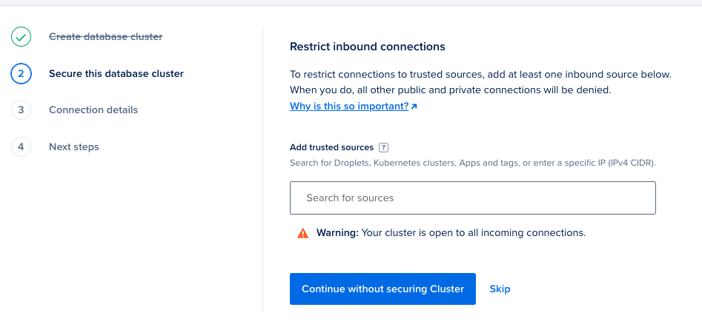
Firewall In Place

Slide 7
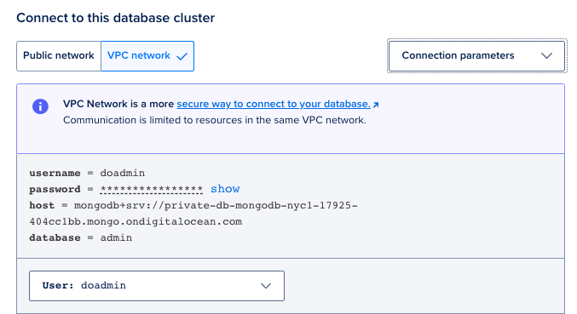
Private VPC connection

Slide 8
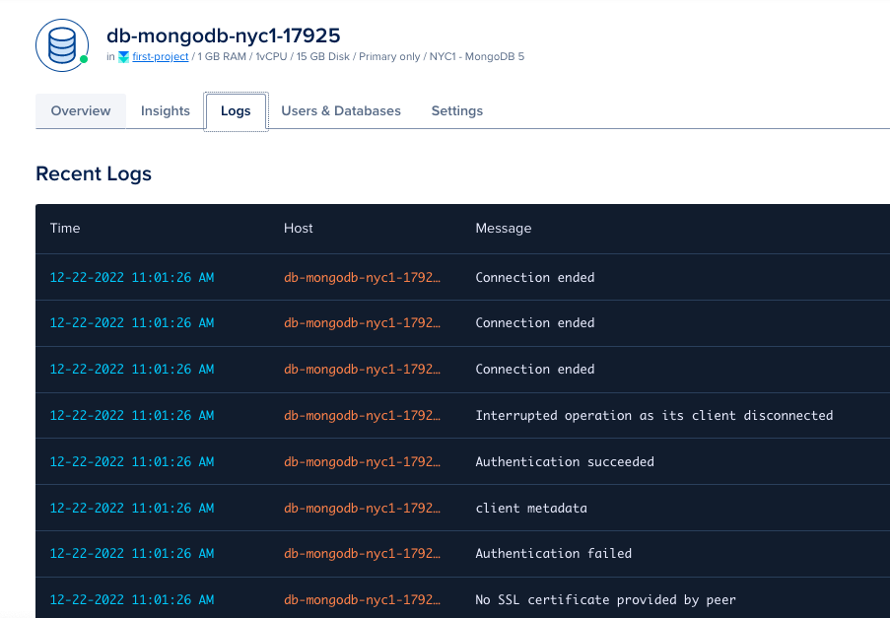
Logging and Monitoring

Slide 9
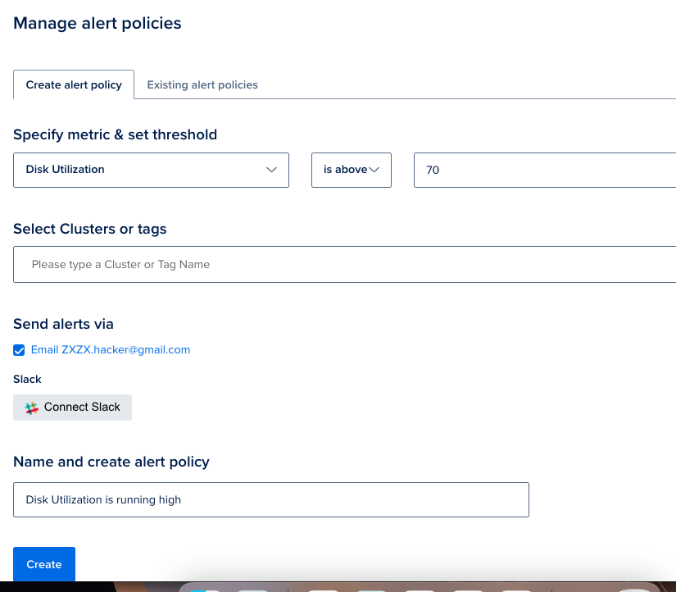
Alert Policies

Slide 10

DigitalOcean Spaces Security

Slide 11
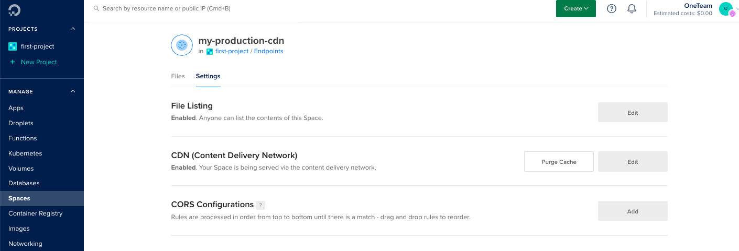
DO Spaces
Notes:
What is wrong in the picture ?

Slide 12
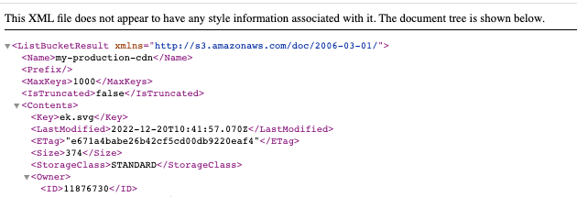

File Listing Enabled

Slide 13
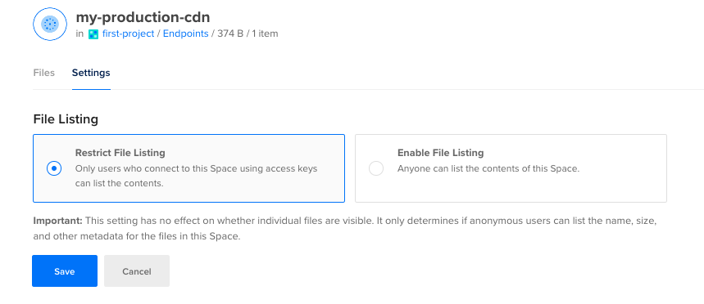
Disable File Listing

Slide 14
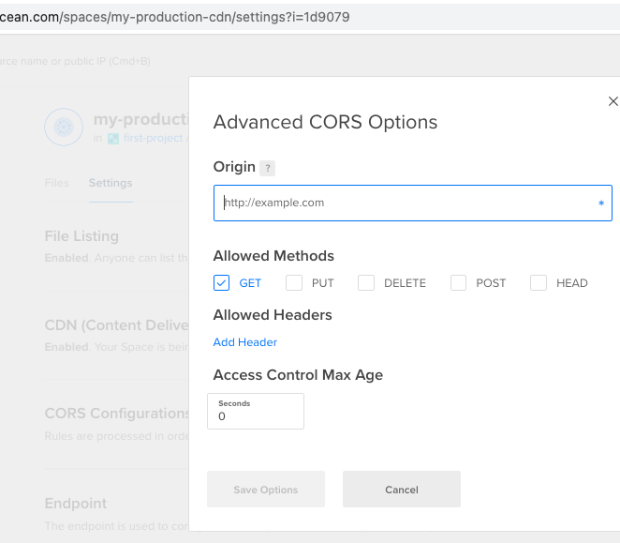
CORS Policy Setup

Slide 15
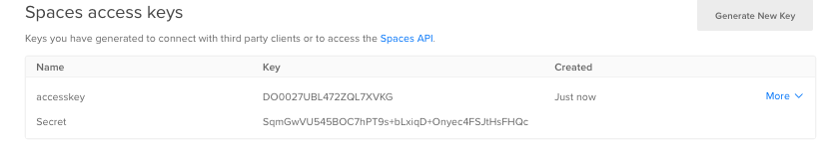
Key Rotation
This can be automated using Digitalocean function and respective service.

Slide 16

Firewall and VPC Architecture

Slide 17
DigitalOcean VPC Security
Make your own custom VPC with required CIDR block.
More granular controls.

Slide 18
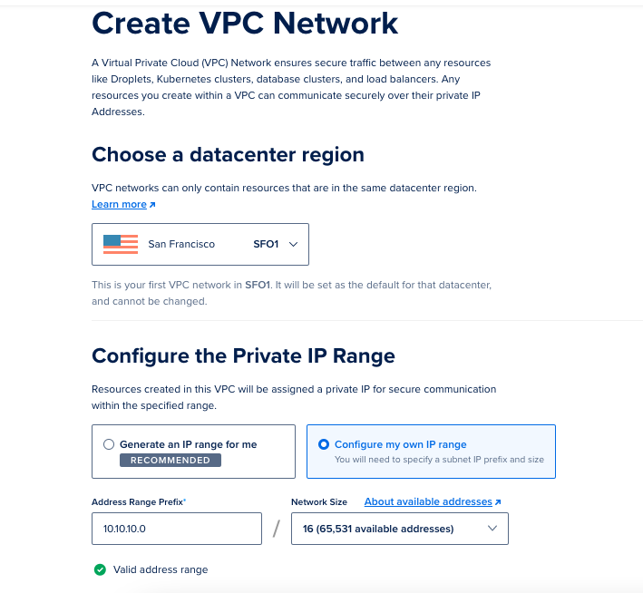
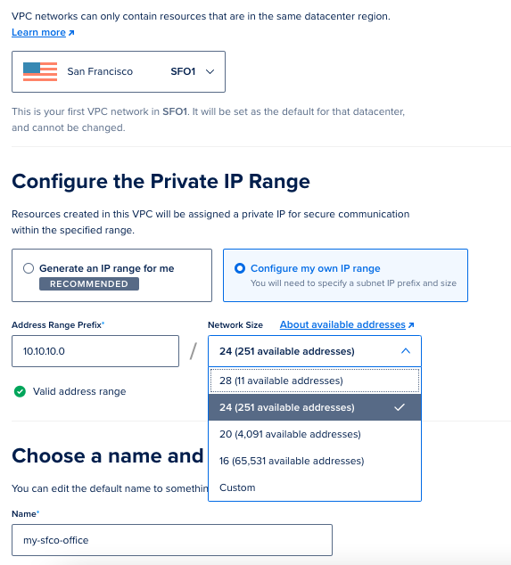
VPC Configuration

Slide 19
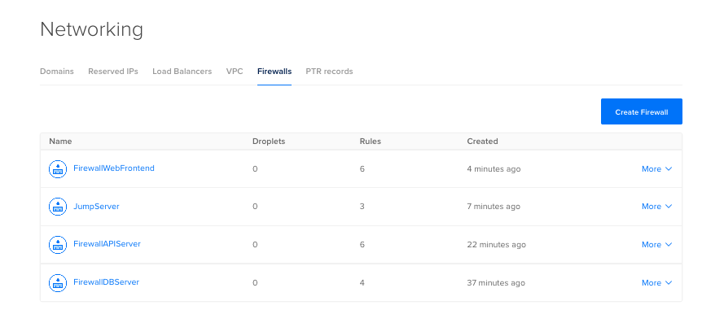
Firewall Best Practices

Slide 20
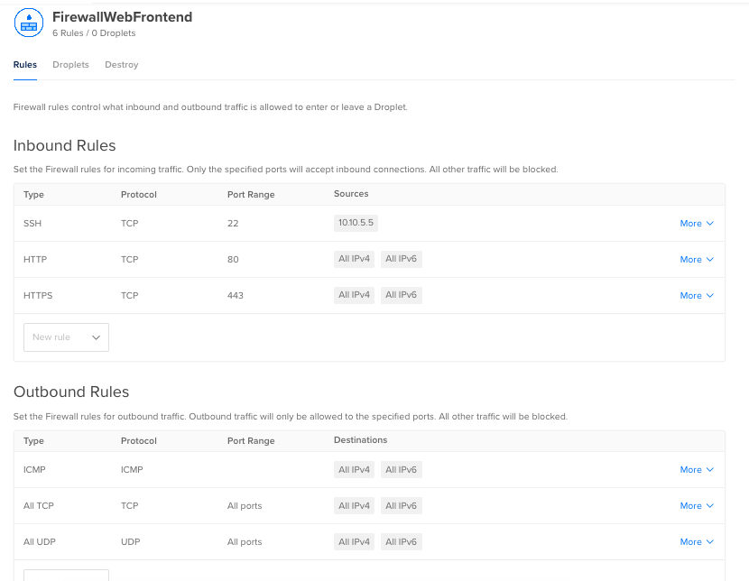
Web Frontend

Slide 21
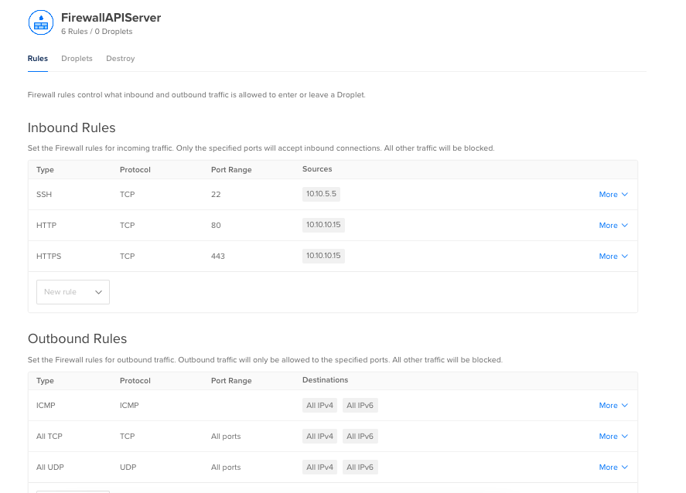
API Server
Assuming that application is consuming data from API server.

Slide 22
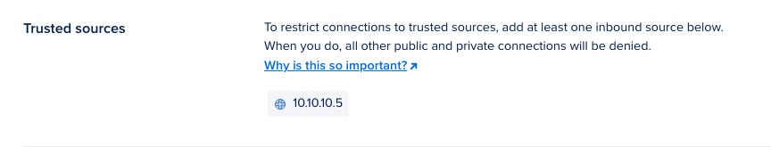
DB Server

Slide 23
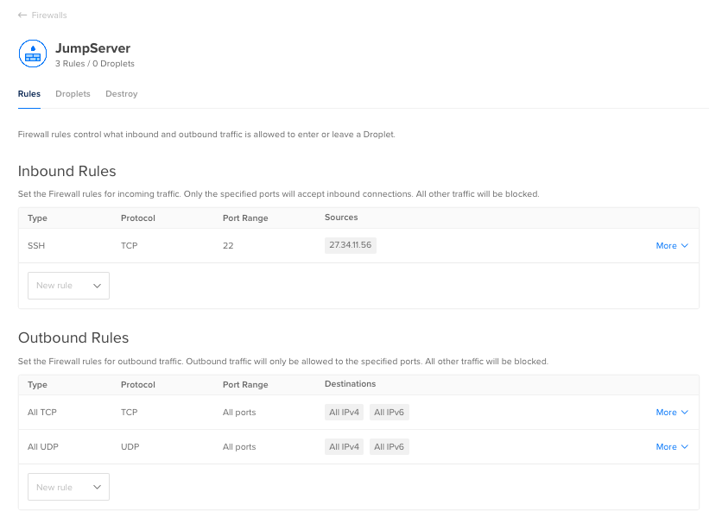
Jump/Pivot Server

Slide 24
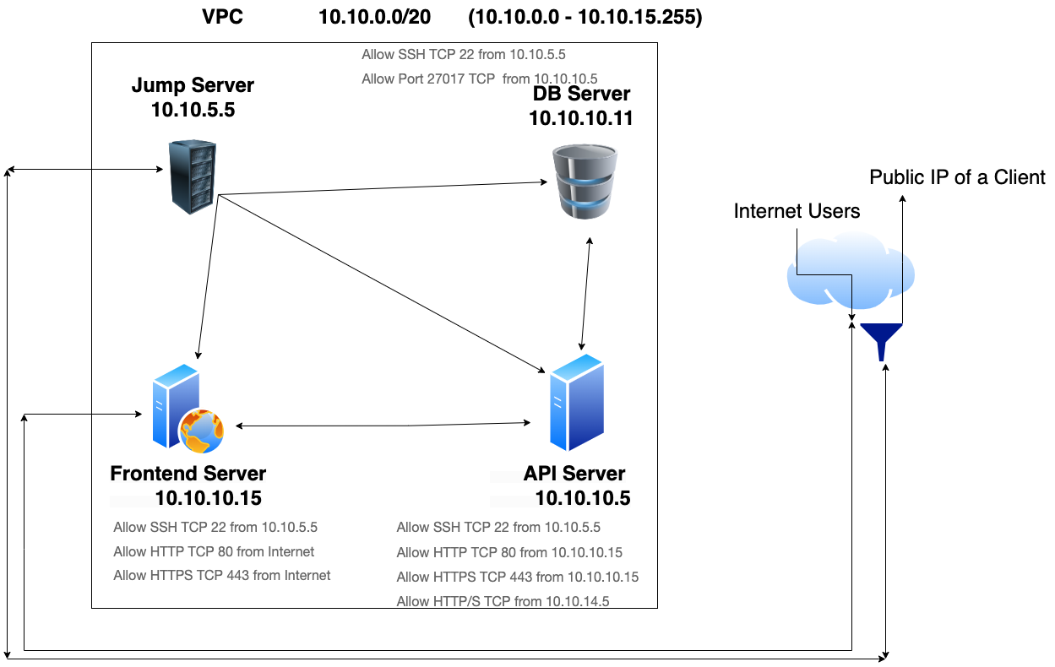
VPC Architecture

Slide 25

Securing Internal Admin Panels using available resources?

Slide 26
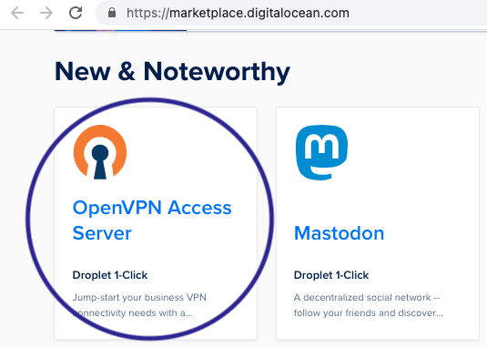
Securing Internal Admin Panels using available resources

Slide 27
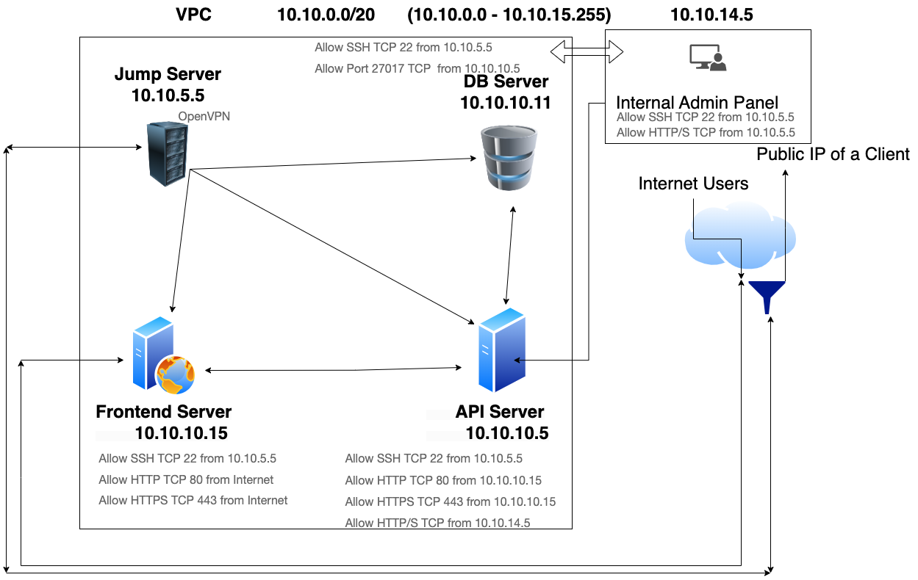
Access Internal Admin Panel with OVPN

Slide 28
DNSZone/Domain Security
Remove dangling DNS/stall entries.
DNS Zone records review.
Continous DNS monitoring using DigitalOcean API.

Slide 29
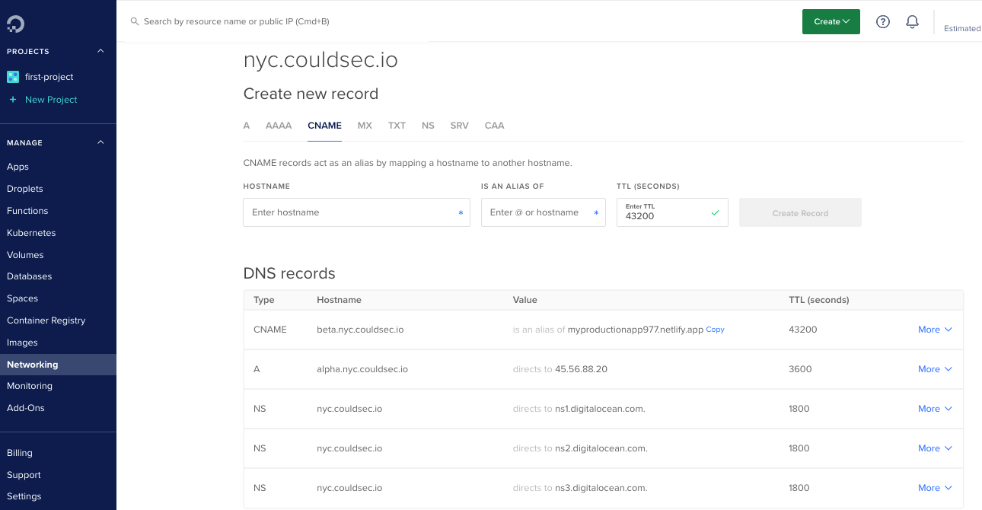
DNS Zone

Slide 30
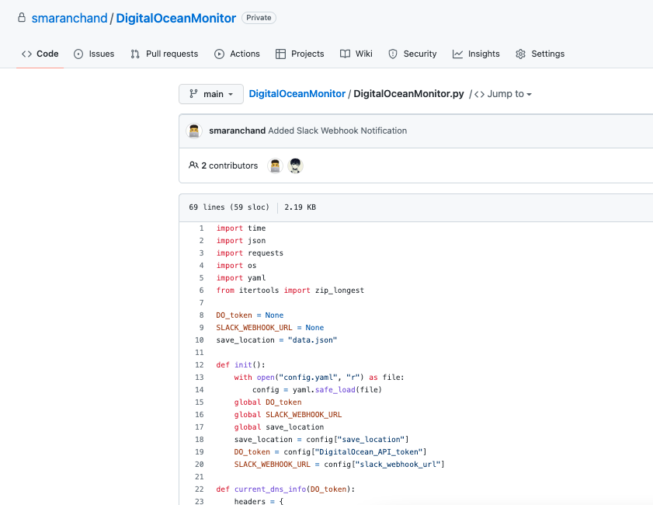
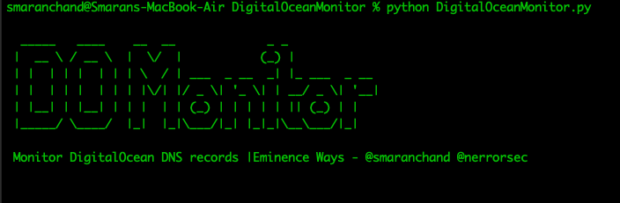
DigitalOcean DNS monitoring tool.

Slide 31

Remove Dangling DNS entries.

Slide 32
Realtime Security Monitoring
Using known available resources to monitor assets.
Security Automation for detecting and fixing bugs in code.
Use of DigitalOcean Marketplace

Slide 33

Security is a continuous process.

Slide 34
Thankyou
Smaran Chand
https://smaranchand.com.np
@smaranchand

