Slide 1

Simple Critical Infrastructure Maps
Now available in Software!

Slide 2
Problem Definition
5 years worth of diagrams, thinking and spreadsheets need to be compressed into a simple user interface in less than 48 hours
5 dimensional data structure being packed into 2 dimensions
Task previously estimated to be roughly €4.000.000 worth of work. ;)

Slide 3
Solution
Django! Easy, fun, not particularly stupid.
Lots of caffeine and tequila

Slide 4
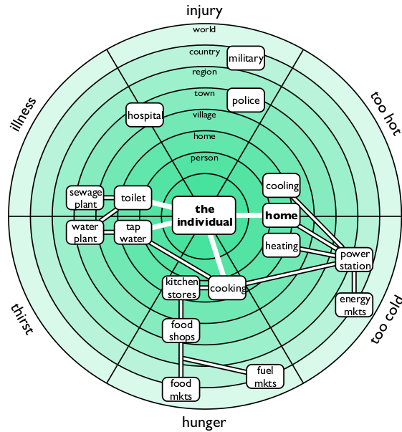

Slide 5
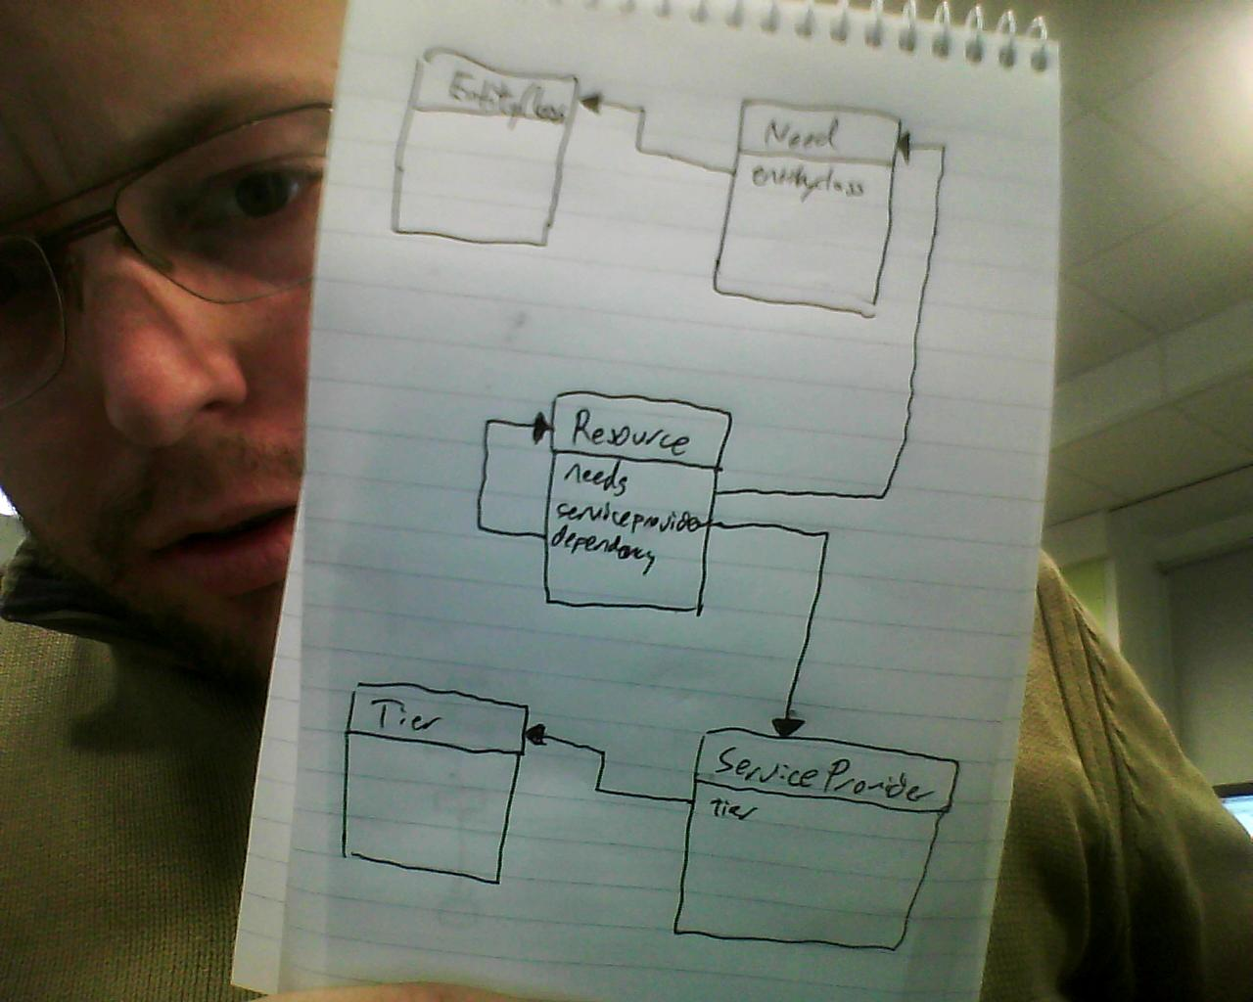

Slide 6
Next steps & Roadmap
Lots of JSON callbacks and other UI stuff needed
First version supports individual mapping.
Version 2 needs to support the group, organization and state organizational entity classes
We need to support more forms of visualization; table format is very limited.

Slide 7
On the plus side
Project is incredibly well documented
Boilerplate done!
Lots of very nice graphics done!
Code is easy to make at this point. Probably 2-3 hackathons away from being ready for public deploy.
We have kittens.

