Slide 1

Wasa2il
‫وسائل
A direct democracy platform
Smári McCarthy
smari@immi.is
@smarimc

Slide 2
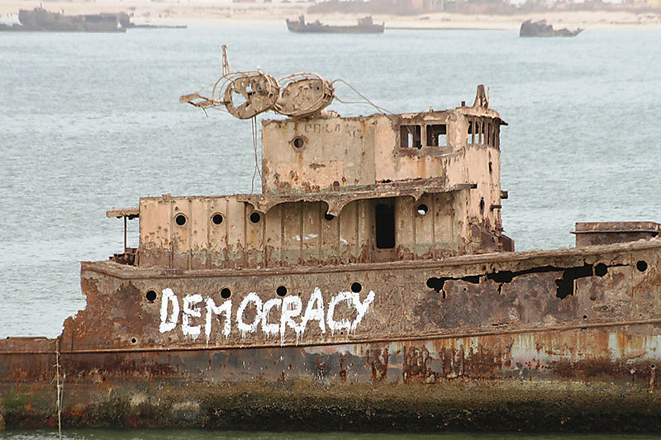
Democracy is pretty old

Slide 3
Legislative assembly
Party
Party
Party
Party
Modern “democracy”

Slide 4
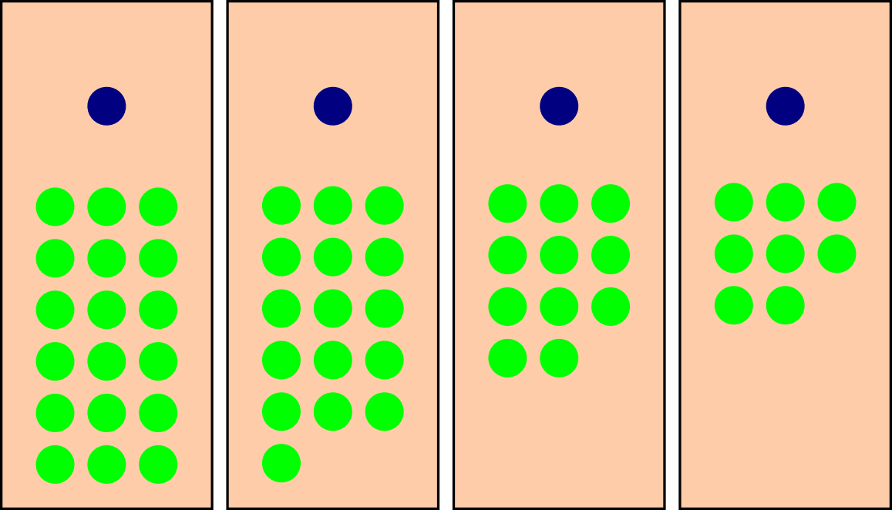
2 seats, 4 candidates, 57 voters

Slide 5
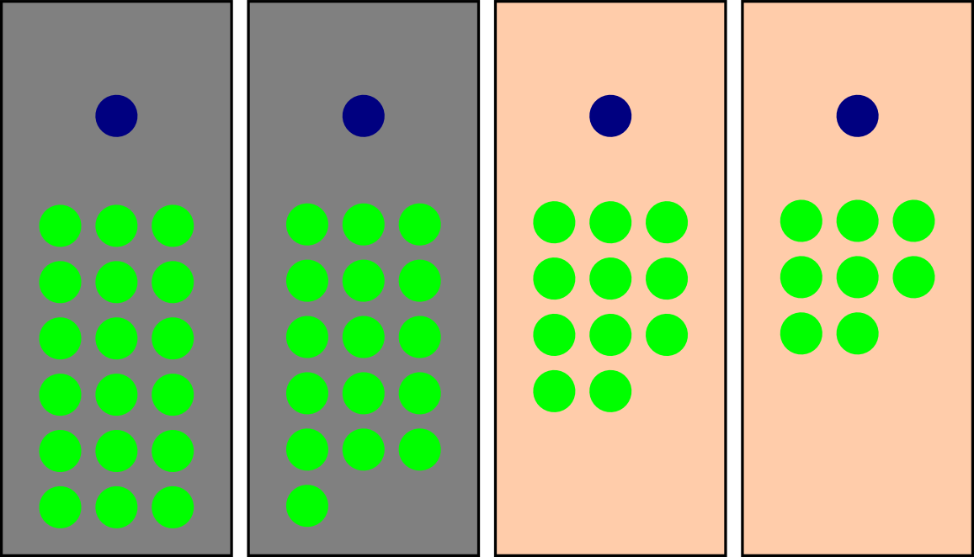
63.1% voters decide 100% of seats

Slide 6
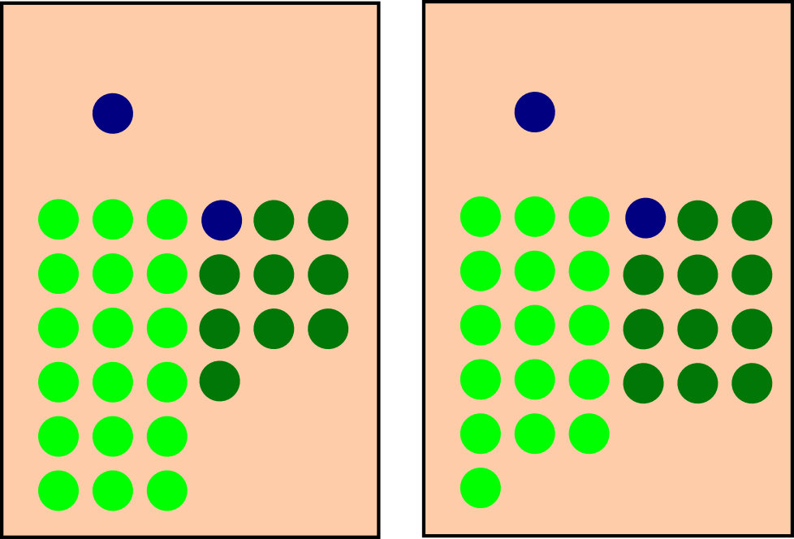
...as if 28-29 had voted for each winner

Slide 7
Compromise Early, Compromise Often

Slide 8
Legislative assembly
“Direct Democracy”?

Slide 9
Participate
Select “yes” or “no”
Abstain
Blank vote or no-show

Slide 10
Participate
Select “yes” or “no”
Abstain
Blank vote or no-show
Proxy
Allow a third party
to use the vote

Slide 11
Vote Proxying
General
Categorical
Per issue
Proxying can happen in three different ways
General (“I'm apolitical, but I trust you.”)
Categorical (“I know nothing of agriculture, but I trust you.”)
Per issue (“I have no opinion on this, but I trust you.”)

Slide 12
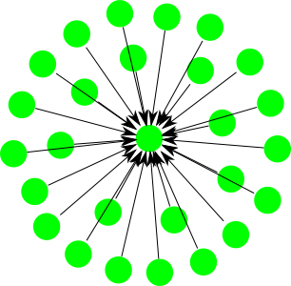
Dictatorship

Slide 13
Representative Democracy

Slide 14
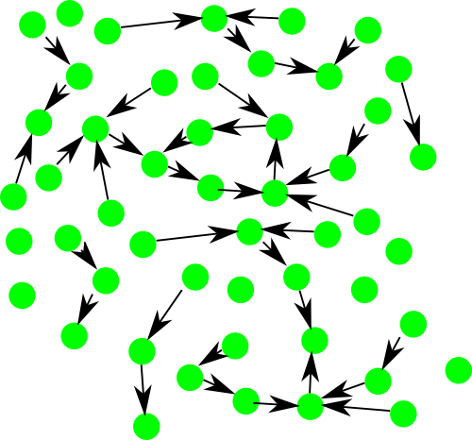
What about this?

Slide 15
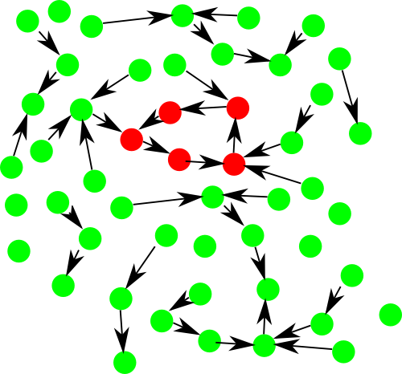
There's a problem here...

Slide 16
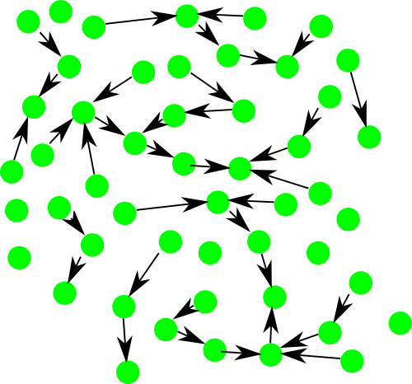
Acyclic directed graph!

Slide 17
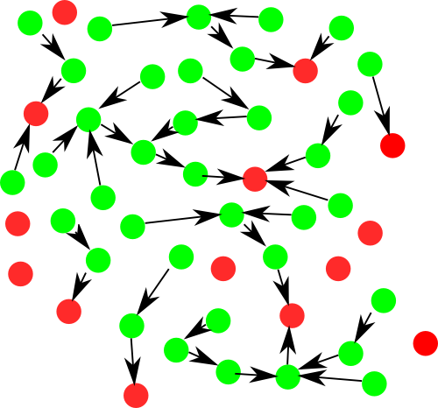
Who makes the decisions?

Slide 18
1
3
6
13
2
1
1
1
1
1
1
12
3
1
3
How much influence?

Slide 19
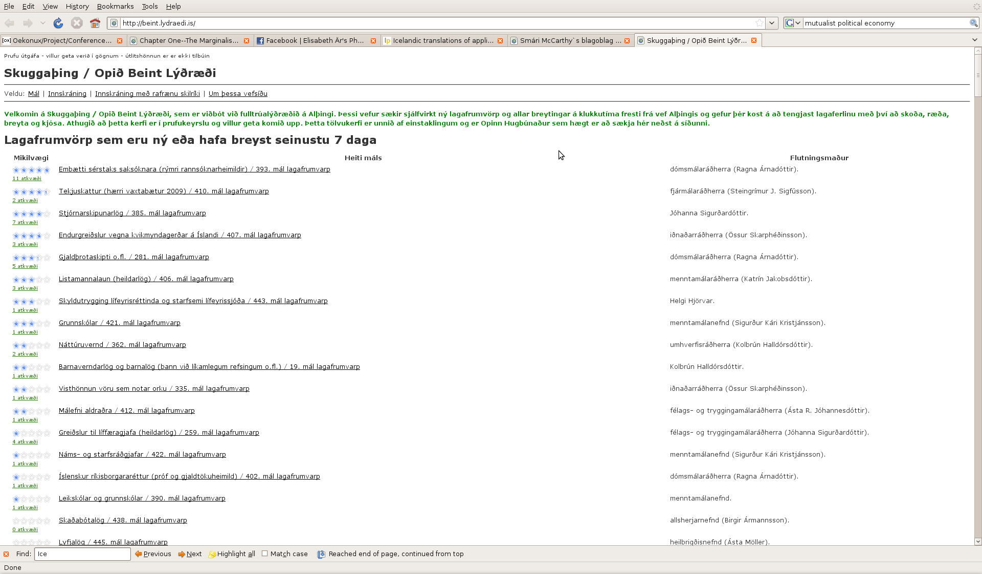
Shadow Parliament Project

Slide 20
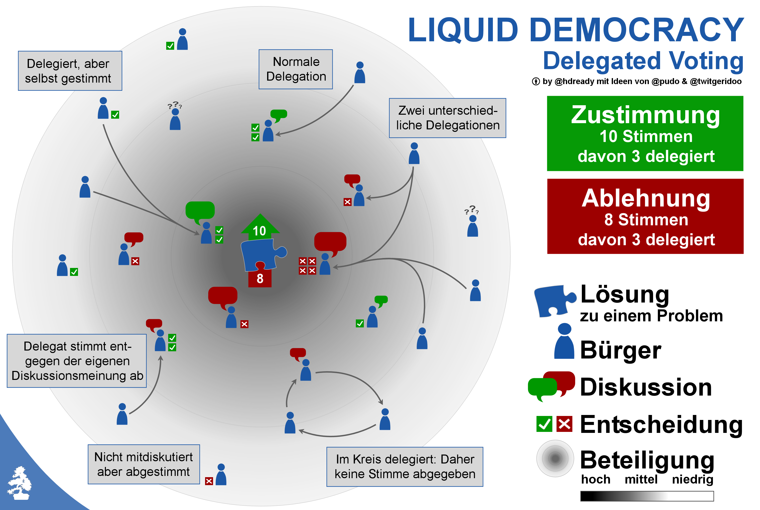
The Pirate Parties Adopted & Adapted

Slide 21

Citizens Foundation

Slide 22
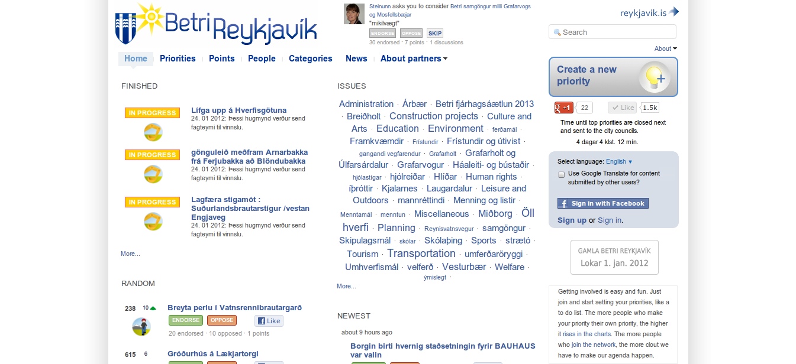
Betri Reykjavík

Slide 23
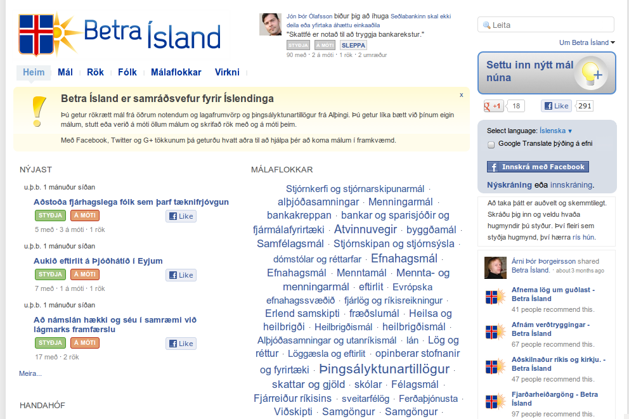
Betra Ísland

Slide 24
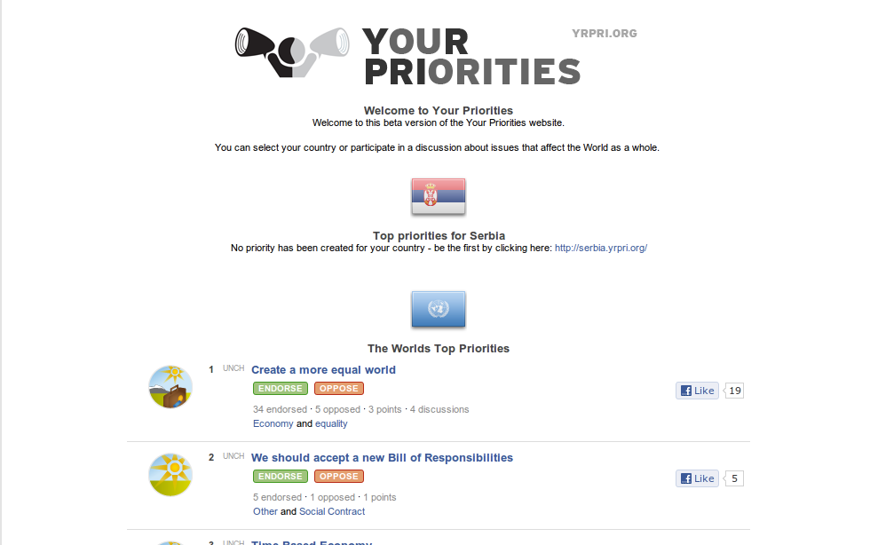
YrPri.org / Your Priorities

Slide 25
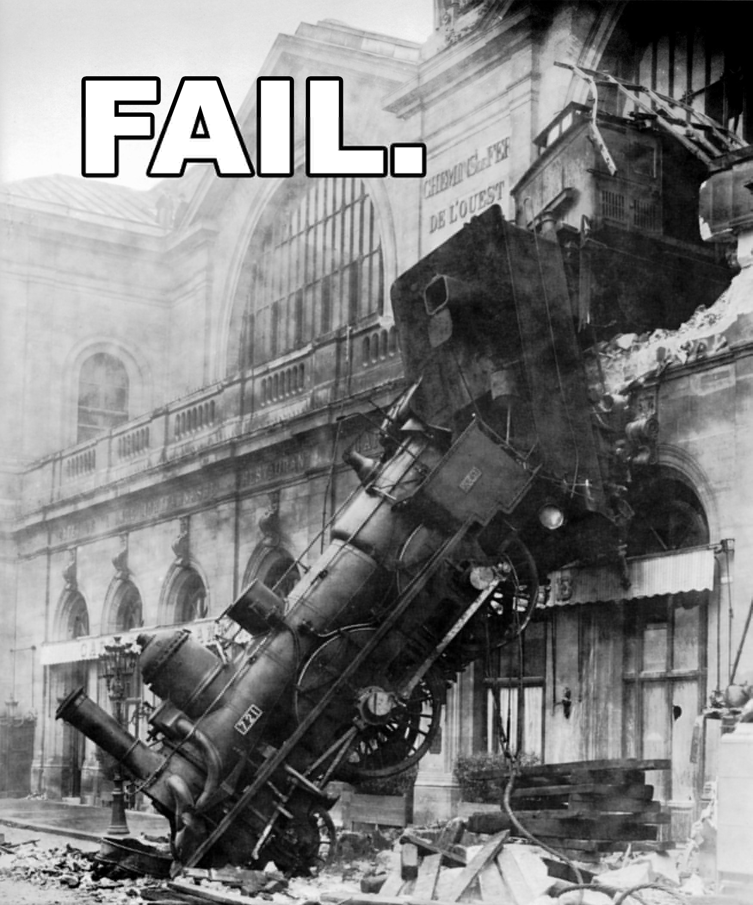
It's a mess

Slide 26
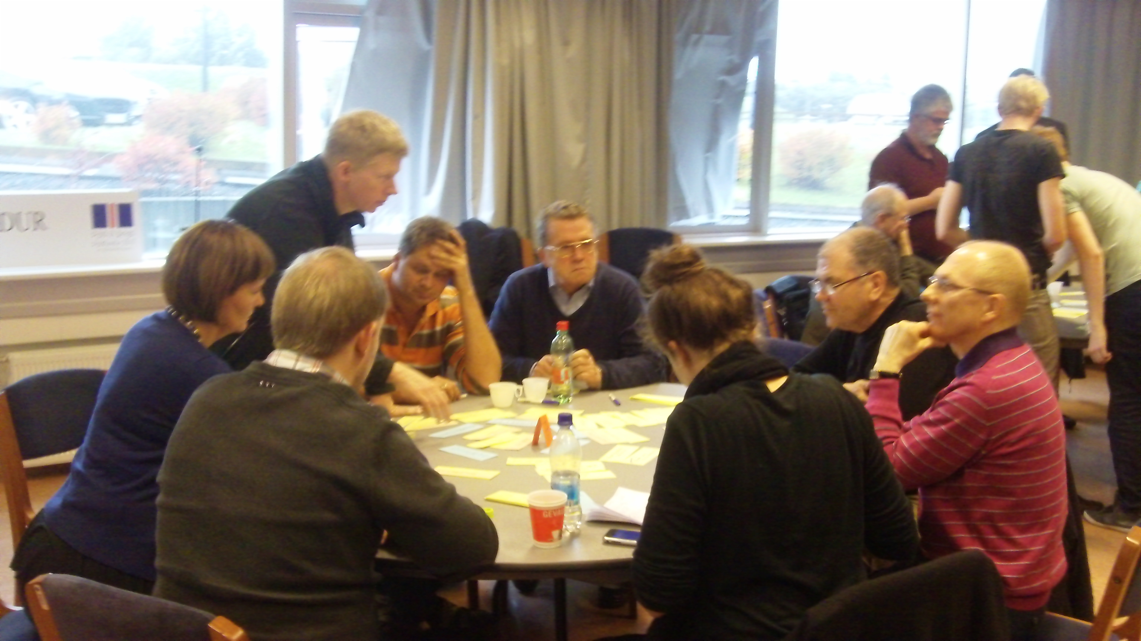
Polities
Groups of people who come together to make decisions and enact their will.
Various names depending on their form, structure, intent, scale and scope:
Countries, towns, clubs, cabals, mafias, federations, treaties, unions, associations, companies, phyles, tribes, counties, regions.

Slide 27
Topics
Many polities deal with a number of types of issues which are different enough from one another that it makes sense to split them up categorically.
A topic belongs to a polity and consists of zero or more issues.

Slide 28
Issues
A member of a polity can raise an issue to talk about an idea, a problem, or whatever makes sense.
An issue belongs to one or more topics.
An issue consists of a conversation and zero or more documents.

Slide 29
Documents
A document is (for these purposes) a structured text which contains the understanding of the polity.
A document that hasn't been adopted is a proposal.
A document that has been adopted is an agreement.
A document belongs to zero or more issues and consists of zero or more statements.

Slide 30
Statement
A statement is an article in a document.
Statements have various types, such as reference, assumption, declaration, and so on.
A statement belongs to a document.

Slide 31
Change
A change proposal is a suggestion for alteration of a statement.
It can either delete, add, alter, or move a statement.
A change belongs to a statement.

Slide 32
Vote
Users can vote on change proposals and documents.
Change proposals that get voted in (adopted) are applied to the document in order of adoption.
Documents which get voted in (adopted) are considered to be agreements.

Slide 33
Polity
1:∞
Topic
1:∞
Issue
∞:∞
Document
1:∞
Statement
1:∞
1:∞
1:1 (User)
Comment
Change
1:1 (User)
Vote

Slide 34
Practical example!

