Slide 1
Lending Club case study
Submitted By
Shanmuga Mari
Sasindran Devaraj

Slide 2
Problem Statement
There are two types of risks associated with any loan request:
if the applicants likely to repay the loan,then not approving the loan results in a loss of bussiness to the lending company.
If the applicant is not likely to repay the loan, i.e loaner is likely to ‘Charged Off’, then approving loan may lead to a finanical loss for the lending company.
Exploratory Data Analysis done on dataset provided by company, which is the existing loaners data records.

Slide 3
Analysis Overview
Steps followed in this Lending EDA Case Study:
Understanding the Dataset
Data Cleaning & Manipulation
Data analysis using plots
Recommendations

Slide 4
Dataset Understanding
Importing the Dataset from the csv files
Dataset contains shape of (39717 rows, 111 columns)
Identified key columns in the dataset to find solution to minimize the risk of loss.
Target column ‘loan_status’ is key indicates “Fully Paid/Charged Off/Current” status of the loan.
“Current” status is ongoing loan, so these rows are ignored from the dataset for our analysis.

Slide 5
Data Cleaning & Manipulations
Null values > 90% columns removed from dataset
Column having a same value in all rows are removed.
Columns int_rate , emp_len, term, issue_d converted to expected format of the data. (removal of %, +Years, months, %b-%y )
Filtering on dataset done and created additional categorical variables columns to help analysis like loan_issued_year, loan_amnt_grp, interest_grp
Identified outliers and standardized values for ‘annual_inc’ columns, which is used for data analysis. Whereas all other columns outliers may not impact our analysis.

Slide 6
Data Analysis
The following list of data analysis executed on the dataset, which will be shown with result in coming slides
Univariate Analysis
Unordered categorical variables
Ordered categorical variables
Segmented analysis
Bivariate Analysis
Continuous Variables
Correlation Matrix

Slide 7
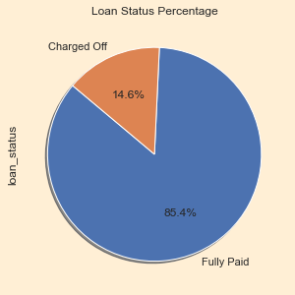
Data Analysis (univariate)
Analysis of Loan status
39717 loans granted & 5627 were charged off
As visual show 85.4% Fully Paid loans vs 14.6% Charged off

Slide 8
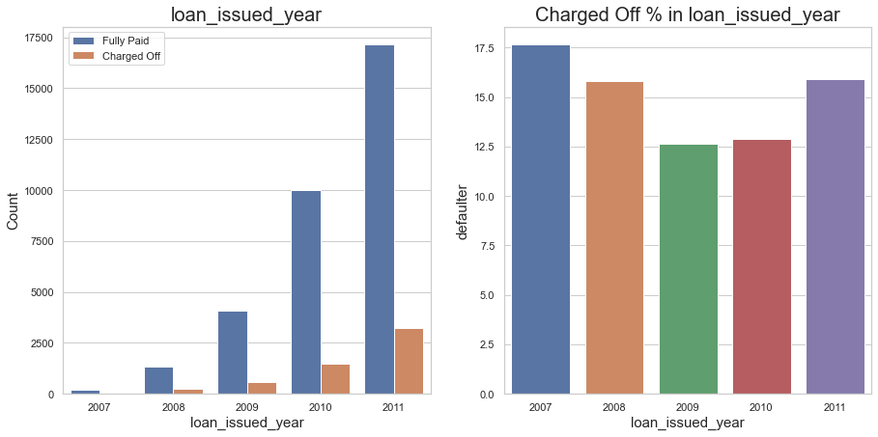
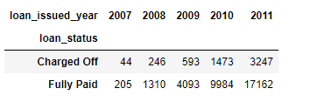
Data Analysis (univariate)
Analysis of Loan Issued vs Charged-Off Year wise
Year 2007 to 2011 number of loans granted gradually increases and max of ~17K loans were given in 2011
As visual shows Year 2007 to 2009 there is gradual dip in charged-off percentage, But 2009 to 2011 again it has upward movement.

Slide 9
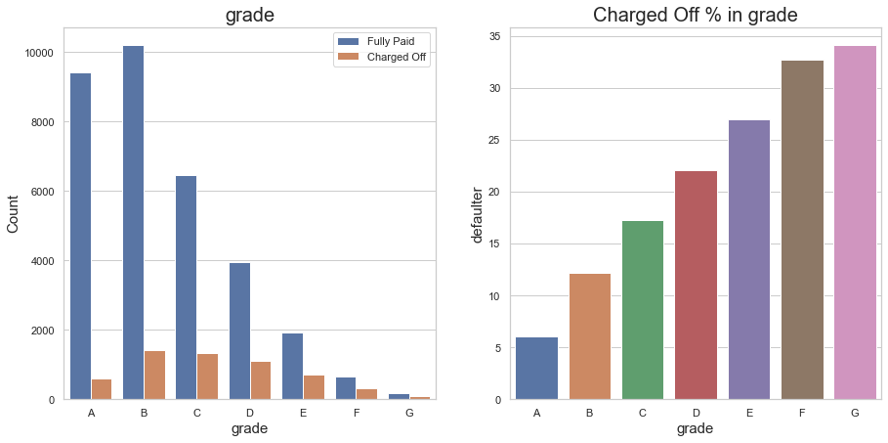
Data Analysis (univariate)
Analysis of Loan status on Grade Wise
Mostly ‘A’ grade less charged off and it gradually increases from A to G(~35%)
Most of the Charged off counts are in B, C, D grades (B2 to C3 subgrades)

Slide 10
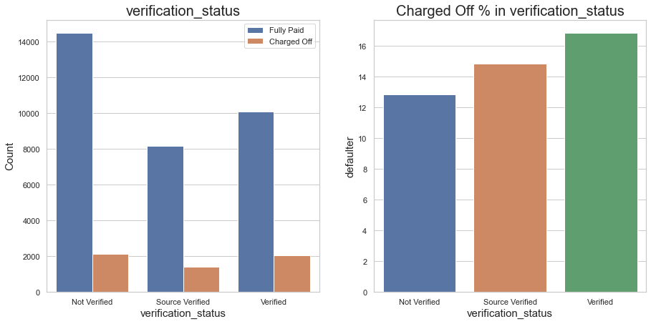
Data Analysis (univariate)
Analysis of verification status
Charged off percentage almost similar across all category of verification_status.
As visual shows loans are issued without any verification is high in number less in defaulters
Loans with verified/sourced-verified having higher defaulters percentage compare to “Not verified”.

Slide 11
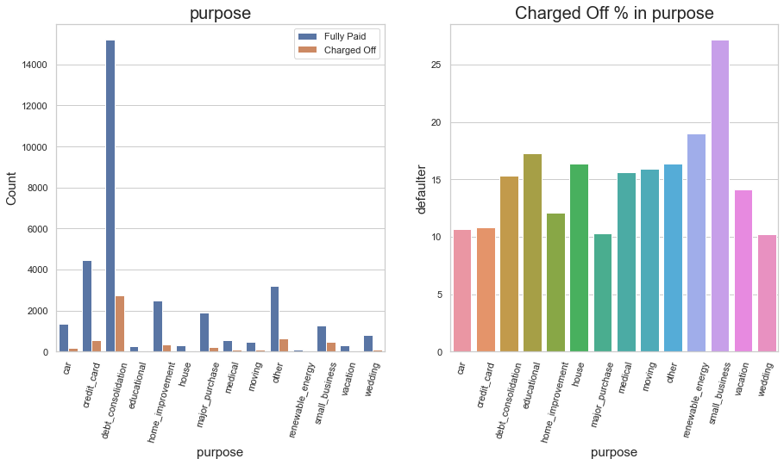
Data Analysis (univariate)
Analysis of loan purpose vs charged-off
Most of the Charged off occurred in debt-consolidation ~2600.
As visual shows those who applied for ‘small-business’ also ~27% in charged off category.

Slide 12
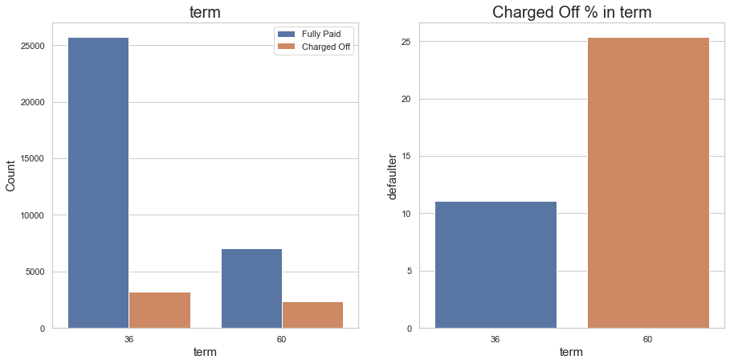
Data Analysis (univariate)
Analysis of loan term vs charged-off
Most of the Charged off occurred in long term loans compare to short one.
As visual shows those who applied for term 60 months are highest of ~25% in charged off category.

Slide 13
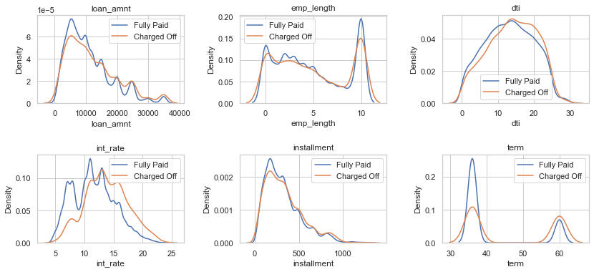
Data Analysis (univariate)
Analysis of Numerical columns in the dataset
As visual shows most of the Charged off occurred in higher loan amounts.
Around 10yrs of employees experience got high number of loans
As visual shows when ‘DTI’ is high, loaner chance increases for charged-off
As visual shows when interest rate increases graph shows charged off increases.

Slide 14
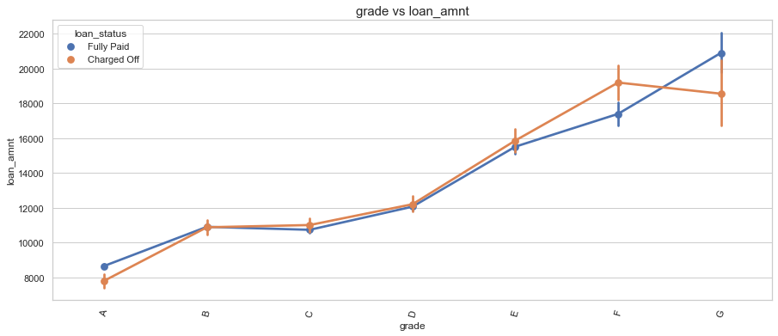
Data Analysis (bivariate)
As visual shows Charged off occurred in B, C, D, E, F, G. But E, F,G grades loaners are very less in count.
As visual shows D, E, F, G grade loaners are got higher loan amount 12k >
As visual shows A grade loaners likely to pay, but loan amount is mostly in the range of 10k to 15k
Average loan amount across grades increase gradually from Grade A - G

Slide 15
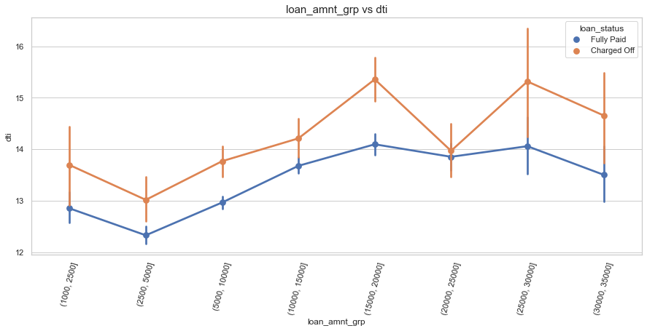
Data Analysis (bivariate)
As visual shows when DTI highly correlated to loan amounts.
As visual shows lower level of debt-to-income ratio loaners likely to repay loan

Slide 16
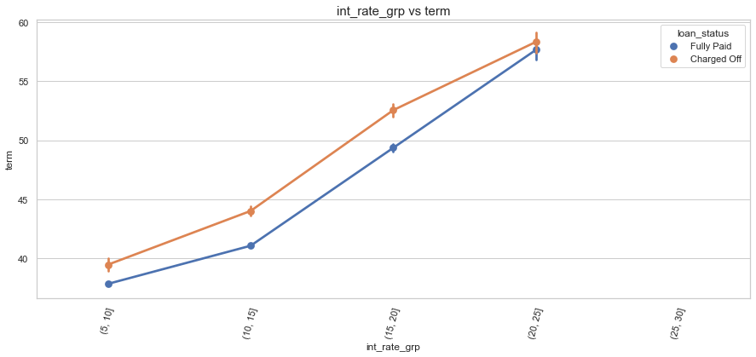
Data Analysis (bivariate)
As visual shows when term is highly correlated with interest rate.
Charged off ratio also increase for higher loan interest rates.
As visual shows mostly 36 months term loans are less chances for charged-off

Slide 17
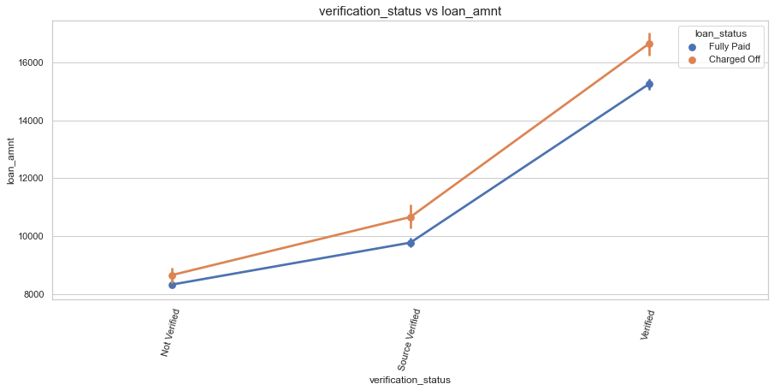
Data Analysis (bivariate)
As visual shows mostly “Not verified” loans are issued for lower amounts.
As visual shows higher loan amounts, source are verified or details verified.

Slide 18
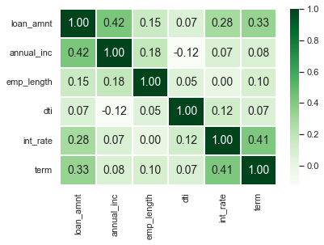
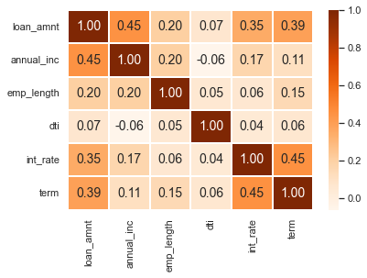
Data Analysis (Correlation Matrix)
As visual shows Fully paid Green correlation matrix Vs Charged-Off Orange matrix columns loan_amnt, int_rate, annual_inc, term are positive correlations with others.
As vishal shows annual_inc vs dti is negative correlation
As visual shows, int_rate and term with low values have high changes of repaying the loan.

Slide 19
Important Driving Factors
After analyzing the datasets, there are driving factors of a loaner with which the bank would be able to identify if loaner will be ‘Charged-Off or Fully-Pay’ the loan.
Observations based on loan dataset analysis:
The columns “funded_amnt/loan_amnt”, “int_rate”, “term”, “grade”, “dti”, “verification_status” are decisive factors for identifying the “Charged-off or Fully-paid” loans
Decisive Factor for “Charged-Off”
loan_amnt – Higher the loan amount, likely to be charged-off
int_rate - Loans with higher interest rate, likely to be charged-off
Term – Higher the loan terms, likely to be charged-off
Grade - The lower grades E, F, G, likely to be charged-off (G has higher percentage of charged-off compared to ‘A’ lowest charged of percentage)
DTI – Higher the debt-to-income, likely to be charged-off
Decisive Factor for “Fully-Paid”
when the loan-amount, interest-rate is moderate and short term, Grades A,B,C people most likely to repay the loan.

Slide 20
Recommendations
EDA for the loan dataset revealed that:
The Bank can reduce the financial loss if it gives loans with short terms.
Average interest rate of the loans are likely to Fully Paid, so if the banks gives loans at moderate level of interest it can avoid loss.
If the bank provides more of loans with higher amount to Grade level ‘A’ to ‘D’ , it can improve the business.
If the bank considers DTI, home_ownership factors before giving the high amount of loan, it can avoid the charged-off counts.
The Bank can avoid the charged-offs with quality verification process for loan approvals when loan amount is higher for the Grade E, F, G.

Slide 21
Thank You

