Slide 1
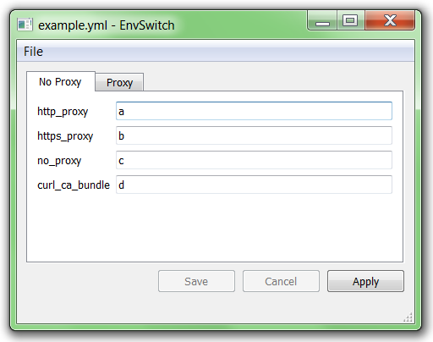
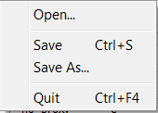
Ui_MainWindow (qt_design.py, generated)
EnvSwitcherView
EnvSwitcherState
set windowFilePath
set windowModified
RSlots
Signals
API
current_file_changed
current_file_changed
xxx.setEnabled
current_config_changed_or_saved
current_config_changed_or_saved
envsTabWidget.addTab
recreate_tabs_view
var_value_editor.setText
Signals
var_value_editor
LSlots
textEdited
set_env_variable
mainButtonBox
LSlots
API
clicked (+filter)
apply_current_env
current_configuration.envs[env_id].apply
rejected
cancel_modifications
cancel_modifications
accepted
save_config
save_modifications
Actions
open_config
(@property setter) current_config_file
save_config_as
save_as
actionOpen
quit
actionSave
actionSaveAs
actionQuit
EnvSwitcherApp
RSlots
current_file_changed
Settings
config_file_path

