Slide 1

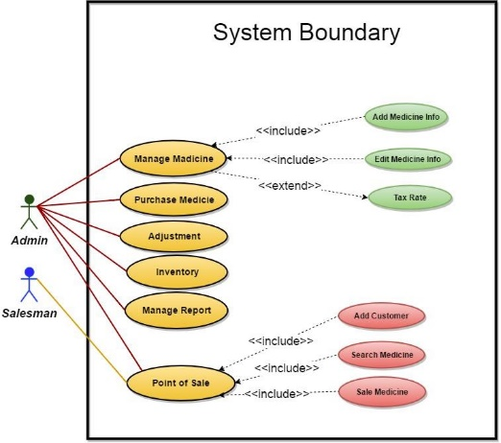
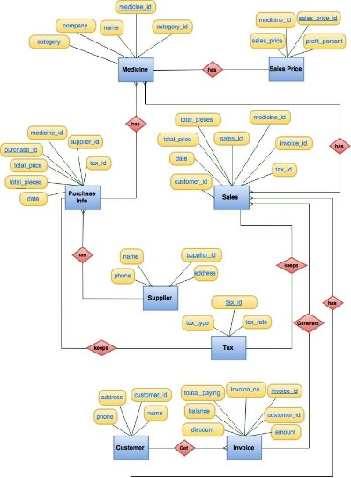
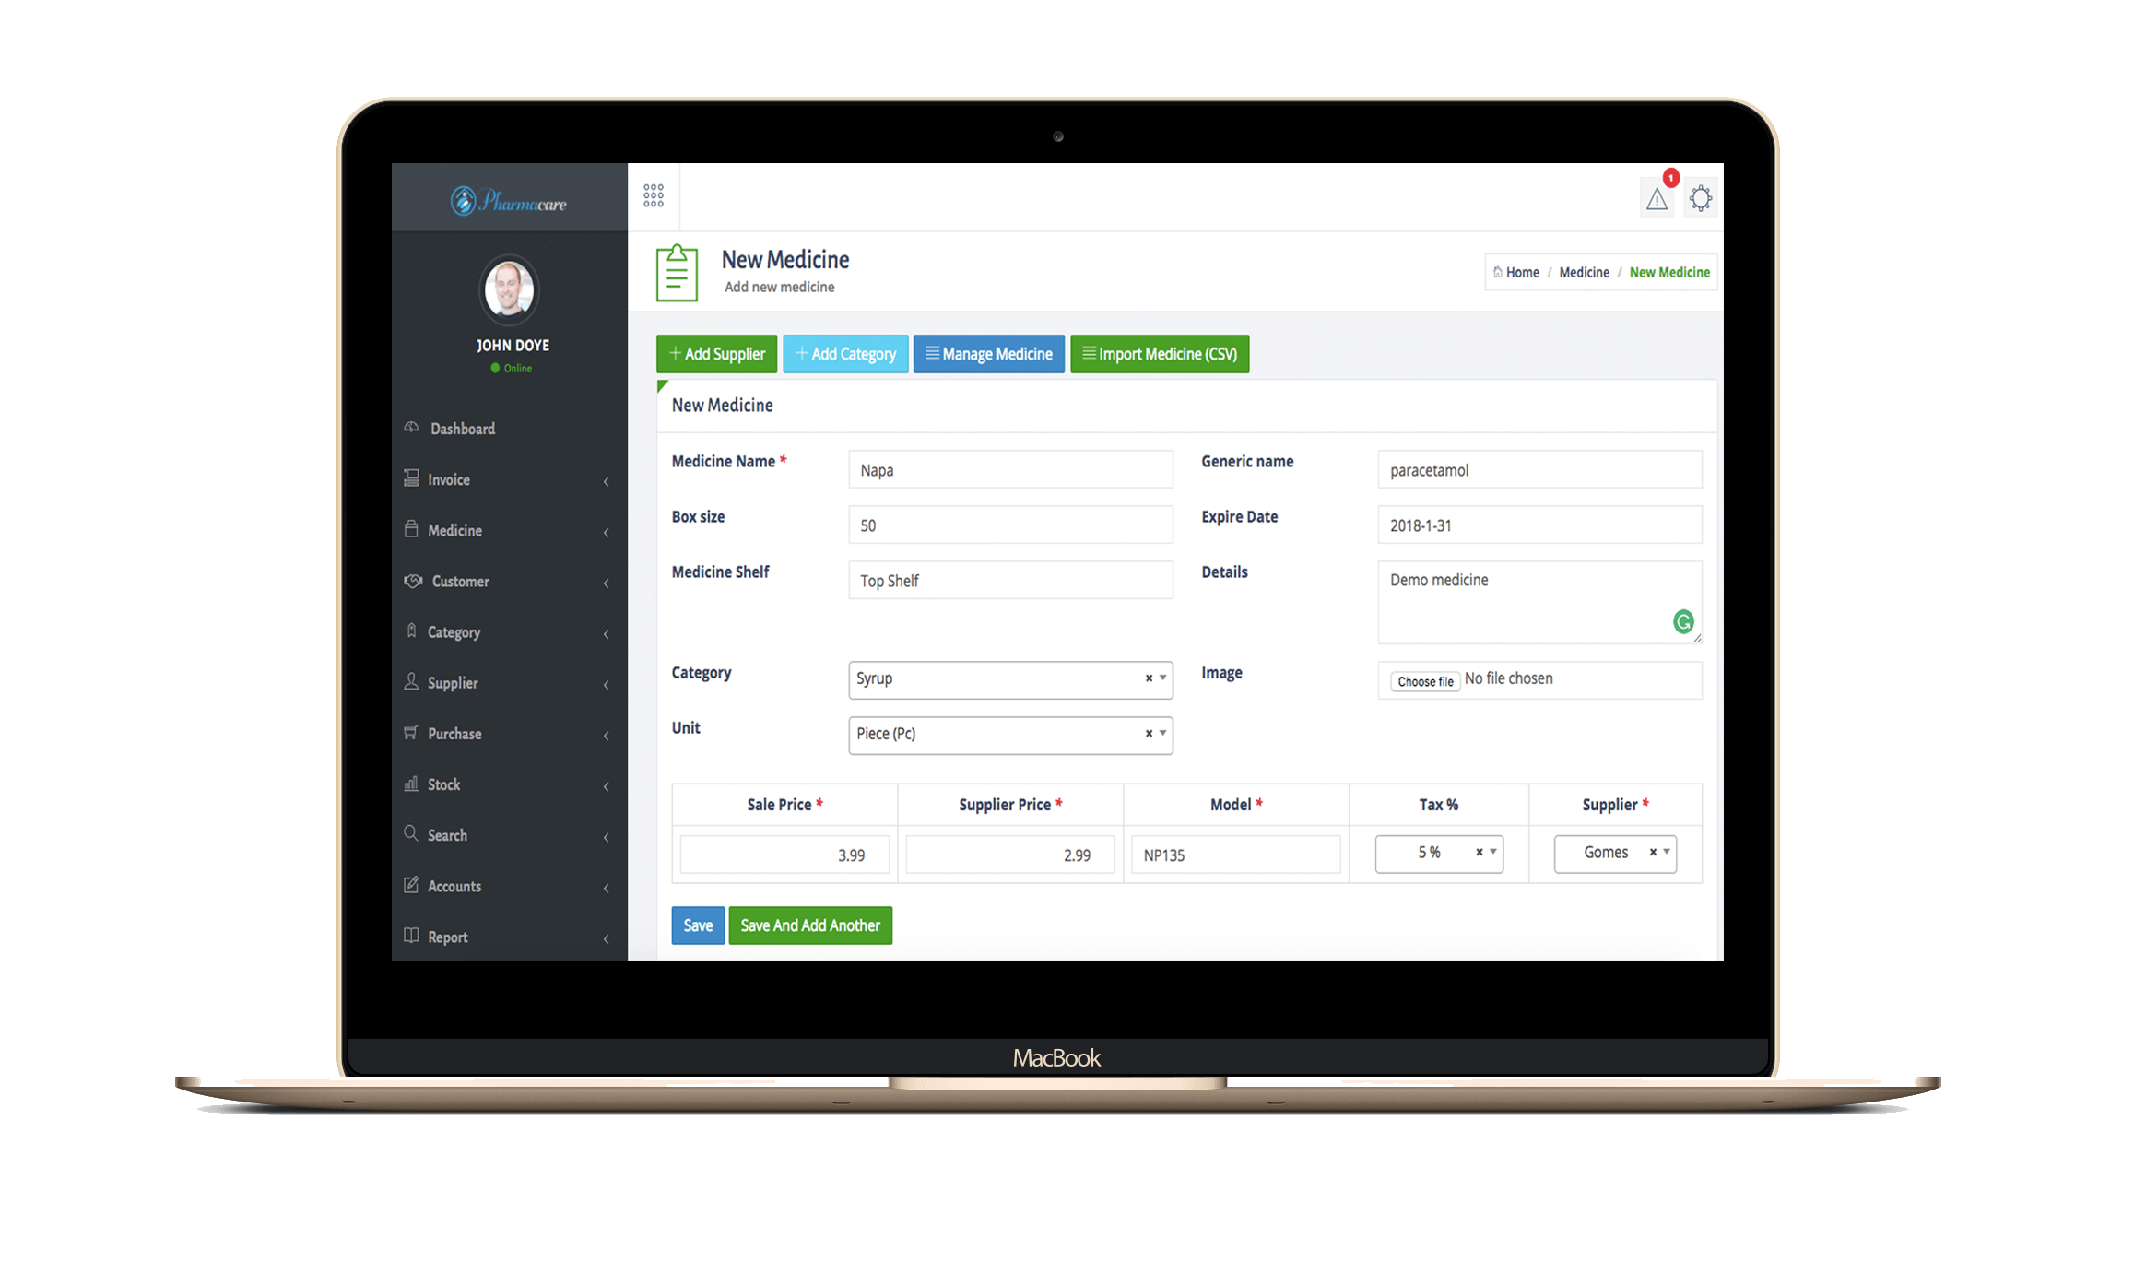
Pharmacy Management System
Apply Automation, Be Dynamic, Accelerate Profit

Slide 2
Group No: 6
Team Members
Md Ariful Islam ID: 171442013
Neegar Sultana ID: 171442513
Miladul Islam ID: 171442013
Submitted To:
Supta Richard Philip
Senior Lecturer
Department of CSE
City University, Bangladesh

Slide 3
Why Pharmacy Management System ?
The current Pharmacy system were manually base system which is almost all works on the pharmacy organization is accomplished by papers.
Compared to the current manual system, the implementation of Pharmacy management system will have reduced the time spent for paperwork and to track the
medicine flow
record daily purchase and sells
calculate expenses & income automatically
record supplier outcome
and many other things

Slide 4

F e a t u r e s
Medicine Management System
Purchase Management System
Sales Management System
Customer and Supply Management
Important Reporting System Integrated
Information Management System

Slide 5
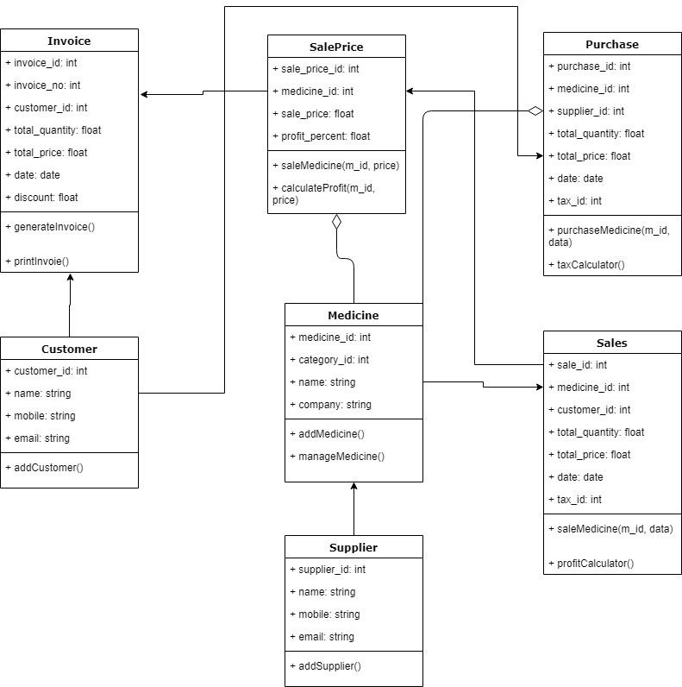

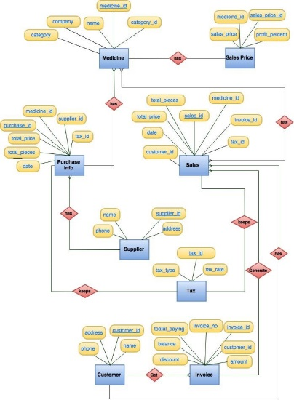
Analytical Diagrams
We have created various type of Analytical Diagrams for this project…

Slide 6

Use Case Diagram

Slide 7
Facilities of the systems
Unlimited User
Access from anywhere
Unlimited PC access
Unlimited Employee Access
Individual access & user panel
Various types of reports

Slide 8
T h a n k Y o u

