Slide 1
GEDU Performance Test Report nMEL 2.5.10, Saltare 5.8
Datapipe
Author : Santosh

Slide 2
Glossary
Concurrent connection - users doing the same activity at the same time, e.g. all instructors registering at the same time, all instructors creating classes at the same time, all students taking a test at the same time, all instructors grading students at the same time etc.
Concurrent user - users using the system at the same time, e.g. instructors registering while students taking tests at the same etc.
Slow transaction - any transaction that takes longer than 5 seconds to complete
Failed transaction - any transaction that has failed to complete, e.g. cannot register, cannot assign activity, cannot take test

Slide 3
Objectives of Performance Testing
Objectives of Performance Testing GEDU were:
Establish Baseline Performance of Key GEDU Scenarios on Datapipe Environment with 14 nMEL Application Servers – nMEL 2.5.10, Saltare 5.8
Establish Baseline Performance of Key GEDU Scenarios on Datapipe Environment with 14 nMEL Application Servers – nMEL 2.5.10, Saltare 6.4
Status:
Objective 1 is Complete.
Objective 2 is in Progress.

Slide 4
Key GEDU Scenarios
Following are the ‘Test Scenarios’ which were in scope of performance testing.
SC05 – Students Change Password, Take Activity in Course
SC06 – Teacher Drills Down Students Grade Book
SC07 – Teacher Drills Down Students Diagnostics
SC08 – Teacher Accepts Common Error
SC09 – Students Take Practice Test
Following are the ‘Scenarios’ used to prepare the data.
SC01 – Admin User Registers Teachers via Batch Upload (for data preparation only)
SC02, SC03 & SC04 - Teacher Creates Course, Register Multiple Students and Assigns Activity to All Students (for data preparation only)

Slide 5
Load Tests Executed
# SC05 – Students Change Password, Take Activity in Course
  This scenario was split into two parts (1) Students Change Password (2) Students Taking Activity In Course, due to Saltare hanging at logout step.
# SC05 – (1) Students Change Password
  Three Tests Executed: 600, 900 and 1620 Concurrent Students
# SC05 – (2) Students Taking Activity In Course
  Three Tests Executed: 600, 900 and 1620 Concurrent Students
# SC06 – Teacher Drills Down Students Grade Book
  One Test Executed – 200 Concurrent Teachers
# SC07 – Teacher Drills Down Students Diagnostics
  One Test Executed – 200 Concurrent Teachers
# SC08 – Teacher Accepts Common Error
  One Test Executed – 200 Concurrent Teachers
# SC09 – Students Take Practice Test
  One Test Executed – 200 Concurrent Students
# SC05 + SC06 + SC07 – Students Take Practice Test, Teacher Access GradeBook & Diagnostics
  One Test Executed – 200 Concurrent Teachers + 810 Concurrent Students

Slide 6
SC05 (1) - Test Results
# SC05 – (1) Students Change Password (600, 900 and 1620 Students)
  Response Times are Acceptable, Excluding ‘Accept Agreement’
  Overall Error % is within the acceptable limit of < 5%
  Saltare MySQL DB connections are hanging for a very long/ indefinite time. MySQL DB server requires upgrade
  Saltare time-outs for few transactions, due to MySQL db connections hanging
  Memcache has High Response Times
  Saltare Application Server CPU Used is ~ 40%
  Saltare Application Server Memory reaches 0 after few tests. Memory requires upgrade
Transaction | 90 Percentile Response Times
 | 600 Students TEST_01 | 900 Students TEST_02 | 1620 Students TEST_04
nMEL Home | 2 sec | 2 sec | 6 sec, 5.8% error
Old Password | 885 msec | 945 msec | 3 sec
New Password | 2.2 sec | 2.2 sec | 6.8 sec
Accept Agreement | 8.5 sec | 7.8 sec | 16 sec, 9% error
Logout | 3.2 sec | 1.5 sec | 2.8 sec
Overall Error % | 0.66 % | 0.16 % | 3 %

Slide 7
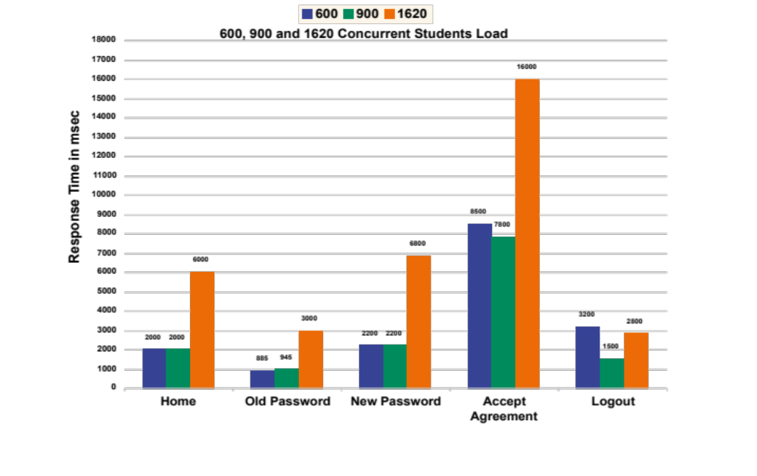
SC05 (1) - Test Results Graph
# SC05 – (1) Students Change Password (600, 900 and 1620 Students)

Slide 8
SC05 (2) - Test Results
# SC05 (2) – Students Taking Activity In Course (600, 900 and 1620 Students)
  Response Times are within the Acceptable limit of 5 sec
  Overall Error % is Acceptable
  Memcache Shows High Response Times
  CPU Usage of Application Servers is 65%, 85% and 100% for 600, 900 and 1620 users respectively
  Memory usage of all nMEL Application Servers is normal
Transaction | 90 Percentile Response Times
 | 600 Students (stress) TEST_01 | 900 Students (15 min) TEST_03 | 1620 Students (15 min) TEST_05
Home | 937 msec | 753 msec | 1.2 sec
Login | 6 sec, 7.33% error | 5.2 sec, 7.33% error | 6.3 sec, 8.34% error
Open Exercise | 2.2 sec | 1.3 sec | 1.3 sec
Submit Exercise | 3.7 sec | 2.5 sec | 2.5 sec
View Report | 1.1 sec | 915 msec | 898 msec
Logout | 3.2 sec | 1.3 sec | 1.3 sec
Error % | 0.66 % | 1.6 % | 2.6 %

Slide 9
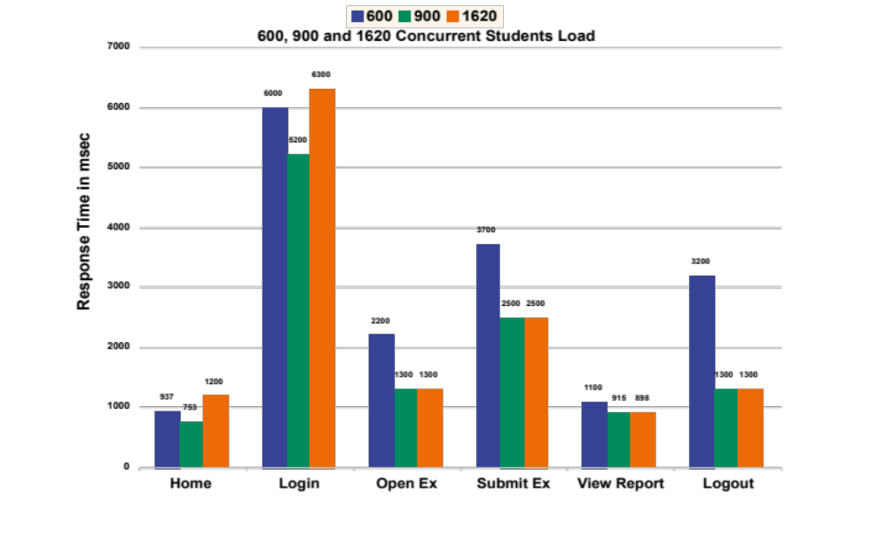
SC05 (2) - Test Results Graph
# # SC05 (2) – Students Taking Activity In Course (600, 900 and 1620 Students)

Slide 10
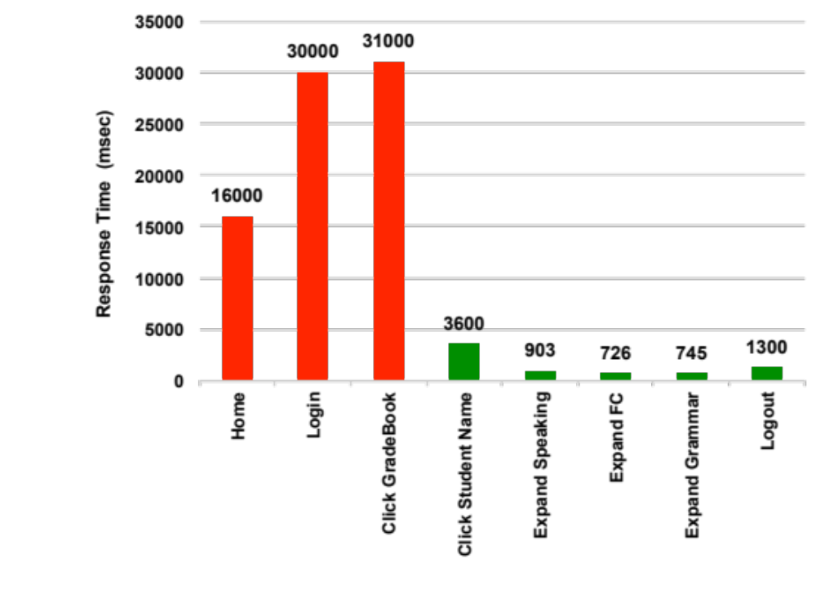
SC06 - Test Results
# SC06 – 200 Teachers Drills Down Students Grade Book
Response Times are Acceptable Except ‘Click Grade Book’, ‘Home’ and ‘Login’
Overall Error % is Acceptable
Memcache has very High Response Times (~ 1min)
nMEL Application Servers CPU is ~ 65% Used
  200 Concurrent Teachers Load
Transaction | 90 Percentile Response Times TEST_07
 | 200 Teachers
Home | 16 sec
Login | 30 sec, 14% error
Click Grade Book | 31 sec
Click Student Name | 3.6 sec
Expand Speaking | 903 msec
Expand Foundation Class | 726 msec
Expand Grammar | 745 msec
Logout | 1.3 sec
Error % | 1.16 %

Slide 11
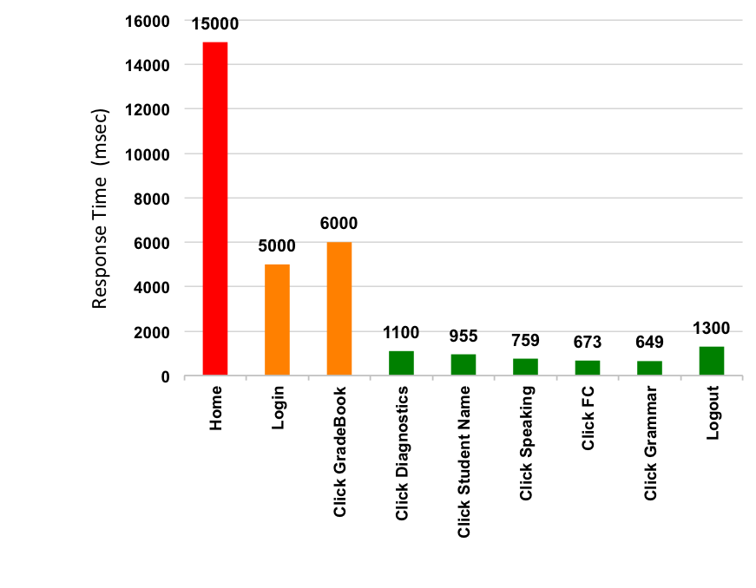
SC07 - Test Results
# SC07 – 200 Teachers Drills Down Students Diagnostics
  Response Times are Acceptable, Excluding ‘Home’
  Overall Error % is Acceptable
  Memcache Shows High Response Times (~ 1min)
  nMEL Application Server CPU Used is ~ 65%
  200 Concurrent Teachers Load
Transaction | 90 Percentile Response Times TEST_07
 | 200 Teachers
Home | 15 sec
Login | 5 sec
Click Grade Book (cached) | 6 sec
Click Diagnostics Student Time | 1.1 sec
Click Student Name | 955 msec
Click Speaking | 759 msec
Click Foundation Class | 673 msec
Click Grammar | 649 msec
Logout | 1.3 sec
Error % | 1.16 %

Slide 12
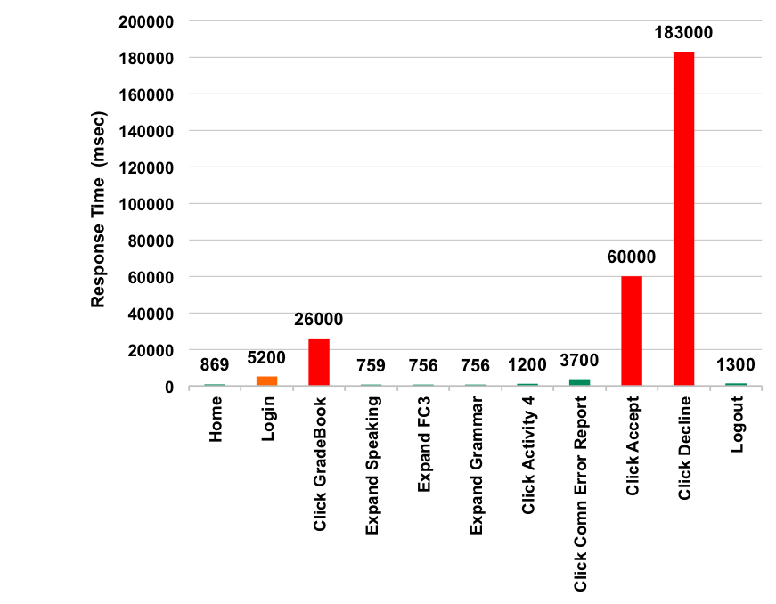
SC08 - Test Results
Transaction | 90 Percentile Response Times TEST_09
 | 200 Teachers
Home | 869 msec
Login | 5.2 sec
Click Grade Book | 26 sec
Expand Speaking | 759 msec
Expand FC3 | 756 msec
Expand Grammar | 756 msec
Click Activity 4 | 1.2 sec
Click Common Error Report | 3.7 sec, 7% error
Click Accept | 60 sec
Click Decline | 183 sec, 25% error
Logout | 1.3 sec
Error % | 1.45 %
# SC08 – 200 Teachers Accepts Common Error
Response Times are Acceptable, Excluding ‘Click Accept’ & ‘Click Decline’
Overall Error % is Acceptable
Gateway Time Out @ ‘Click Accept’, ‘Click Decline’
Memcache High Response Times (~ 12 sec, Count=232 )
Application Server CPU is ~ 45% Used
  200 Concurrent Teachers Load

Slide 13
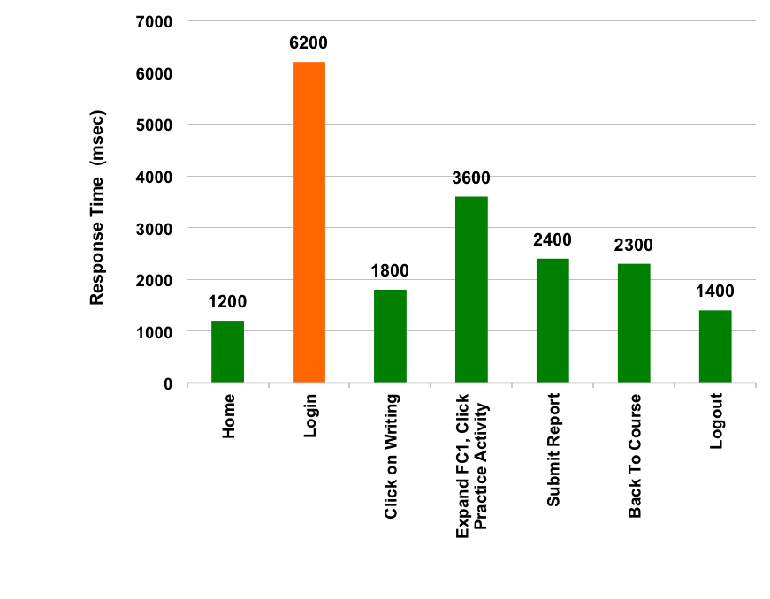
SC09 - Test Results
# SC09 – 810 Students Taking Practice Test
  Response Times are Acceptable
  Overall Error % is Acceptable
  nMEL Application Servers CPU Usage is ~ 60%
  Saltare Performance is Normal
  810 Concurrent Students Load
Transaction | 90 Percentile Response Times TEST_08
 | 810 Students
Home | 1.2 sec
Login | 6.2 sec
Click On Writing | 1.8 sec
Expand FC1, Click Practice Activity | 3.6 sec
Submit Report | 2.4 sec
Back To Course | 2.3 sec
Logout | 1.4 sec, 5.3% error
Error % | 1.03 %

Slide 14
SC05 + SC06 + SC07 - Test Results
SC05 - Transaction | 90 Percentile Response Times TEST_06
 | 810 Students
Home | 34 sec
Login | 43 sec
Open Exercise | 1.2 sec
Submit Exercise | 2.4 sec
View Report | 845 msec
Logout | 1.2 sec
Error % | 48%
# SC05 – 810 Students Taking Activity In Course
# SC06 – 200 Teacher Drills Down Student Grade Book
# SC07 – 200 Teacher Drills Down Student Diagnostics
  Very High Response Times for ‘Home’, ‘Login’ and ‘Click Grade Book’
  Overall Error % is Very High for SC05
  nMEL Application Server CPU Usage is ~ 85% - 100%
  Saltare Application Server CPU Usage is ~ 60%
SC06 - Transaction | 90 Percentile Response Times TEST_06
 | 200 Teachers
Home | 7.8 sec
Login | 38.6 sec
Click Grade Book | 46 sec
Click Student Name | 3.7 sec
Expand Speaking | 900 msec
Expand Foundation Class | 739 msec
Expand Grammar | 742 msec
Logout | 1.4 sec
Error % | 1.05 %
SC07 - Transaction | 90 Percentile Response Times TEST_06
 | 200 Teachers
Home | 722 msec
Login | 5 sec
Click Grade Book (cached) | 6.5 sec
Click Diagnostics Student Time | 1.1 sec
Click Student Name | 2.8 sec
Click Speaking | 8.4 sec
Click Foundation Class | 708 msec
Click Grammar | 655 msec
Logout | 1.3 sec
Error % | 0.31 %

Slide 15
Results Observation
Right Scale Monitoring:
  CPU usage of the 14 nMEL application servers increase as the load is increased. Application servers become CPU bound (CPU is 100% Used) at (1) 1620 students load (2) 800 Students + 200 Teachers load
  There is only one CPU core used out of the four CPU cores available in each of the 14 nMEL application servers
  Saltare application servers suffer memory shortage
New Relic Monitoring:
  Teacher scenarios performance is impacted by Memcache taking long time (1 to 2 min)
  Saltare DB connections are hanging at 1620 Students load which impacted Login and Logout transactions

Slide 16
Conclusion
  Saltare can serve 900 users with acceptable performance. CPU and memory upgrade to the Saltare DB and application servers may scale up Saltare to serve the peak load of 1620 users.
  Current version of nMEL on GEDU has Memcache performance issue.

Slide 17
Recommendations
      Investigate the issue: Only one CPU core begin used on all the 14 nMEL application servers
      Fix the performance issue of Memcache
      Re-Execute all the load tests with Saltare version 6.4
      Upgrade the Memory and CPU of Saltare Application and DB Servers, Re-Execute 1620 users login and password change test

Slide 18
Test Execution & Results - Detail
Aggregate JMeter report tables for all the tests executed are stored in a Google spread sheet.
It is located at:
      JMeter Aggregate Report in Google Drive (Web Link)
      Contact santosh.marigowda@pearson.com or kashsifsaleem@pearson.com for access
      Note: Right click > Hyper Link > Open Hyper Link to open the link.

Slide 19
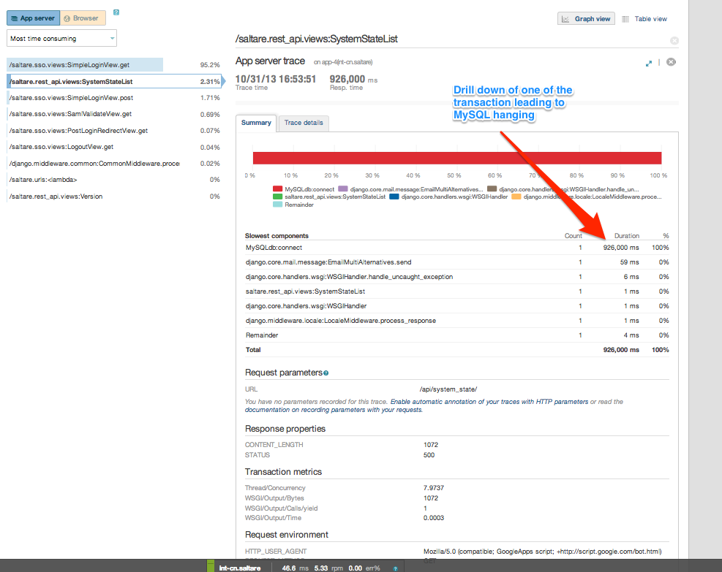
Saltare DB Connections Hanging
A drill down of one of the transaction leading to Saltare MySQL DB connection hanging for 15 min

Slide 20
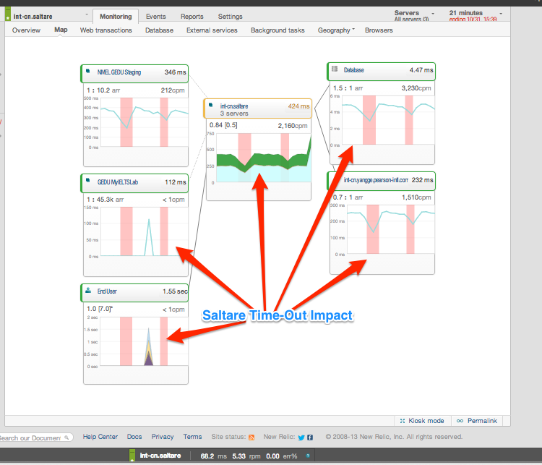
Saltare Times-Out @ 1620 Users
Saltare Times-Out impacting the transactions end-2-end

Slide 21
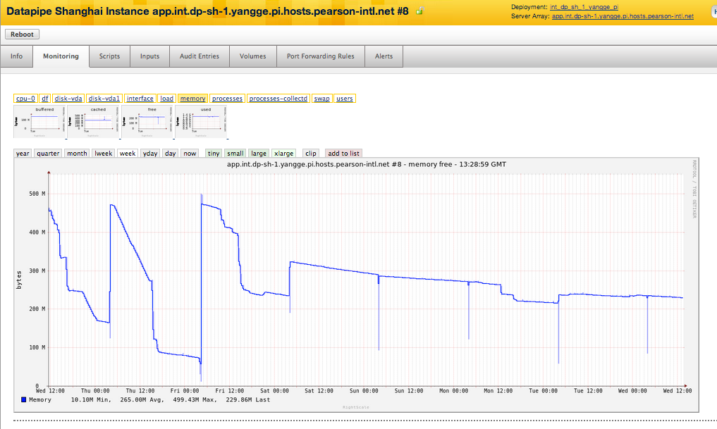
Saltare Application Server Memory Reaches 0%
Saltare application server memory reaches 0%

Slide 22
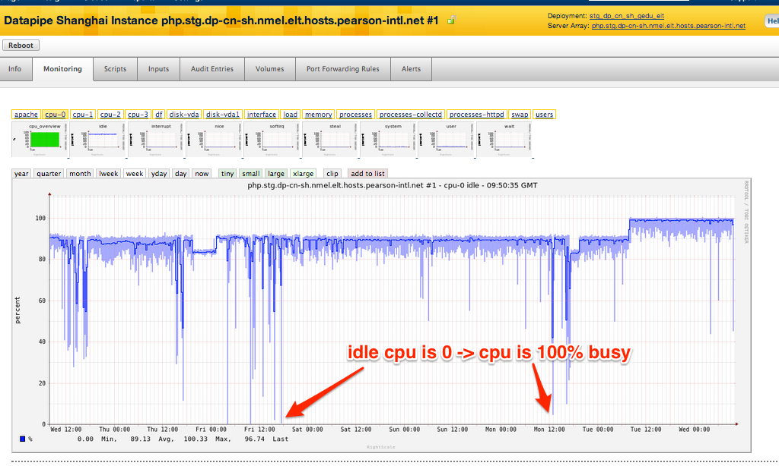
nMEL Servers CPU 100% busy at 1620 Users
nMEL application servers CPU usage reaches 100% at 1620 users load

Slide 23
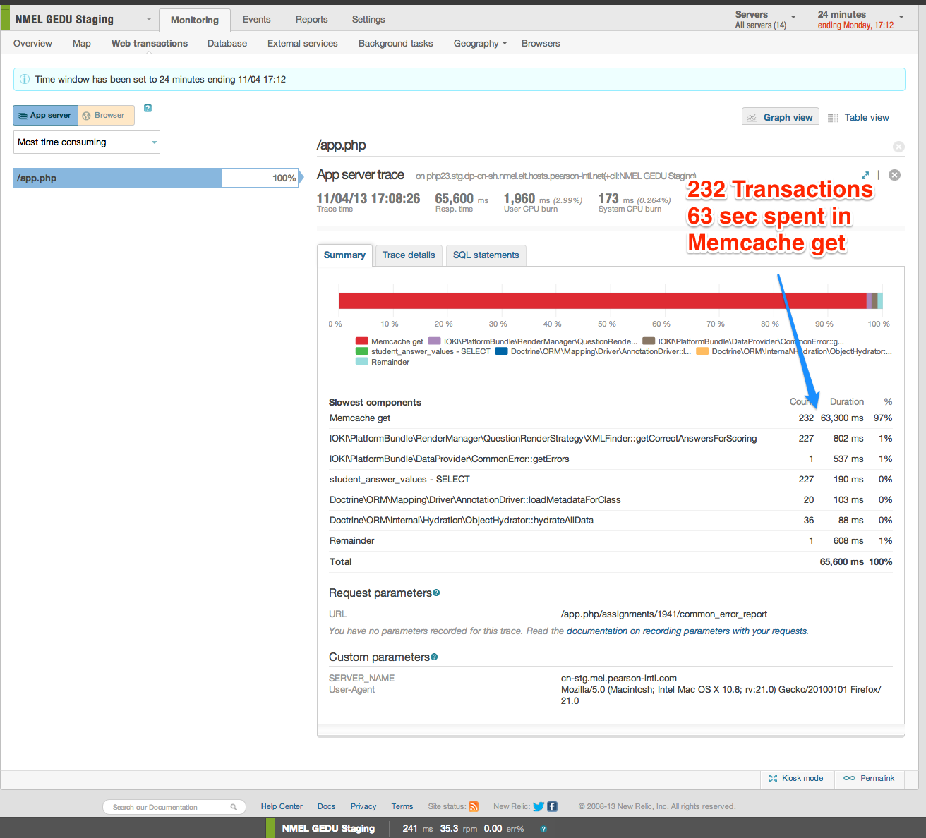
MemCache High Response Time

Slide 24
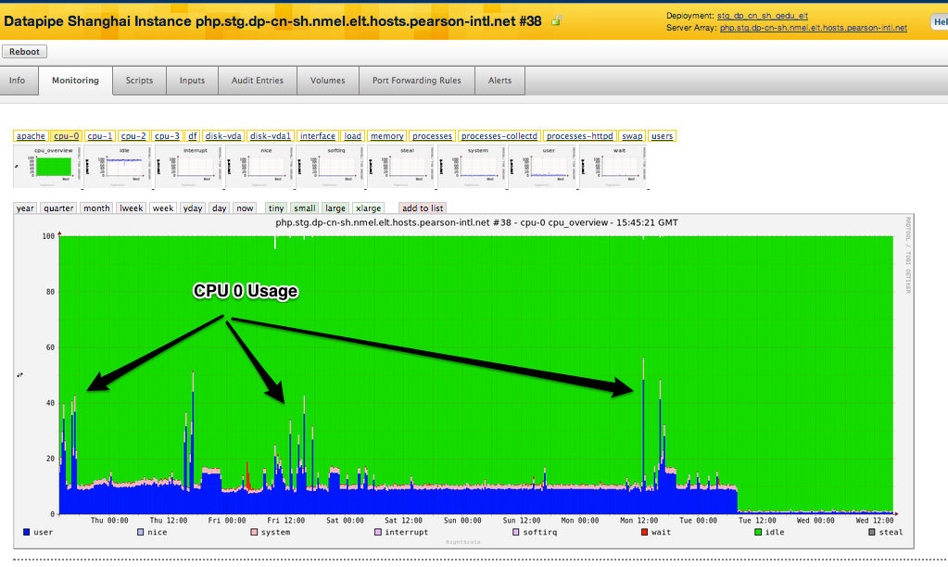
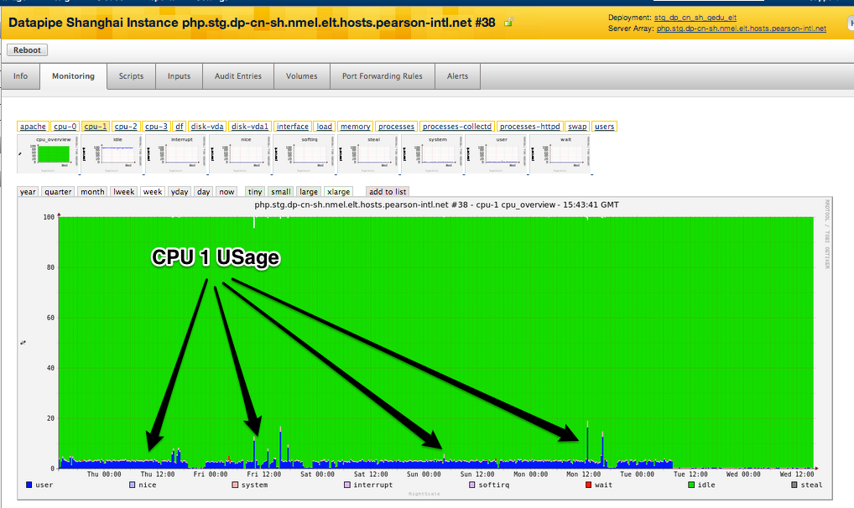
Only one of 4 CPU Core Used
CPU 0 fully utilized
CPU 1 (2 & 3) not fully utilized

Slide 25
End of Report

