Slide 1
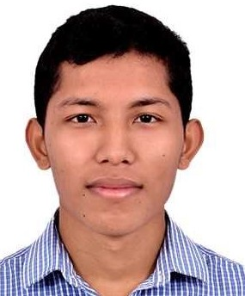


Vikram Thapa
Analyst
Bachelor of Engineering
Electronics and Communication : 2018- 2022
Skills
Java 8 /J2EE | Java Basics, OOPS, Generics, Collections, Arrays, Loops, Lambda Exp, Stream API Junit, Mockito, Servlets
Spring core | IOC & Dependency Injection, Autowire
Spring REST | REST controllers, Implementation of GET, POST, PUT & DELETE, Bean Validation & Exception Handling, Testing Services, Controller & Repository layer
Spring Data JPA | Implement DAO layer using spring Data repositories, Transaction Management
Spring Boot Microservices | Spring Boot Starters, annotations, Messaging Service, Sync/Async comms, Swagger API documents
Spring Cloud | Eureka, Netflix Ribbon, Feign Client, Netflix Hystrix, Netflix Zuul & Config Server
React | Components, Hooks, Event handling, Redux, Reducers, Testing using Jasmin & Karma
Database | MongoDB No Sql Basics My SQL RDS Basics
UI Tech | HTML 5 & CSS 3,JavaScript, ES6 & TypeScript Reusable templates, Optimized UI Designed
Tools | Git, Postman, Maven, IDE
Add On skills | Communications, Team management. Peer learning
Data analysis | Python , SQL , Mathematics and statistics
Bangalore
Vikram.thapa@capgemini.com
+918058138072
A4
Full Stack Developer
Hands on experience in creating microservices with Springboot, Spring Security, Spring Cloud API Gateway, Eureka server, load balancing.
Hands on experience in implementing polyglot architecture with ReactJS & spring boot
React developer with working knowledge on ReactJS with react hooks,reactive forms,routing and Material UI
Development experience using Eclipse,intellij,VS Code, pgAdmin for postgreas, postman Api connection and MangoDB by Atlas
Experience in creating documentation with swagger UI and in unit testing using Junit, Mockito
Coupons and Deals Finder App
Completed end to end case study of Coupon Finder Application along with JWT authentication, Swagger documentation and payment integration with testing using Junit and mockito, responsive UI with Material UI and ReactJS used for user interface.
Payment Gateway Application
Payment wallet using spring boot java and it works and Customers will keep money in and can withdraw form it .
Data Anaylysis
Worked and learnt on Olympics games analysis using python Generating output in the order required for analysing the statistics. Generating graphs if required for better analysis and understanding.
Check out my work on GitHub & Video Profile

