Slide 1
Rockbuster
An Analysis of
Customer Base
Revenue
Films

Slide 2
Customer Base
Rockbuster has 599 customers from 109 different countries
The average customer spends 102.36 on movie rentals
The countries with the highest number of customers and revenue are India, China, the United States, Japan, and Mexico

Slide 3
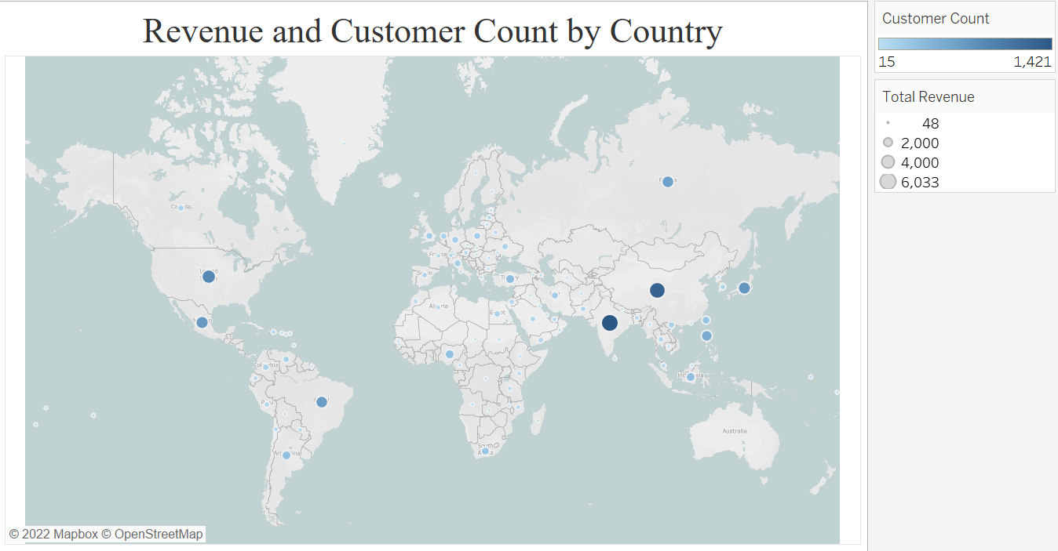
The highest revenue countries were
India
China
United States
Japan
Mexico
Brazil
Russia
Philippines
Turkey
Indonesia

Slide 4
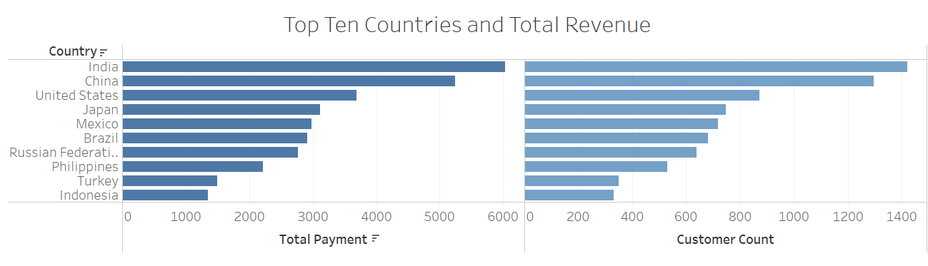
There is a strong correlation between the customer count and total revenues in our top ten highest earning countries.

Slide 5
Films
Rockbuster has 1000 films in its data base, all released in 2006
The average film rental period is 4.98 days
Our highest revenue genres are Sports, Sci-Fi, Animation, Drama and Comedy.
The highest revenue rating category is PG-13

Slide 6
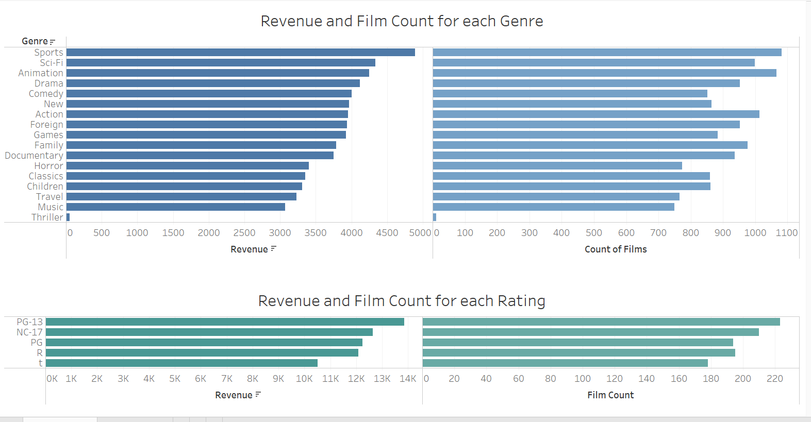

Slide 7
Conclusions
There is a consistent pattern between categories and revenues. Higher amounts in each categories equate to higher revenues
Countries with the highest customers generate the highest revenue
Movie genres and categories with the highest number of films generated the most revenue

Slide 8
Recommendations
Do an analysis of revenue per genre category to find which ones earn us the most income per film. For example, how much do we earn for the average Sports movie versus Animation? Are there any genres that stand out?
This analysis should then go one step further and compare this to our cost per each genre, film, and rating. The ones that give us the highest output for the lowest ones we should concentrate on expanding.

Slide 9
Tableau Visualizations
https://public.tableau.com/app/profile/sharon1873/viz/3_10_2/Presentation?publish=yes

