Slide 1
Planes, Trains, and Automobiles
Modeling Rail Transportation’s Effect on Emissions, Safety, and Travel Time
Saketh Marrapu and Isaac Martinez

Slide 2
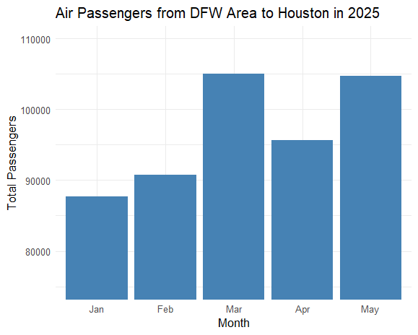
Motivation and Introducing the Data
US is one of the largest countries in the world yet trails other developed countries in its implementation of rail transportation
There is travel demand for what is largely considered the “goldilocks” zone of rail, about 100-500 miles (“Breakeven Distances”).
US is one of the largest countries in the world yet trails other developed countries in its implementation of rail transportation
There is travel demand for what is largely considered the “goldilocks” zone of rail, about 100-500 miles (“Breakeven Distances”).

Slide 3
Motivation and Introducing the Data
Looked at data from the EU, where many countries have established rail networks and reliable data
With these EU data, our aims were to see rail’s effect (relative to air and road transportation) on
  Travel time
  Emissions
  Safety
After fitting our models, we extrapolate to the US to see how rail might measure up against air and road

Slide 4
01
Travel Time

Slide 5
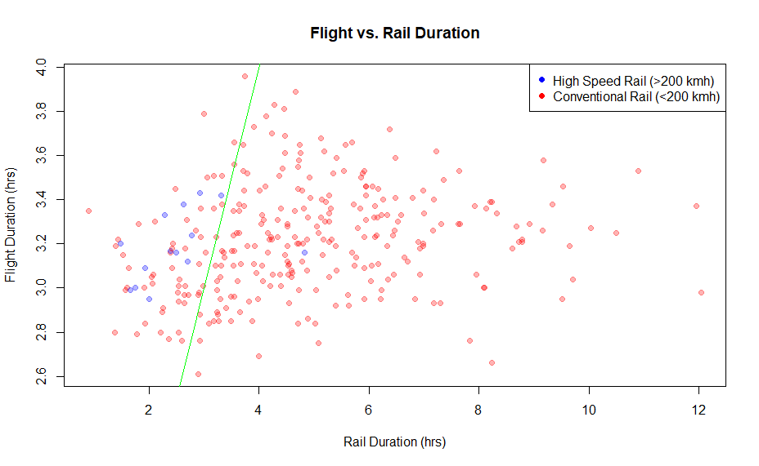
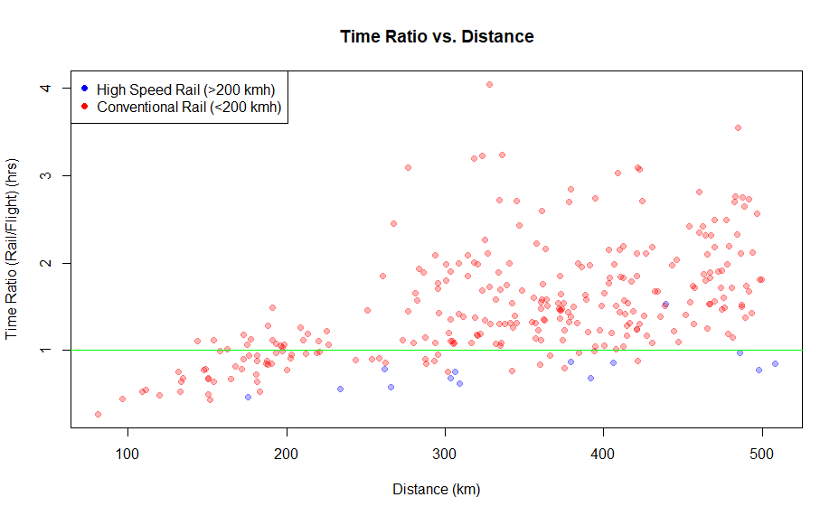
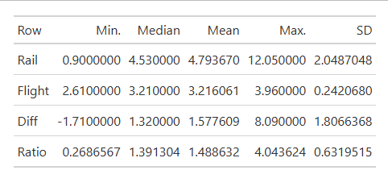
n = 297 (14 HSR, 183 CR)
Ratio has a greater variance as distance increases, but linear
CR slower, HSR faster (low sample size)
Much higher variability in rail, due to more service factors and interruptions

Slide 6
Paired T-testing
 | Conventional | High-Speed
t | 14.279 | -3.1829
df | 282 | 13
p | < 2.2e-16 | 0.0072
Diff | 1.689 | -0.670
CI | (1.456,1.922) | (-1.139,-0.217)
Notes:
Hypothesis that the times are different are true for both
Mean diff is CR is 1.5-1.9 hours slower
Mean diff for HSR is 0.2 to 1.13 hours faster than plane

Slide 7
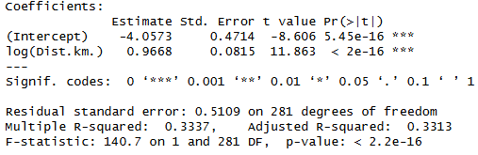
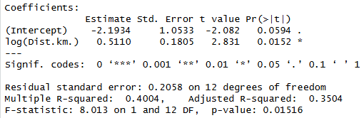


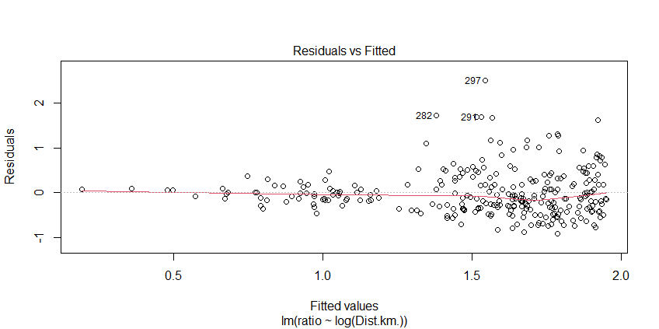
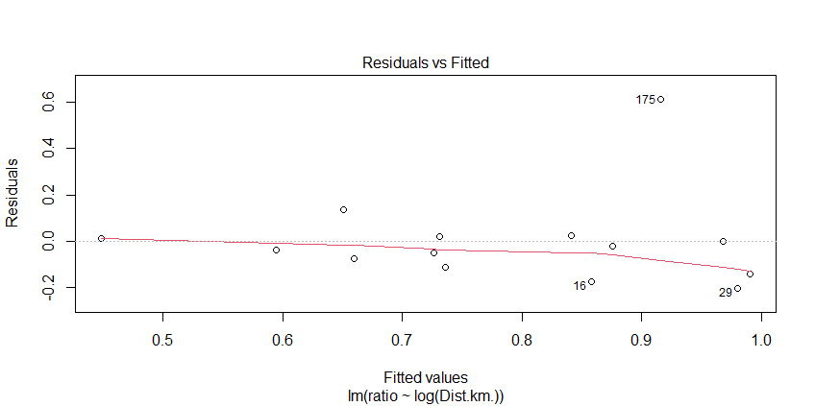




Modeling
Conventional
High-Speed
Notes:
Dist estimate is positive for both, meaning rail across the board does worse the longer the trip is. This is consistent with the idea of it being good for short-mid range
Heteroskedasticity (Shapiro wilk) – longer trips increase the variance of the flight time because there are more chances for things like turbulence to occur or to not occur (flight going well or not matters more the longer it goes on)

Slide 8


Extrapolation
State | Route | Dist (km) | Flight Time (hr) | Conventional | High-Speed
TX | DAL-SAT | 397 | 1.167 | (1.66,1.80) | (0.73,0.99)
CA | LAX-SFO | 543.1 | 1.5 | (1.93,2.13) | (0.80,1.25)
CO | DEN-COS | 117.3 | 0.833 | (0.38,0.72) | (-0.19,0.68)
NY-MA | JFK-BOS | 300.5 | 1.333 | (1.40,1.52) | (0.59,0.85)
Notes:
Took some of the most common short-mid range flights in the US
Notably, Conventional rail was still faster for DEN-COS which is very common for connections. This might suggest that for going to smaller places in the US even CR would be an upgrade. For instance, many people who want to fly in to cstat end up doing a connection from Dallas or austin which could be a good conventional railway
HSR CI for LAX-SFO includes 1, meaning we cant say with 95% confidence it will be faster. This makes sense as it is the longest route we extrapolated for and as we saw earlier with the parameter estimate rail gets worse the longer the route is

Slide 9
02
Emissions

Slide 10
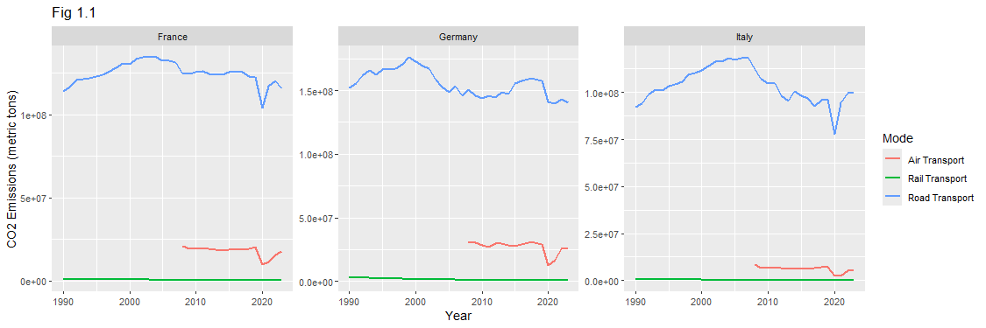
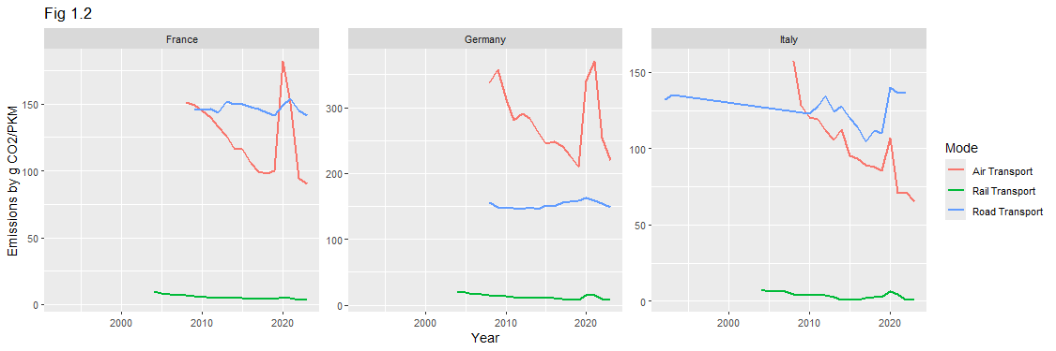
Emissions: Initial Considerations and EDA
The data are emissions of CO₂ in metric tons
Need some way to normalize: passenger-kilometers (PKM) allows to us normalize by usage, giving us g CO₂/PKM
“Raw” Emissions
Normalized Emissions
Notes:
Not every country has data on all three modes of transport data each year. Most countries have data for road and rail transport from 1990 to 2003, but for air transport, some countries started reporting as late as 2008.
The trends over time are still noticeable, however

Slide 11
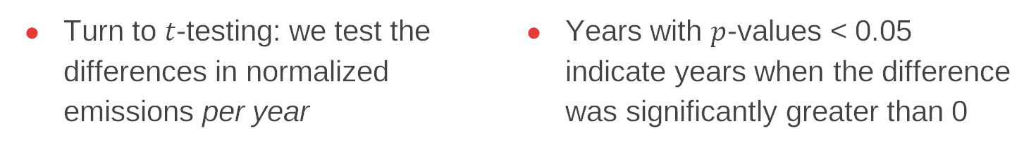
Emissions: Initial Considerations and EDA
Turn to $t$-testing: we test the differences in normalized emissions per year
Years with $p$-values < 0.05 indicate years when the difference was significantly greater than 0
t-tests of the difference between normalized road and rail emissions, selected years
Year | Mean Difference | t-statistic | p-value | n
2008 | 75.2 | 0.886 | 0.198 | 11
2009 | 162 | 1.56 | 0.0737 | 12
2010 | 161 | 1.58 | 0.0712 | 12
2013 | 99.6 | 1.9 | 0.0421 | 12
2017 | 89.5 | 1.53 | 0.0823 | 9
2020 | 140 | 14.3 | 0.00000365 | 7
2023 | 510 | 2.15 | 0.0341 | 8
t-tests of the difference between normalized air and rail emissions, selected years
Year | Mean Difference | t-statistic | p-value | n
2008 | 259 | 1.3 | 0.103 | 25
2009 | 61.9 | 1.22 | 0.118 | 24
2010 | 291 | 1.42 | 0.0842 | 24
2013 | 243 | 1.53 | 0.0703 | 24
2017 | 300 | 1.56 | 0.0671 | 23
2020 | 930 | 1.3 | 0.105 | 22
2023 | 336 | 1.75 | 0.0471 | 22
Notes:
we perform one-sided t-tests with an alternative hypothesis of the difference being greater than 0.While there is complete data for about 20 years, we will only observe a select group of “interesting” years.
We see that despite there being large mean differences, sometimes well in the hundreds, the difference is not significant.

Slide 12
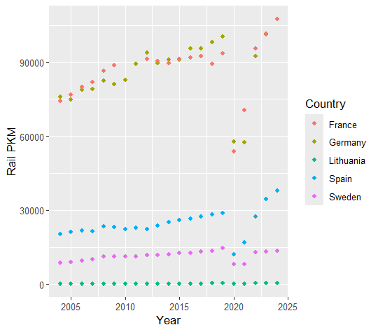
Emissions: Initial Considerations and EDA
Why are differences not significant?
  Countries like Lithuania, Estonia, and Croatia consistently give negative difference for one or both differences
  These countries have lower rail utilization
  Economic development potentially a factor

Slide 13
Emissions: Modeling
Single factor (log(GDP per capita)) linear model for Road - Rail for the year 2013
Coefficient estimate | Std. error | p-value
(Intercept) = -25.517224 | 117.024252 | 0.832
(GDP) = 0.004020 | 0.003377 | 0.261
We start with fitting linear models of both differences year-by-year
Predictors: GDP per capita, urbanization rate, share of renewable energy
Hardly any significant, even after simplifying to one predictor, GDP per capita
Table 1.4: Summary of single factor (GDP per capita) linear model for Air- Rail for the year 2023
Coefficient estimate | Std. error | p-value
(Intercept) = -736.0 | 215.6 | 0.00275
(GDP) = 0.02982 | 0.005018 | 8.21*10⁻⁶
Notes:
We move to Modeling
Don’t want to spend too much time discussing these models

Slide 14
Emissions: Modeling
Random intercept model underwent several trials
  Log transform emissions to stabilize variance
  Removed Malta and Luxembourg from dataset (small countries < 1,000 mi2)
  Introduced new predictor land area; no significant effect
  Centered GDP to address collinearity with intercept

Slide 15
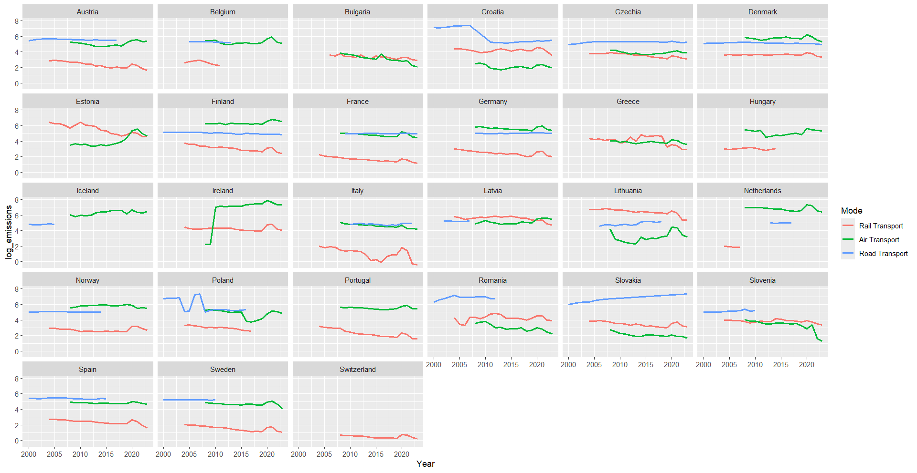
Emissions: Modeling
Notes:
Justification
Mode effects are estimated globally, not within each country
Each country still identifies its random intercept

Slide 16
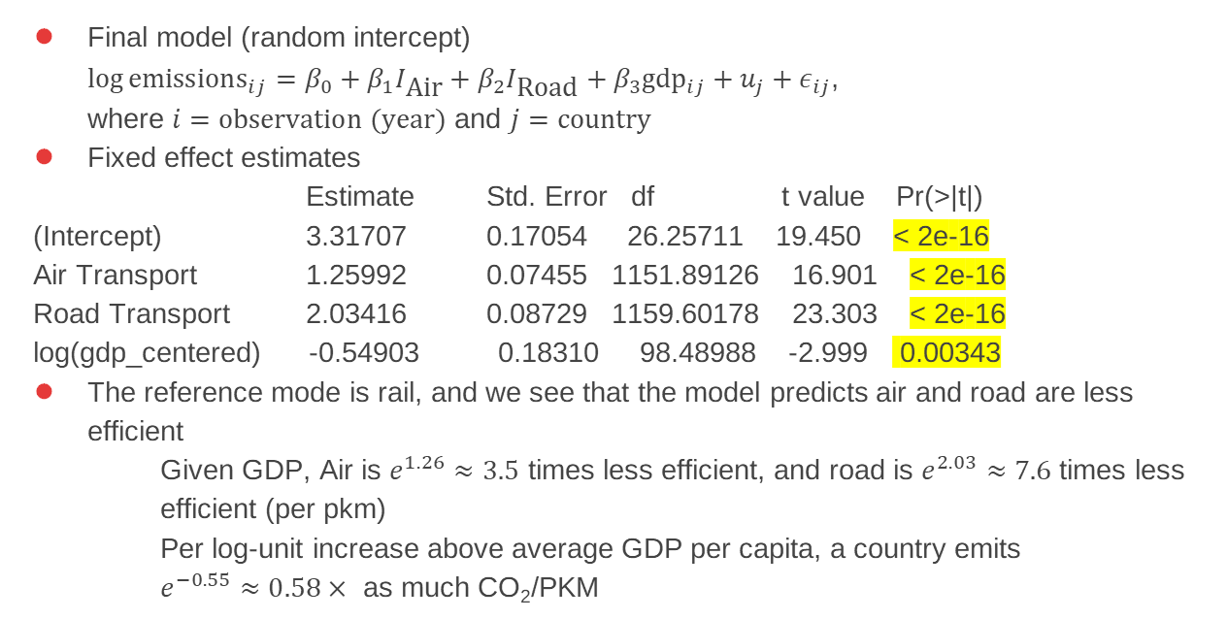
Emissions: Modeling
Final model (random intercept)
$\log{{\text{emissions}}_{ij}=β_{0}+β_{1}I_{\text{Air}}+β_{2}I_{\text{Road}}+β_{3}{\text{gdp}}_{ij}+u_{j}+ε_{ij}}$,
where $i=\text{observation}\text{ (}\text{year}\text{)}$ and $j=\text{country}$
Fixed effect estimates
Estimate Std. Error df t value Pr(>|t|)
(Intercept) 3.31707 0.17054 26.25711 19.450 < 2e-16
Air Transport 1.25992 0.07455 1151.89126 16.901 < 2e-16
Road Transport 2.03416 0.08729 1159.60178 23.303 < 2e-16
log(gdp_centered) -0.54903 0.18310 98.48988 -2.999 0.00343
The reference mode is rail, and we see that the model predicts air and road are less efficient
Given GDP, Air is $e^{1.26}≈3.5$ times less efficient, and road is $e^{2.03}≈7.6$ times less efficient (per pkm)
Per log-unit increase above average GDP per capita, a country emits
$e^{−0.55}≈0.58×$ as much CO₂/PKM

Slide 17
Emissions: Modeling
Random effects
  Most countries have random intercept effects less than 1, and Iceland, Ireland, and the Netherlands are the only countries with effects greater than 1
  Switzerland has random effect of about -2
Variance estimates:
  Groups Name Variance Std.Dev.
  Country (Intercept) 0.7375 0.8588
  Residual 1.1666 1.0801

Slide 18
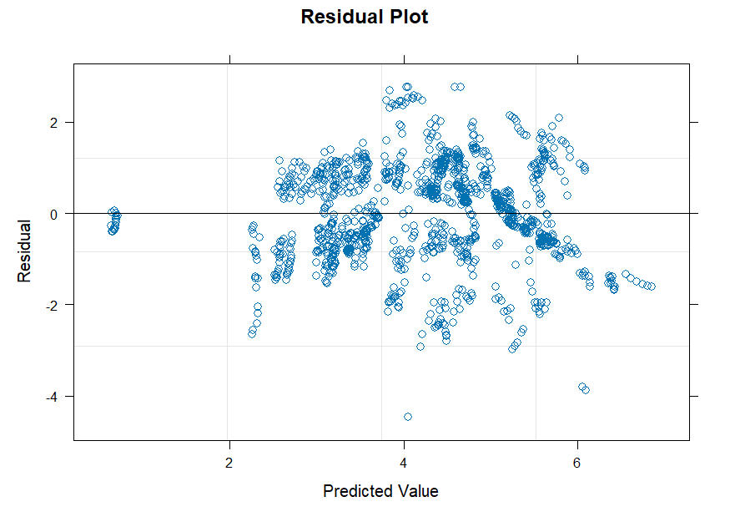
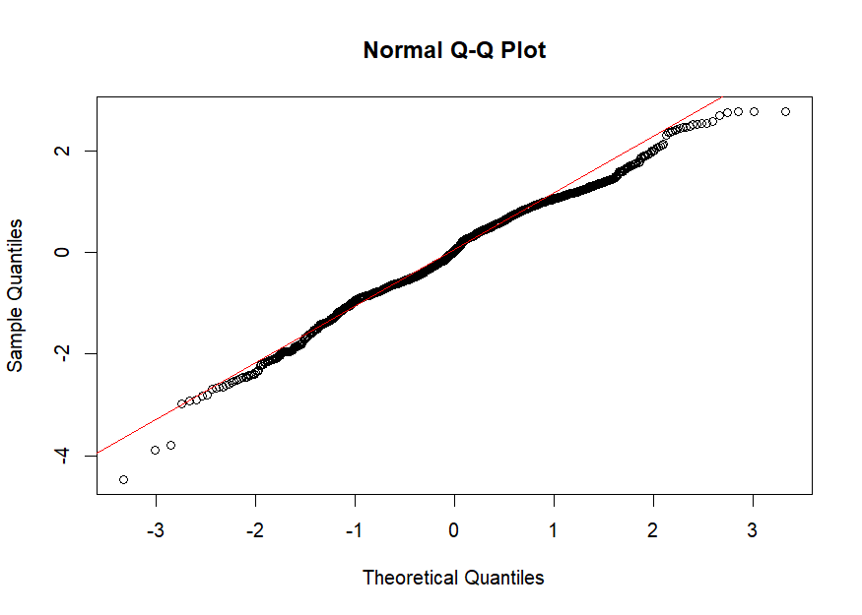
Emissions: Modeling
Diagnostics
CH

Slide 19
Emissions: Extrapolation
Extrapolation to 4 U.S. States
  Used predInterval() from merTools package
  Compute 80% prediction intervals
  These intervals only consider fixed effects
  Use GDP data from 2023
Texas
Rail
Estimate: 28.27, Interval: (7.44, 122.46)
Air
Estimate: 101.54
Road
Estimate: 224.25

Slide 20
Emissions: Extrapolation
California
Rail
Estimate: 26.69, Interval: (6.72, 111.01)
Air
Estimate: 89.59
Road
Estimate: 215.29
Colorado
Rail
Estimate: 27.16, Interval: (6.63, 110.93)
Air
Estimate: 98.10
Road
Estimate: 226.38
Minnesota
Rail
Estimate: 29.75, Interval: (7.27, 112.67)
Air
Estimate: 106.51
Road
Estimate: 216.98
New York
Rail
Estimate: 24.54, Interval: (6.15, 99.61)
Air
Estimate: 91.27
Road
Estimate: 197.50

Slide 21
03
Safety

Slide 22
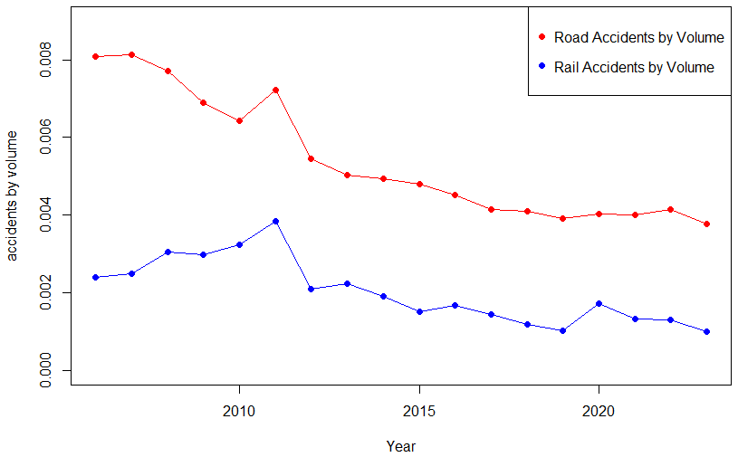
Notes:
Road is always higher
Global peak in 2011 – this is due to extra countries reporting in this year specifically. Why? I couldn’t tell you
Bump in 2020 in rail volume bc high traffic railways were shut down for covid

Slide 23
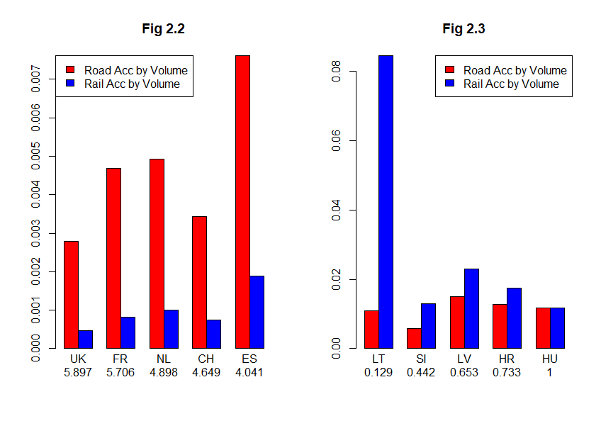
Notes:
Richer on the left side (safest rail) and higher population
Higher gdp = more money to spend on infrastructure
Poorer on the right side
Small population = the smaller country population means less demand meaning it matters much less for those countries to invest into public transport

Slide 24
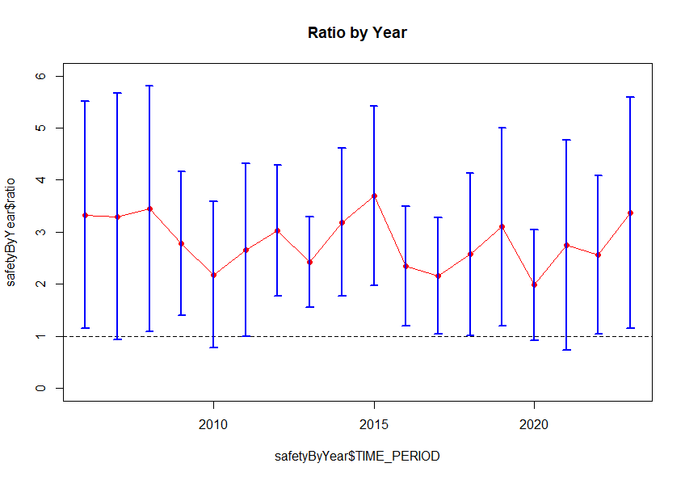
Hypothesis Testing
1-Sided Paired T-test across countries from 2006-2023
H0: μ = 1 Ha: μ > 1
95% 2-Sided Confidence Intervals for each year
2009-10 – Dip due to recession
2014-15 – Large decrease in Rail Accidents by Volume in Spain, France and the UK due to new infrastructure
2020 – Pandemic cause a lot of rail shutdowns causing lower passenger volumes while the rail accidents didn’t change that much
Notes:
T-test for mu greater than 1 bc if =1 then that means rail and road are the same safety
Talk about the years

Slide 25
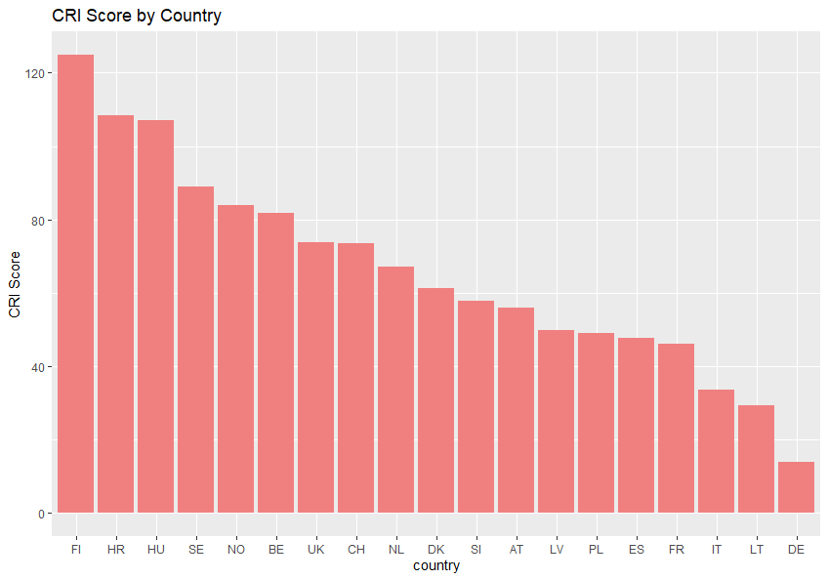
Modeling: EDA
High Scores: Finland, Sweden, Norway, Hungary, Croatia
    FI, SE, NO – quite northern
    HU, HR – quite mountainous
    Low Scores: Germany, Lithuania, Italy, France, Spain
    Germany, Italy, France, Spain – Large countries with lots of flat land
    Lithuania – Incredibly flat topography
    Trains struggle with elevation changes as well heavy weather effects
Notes:
CRI is the risk of any specific country to experience significant weather conditions
Wanted to use bc it accounts for environmental effects that trains might face

Slide 26
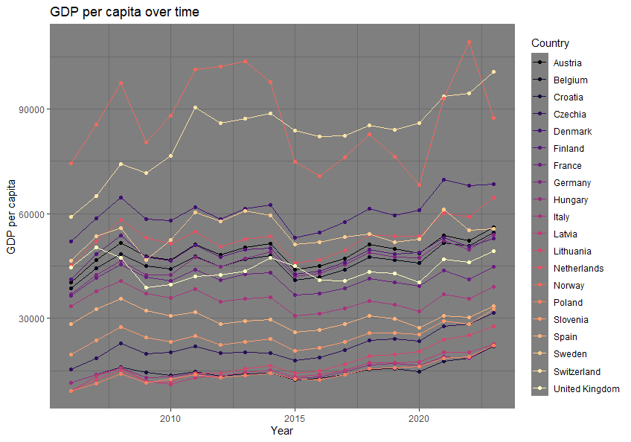
Modeling: EDA
High: Switzerland, Denmark, and Norway
Relatively small populations with high amounts of wealth. Known for higher social infrastructure.
Middle: Germany, UK, France, Spain
High populations and accompanying wealth match each other.
Bottom: Slovenia, Croatia, and Latvia
Younger countries without much industry
Notes:
We use nominal gdp per capita
Cover the different groups
Talked about smaller populations needing rail less, but if you have more per person theres more to spend on things lower on the list

Slide 27
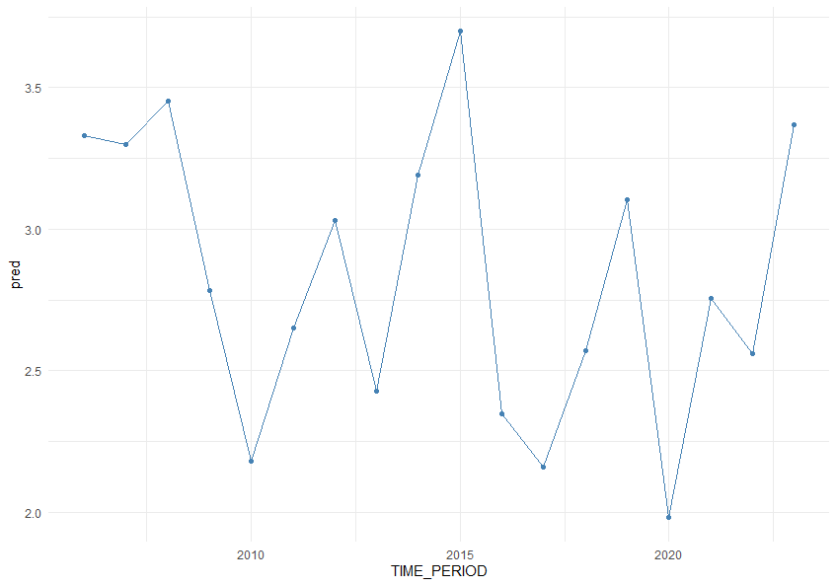
Modeling: Linear by Year
Identified trends in significant years
Only one year with non-normal residuals. The UK in 2016 was an outlier due to the beginning of railway strikes causing the ratio to spike.
CRI Score – 1/18
Negative so more weather events means roads were safer
GDP – 11/18
Positive because more money means more money to put into infrastructure. Reflected in 2015
Area – 7/18
Positive because the bigger a country is, the higher number of urban areas develop. This causes increasing amounts of Road Accidents by volume due to increasing intra-city roads.
Notes:
Go through text on the slide

Slide 28
Modeling: Mixed Effects
Source | Estimate | SE | DF | T | p
(Intercept) | -22.03 | 5.62 | 19.31 | -3.92 | 0.0009
log(area) | 0.63 | 0.30 | 14.05 | 2.08 | 0.056
log(gdp) | 1.69 | 0.46 | 25.96 | 3.64 | 0.001
GDP – very significant
Area- only significant at 90% but kept in model for prediction accuracy
CRI – removed as it was never significant (p>0.25) across all tested models
Groups | Variance | SD | % Var
geo | 1.741 | 1.319 | 83.67%
Residual | 2.067 | 1.438 | 100%
geo accounts for much of
the variance due to differing
intangibles between cultures
that are not accounted for
in the model
Notes:
Read off slides
Fits with estimates from before (sign)

Slide 29
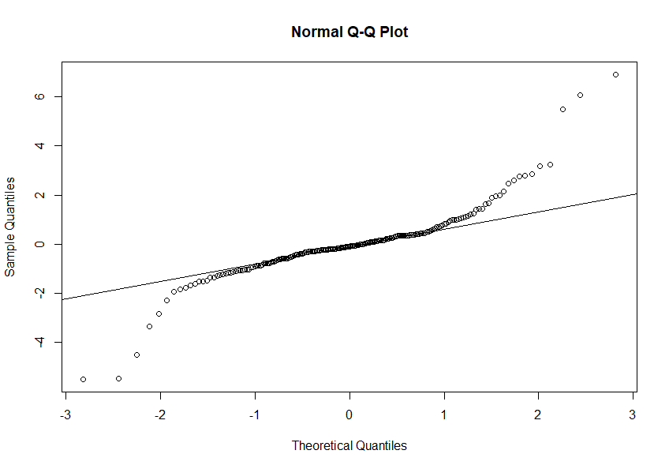
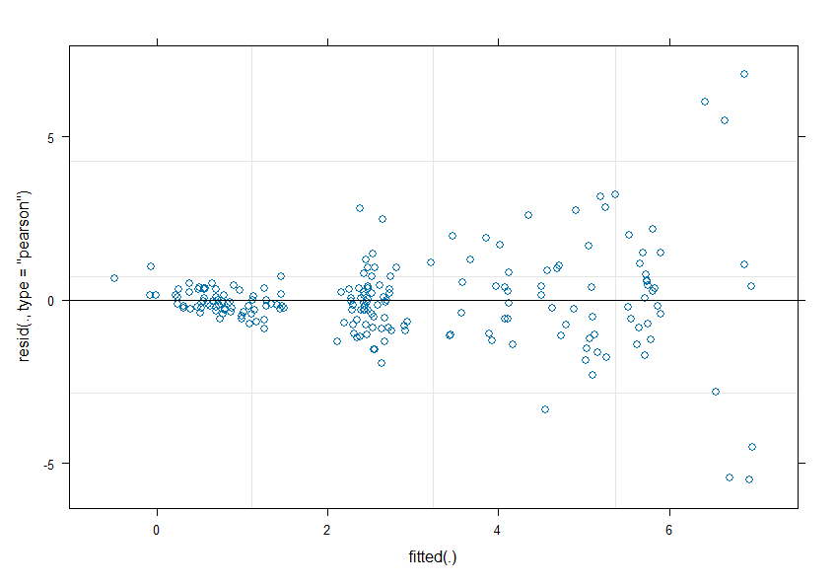
Modeling: Mixed Effects GoF
AIC = 777.22
BIC = 793.8106
R²_{conditional} = 0.6342995
R²_{marginal} = 0.328275
Extremely heavy tails though no signs of skewness
Heteroskedasticity
As countries have higher GDP per capita that is usually correlated with a greater amount of differing lifestyles
Bigger countries have greater space for locations with differing transport cultures
Notes:
Aic, bic were lowest of models
Read off slides

Slide 30
Extrapolation
State | EU | Marginal | Marginal CI | Conditional | Conditional CI
TX | NO | 5.53 | (2.330,8.58) | 7.07 | (3.75,10.12)
CA | CH | 5.70 | (2.40,8.58) | 6.92 | (3.65,9.99)
CO | NO | 5.20 | (2.24,8.3) | 6.54 | (3.36,9.72)
MN | UK | 4.78 | (1.79,7.92) | 6.79 | (3.63,10.04)
NY | CH | 5.18 | (1.86,8.14) | 6.52 | (3.45,9.59)
Notes:
Read off the table. The marginal shows that it would still be much safer to implement a rail system. Even more so if it was implemented in a manner similar to the countries in the EU
All of the EU’s chosen actually had positive random effects (did not show all of the ranef earlier)
American states have the means to create not just safe rail systems but ones that are safer than the average ones in Europe
Note that part of the reason geo takes so much of the variance is because of cultural transport difference and the US is much more passionate about cars and car infrastructure than Europe as a whole so the variance could be much higher. We don’t know

Slide 31
Thanks!
Questions?
Please keep this slide for attribution

Slide 32
Sources
“Breakeven Distances between Conventional Rail, High Speed Rail and Air Transportation.” The Spatial Organization of Transportation and Mobility, The Geography of Transport Systems, 18 Apr. 2024, transportgeography.org/contents/applications/high-speed-rail-systems/breakeven-distances-rail-air-transport/.
Bureau of Transportation Statistics. United States Department of Transportation, bts.gov.
Eurostat. “Air emissions accounts by NACE Rev. 2 activity (env_ac_ainah_r2).” Eurostat, ec.europa.eu/eurostat/databrowser/view/env_ac_ainah_r2__custom_18136650/default/table.
Eurostat. “Database – Transport.” Eurostat, ec.europa.eu/eurostat/web/transport/database.
European Environment Agency. “Air quality statistics.” European Environment Agency, 31 Oct. 2025, eea.europa.eu/en/analysis/maps-and-charts/air-quality-statistics-dashboards?activeTab=570bee2d-1316-48cf-adde-4b640f92119b.
U.S. Census Bureau. “Annual Estimates of the Resident Population for the United States, Regions, States, District of Columbia, and Puerto Rico: April 1, 2020 to July 1, 2024 (NST-EST2024-POP).” State Population Totals: 2020-2024, www2.census.gov/programs-surveys/popest/tables/2020-2024/state/totals/NST-EST2024-POP.xlsx.
Eurostat. “Railway transport.” Eurostat, ec.europa.eu/eurostat/web/transport/information-data/railway-transport.
World Bank. “Land area (sq. km) (AG.LND.TOTL.K2).” World Development Indicators, databank.worldbank.org/reports.aspx?source=2&series=AG.LND.TOTL.K2&country=EUU.

