Slide 1
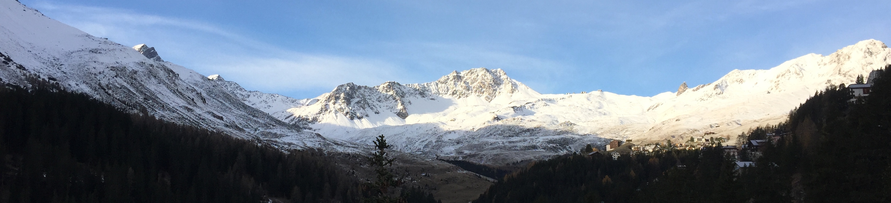
Smart Arosa
Connecting the physical space with the information space

Slide 2
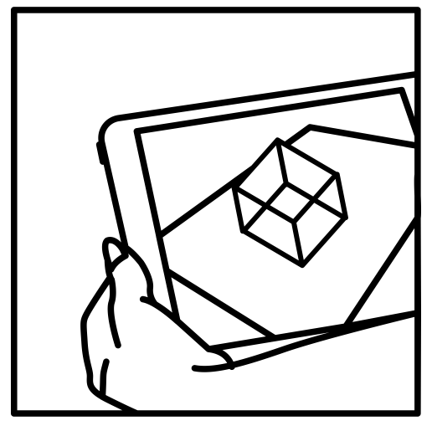

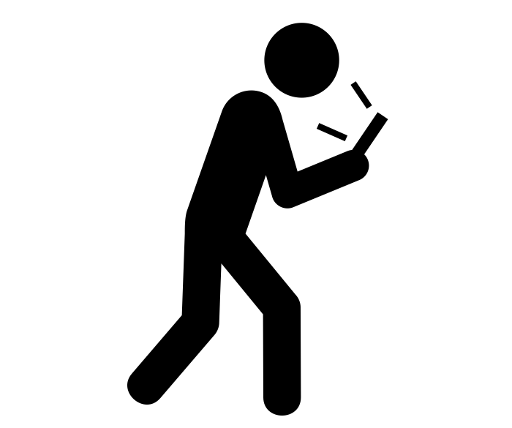
Smart Tourists with a Smart Environment
Today's tourists aren't tourists.
They a webizens pilgrimaging and exploring the physical world.

Slide 3
Technological landscape
Web of documents -> Web of data
Persons, places, documents, ideas…
Individual interests, preferences and background
Pervasive geo-located mobile devices

Slide 4
Advantages for Providers
Tourists stay longer
Tourists learn about and visit more places
More equally distributed stream of visitors

Slide 5
Advantages for Tourists
They aren't tourists: they discover on their own
They can “see through walls”: they can see what other places there are behind the wall of the museum they're visiting
i.e. They avoid queues by having real-time data
Museums, ski lifts, restaurants for optimum times

Slide 6
Data
Data used
Data we missed
A small subset of wikidata
Transport data ("Where do I go next?")
Real time data on usage of facilities
Geotagged pictures
More information about monuments/places

Slide 7
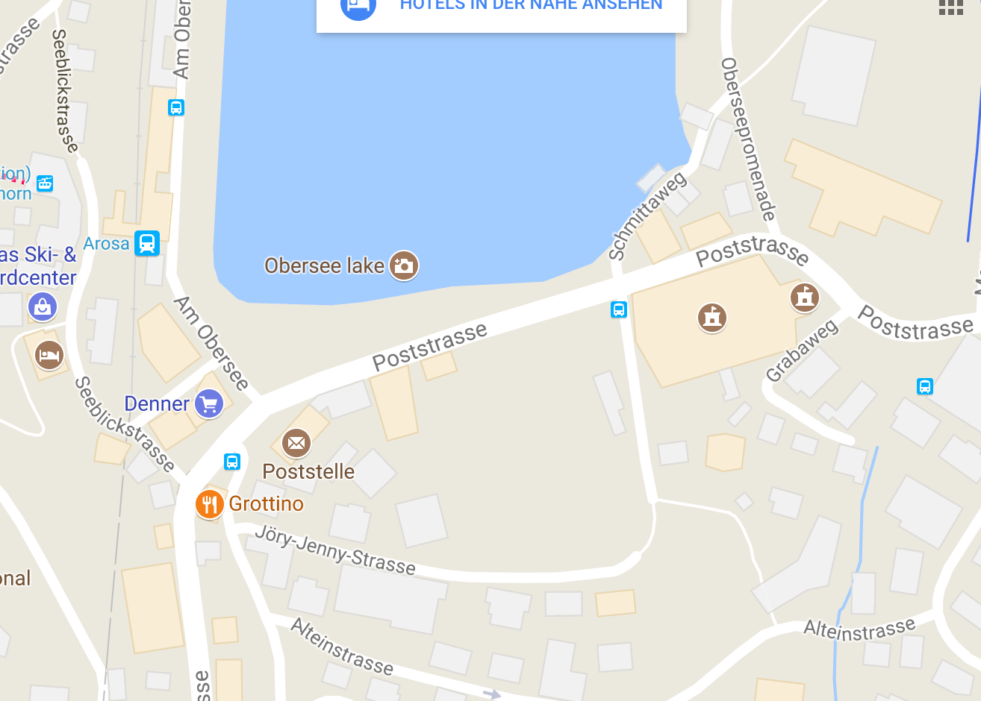

Slide 9
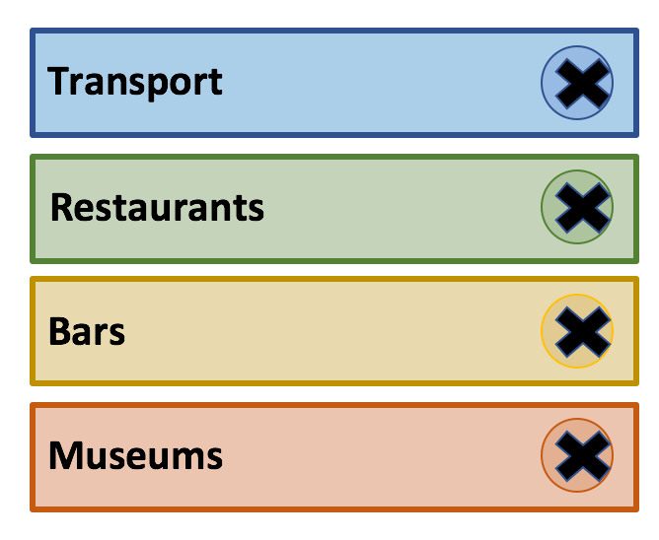
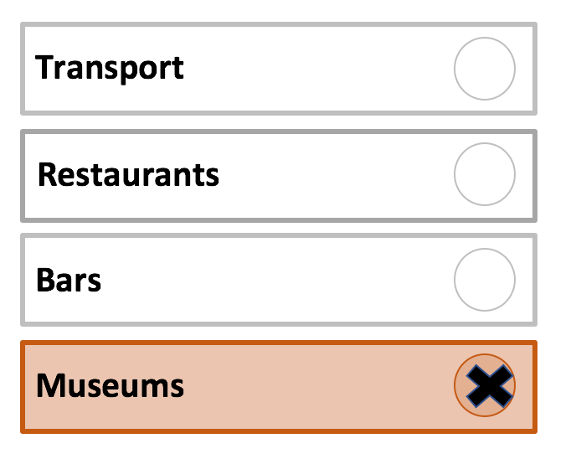
Notification Preferences

Slide 10
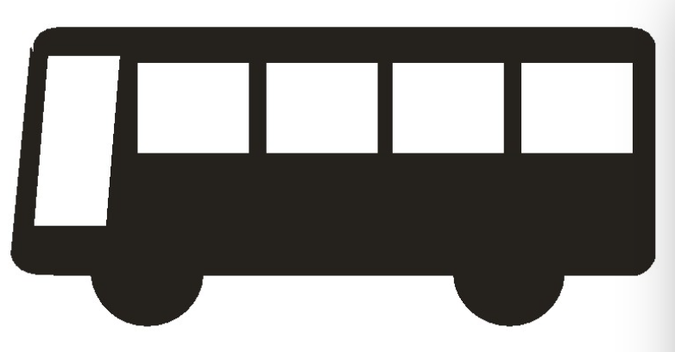




Slide 11
