Slide 1
Smart Arosa
Connecting the physical space with the information space

Slide 2
There are no tourists
Today's tourists aren’t tourists.
They a webizens pilgrimaging and exploring the physical world.

Slide 3
Technological Landscape
Web of documents -> Web of data
Persons, places, documents, ideas…
Individual interests, preferences and background
Pervasive geo-located mobile devices

Slide 4
Limitations
Geo-Location -> Limitations in buildings
Mobile broadband -> Limitations in the wilderness and when roaming
-> Bluetooth Beacons to annotate the physical space

Slide 5
Bluetooth Beacons
Bluetooth Low Energy Beacon technology allows to annotate the physical space

Slide 6
Smart Arosa Advantages for Providers
Tourists stay longer
Tourists learn about and visit more places
More equally ditributed stream of visitors

Slide 7
Smart Arosa Advantages for Tourists
They aren't tourists: they discover on their own
They can see through walls: thy can take see what other places there are behind the wall of the museum they're visiting
They avoid they queue buy having real-time data and know on which ski lift there's not a lot of people

Slide 8
Data
Data used
Data we missed
A small subset of wikidata
Transport data ("Where do I go next?")
Real time data on usage of facilities
Geotagged pictures
More informtaion about monuments/places

Slide 9
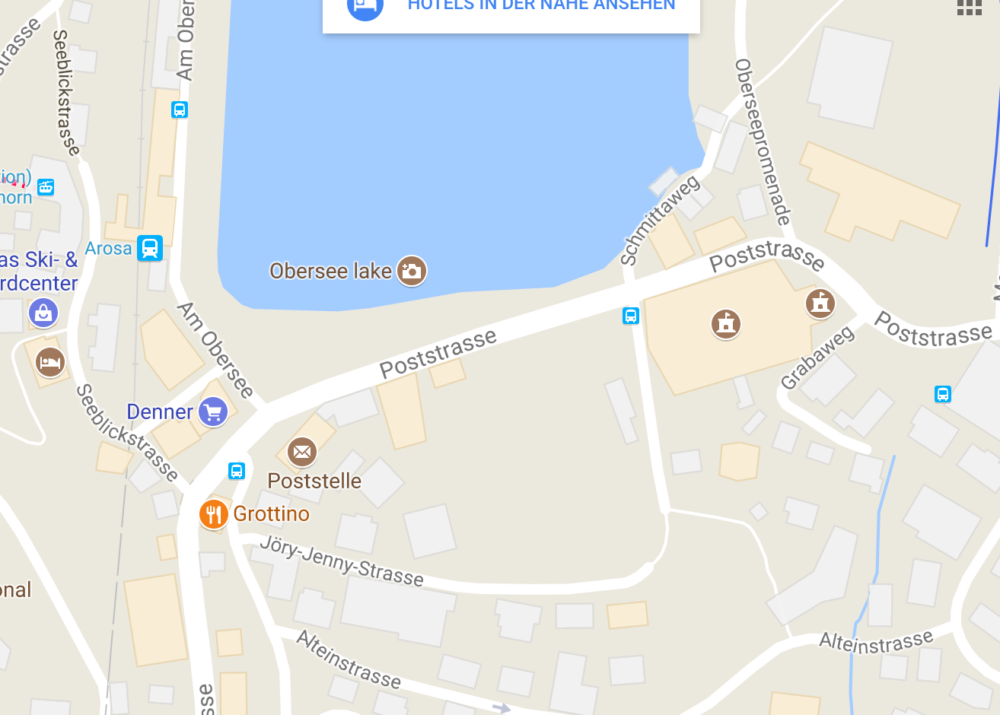

Slide 11
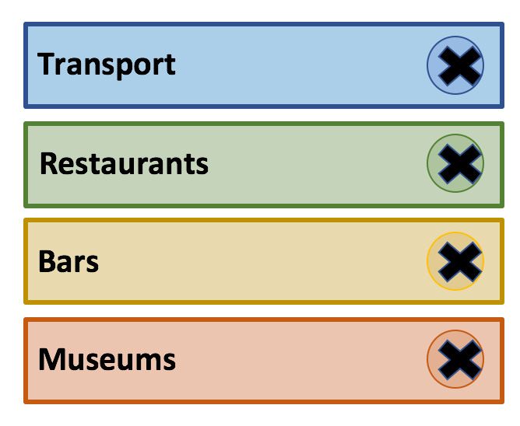
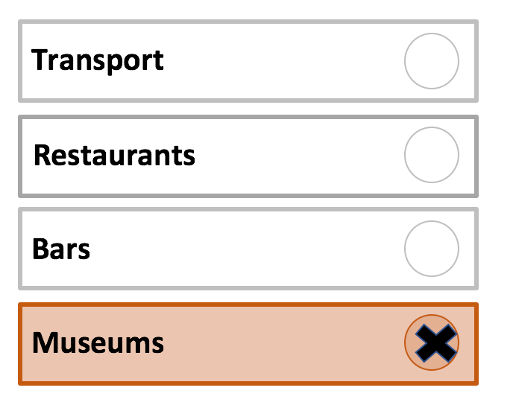
Notification Preferences

Slide 12





Slide 13
