Slide 1
The power of plain text
a.k.a. a gentle introduction to personal knowledge management using Zettlr Alan CASTELLINO (author), Benjamin ABEL (facilitator)

Slide 2
Goal and overview

Slide 3
Objectives
Figure out why you should get familiar with knowledge management and content publishing
Figure out the advantages of plain text and multi-format exporting
Get familiar with Markdown and basic exporting using a simple tool
Start to elaborate personal PKM practices
Experience how a tool like Zettlr can help with the PKM process

Slide 4
Overview
Have a look at what you can get with a bit of practical knowledge of plain text workflows (quarto) and GitHub: https://smart-edtech.github.io/smarties/
Automatic build of the website
Multi-format exporting avairable

Slide 5
Basics

Slide 6
Raison d’être of Personal Knowledge Management (PKM)
We live in an information society. We are overloaded with information of diverse nature and quality.
There is more than information overload: tools overload, social overload and reference overload.
Most individuals are passive against these concerns. However, the digital medium has its very own characteristics we need to embrace to develop a personal.

Slide 7
What is PKM?
PKM is the field that precisely studies that issue: how, as individuals, can we thrive in the informational age? How can we make the most out of information technologies without feeling overwhelmed?

Slide 8
A plethora of tools
Notion, Roam, Tana, Obsidian, Logseq, AnyType, Affine, TiddlyWiki, Zettlr…
Local vs Web-aware vs Web-based
FOSS vs Freeware vs Paid
Specific ↔ Extensible ↔ Malleable
User-friendly?

Slide 9
Advantages of plain text editing
Lightweight: you can work with just a simple text editor. You can store your files anywhere.
Easily readable and writable: a whole range of apps work with plain text. It is also easy to manipulate programmatically.
No lock-in: you can use your text files in different apps for different purposes. You can switch to a new app that better fits your needs seamlessly.
Teaches you about computing and the hacker mindset in a hands-on way.

Slide 10
Meet Zettlr
Zettlr is:
Designed with simplicity in mind
Free and Open-Source
Web-aware
Supported by a community (Discord, Reddit)
Specific but plays nicely with other tools (bibliography, export)

Slide 11
Install Zettlr
Simply go to the official website: zettlr.com/download
Install and open it.
If you write academic articles, you will need LaTeX at some point. Simply use MikTeX (this is not the point today).

Slide 12
Markdown syntax
# Section heading
## Subsection heading…
This is _emphasized_ and this is **strong**
This is a - List item
This is a 1. Numberred item
This is a [link](https://zettlr.com)
This is an ![cute_cat.png](image)
YAML: metadata and options

Slide 13
Basics and Exporting
Create a new file
Fill it up with some headings and content.
You have some shortcut icons (e.g. links and images)
Left pane: files explorer
Right pane: outline and more
Export button: select one of the available formats (except LaTeX)

Slide 14
Diving deeper

Slide 15
Key skills in PKM
Management
Lifelong learning
Communication and interpersonal skills
Technological fluency
Forecasting and anticipating

Slide 16
Key skills in PKM (cont’d)
Use frameworks, models and conceptual tools to build upon your current KM practices.
Implement PKM strategies using digital technologies.
PKM practices are ultimately personal and evolving constructs.
Reflect about the process, iterate, exchange with others

Slide 17
Some concrete insights
Find an equilibrium between content consumption and content creation
Move from note-taking to note-making: think about your notes, not just their content
Showcase your learning: learn in public, build a digital garden
View digital tools as opportunities to design new workflows

Slide 18
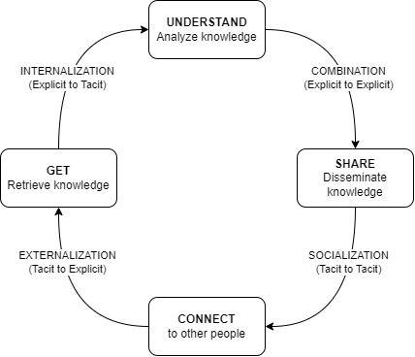
The GUSC model
We will use the GUSC model. It can be seen as a concretization of the SECI model.

Slide 19
→ A simple yet powerful model. We need to associate concrete actions to each phase.

Slide 20
The GUSC model in more details
Get: gather information from different sources
Understand: interpret, combine information into a (personal) whole
Share: produce artifacts to make the learning process visible
Connect: collaborate and exchange with others

Slide 21
Back to practice
→ We will see how Zettlr can help us implement strategies for the first 3 steps of the GUSC model (Get, Understand, Share).

Slide 22
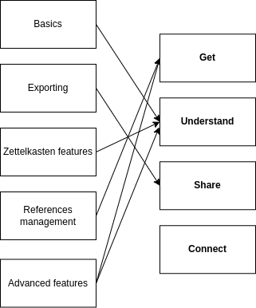
GUSC in Zettlr

Slide 23
Get phase: referencing with Zotero and Zettlr
Install Zotero. You will manage all your references from here.
Install the BetterBibTeX plugin for Zotero
Export your Zotero library
Open it in Zettlr
Type in @ and select one of your refs.
Example [@resnickLifelongKindergartenCultivating2017] and others emphasize the need to develop creativity in computing education.
[@morPracticalDesignPatterns2014] have developed design patterns for implementing technology-enhanced pedagogy.

Slide 24
References

Slide 25
Understand phase: Zettelkasten in Zettlr
A methodology to make sense of your notes.
Some insights:
Use #tags.
Link to other files, such as in [[about_tags]].
Give unique IDs to files such as [[20231216180452]] Another file

Slide 26
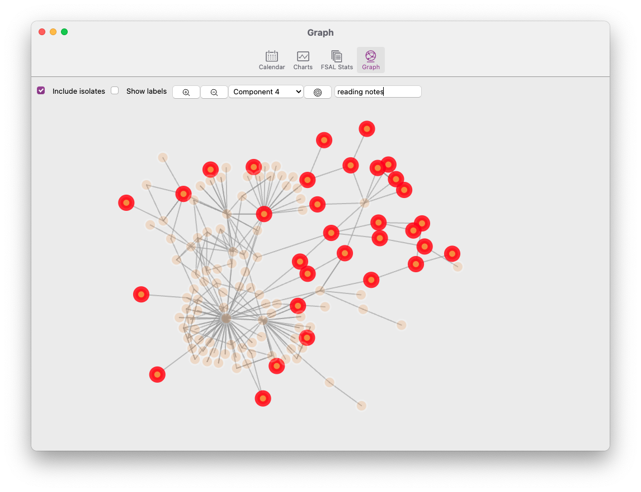
Understand phase: the Graph view:

Slide 27
Share phase: extending export capabilities
Change how things look
Add new export possibilities thanks to Pandoc
We will use the Assets dialog: File > Preferences > Manage assets
Challenge 1: use custom CSS to style HTML output
The given file is custom.css.
Select the HTML profile. On line 46, add custom.css between the brackets.
You can also add css: custom.css to the YAML on each file you want to export with custom.css.

Slide 28
Share phase: extending export capabilities (cont’d)
Challenge 2: enable export to PowerPoint presentations
By default, Zettlr offers no possibility to export to .pptx (PowerPoint). However, pandoc can do it.
Create a new profile with reader: markdown and writer: pptx
Challenge 3: modify how things look in docx, pptx, odt
You can specify a template by adding reference_doc: template.pptx to the corresponding profile.
We provide custom.docx, custom.odt and custom.pptx
Modify the slide masters in the provided template
For docx/odt, modify the styles.

Slide 29
Thank you!

