Slide 1
SGIP Nashville 2011 Meeting
Semantic Working Party

Slide 2
Agenda
The SGAC Semantic Modeling Working Party will be meeting to further discuss topics related to harmonizing various semantic models primarily under construction by the PAPs and Working Groups of the SGIP. The following topics will be discussed:
[20 min] Managing a Smart Grid semantic model repository containing CIM, 61850, C12.19, SEP2.0, EMIX, ASHRAE 201, ...
[20 min] Defining the relationship between models based on CIM and CIM itself
[30 min] Determining role of OWL and other semantic tools in semantic working party – primary or accessory
[20 min] Fleshing out further the SGAC Semantic Framework paper that describes how to determine where alignment exists and where translations need to occur.
[15 min] PAP14 – Overview of priority process to identify key Use Cases necessary for Smart Grid in the T&D Domains.
[60 min] Dig into specific examples of semantic harmonization use cases in more detail - We are inviting attendees to bring examples to discuss.

Slide 3
Managing a Smart Grid semantic model repository containing CIM, 61850, C12.19, SEP2.0, EMIX, ASHRAE 201, ...

Slide 4
Semantic Models in the Customer Demand Side Management PAPs
IEC 61968/61970 (CIM)
IEC 61850
IRC Pricing Models
UCAIug OpenADR
SEP 2.0
NAESB PAP10 EUI
OASIS PAP030409 EMIX EI
ASHRAE SPC201 PAP17

Slide 5
What Should a Library Look Like
Components
CIM, 61850, SEP2.0, FSGIM, NAESB, …
Versioning
Disclaimers and copyright notices
What else????
Mapping from model to model
What do we need to do to facilitate how to use these standards
Repository vs. Registry?
Needs for current version (reference) as well as frozen version (copy)
How to distinguish between working copies and reference copies.
What is use case for such a library?
For study of standards and their relationships
What kind of uses people have made of the models

Slide 6
Defining the relationship between models based on CIM and CIM itself

Slide 7
Model Evolutions
IEC 61968, 61970
SEP 2.0
NAESB PAP10
ASHRAE SPC201

Slide 8
Model Roullette
IEC Community
IEC 61968,61970 CIM
WG 14
Part 9 Model Mgrs
V_CIM1
V_NAESB1
V_CIM2
Version timeline
NAESB Community
PAP10 EUI (REQ18, WEQ19)

Slide 9
Methodology
Inheriting from CIM, 61850
Profile definitions
Continuous interaction with the “model managers” to help maintain semantic quality
“Style guide” for extending CIM
Versioning
Normative models vs. models in flight
Handback
Repository of outstanding extensions that have not been reabsorbed
Document differences
See “style guide”
High level coordination?

Slide 10
Determining role of OWL and other semantic tools in semantic working party – primary or accessory

Slide 11
Challenge: How to reconcile vocabularies, concepts and relations among all the smart grid standards?
Currently 82 standards in the SGIP Catalog of Standards
Overlapping, different, sometimes contradictory vocabularies and definitions
We need a way to manage
Differences
Constraints on usage
Relationships between vocabularies

Slide 12
How to proceed?
Align vocabularies
Capture relationships and constraints
Create mappings among standards

Slide 13
What are the alternatives?
Spreadsheets
UML tools
Enterprise Architect (Sparx Systems)
Rational Software Architect (IBM)
MagicDraw (No Magic)
Visual Ontology Modeler (Sandpiper)
Other semantic tools haven’t tackled vocabulary management among multiple models
Protégé (Stanford)
Anzo (Cambridge Semantics)

Slide 14
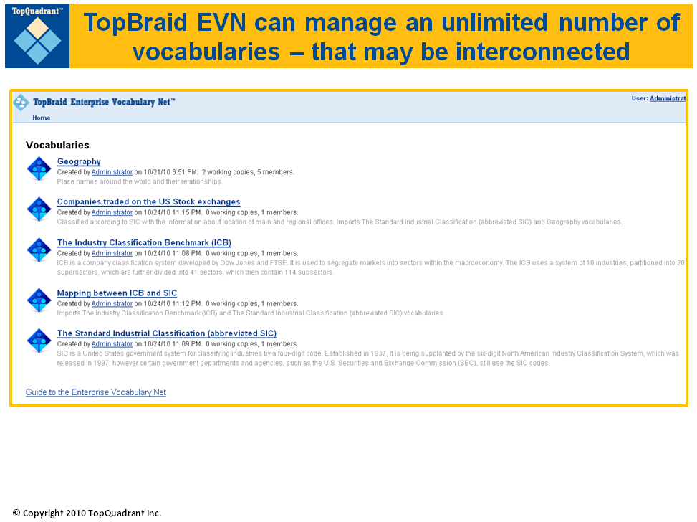
One option:
TopBraid’s Enterprise Vocabulary Net (EVN)
Runs from the cloud

Slide 15
TopBraid EVN Features include:
Intuitive graphical user interface
Multi-user support
Editing and review of multiple working copies is supported
Working copies of a vocabulary can be provisionally changed and reviewed without affecting the production vocabulary until changes are published
Controlled role-based access
staff members can be provided appropriate access to vocabularies and working copies depending on their assigned roles
Change tracking
Built-in and custom rules
Support of all relevant W3C standards
e.g., SKOS and RDF
Import/Export and seamless integration using web services
Easy extensibility of features
using TopQuadrant's TopBraid platform
Notes:
Intuitive graphical user interface optimized for fast editing
Multi-user support
Editing and review of multiple working copies of a vocabulary without affecting the production vocabulary until changes are published
Different access to vocabularies and working copies for different staff members depending on their assigned roles
Change tracking
Built-in and custom rules
Support of all relevant W3C standards e.g., SKOS and RDF
Import/Export and seamless integration using web services
Easy extensibility of features using TopQuadrant's TopBraid platform

Slide 16
TopBraid EVN Capabilities include:
Vocabulary Editing: Cloning, merging, repositioning and re-numbering of concepts; global edit operations for selected groups of concepts
Easy Customization: Easy customization of user interfaces, custom validation rules and processing via SPARQL Rules and SPARQLMotion
Unlimited Work-in-Progress Copies: Virtual work-in-progress copies of vocabularies enable controlled publishing, review and approval
Reporting: Built-in reports as well as advanced query-building tools and reporting through graphical interfaces
Merging, Importing, and Exporting: From and to RDBMs, spreadsheets (CSV & Excel), XML, RSS feeds, SPARQL endpoints, RDF and OWL
Systems Integration: Integrates with existing enterprise or vocabulary management systems via Web Services interfaces and APIs
Enterprise-ready: Scalable architecture offers a choice of relational and RDF database repositories with LDAP integration for access control
Notes:
Intuitive graphical user interface optimized for fast editing
Multi-user support
Editing and review of multiple working copies of a vocabulary without affecting the production vocabulary until changes are published
Different access to vocabularies and working copies for different staff members depending on their assigned roles
Change tracking
Built-in and custom rules
Support of all relevant W3C standards e.g., SKOS and RDF
Import/Export and seamless integration using web services
Easy extensibility of features using TopQuadrant's TopBraid platform

Slide 17
How can the output be used?
What is the output?
SKOS, RDF, OWL -- W3C standards
UML diagrams, XML Schema, XSD
How can the output be used without EVN?
Resulting models can be imported into other mainstream modeling tools

Slide 18
TopQuadrant is in discussions with the SGIP PMO-EnerNex to formally offer the EVN free of charge to SGIP.
Philip Bane from TopQuadrant is at SGIP meeting if you have any questions.

Slide 19
Fleshing out further the SGAC Semantic Framework paper that describes how to determine where alignment exists and where

Slide 20
GWAC Stack

Slide 21
Some definitions…
Semantics refers to the meaning of a set of information.
A semantic model is a structured description of the semantics of a set of information, using some information modeling language (e.g. UML).
A semantic model contains ‘metadata’.
Many different semantic models are possible for the same semantics, even within one modeling language.
Semantic modeling only represents information content – it does not include formatting/encoding (syntactical) specifications.
A semantic transformation is a procedure for converting a given semantic from one semantic model representation to another.
This is to be distinguished from a syntactic transformation that would convert a set of information governed by one semantic model from one format to another.

Slide 22
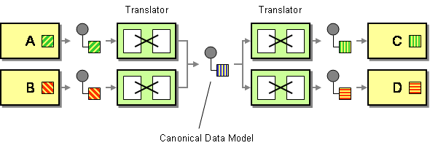
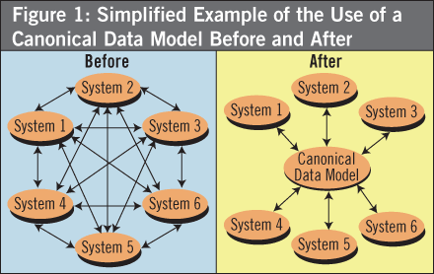
A canonical data model (CDM) is a semantic model chosen as a unifying model that will govern a collection of data specifications.

Slide 23
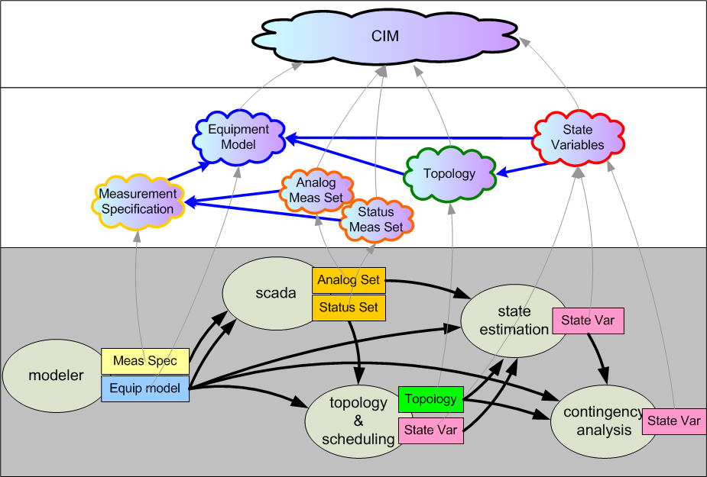
Example usage of CDM to define a collection of standard interfaces.
Canonical Data Model
derived from
Exchange Profiles
defined by
Exchange
Payload Instances

Slide 24
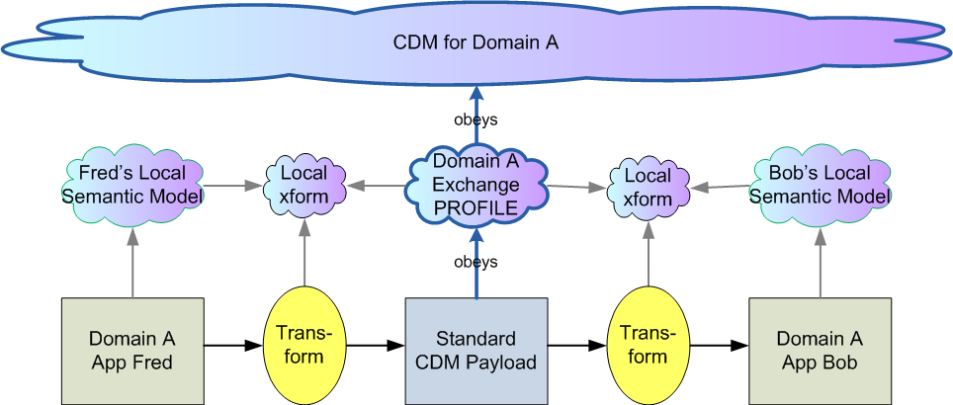
Standard semantic integration within a unified domain – one CDM.

Slide 25
Considering the possibility of a single unified model.
Definition: a unified model:
Is ‘normalized’ (no duplicate modeling of the same semantic).
Covers the entire problem scope of Smart Grid.
Challenges:
A scope as large as Smart Grid has to be partitioned somehow into domains so that different focus groups can operate in parallel.
The difficulty of coordinating normalized modeling goes up exponentially with the number of different domains.
There is already significant investment in separate domain models which would have to be changed to achieve a global normalization.

Slide 26
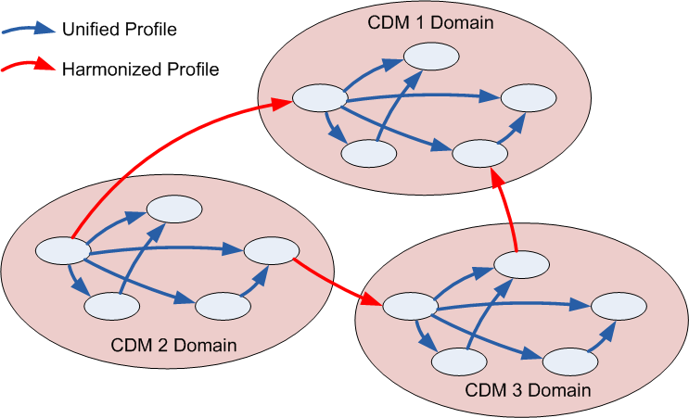
In the real world, there are multiple CDMs.

Slide 27
Harmonization: the next best thing for coordinating CDMs.
Definition: two CDMs are harmonized if:
There is a lossless transformation defined between all duplicated semantics.
Both sides undertake to maintain the harmony, once established.

Slide 28
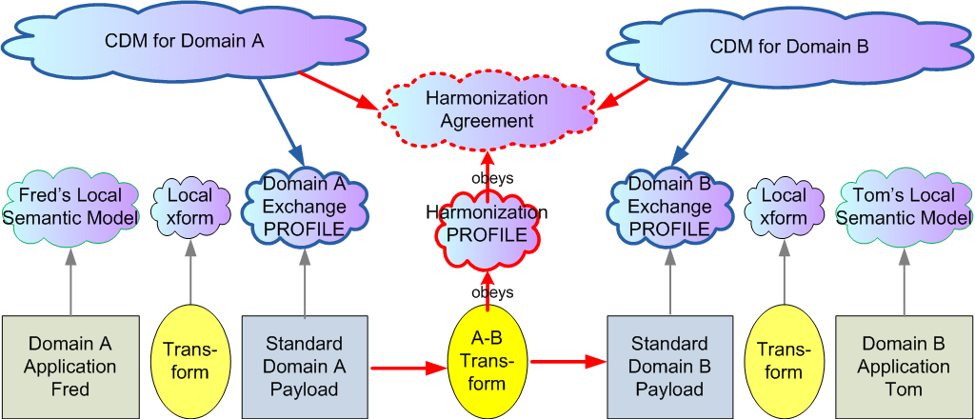
Standard semantic integration between harmonized domains – two CDMS.

Slide 29
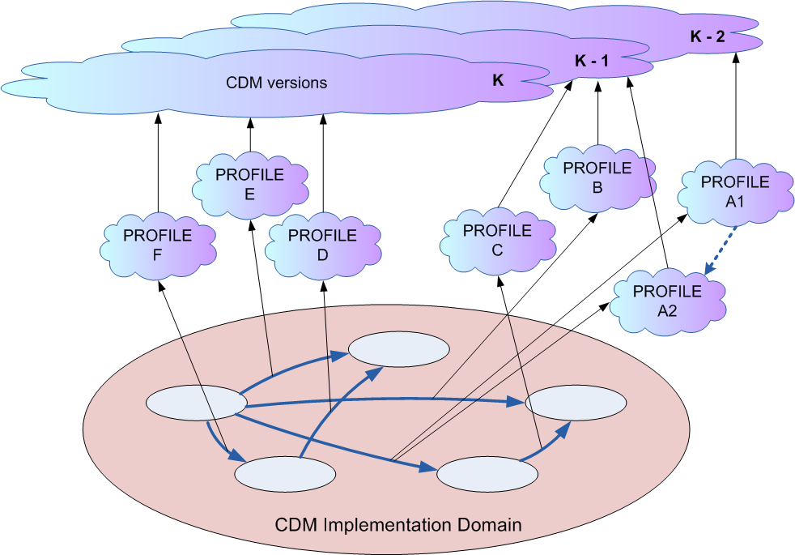
In the real world, semantic models and standards need to evolve.

Slide 30
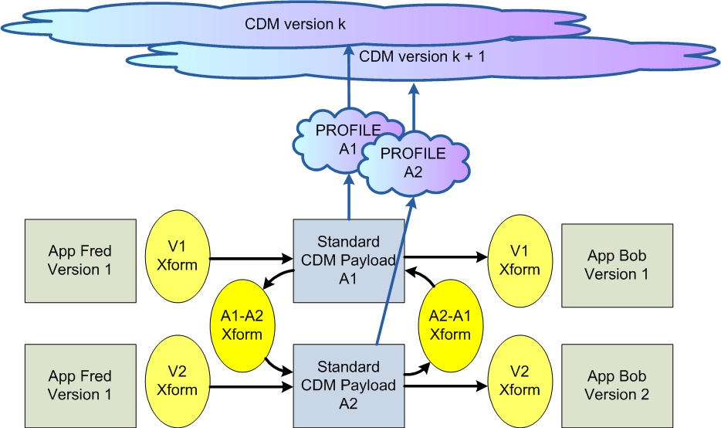
Version migration within a profile.

Slide 31
IEC Profile Group
IEC TC57 has recently launched an effort to define more precisely the notion of a ‘profile’.
This comes from a growing recognition that:
Profiles have a different purpose than CDMs.
Profiles are where the software investment is made.
Profiles are what is tested.
Profiles are where backward compatibility and versioning must be dealt with.
The group is reporting to WG19 with membership from a variety of WGs.

Slide 32
How many CDMs does it take to screw in a light bulb?
Problem:
You want to standardize a new exchange.
After researching requirements:
No single CDM has everything you need.
Several CDMs have useful content.
What do you do?
Objective:
Each exchange payload derives from one CDM.
Rationale:
Coordinating a profile with one SDO is challenge enough!
Discussion:
In addition to asking what your SDO can do for you, ask also what you can do for your SDO.
The short-term is the enemy of the long-term.

Slide 33
The Semantic Framework aims to provide:
Methodology Guidance for Smart Grid
CDMs
Profiles
Version Management
Harmonization
Implementation Map of Smart Grid Semantic Standards
What CDMs by what SDOs
What exchanges require profiles by what SDOs.
What CDMs have what harmonization agreements.

Slide 34
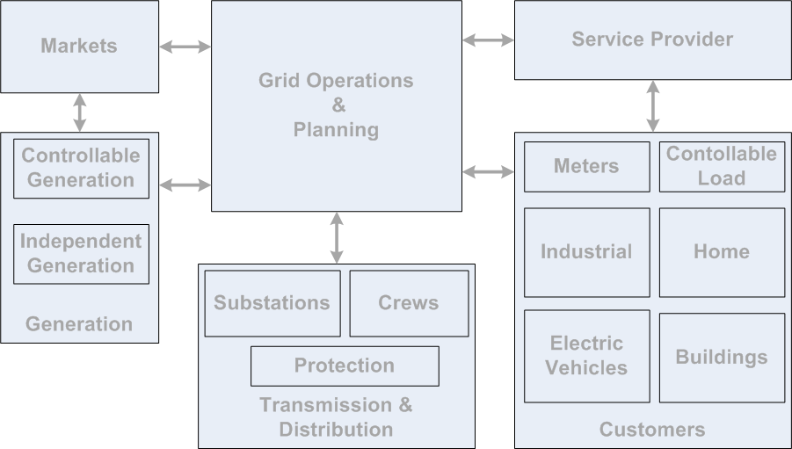
Draft Semantic Mapping
62351-7 comm net and system mgnt
Abstract Model – Shared Concepts, Fragments???
WS Calendar
OASIS energy interop
EMIX
CIM 62325
CIM 61970
CIM 61968
ICCP
C12.19
Multispeak
61850-410 hydro
ISA88
61850-420 DER (solar…)
ISA95
Zigbee smart energy profile
61400-25-2 wind
61850
Ieee 1815 dnp3
Ieee c37.239
comfede
61850-420 DER (solar…)
ISO 16484 BACnet
naspi
CEA 709 LonTalk
NAESB energy usage info

Slide 35
PAP14 – Overview of priority process to identify key Use Cases necessary for Smart Grid in the T&D Domains.

Slide 36
Agenda
PaP 14 Overview
Priority Process Release Version
Status of PAP 14 Specific Development Areas

Slide 37


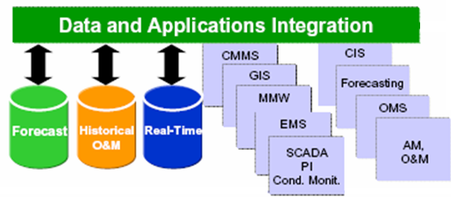
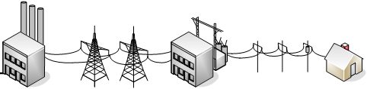


PAP 14: Transmission and Distribution Power Systems Model Mapping: Scope Perspectives
Applications
Power procurement Market operations
Regional Transmission Operator
Distribution Control Center
External corporations
Data integration
PAP 14
Communication Infrastructure
Controls sensors
Large Scale Generation integration
Transmission Ops
Substation automation
Distribution automation
AMI
WAMAC
DER integration
Power System Resources

Slide 38
SDOs and Consortia Related to PAP 14
CSWG Liaison: Stan Klein, [[stan@osecs.com]
SGAC Liaison: Jay Britton
SDO Lead: Christoph Brunner, Convenor IEC TC57, WG10
Other SDOs: IEEE Power Systems Relay Committee (PSRC )H3 Committee Chair Bill Dickerson IEEE PSRC H2 Committee Chair Mark Simon IEEE PSRC H5 Committee Chair Jürgen Holbach IEEE PSRC H16 Committee Chair Mark Adamiak IEEE PSRC Communications Subcommittee: Veselin Skendzic IEC WG13 Convenor Terry Saxton IEC WG14 Convenor Greg Robinson, IEC TC 57 WG 19 Paul Skare Convenor, Herb Falk, Harmonization Multispeak: Gary McNaughton
Users Groups: UCAIug, Mark Adamiak
Technical Team: Alex Apostolov (Member IEC TC57, WG10, 19, IEEE PSRC H3, H5 and H16)

Slide 39
PAP 14 Revised Scope..
PAP 14 Domain
Transmission Operations
PAP 7,13,14,16
Transmission Bus Load Model
PAP 14
Distribution Operations
PAP 7, 8
Customer Dynamic Loads:
PAPs 3,4,9,10,11,17

Slide 40
PAP 14 Priority Criteria: Dual Track Priority Criteria
Key Application Needs
Key Standards Gaps
Key Application Needed by the Industry
Cross Cutting Applications
Don’t replicate, complement those addressing key needs
PAP 14 “breadth” to other related PAP “Depth”
Integration, Harmonization, Unification of Field Equipment and Back Office*
Event Model Integration*
Relay Setting Standards*
Electronic Tagging
Transmission Bus Load Model Development
Other
*Initial PAP 14 Scope

Slide 41
PAP 14 Goals
Narrow Focus to Key Transmission Related Application and Associated Standards Development Issues
Select a small number of transmission operations functions which have:
Address Needs for Key needed applications
Address Significant Standards Development and Integration Needs
Address cross-cutting needs
Are architecturally significant, i.e.
Involve most of the actors
Require critical performance characteristics

Slide 42
PAP 14 SpreadSheet Priority Tool Criteria
Scoring from 0 to 5 points
Criteria for Prioritizing PAP 14 (T&D System Models) Use Cases (DRAFT Instrument)
Track 1: Key Applications Criteria |  |  |  | Track 2: Standards Development Criteria |  |  |  |  | Comment /Lead SDOs
1A. Addresses Critical Application(s) Needed for smart grid Development | 1B. Supports Cross Cutting Applications | 1C. Addresses Architecturally Significant Issues | 1D. Addresses Application(s) Not Addressed by Others | 2A. Supports critical areas of needed standardization development i.e.relay settings | 2B Defines specific strategies to integrate/harmonize existing standards | 2C. Develops Standards that Support Multiple Applications i.e. Event Models | 2D. Addresses specific critical technical issues necessary for standards integration | Total Score

Slide 43
Format of PAP 14 Spreadsheet Priority Tool
Note: Blue=Ops Driven Sources (Ops), Green=Standards Driven Sources (STD), Blue/Gray=Other Contributions(Cont) |  | Track 1: Key Applications Criteria |  |  |  | Track 2: Standards Development Criteria |  |  |  |  | Comment /Lead SDOs
Use Case Title/Category | Relationship to Other Use Cases | 1A. Addresses Critical Application(s) Needed for smart grid Development | 1B. Supports Cross Cutting Applications | 1C. Addresses Architecturally Significant Issues | 1D. Addresses Application(s) Not Addressed by Others | 2A. Supports critical areas of needed standardization development i.e.relay settings | 2B Defines specific strategies to integrate/harmonize existing standards | 2C. Develops Standards that Support Multiple Applications i.e. Event Models | 2D. Addresses specific critical technical issues necessary for standards integration | Total Score
Transmission Bus Load Model (TBLM) | Information Support for WASA, OPF-SCD, SCA, DSA, WAMCS, REST |  |  |  |  |  |  |  |  |  | IEC TC 57 WG 13
Wide Area Situational Awareness (WASA, incl. SE) | Uses TBLM information; information suppport for OPF-SCD, SCA, DSA, WAMCS, REST |  |  |  |  |  |  |  |  |  | IEEE PSRC
Optimal Power Flow and Security Constraint Dispatch (OPF-SCD) | Uses TBLM and WASA information; information suppport for SCA, WAMCS, REST |  |  |  |  |  |  |  |  |  | IEC TC 57 WG 10, 19/IEEE PSRC

Slide 44
PAP 14 Additional Use Cases From Twiki Contributions
Fault Location
Automated Fault Analysis
Back-up protection
Protective relay application testing
State Estimation
Electronic Tagging

Slide 45
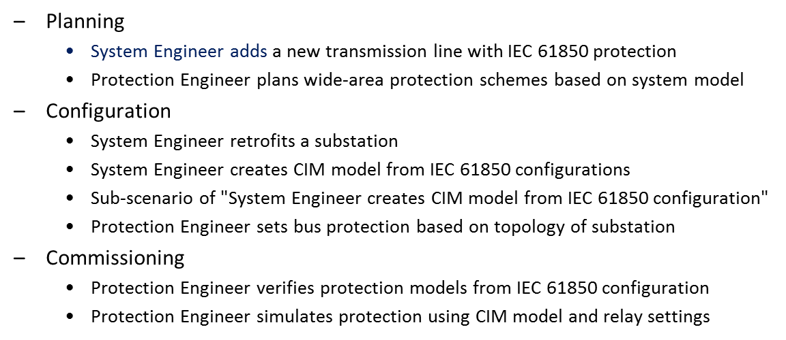
Applications Driving Standards Harmonization

Slide 46
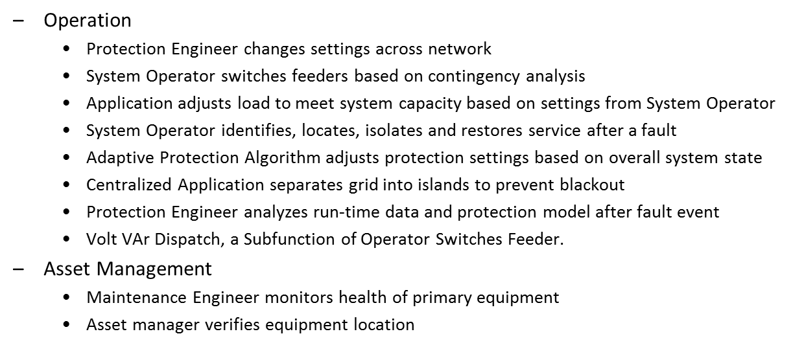
Applications Driving Standards Harmonization Continued

Slide 47
IEEE PES Power Systems Relay Committee (PSRC) H2 Use Cases
Dynamic Settings based on Real-Time Conditions
Reclosing Supervision Based on Smart Grid Data
Conservation Voltage Reduction
Fault Location
Applications of Power Quality Data
Time Management (Local and Wide Area)
Applications of GOOSE
Distributed Energy Resources Protection
Load Shedding and Load Based Applications
H2 Applications for Smart Grid, Chair Mark Simon

Slide 48
Use Cases from Prior Work (EPRI IntelliGrid Posted on SGIP Interoperability Knowledge Base)
•AdvancedAutoRestoration.doc
•AutomatedControlBaseline.doc
•ContingencyAnalysisBaseline.doc
•ContingencyAnalysisFuture.doc
•EmergencyOperationsBaseline.doc
•Inter-AreaOscillationDamping.doc
•Self_healing_grid.doc
•SynchroPhasorDomainDescription.doc
•VoltageSecurity.doc
•Wide-Area_Wind_Generation_Forecasting.doc
•EnterpriseManagementGenericUseCase.doc
•System Wide Automatic Voltage Control (SAVC)

Slide 49
Generic Standards Integration Harmonization Issues

Slide 50
Proposed Priority Process
Finalize Initial List of Candidate Use Cases
Complete Criteria for Prioritizing
Reach out to T&D DEWG, SDOs and Consortia, S for participation
If you are interested in participating please send an email to Joe Hughes: email reefarch.gmail.com

Slide 51
Dig into specific examples of semantic harmonization use cases in more detail - We are inviting attendees to bring examples to discuss.

Slide 52
6 Dig into specific examples of semantic harmonization use cases in more detail
[15 min] CIM harmonization and mapping with MultiSpeak
[15 min] ASHRAE SPC201 Information Modeling
[15 min] Transmission Bus Load Model Use Case
[15 min] PNW project and its deliberation about semantic standards (i.e. message payload models)

Slide 53
CIM – MultiSpeak® Harmonization Progress

Slide 54
Why are we doing this?
Give utilities more choices in application selection
Provide a level playing field for vendors
Support NIST PAP 8
Support IEC TC 57 WG 14 (CIM for Distribution)

Slide 55
Challenges
Both IEC 61968/61970 and MultiSpeak have very robust models
Mapping the entire models is impractical
Lack scope and context
Using the CIM profiles is a better starting point
Provides message exchange context
There are no equivalent MultiSpeak profiles

Slide 56
Tools
Sparx Enterprise Architect
Both CIM and MultiSpeak have EA reference models
CIM EA (www.cimea.org) – freely available add-in to Enterprise Architect
Facilitates the creation of CIM equivalent MultiSpeak profiles
Used to generate XSDs based on the created profiles
Altova XMLSpy – edit and validate the XSDs
Altova MapForce – used to generate point-to-point maps

Slide 57
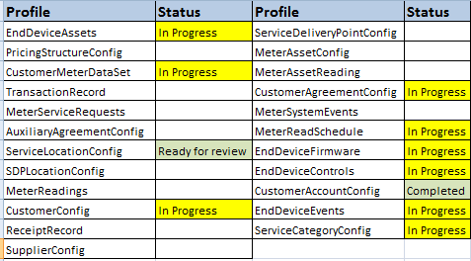
Profile Status
23 profiles to be mapped (IEC 61968/61970)

Slide 58
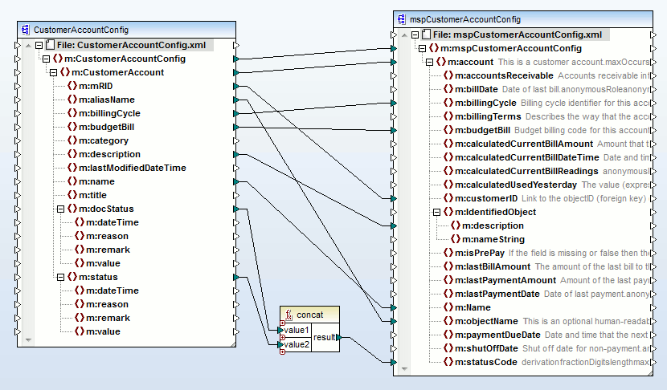
CustomerAccountConfig
Preliminary assessment
Some profiles show considerable correlation
However, some significant gaps identified
e.g. Document class (no MultiSpeak equivalent)

Slide 59
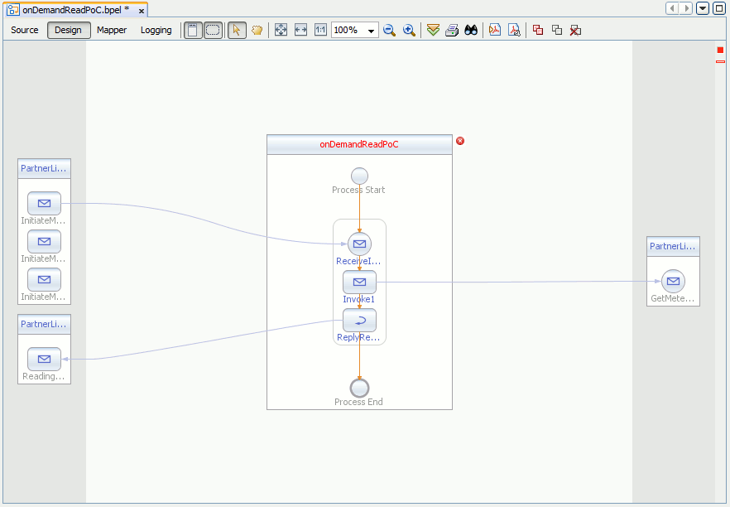
CIM-MultiSpeak Proof of Concept
Using OpenESB (based on GlassFish application server and NetBeans)
Mapping MultiSpeak InitiateMeterReadingsByMeterID to CIM GetMeterReadings, with a return to MultiSpeak
Demonstrate how MultiSpeak can be mapped to CIM in a practical application
Leverages the on demand meter read use case

Slide 60
WG14-14 documentation
Created initial draft IEC 61968-14-1 which will document findings from the CIM-MultiSpeak Proof of Concept and the strategy employed
Created initial draft of IEC61968-14-9-1 which will document the profile mappings from CIM Part 9 1st Ed. to MultiSpeak v4.1

Slide 61
Together…Shaping the Future of Electricity

Slide 62
ASHRAE SPC201 Information Modeling

Slide 63
The case of ASHRAE SPC201 using CIM, 61850, SEP, NAESB, & OASIS information models.
NAESB PAP10 (extends CIM, SEP)
OASIS EMIX
IEC 61850-7-420

