Slide 1

Architecture Element Categorization – Results Todate
Dr. Elizabeth Sisley, Dr. Steve Ray, Ron Cunningham November 10, 2016

Slide 2

Agenda
ADWP’s Arch. Elements Categorization Key Contributors
Problem Statement
Objective/Goal
Results To Date
Architectural Element Categorization Guidance
Neutral Concepts Model Approach
Next Steps
2016 Copyright © SGIP, Inc. CONFIDENTIAL. ALL RIGHTS RESERVED Page 2

Slide 3
ADWP’s Architectural Elements Categorization Key Contributors
Chair (2014-present): Dr. Elizabeth Sisley (Calm Sunrise Consulting)
Dr. Steven Ray (Carnegie Mellon University)
Ron Cunningham (AEP)
Dr. Gerald Gray (EPRI)
Stephan Amsbary (past member, previously ENERNEX)
John Ruiz (past member/Chair, Johnson Controls)
2016 Copyright © SGIP, Inc. CONFIDENTIAL. ALL RIGHTS RESERVED Page 3

Slide 4
Problem Statement(s)
Each IT Project tends to:
if fortunate, have access to prior/related projects’ artifacts to work from, but many times discover:
the same terms (or named things) are defined differently from one project to the next, or from one group/company to another; or
what are in reality the same thing are named differently, or
architectural contexts and abstraction level are not the same for those terms
many projects end up identifying/naming/defining their own set of Actors, ServiceCompositions (~roles), Services used to document business scenarios, use cases, stories
struggle to gain consensus in understanding with others, when integrating that project’s application(s), data, and messaging with another group’s/company’s set of application(s), data, messages, or
worse yet, make assumptions that the projects defined terms are interpreted the same with everyone else and finding out when in full production they are not
2016 Copyright © SGIP, Inc. CONFIDENTIAL. ALL RIGHTS RESERVED Page 4

Slide 5
Objectives/Goals
Provide Guidance/Examples on how to align from one project’s set of architectural/business elements to another. Alternately encourage reuse of a reduced number of sets of architectural/business terms via understanding how setA-element relates to a setB-element
Along the way start building up a common set of architectural/business elements and the relationships between them, that can be used, interpreted, and modeled the same way across projects and organizations
Reduce the time/effort of each project’s re-identifying/re-naming/re-defining Actors, ServiceCompositions (~roles), Services, relationships and associated missteps from one integration to the next
help create a common vocabulary of terms and elements that is expected to make it easier to create new business use cases/stories that in turn are used to help identify the business requirements and services/capabilities that are used in project business scenarios and use case development, and advancing interoperability standards work.
2016 Copyright © SGIP, Inc. CONFIDENTIAL. ALL RIGHTS RESERVED Page 5

Slide 6

Results To Date

Slide 7
Results To Date
SGAC Architecture Development Working Party (ADWP), gathered set of Use Case elements from 18 organizations and performed initial categorization of elements to Conceptual, Logical, Physical architecture abstraction levels. Combined set contains:
~ 180 Actors
~ 230 ServiceCompositions (~role)
~ 800 Services
Created an OWL model (SOA focused), that shows the relationships of the elements across the Conceptual, Logical, Physical abstraction levels
Currently working on:
using a specific real world use case set of Actors, Services, messages to vet out the OWL model;
relating the use case set of elements to the gathered set of elements using a “neutral concepts” OWL model of the business scenario that the use case came from;
Intent is to create the appropriate relating of one set of elements to another for the purposes of helping identify a common vocabulary of architectural/business terms and elements.
2016 Copyright © SGIP, Inc. CONFIDENTIAL. ALL RIGHTS RESERVED Page 7

Slide 8
Architectural / Business Element Categorization Guidance

Slide 9
Conceptual Definition*
Conceptual Architecture models the actual business as the Owner conceptually thinks the business is, or maybe wants the business to be. What are the services that are required to satisfy the future needs?
Conceptual Services represent the goals of the stakeholder
What I want to do, which is driven by my mission.
What I need to do , which is often driven by regulations.
Have a lot of attributes
Service levels and other non-functionals
Specifications of functionality
Simplest questions to find them:
WHAT are the essential elements within scope?
Which services do I need to provide to the outside world to fulfil my mission ?
Which services from the outside world do I need to do that?
* Based upon Zachman Framework
2016 Copyright © SGIP, Inc. CONFIDENTIAL. ALL RIGHTS RESERVED Page 9

Slide 10
Logical Definition
Logical Architecture models of the “systems” of the Business, logical representations of the Business that define the logical implementation of the Business. How is the Architecture (ideally) structured?
HOW are basic elements related, according to the specific objectives and constraints of the architecture? (Logical Structure)
Are descriptions of the ideal building blocks needed to run the business as defined in the Conceptual Architecture
Building blocks are technology independent services.
For the construction we need criteria to cluster the Services into these building blocks
This is more about the interfaces than the technologies
2016 Copyright © SGIP, Inc. CONFIDENTIAL. ALL RIGHTS RESERVED Page 10

Slide 11
Physical Definition
Physical Architecture is the technology-constrained, physical implementation design of the systems of the business. How is the Architecture (ideally) designed?
What software and processes are necessary?
Which elements of structure will be realized, according to strategies and implications, and with WHAT can this be achieved?
Describes implementation components necessary to implement. At this point technology choices are being made
Is a representation of components of building blocks an architect will use, like:
A person
A process
A piece of software
A piece of infrastructure
Provides implementation technical specifications; the details needed for white box development process (eg: ITIL, Rational Unified Process, SDLC, Agile), vendor solutions, and manual processes (TOGAF Phase E)
2016 Copyright © SGIP, Inc. CONFIDENTIAL. ALL RIGHTS RESERVED Page 11

Slide 12
Abstraction Levels Applied to SOA
2016 Copyright © SGIP, Inc. CONFIDENTIAL. ALL RIGHTS RESERVED Page 12

Slide 13
Cooling Example
2016 Copyright © SGIP, Inc. CONFIDENTIAL. ALL RIGHTS RESERVED Page 13

Slide 14
Categorization Guidelines for the Elements
Categorize the original elements
Identity elements as Actors, Services, ServiceCompositions, and ServiceContracts
Architecture Levels
Conceptual - these are the business-to-business (B2B) relationships, the B2C (consumer), and the B2R (regulatory & policy). Thus a black-box view of the business.
Logical – this is where Actors come in, but there are also Services. This is a white-box view of the business, showing the internal elements and their relationships.
Physical - the representation of a Specification, where the required features (functional and non-functional) are included.
Implementation – actual technology and implementation configuration decisions are made.
2016 Copyright © SGIP, Inc. CONFIDENTIAL. ALL RIGHTS RESERVED Page 14

Slide 15
Categorization Guidelines for the Elements cont’d
Semantics should be explicitly documented to reduce ambiguity
An Actor is considered to be a person, organization, or system that has at least one role (ServiceComposition) that initiates or interacts with other Actors. Actors may be internal or external to an organization
A ServiceComposition (~role) is the usual or expected function, or context, in which an actor consumes/provides a service. An Actor may play a number of roles
At the highest level, a Conceptual ServiceComposition represents the goals of the stakeholder (e.g.: Energy Provider). A Conceptual role (ServiceComposition) will have many defining characteristics
A Logical ServiceComposition decomposes/partitions a conceptual role into functional components. At the Logical level is where the mapping from roles to Actors occurs
There is no such thing as a Physical ServiceComposition (~role). At this level an Actor simply offers services according to advertised interfaces. Similarly, there is no such thing as a Conceptual Actor
A Conceptual ServiceComposition maps to one or more Logical Service Compositions, which get related to one or more Logical Services which are consumed or provided by Logical Actors
A Physical Actor is an instantiation of a Logical Actor. A Physical Actor performs a set of actions which is a Physical instantiation of a Logical role
2016 Copyright © SGIP, Inc. CONFIDENTIAL. ALL RIGHTS RESERVED Page 15

Slide 16
Neutral Concepts Model Approach

Slide 17
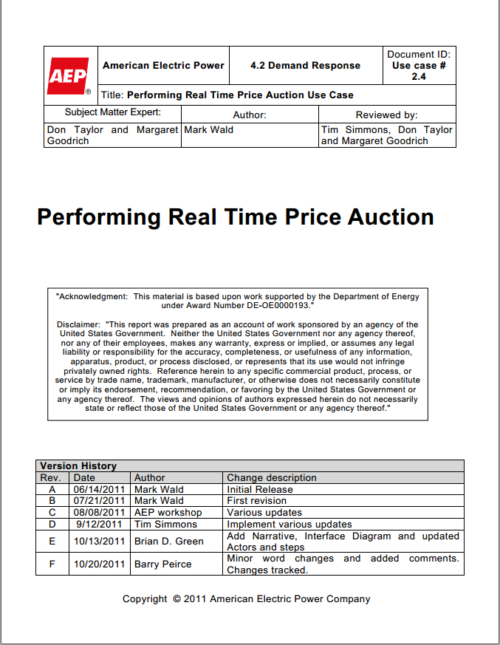
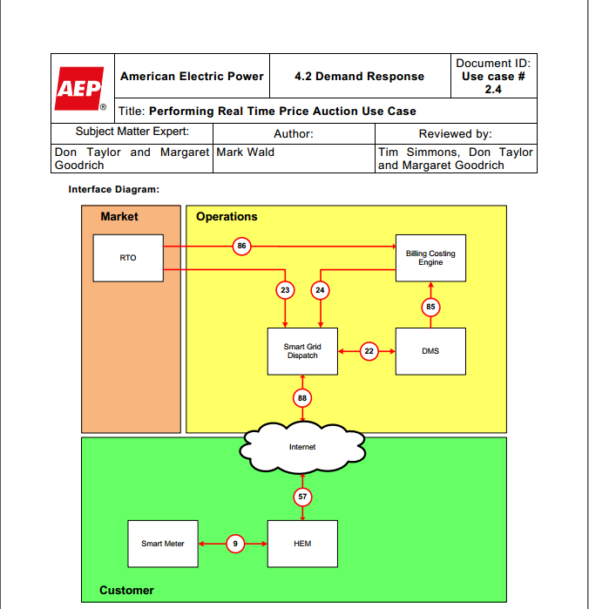
Mapping Use Case Terms
Let’s look at this term
2016 Copyright © SGIP, Inc. CONFIDENTIAL. ALL RIGHTS RESERVED Page 17

Slide 18
The HEM in the AEP/EPRI use case
HEM stands for “Home Energy Management System”
What does that really mean?
Home Energy Management System
=
A piece of hardware and/or software
(an Actor)
…that performs a set of Services
2016 Copyright © SGIP, Inc. CONFIDENTIAL. ALL RIGHTS RESERVED Page 18

Slide 19
The HEM in the AEP/EPRI use case
A piece of hardware and/or software
(an Actor)
There are different kinds of hardware.
What kind of hardware?
There are different grades of hardware.
Sensor hardware
Industrial grade
Actuator hardware
Commercial grade
Control hardware
Residential grade
2016 Copyright © SGIP, Inc. CONFIDENTIAL. ALL RIGHTS RESERVED Page 19

Slide 20
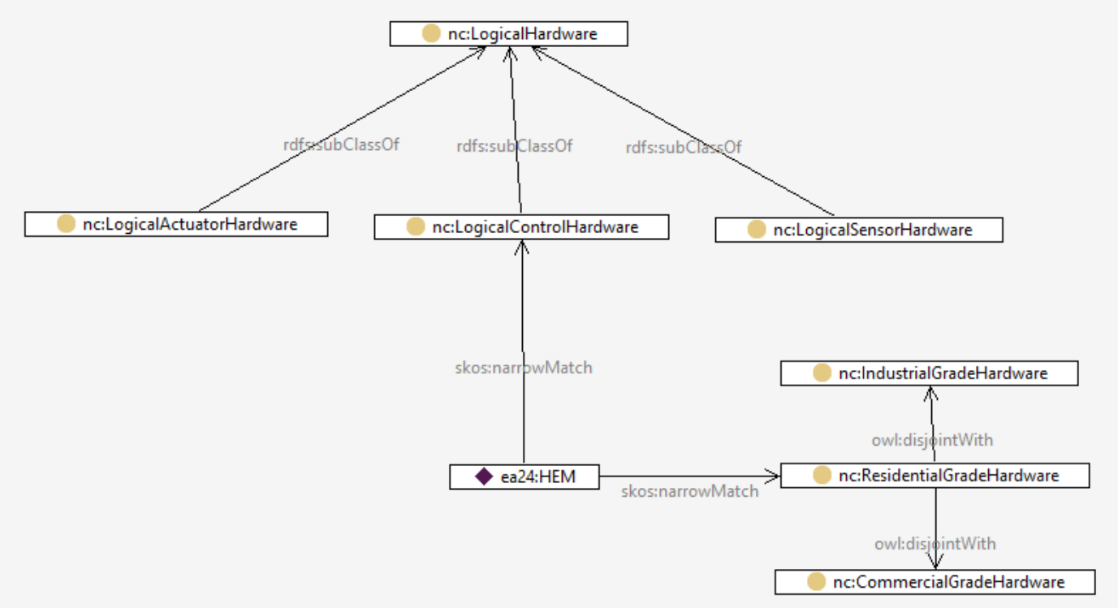
The HEM in the AEP/EPRI use case
2016 Copyright © SGIP, Inc. CONFIDENTIAL. ALL RIGHTS RESERVED Page 20

Slide 21
The HEM in the AEP/EPRI use case
OK, we have characterized the hardware.
What about the Services it performs?
Home Energy Management System
=
A piece of hardware and/or software
(an Actor)
…that performs a set of Services
2016 Copyright © SGIP, Inc. CONFIDENTIAL. ALL RIGHTS RESERVED Page 21

Slide 22
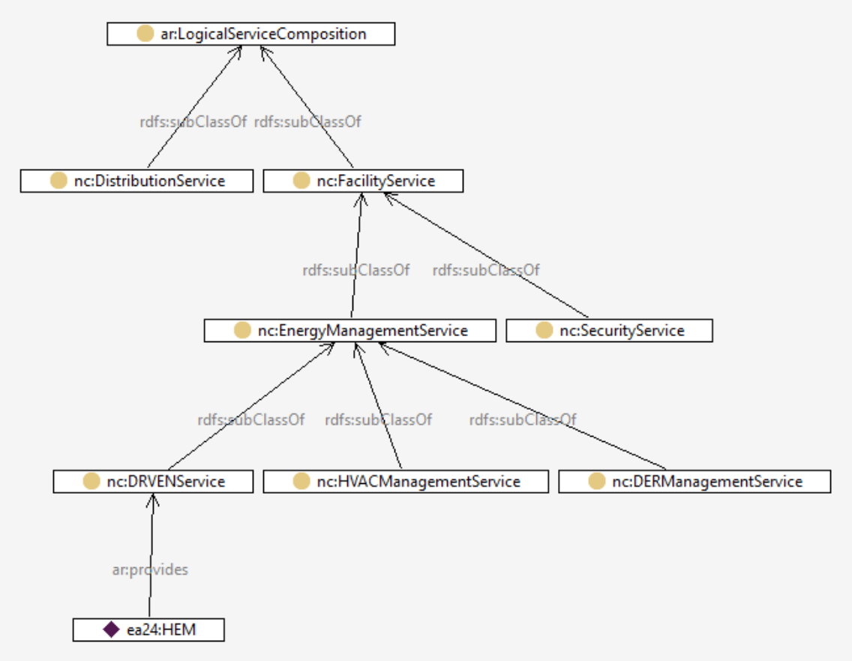
The HEM in the AEP/EPRI use case
Services
We can define a hierarchy of Services
For this DR use case, we know the HEM provides at least a DR service
2016 Copyright © SGIP, Inc. CONFIDENTIAL. ALL RIGHTS RESERVED Page 22

Slide 23
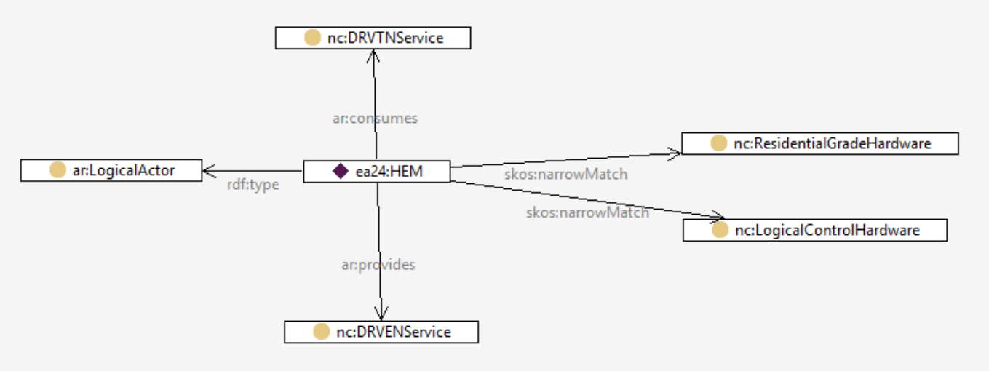
The HEM in the AEP/EPRI use case
Definition of HEM
So, a definition of the HEM in this use case might be captured as follows:
2016 Copyright © SGIP, Inc. CONFIDENTIAL. ALL RIGHTS RESERVED Page 23

Slide 24
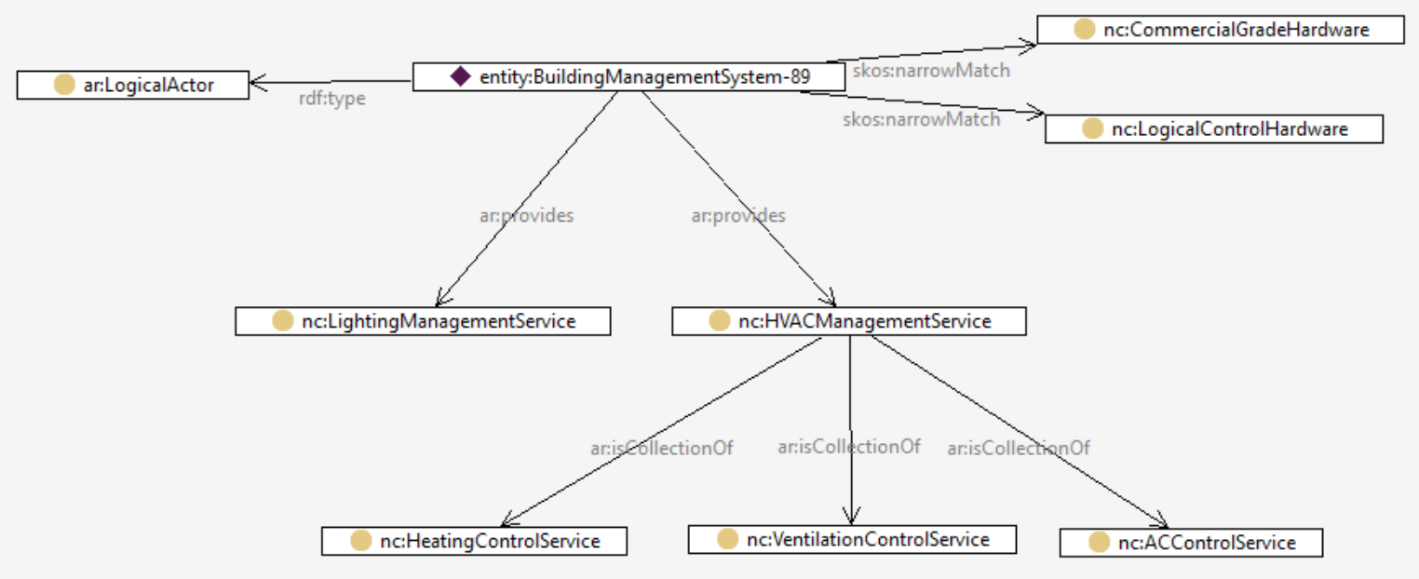
“BuildingManagementSystem”
Definition from the EU
A system consisting of several decentralized controllers and a centralized management system to monitor and control the heating, ventilation, air conditioning, light and other facilities within a building.
2016 Copyright © SGIP, Inc. CONFIDENTIAL. ALL RIGHTS RESERVED Page 24

Slide 25
“BuildingManagementSystem”
How does this help? Because if you want to interface with something that provides HVACManagementService, then you are guaranteed that it can perform HeatingControlService (for example).
2016 Copyright © SGIP, Inc. CONFIDENTIAL. ALL RIGHTS RESERVED Page 25

Slide 26
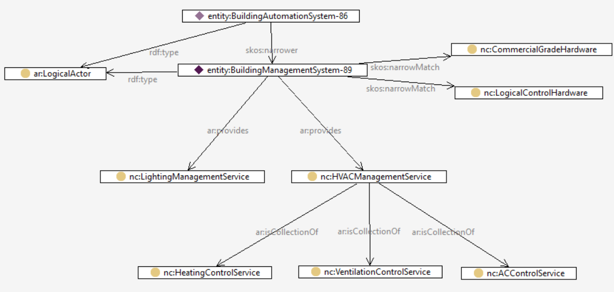
“BuildingAutomationSystem”
…and BuildingAutomationSystem can do everything BuildingManagementSystem can do because of the skos:narrower relation.
Actor (from CSWG NISTIR 7628)
Actor (from TC8 WG6)
2016 Copyright © SGIP, Inc. CONFIDENTIAL. ALL RIGHTS RESERVED Page 26

Slide 27
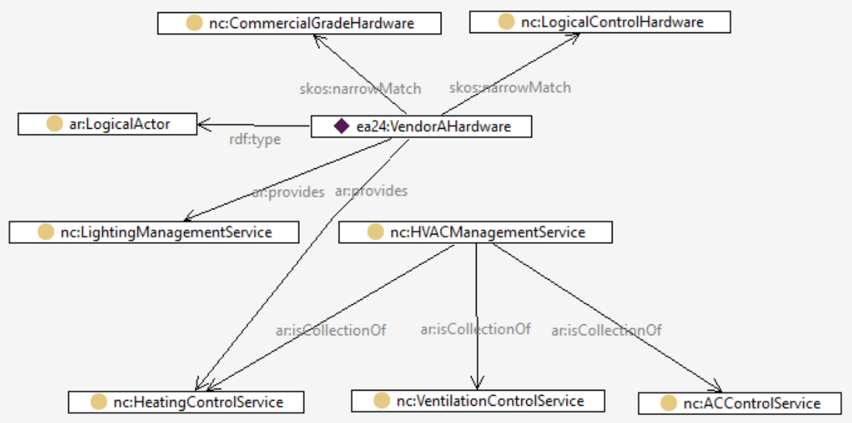
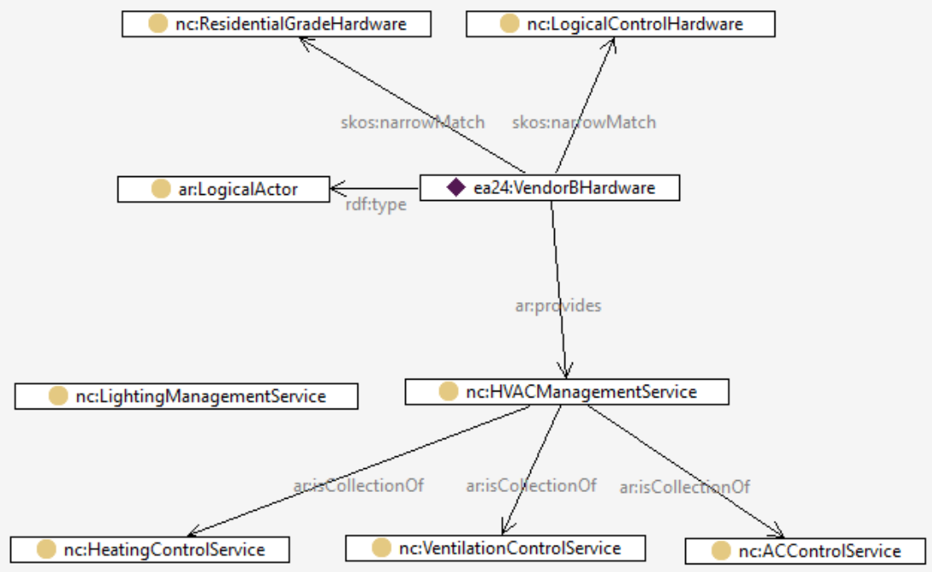
Implications
Because all this information is represented formally in a semantic language (OWL), it is possible to perform logical reasoning on it. Therefore, if we correctly categorize systems and services, we can begin to automatically identify where interoperability is possible, and where there will be problems.
Vendor B
Insert Vendor A and Vendor B
Vendor A
2016 Copyright © SGIP, Inc. CONFIDENTIAL. ALL RIGHTS RESERVED Page 27

Slide 28
Next Steps?
Let’s Talk

Slide 29

Thank you!

