Slide 1
Semantic Overview
Stephan Amsbary - EnerNex
Jay Britton - Alstom
2011.Dec.06 – SGIP F2F
Semantic Working Party

Slide 2
Agenda
Semantic Overview
  (Jay Britton & Stephan Amsbary)
  Need (why you should care)
  Example
  Intro to semantics and semantic technologies
Web semantic tool demonstration
  (Ralph Hodgson & Steve Ray)
  Converted ASHRAE SPC201P from UML to OWL
  Standard discrepancy discovery
  Query capabilities
Next Step Proposal and discussion

Slide 3
Background
Standards are developed in functional silos
Each model represents attributes unique for that standard’s function
Ancillary functions are either not addressed or they are described in light of anticipated future use within the functional perspective of that group
They use different methods to describe their model
Little or no coordination with other standard bodies

Slide 4
Background (Continued)
Needs to be solved
Relationships between models are not understood – or worse interpreted incorrectly
Depth: Many standards are still developing – therefore, many aspects of a model are incomplete or described more fully by another organization (see next)
Duplication: Standards describe their environment using a model, different models quite often describe identical or similar concepts
Contradiction: sometimes a model’s concept describes elements that contradict how another model addresses it

Slide 5
Implications
Consequences
Standards take longer to evolve because a SDO group does not understand or unaware of similar work in other standards/SDO
Functional gaps amongst standards are not understood or seen
Relationships amongst standards are not realized – model harmonization is cumbersome at best
Maintaining currency amongst standards does not exist

Slide 6
Implications (Continued)
Solution
Apply a common semantic method to document each standard’s elements – this defines an unambiguous definition of a standard’s elements relationships to one another
Result
Identify identical element across the standards
Infer relationships that are not explicitly defined amongst standards
Identify conflicts between models
Manages the complexity of emerging and evolving standards
  Accelerates development and harmonizes change
  Accelerates standards uptake and interoperability

Slide 7
Challenge
How to reconcile vocabularies, concepts and relations among all the smart grid standards?
Currently 268 standards in the SGIP Catalog of Standards
  Overlapping, different, sometimes contradictory vocabularies and definitions
We need a way to manage
  Differences
  Constraints on usage
  Relationships between vocabularies

Slide 8
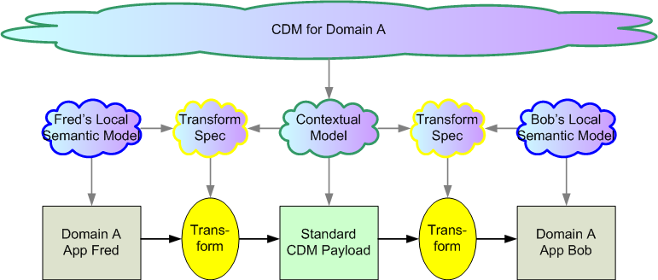
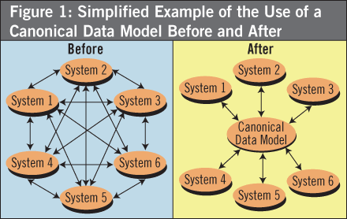
Semantic integration within a unified domain (one CDM)

Slide 9
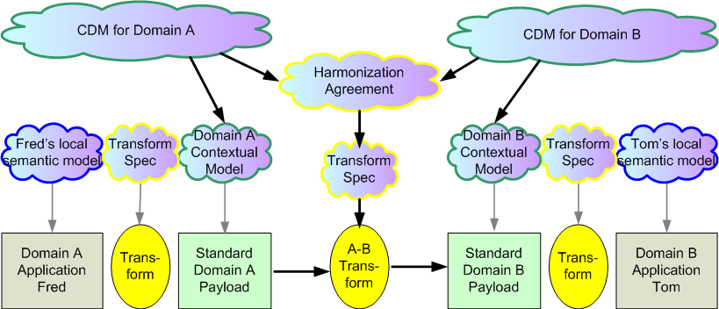
Semantic integration between harmonized domains (two CDMS)

Slide 10
Demand Response Pricing Use Case Example
Operations
SCADA/EMS
DRACS
CIM
Market
Market Management
OpenADR
Service Provider
DR Enrollment/
rules
Customer
IEC61850SEP2.0
…
Premise Automation System
Device

Slide 11
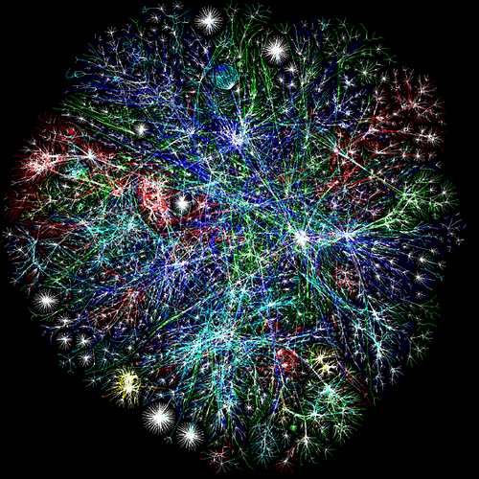
Need for a Semantic Vocabulary
Natural Language is Ambiguous
  One Reality, Multiple Views of It
  Meaning is Relative to a Perception
  Perception is Contextualization
Ambiguity can be eliminated with Contextualization
Contextualization can be defined through Relations

Slide 12
Vocabulary and Semantics
Information Challenges
Ambiguous Semantics
  Inter-domain communications
Multiple Technologies
  Consistency
Partially Known Value-Chain
  Cross Business-Unit Operational implications
Low Data Quality
  Decisions/Trust-Risk
Poor Data Specification
  Expectations
Success Factors
Well defined vocabulary and semantics
Eliminate technology dependencies/disparities
Precise Relations
Clear Expectations

Slide 13
What is Semantic Technology?
Semantic Technology allows the meaning of and associations between information to be represented precisely and, used in a run-time environment
Semantic Technology represents information in a neutral form called Triples that consist of a Subject, a Predicate and an Object. Each of these can have properties that infer new information. Each has a unique identity, enabling merging of different datasets.
Subject
Predicate
Object
Schedule
has TimePoints
CimTimePoints
CimTimePoints
has TimePeriod
TimePeriod
TimePeriod
startTime
xsd:DateTime
TimePeriod
endTime
xsd:DateTime

Slide 14
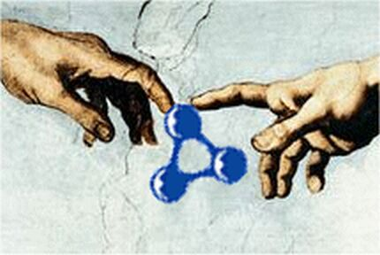
Semantic Modeling Language
Need for actionable vocabulary beyond model languages such as Universal Modeling Language (UML)
  Open Source managed by W3C a non-propriety file format
  Ontology Web Language (OWL) is more expressive than UML
Actionable
  Simple Structure
    Subject, Verb, Object (triple) which is stored in a Resource Description Framework (RDF) for access
    Triplets can be transparently merged across data sources
  Provides formal verification across diverse vocabularies
  If it’s Web addressable, its available for use
  Analysis/query (SPARQL)

Slide 15
What Problems can be Solved by Semantic Technology
Terms and relationships alignment
Generation of controlled vocabularies
Universal Identifiers are required
Aggregation of data from disparate sources
“Smart Data” - Infer new information from data
Generation of consistent (XML) Schemas
  Component-Based

Slide 16
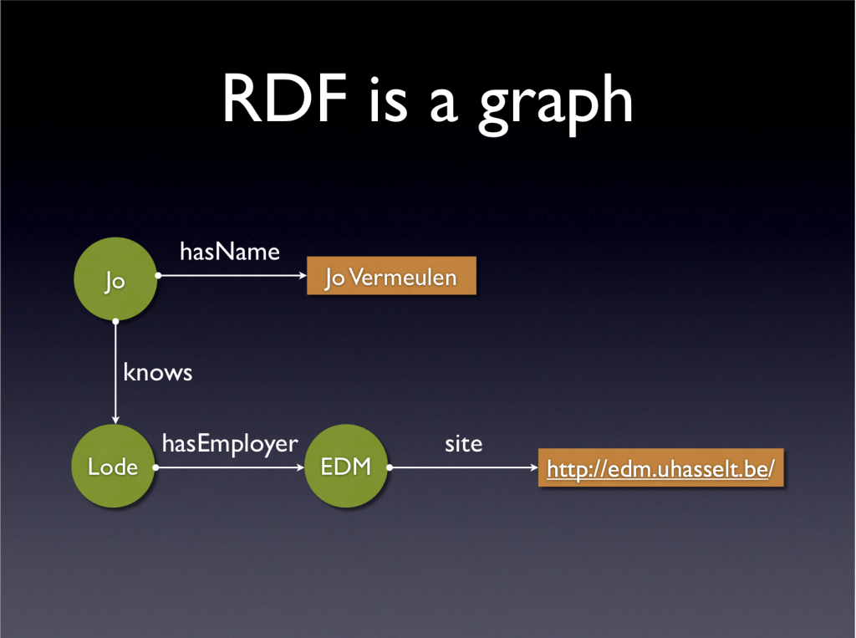
Three triplets
RDF Example
URI
as
Steve
Steve Ray
URI
URI
Steph
EnerNex
http://www.enernex.com/employees/stephan-amsbary/#!/

Slide 17
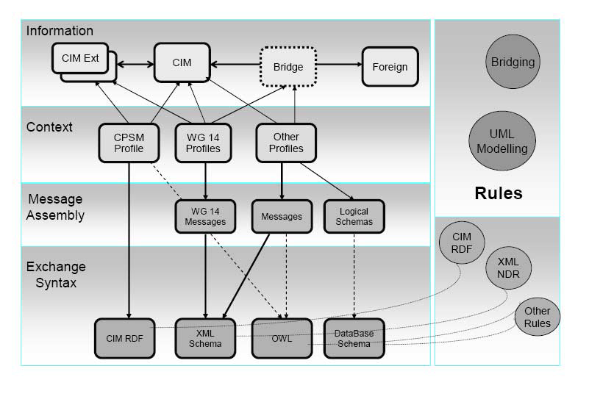
Next Generation CIM*
Names and Design Rules (NDR)
Resource Definition Framework (RDF)
Ontology Web Language (OWL)
*IEC Smart Grid Standardization Roadmap
SMB Smart Grid Strategic Group (SG3) June 2010; Edition 1.0

Slide 18
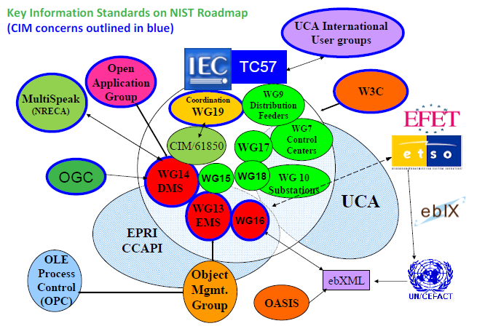

Slide 19
WEB Semantic Tool Demonstration
Roger Hodgson - TopQuadrant
Steve Ray - CMU
2011.Dec.06 – SGIP F2F
Semantic Working Party

Slide 20
Next Step Proposal
2011.Dec.06 – SGIP F2F
Semantic Working Party

Slide 21
How to proceed?
Work on a use case that is relevant (example used earlier)?
  Align vocabularies
  Capture relationships and constraints
  Create mappings among standards
  Use Web Semantic Technology to document resulting taxonomy/ontology
Translate Herb’s and Terry’s CIM/61850 harmonization's whitepaper into web semanbtics – does it make sense?

Slide 22
Methodology?
Similar to Conceptual Architecture activities
Schedule work sessions – nominated by SGAC
  SGAC lead
  Member of SDO/SDO/PAP
  Volunteers from SGIP and SGIP
Results voted upon by SGAC (and of course SDO/SSO) and entered into CoS

Slide 23

Questions
STEPHAN AMSBARY
Director, Utility Enterprise Architecture
Stephan@EnerNex.com
Phone: +1.828.559.1110
FAX: 865.218.8999
1993 Grants Mountain Rd, Marion, NC, 28752-9513
Electric Research, Engineering, and Consulting

