Slide 1
Supply Side and Demand Side
Practical Course: Smart Energy Systems Sandro Speth, Markus Zilch, Dominik Wagner

Slide 2
Weather Service

Slide 3
Weather Service
Weatherbit.io
Free online weather service
API Key needed
Two APIs for gathering weather data
Current weather: https://api.weatherbit.io/v2.0/current
Query String parameter: key, lat, lon, units (optional)
24 hours weather forecast on hourly basis: https://api.weatherbit.io/v2.0/forecast/hourly
Query String parameter: key, lat, lon, units (optional)
1000 requests per day

Slide 4
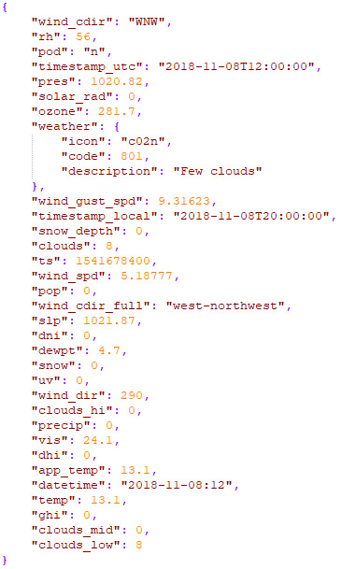

Weather Service
Weatherbit.io

Slide 5
WeatherCollector
Data used
lat: Latitute
lon: Longitute
timestamp_utc: UTC Timestamp
rh: Relative humidity in %
pres: Air pressure in mb
wind_spd: wind speed in m/s
temp: Temperature in Celsius
ghi: Global horizontal solar irradiance in W/m^2

Slide 6
WeatherCollector
Two HTTP REST endpoints
Create new WeatherCollector object by location
Path: POST /weathercollectors
Body as application/json: { "lat" : <lat>, "lon" : <lon> }
Response as application/json: { "lat": <lat>, "lon": <lon>, "id": <id> }
Response status code: 201, 400
Delete WeatherCollector object of given location
Path: DELETE /weathercollectors
Body as application/json: { "id": <id> }
Response status codes: 200, 400

Slide 7
Energy generation

Slide 8
Windturbine

Slide 9
Windturbine
Energy produced:
0.5 * areaSwept * moistAirDensity * windSpeed^3 * efficiencyCoefficient
Area swept:
r^2 * PI
Windspeed and efficiencyCoefficient :
User Input

Slide 10
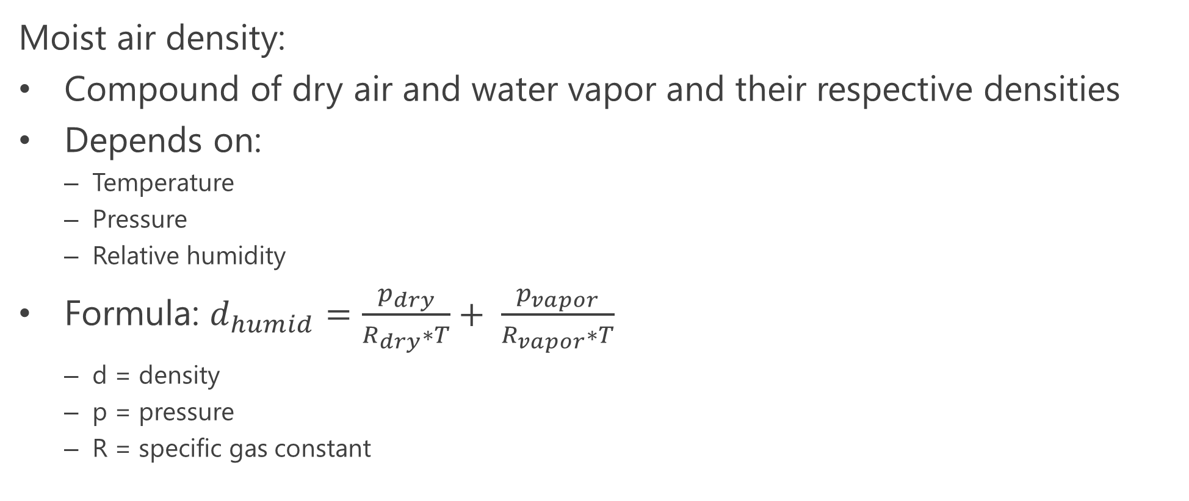
Windturbine
Moist air density:
Compound of dry air and water vapor and their respective densities
Depends on:
Temperature
Pressure
Relative humidity
Formula: $d_{humid}=\frac{p_{dry}}{R_{dry}∗T}+ \frac{p_{vapor}}{R_{vapor}∗T}$
d = density
p = pressure
R = specific gas constant

Slide 11
Windturbine
Partial pressure of dry air and water vapor:
Total pressure -> Partial pressure of dry air + partial pressure of water vapor
Partial vapor pressure computable with the formula:
Relative humidity * saturated vapor pressure
Partial dry air pressure:
Measured air pressure – partial vapor pressure
Saturated vapor pressure:
=> Herman Wobus equation, only depends on the Temperature and a lot of constants

Slide 12
Photovoltaic

Slide 13
Photovoltaic
Energy generated:
module area * solar panel yield * performance ratio * solar radiation incident
User inputs:
Module area and Watt peak
Depends on:
Temperature
Solar radiation
Day of the year

Slide 14
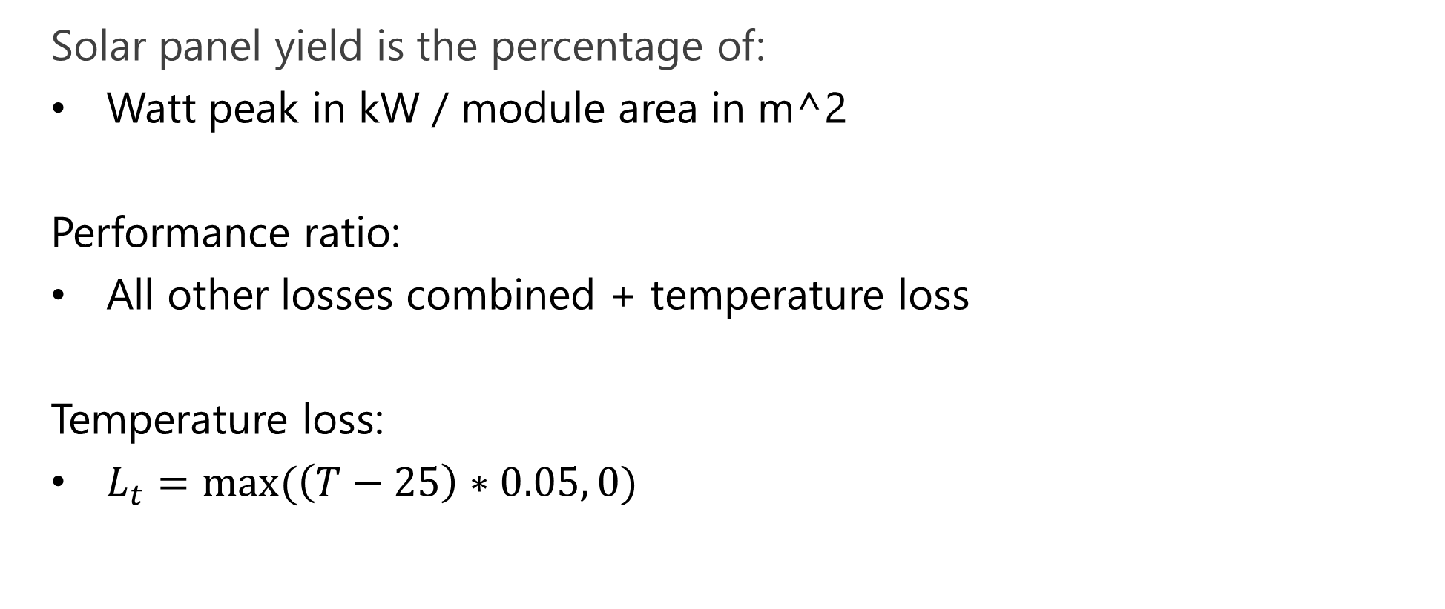
Photovoltaic
Solar panel yield is the percentage of:
Watt peak in kW / module area in m^2
Performance ratio:
All other losses combined + temperature loss
Temperature loss:
$L_{t}=max⁡(\left(T−25\right)∗0.05, 0)$

Slide 15
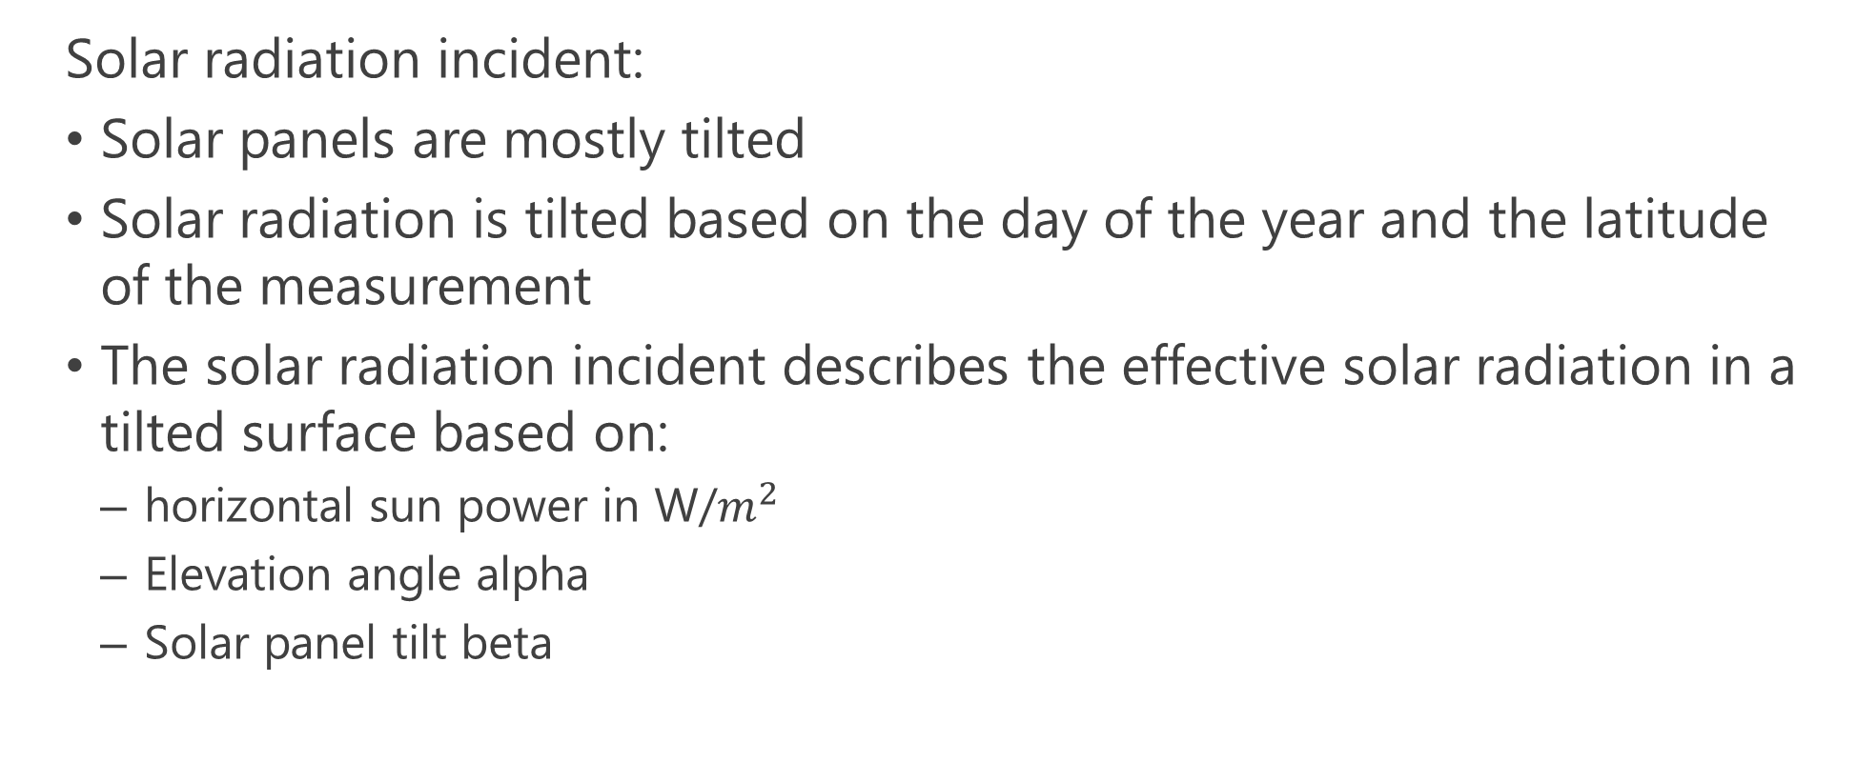
Photovoltaic
Solar radiation incident:
Solar panels are mostly tilted
Solar radiation is tilted based on the day of the year and the latitude of the measurement
The solar radiation incident describes the effective solar radiation in a tilted surface based on:
horizontal sun power in W/$m^{2}$
Elevation angle alpha
Solar panel tilt beta

Slide 16
Photovoltaic
Elevation angle alpha:
90 – latitude of panel + delta
Declination angle delta:
23.45 * sin(360/365 * (284 * day of the year))
To get the solar radiation incident the following equation can be used:
Horizontal sunpower * (sin(alpha*beta)/sin(alpha))

Slide 17
Battery

Slide 18
Battery
For the battery we set the interval for charging and discharging to one hour.
The equation given in the slides therefore becomes easier.
The equation in the implementation uses max and min functionalities to ensure the constraints of the battery as defined in the slides hold true.

Slide 19
Demand side

Slide 20
Demand side
For the demand model we implemented 2 different profiles:
normal consumers
commercial consumers
For both we calculated the power demand per m² based on the hour of the day.
To get the power demand of a specified consumer type one therefore only must specify the area, the occupation (between 1 and 0) and the hour of the day:
Consumption[h] * area * occupation

Slide 21
Home

Slide 22
Office building

Slide 23
Demo

