Slide 1
SMART HEALTH CONSULTATION
GUIDED BY
JITHA PB
Asst. Professor
CCET
PRESENTED BY
BANEE ISHAQUE K
SAFA
SAI KRISHNA K

Slide 2
ABSTRACT
Smart Health Consultation is a 24x7
online Patient-Doctor interactive System.
The user can arrange appointments with desired doctor by inputting his/her disease symptoms.
It keeps patient’s updated medical history too.

Slide 3
The SHC predicts the disease of the patient.
System also predicts a list of doctors,
specialized for respective treatments.
Schedule & location data of doctor is also shown.
Patient can choose appropriate appointment, And fix appointment via various payments.

Slide 4
INTRODUCTION
The proposed system consists of following Actors
General user area
Help system:
Video tutorials and offline documentation.
Testimonials.
Doctor’s area
Daily schedule:
Details of appointments per day.
Leave management.

Slide 5
Patient’s area
Medical data management.
Registration for treatment.
Billing.
Admin
Doctors manipulation
Suspension
Authorization
Freezing of accounts
Affiliation manipulation
Complaints management
User voice management

Slide 6
EXISTING SYSTEM
Consulting doctor is tiresome task.
In case of emergencies especially when the patient is in unknown area, finding a doctor is not easy.
Patient’s appointment may cancelled when doctor’s schedule get changed.
Time consumption in emergencies may cause harm to the patient.

Slide 7
PROPOSED SYSTEM
User need to register as a member.
Medical history should be updated.
System predicts a list of doctors as per requirements (e.g.: Orthopedic, General Physician etc)
Online appointments.
Authorized doctors

Slide 8
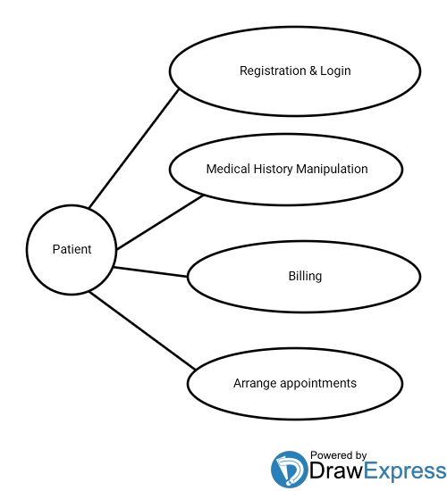
USE CASE DIAGRAM

Slide 9
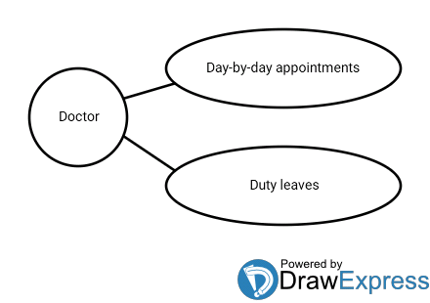
USE CASE DIAGRAM

Slide 10
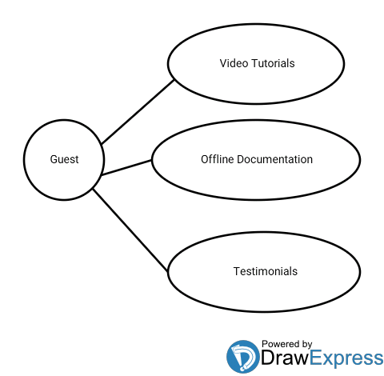
USE CASE DIAGRAM

Slide 11
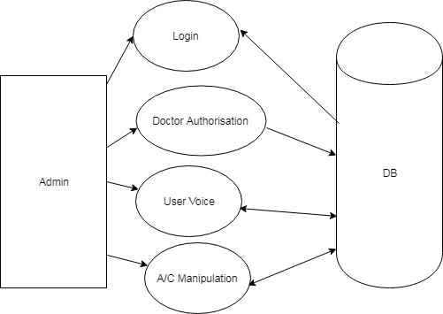
DATA FLOW DIAGRAM

Slide 12
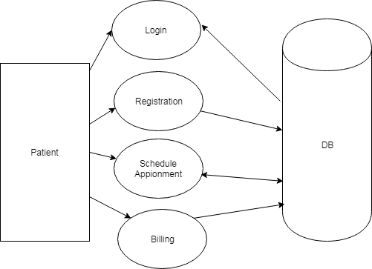
DATA FLOW DIAGRAM

Slide 13
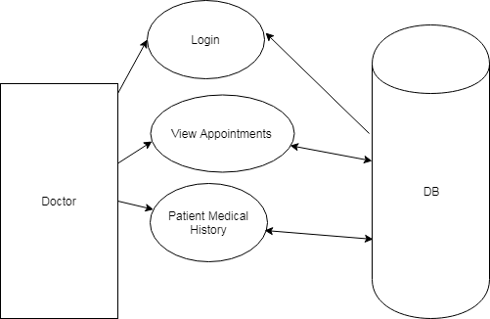
DATA FLOW DIAGRAM

Slide 14
H/W Requirements
Client Side
Android Smart Phone
Server Side
4 GB RAM
160 GB HDD
Windows 7
Keyboard & Mouse

Slide 15
S/W Requirements
Client Side
At least API 19 (KitKat)
Server Side
Python with ML Libraries (Naive - Bias)
MySQL
Google Datasets

Slide 16
COMPARISON BETWEEN EXISTING AND PROPOSED SYSTEM
EXISTING SYSTEM
PROPOSED SYSTEM
Time consuming.
Difficult to find doctors in unknown areas.
Patients are unaware if doctors schedule get changed due to lack of communication.
Fast access.
Easy to find doctors in unknown areas.
Patients are able to view and fix appointments at any time.

Slide 17
Limitations
Users must have internet connectivity
Workaround : SMS based system
USSD based system

Slide 18
CONCLUSION
The proposed system is helpful for patients to find appropriate doctors.
Simplifies the burden of patient and doctor.
This application facilitates the interaction between patient and doctor.
Optimize the work of patient and doctor.
Effortless, efficient and influential mobile app for the society.

