Slide 1

Emergency Reporting Tool
UNITGLO SOLUTIONS PVT LTD | help@unitglo.com

Slide 2
Application Security Highlights
User Login and Access
  Our webapp is flexible to run on any secure browser may it be mobile, desktop or laptop as we used SSL for secure browsing.
  Main URL is hidden using URL Re-writing technique.
  Login credentials Alphanumeric, Alphabetical (Lower Case and Upper Case), Special Characters are compulsory.
  Application does not have any type of Guest Login.
  Admin can control the system logins via activating or deactivating the users.
Data Storage
  All the data is stored on cloud servers.
  All data will be stored in SQL and File format.
  There will be two file format extensions that we use to store data.
  1) .png 2) .jpeg
  Protected data is stored using Hashing Algorithm “SHA256” or “MD5”
SQL Database Log Management
  SQL database enable standard transaction Log records. The start and end of each transaction, Every database operations like (Insert , Update, Delete , Create, Drop, Index ) Logs will be maintained in SQL database.
  Database Roll back operations are also Logged.
UNITGLO SOLUTIONS PVT LTD | help@unitglo.com

Slide 3
PHP Framework Security Highlights
URL Security
    CodeIgniter is fairly restrictive regarding which characters will be allowed in your URI strings in order to help in minimize the possibility that malicious data can be passed to your application. URI’s may only contain the following:
CSRF Protection
  CSRF stands for Cross-Site Request Forgery, which is the process of an attacker tracking their victim into unknowingly submitting a request.
  CodeIgniter provides CSRF protection out of the box, which will get automatically triggered for every non-GET HTTP request, but also needs you to create your submit forms in a certain way.
Validate Input Data
  CodeIgniter has a Form Validation Library that assists you in validating, filtering, and prepping your data.
Alpha-numeric text (Latin characters only) Tilde: ~ Percent sign: % Dot: . Colon: : | Underscore: _ Dash: - Space:
UNITGLO SOLUTIONS PVT LTD | help@unitglo.com

Slide 4
Application Environment Details
Application Server Detail
  We can use IIS server for application.
  Application can run only on secure port.
  IIS Server enabled PHP module to run our System.
Framework Details Back-End
  PHP 8.3 is a widely-used general-purpose scripting language that is especially suited for Web development and can be embedded into HTML.
  We are following CodeIgniter PHP framework standards.
Framework Details Front-End
  Using Bootstrap 5 we are design all HTML components.
  UX, We use jQuery to improve user experience.
Database
  MySQL Database
Using ODBC Driver
  PHP for SQL Server driver version 5.6.
  ODBC Driver 17+ for connecting to SQL server.
OS
  Windows 10 and above.
UNITGLO SOLUTIONS PVT LTD | help@unitglo.com

Slide 5
ALert Module Details
WebApp Activities I
  Masters
    Add, edit, delete users.
    Add, edit, delete clients.
    LMRA control as well as LMRA category control.
    Near Miss , Minor injury , Major injury Reporting and verification.
    Location master for add, update or delete region, cluster masters.
    Audit master for adding Audit templates and audit questions.
  Random Audit
    Safety Audit
      LMRA Report
        List of all LMRA reports
        User can add report by filling up a form.
      Near Miss Report
        List of all Near Miss reports
        User can add report by filling up a form.
    Other Audit
      6s Audit Report
        List of all 6s Reports with details
        User can add report by filling up a form
UNITGLO SOLUTIONS PVT LTD | help@unitglo.com

Slide 6
ALert Module Details
WebApp Activities II
  Structure Audit
    Audit template
      Shows list of all Audit templates available for all audit types like Normal, OE & HSC.
      Auditor can directly perform audit also can view the audit template.
      Filters with search options are also provided in order to check respective audit templates as per audit type.
    Normal Audit
      All the normal audits perform by auditors are displayed here.
      Auditor can perform reaudit, while all the other users can download the audit report in PDF format.
      Filters are given for audits which have no NC and with NC’s with generic search options.
    HSE Audit
      List of all audits with all necessary details are displayed here.
      Auditor can perform reaudit, while all the other users can download the audit report in PDF format.
      Filters are given for audits which have no NC and with NC’s and recommendation with generic search options.
    Reaudit
      Here the list of all old audits on who reaudit has been preformed are shown.
      Filter given to choose between Normal, OE and HSC audits for reaudit views.
      Users can download the report in PDF format for any audit.
UNITGLO SOLUTIONS PVT LTD | help@unitglo.com

Slide 7
ALert Module Details
WebApp Activities III
  OE NC Tracker
    All the nc are listed here.
    As per role the NC’s and their relevant actions are defined here.
    Firstly, there is a dependent filter for viewing NC’s from Specific region, Cluster, Location and from specific month, user other than cluster manager and WH-Manager can view all the data. Cluster manager and WH-Manger will be able to see the NC’s
UNITGLO SOLUTIONS PVT LTD | help@unitglo.com

Slide 8
Registration and Login Module
Registration
  Only admin has the right to create a login of any employee for using this application.
  Also, when a user tries to login with new credentials, his/her hardware device specification are noted at the admin panel and if the admin grants permission for specific accounts from the admin panel after that user can use the application. Until then the user can’t use the application.
  If the admin denies/deactivates the permission for specific hardware, then the user will not be able to login from that same device again till the admin activates that hardware again.
Login
  After granting the permission for specific hardware, user can login and use the application.
UNITGLO SOLUTIONS PVT LTD | help@unitglo.com

Slide 9
LMRA (Last Minute Risk Assessment) Module
Add New LMRA
  All the engineers have privileges to add LMRA report.
  The user can allocate the LMRA to his/her fellow engineer. If he/she has been allocated the LMRA, then the allocated user can chat in private with the authorized person on that issue.
Verify Reported LMRA
  Admin need to be Approved reported LMRA then it can be visible to all users.
  If admin not verify this reported LMRA, then again fill-up a new form and submit a new report.
View LMRA
  All the users in that specific zone/Area can only view LMRA reports.
  They can also share the PDF of LMRA by mail.
Comment on LMRA
  All the user in that specific zone can comment on LMRA report.
Automatic Email when High risk work and low security
  In the case of High Severity and Low (or Zero) precautions the system-generated mail will be shot to higher authority mentioning the immediate actions.
UNITGLO SOLUTIONS PVT LTD | help@unitglo.com

Slide 10
Near Miss Module
Add New Near Miss, Minor injury, Loss time injury
  All the engineers have privileges to add Near miss report.
  The user can allocate the Near miss to his/her fellow engineer. If he/she has been allocated to Near miss, then the allocated user can chat in private with the authorized person on that issue.
Verify Reported Near miss
  Admin need to be Approved reported Near miss so that it can be visible to all users.
  If admin not verify this reported Near miss then again fill-up a new form and submit a new report.
View Near miss
  All the users in that specific zone/Area can only view Near miss reports.
  They can also share the PDF of Near miss by mail.
Chat Feature on verified Near miss
  All the users are involved in this Near miss, they can chat and share images of that particular problem .
Using email share option
    User can share the report in PDF format by mail.
UNITGLO SOLUTIONS PVT LTD | help@unitglo.com

Slide 11
Report Module
LMRA Reports
  In this module, user can see all the LMRA reports from his/her zone as well as which LMRA are pending and actions taken on all the closed LMRA’s.
  User can export those reports to PDF or excel format.
Near-Miss Reports
  All the data will be represented in the form of graphs, pie-charts and vein diagrams.
  In this module, user can view all the Near-Miss reports from his/her zone as well as see the status of those reports.
  User has given privilege to get the reports in Excel and PDF as well.
Graphical Representation of data
  Abstract Near miss , LMRA , Minor Injury
  Month wise Near miss and Minor injury report.
UNITGLO SOLUTIONS PVT LTD | help@unitglo.com

Slide 12


Access control based on Role
Sr. No | Title | Higher Authority | Auditor | Cluster Manager | Account Manager
1. | Dashboard View
2. | View Audit
3. | Perform Audit/Re audit
4. | View NC
5. | Work on NC/ Submit to review
6. | Close/Reject an NC
7. | View Gemba Reports
8. | Create Gemba NC
9. | Close Gemba NC
UNITGLO SOLUTIONS PVT LTD | help@unitglo.com

Slide 13
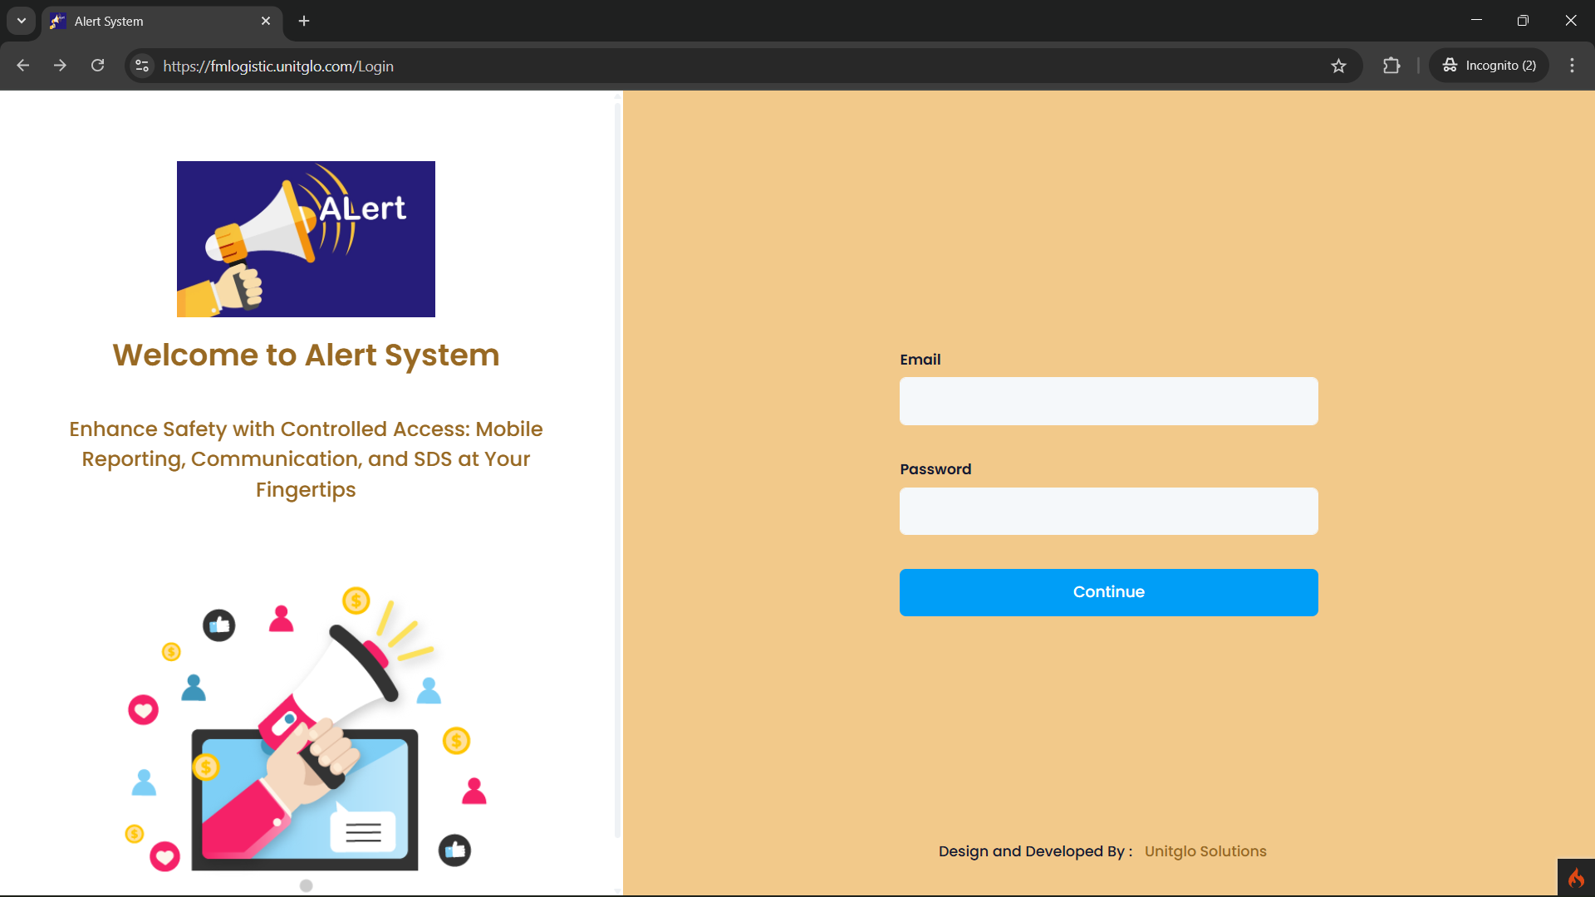
Login Screen
Login via Email and Password and click Submit
UNITGLO SOLUTIONS PVT LTD | help@unitglo.com

Slide 14
qHSE Dashboard

Slide 15
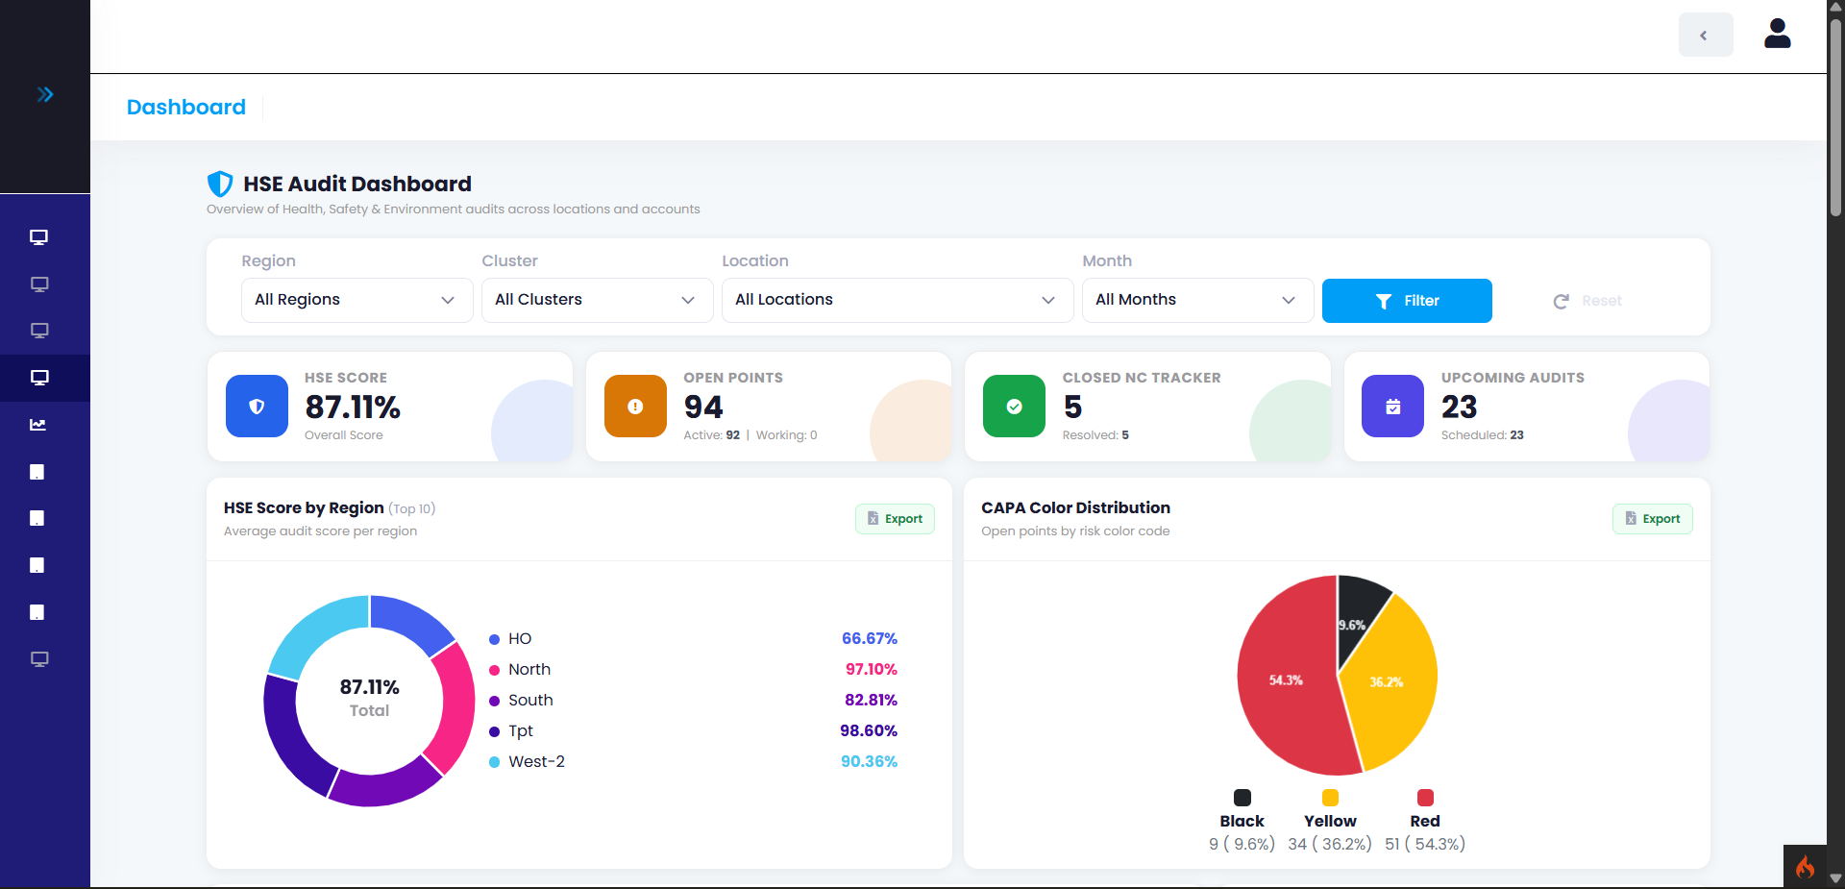
qHSE Audit Dashboard - 1
HSE Audit Filters
Brief
Summery
HSE region
wise score with
Export option
CAPA Wise point distribution with export option
UNITGLO SOLUTIONS PVT LTD | help@unitglo.com

Slide 16
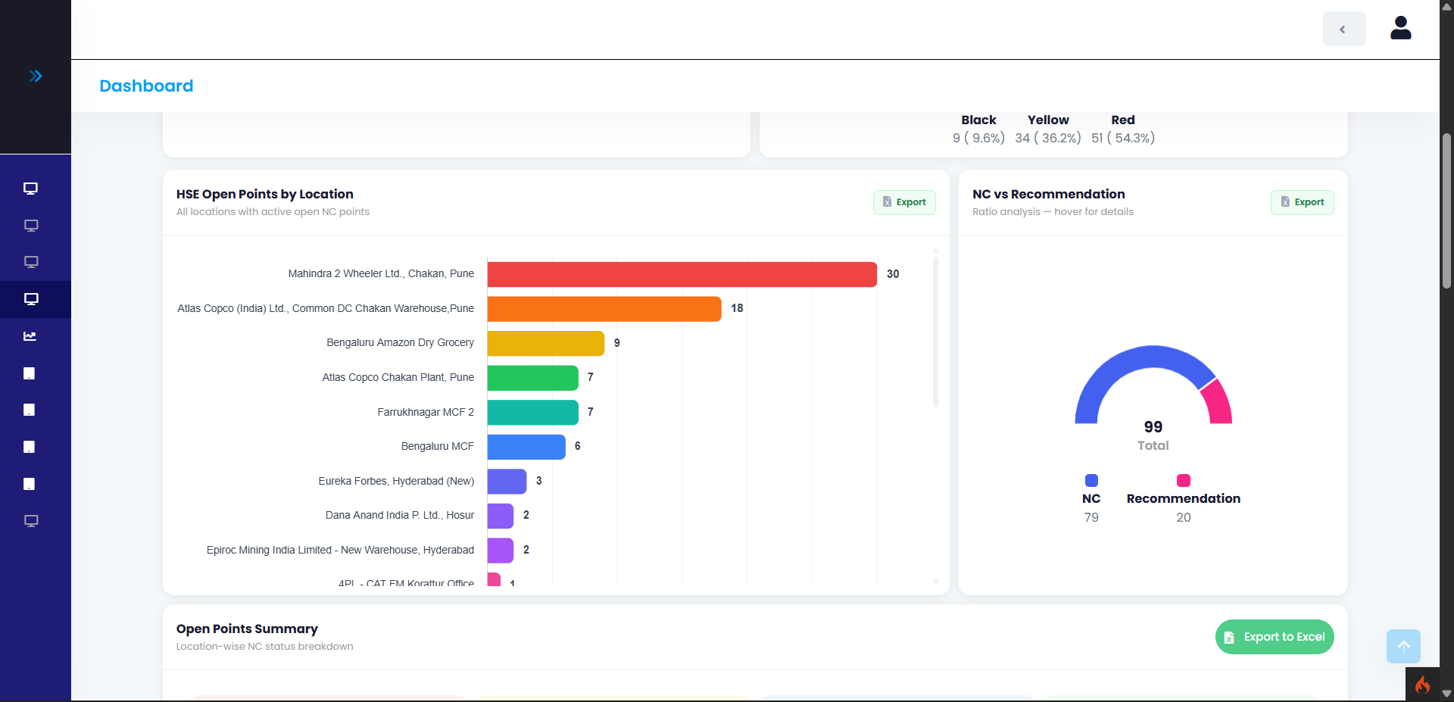
qHSE Audit Dashboard - 1
HSC Open by Location
NC vs Recommendation with export option
UNITGLO SOLUTIONS PVT LTD | help@unitglo.com

Slide 17
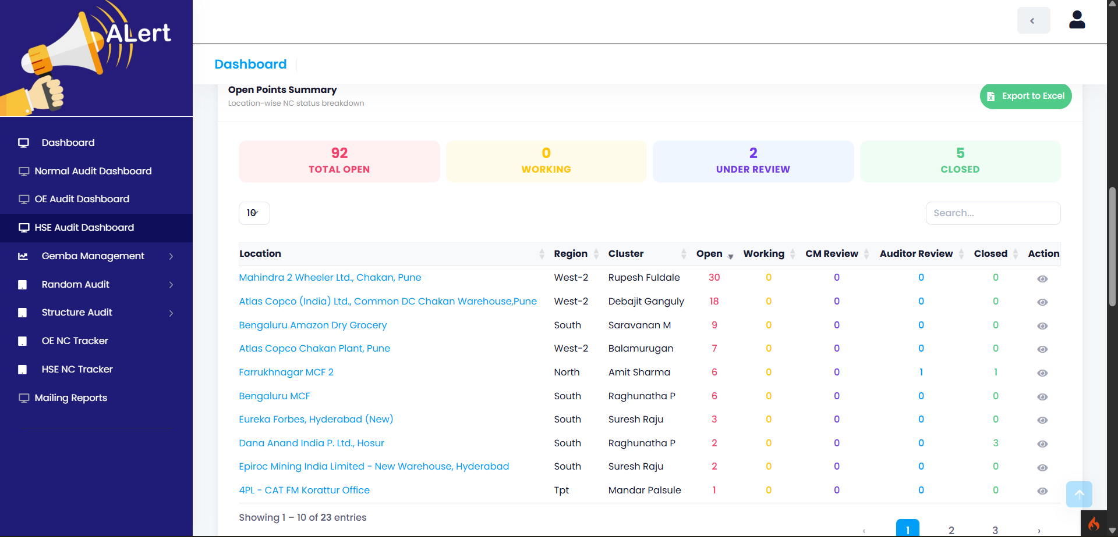
HSE Audit Dashboard - 3
Export
to Excel
Open Point Summary with Accounts and point
Active
Tab
UNITGLO SOLUTIONS PVT LTD | help@unitglo.com

Slide 18
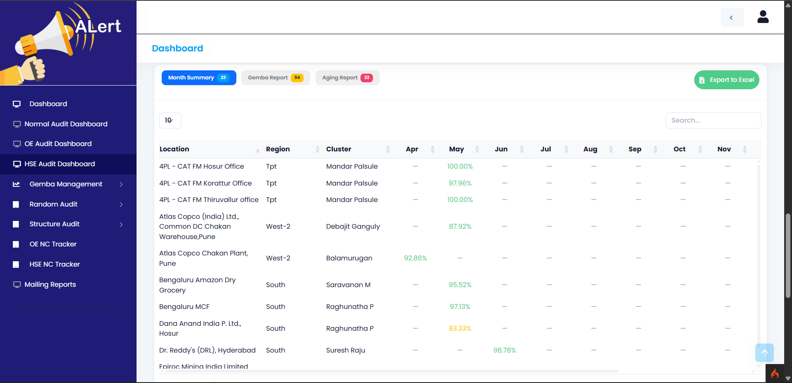
qHSE Audit Dashboard -3
Option to Switch
between
type of report
Month Summary with Accounts
Export
to Excel
Active
Tab
UNITGLO SOLUTIONS PVT LTD | help@unitglo.com

Slide 19
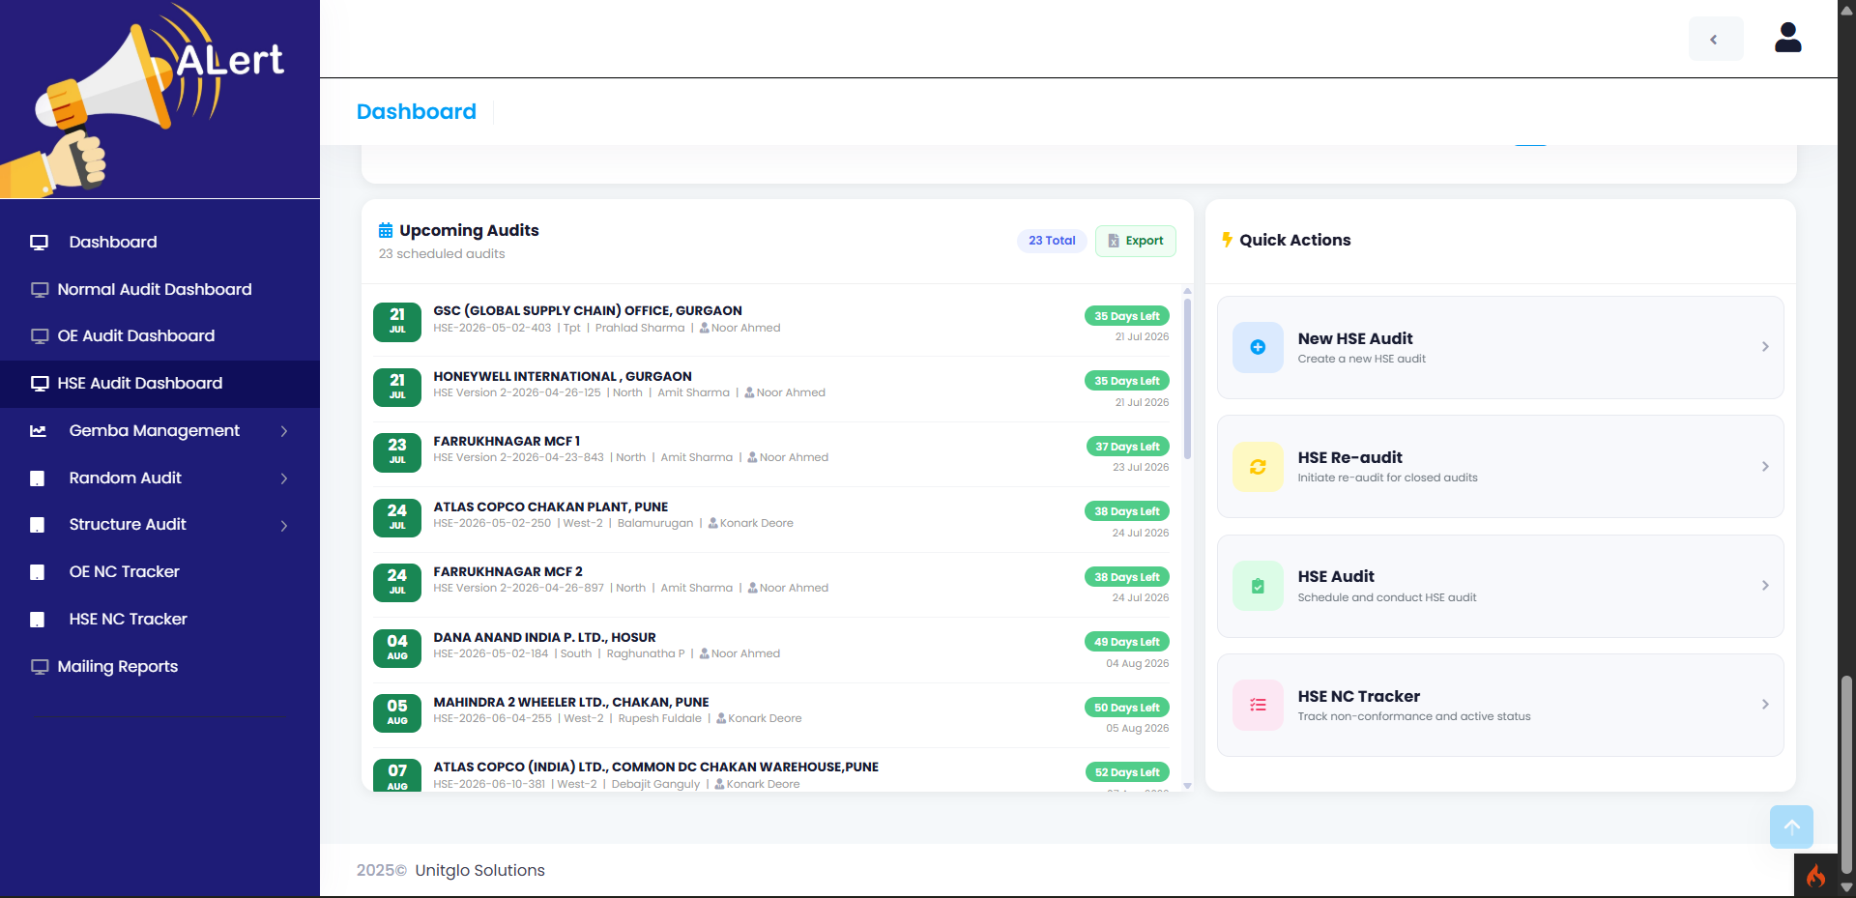
HSE Audit Dashboard - 4
Upcoming Audits with export option
Quick Actions
Active
Tab
UNITGLO SOLUTIONS PVT LTD | help@unitglo.com

Slide 20
qHSE Audit

Slide 21
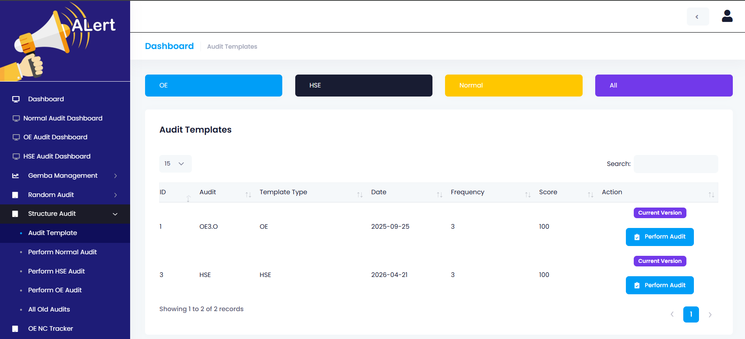
Structure Audit -> HSE Audit Template
Filter for Audit Template Categories
All Audit Templates
Perform a New Audit From Here
Audit Template
UNITGLO SOLUTIONS PVT LTD | help@unitglo.com

Slide 22
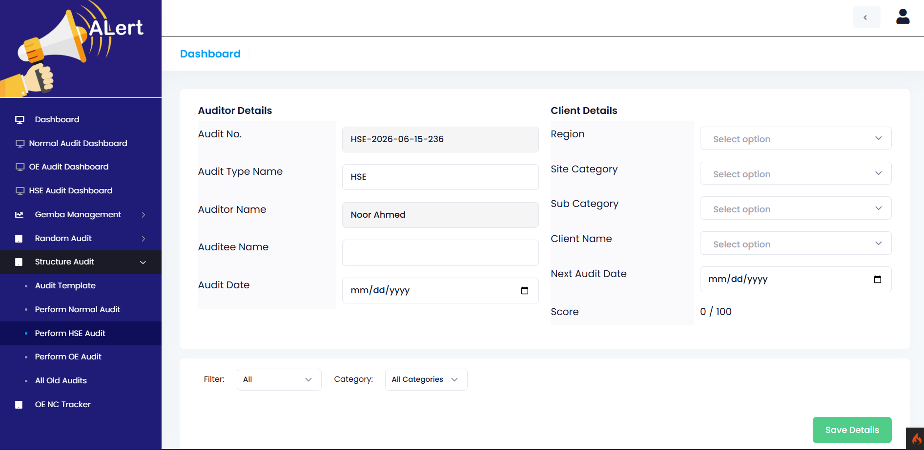
Structure Audit -> Perform Audit Part 1
Select the clients' details from here
Enter Auditee Name here, Like account Manager or cluster Managers also select Audit date
Live Audit Score Here
UNITGLO SOLUTIONS PVT LTD | help@unitglo.com

Slide 23
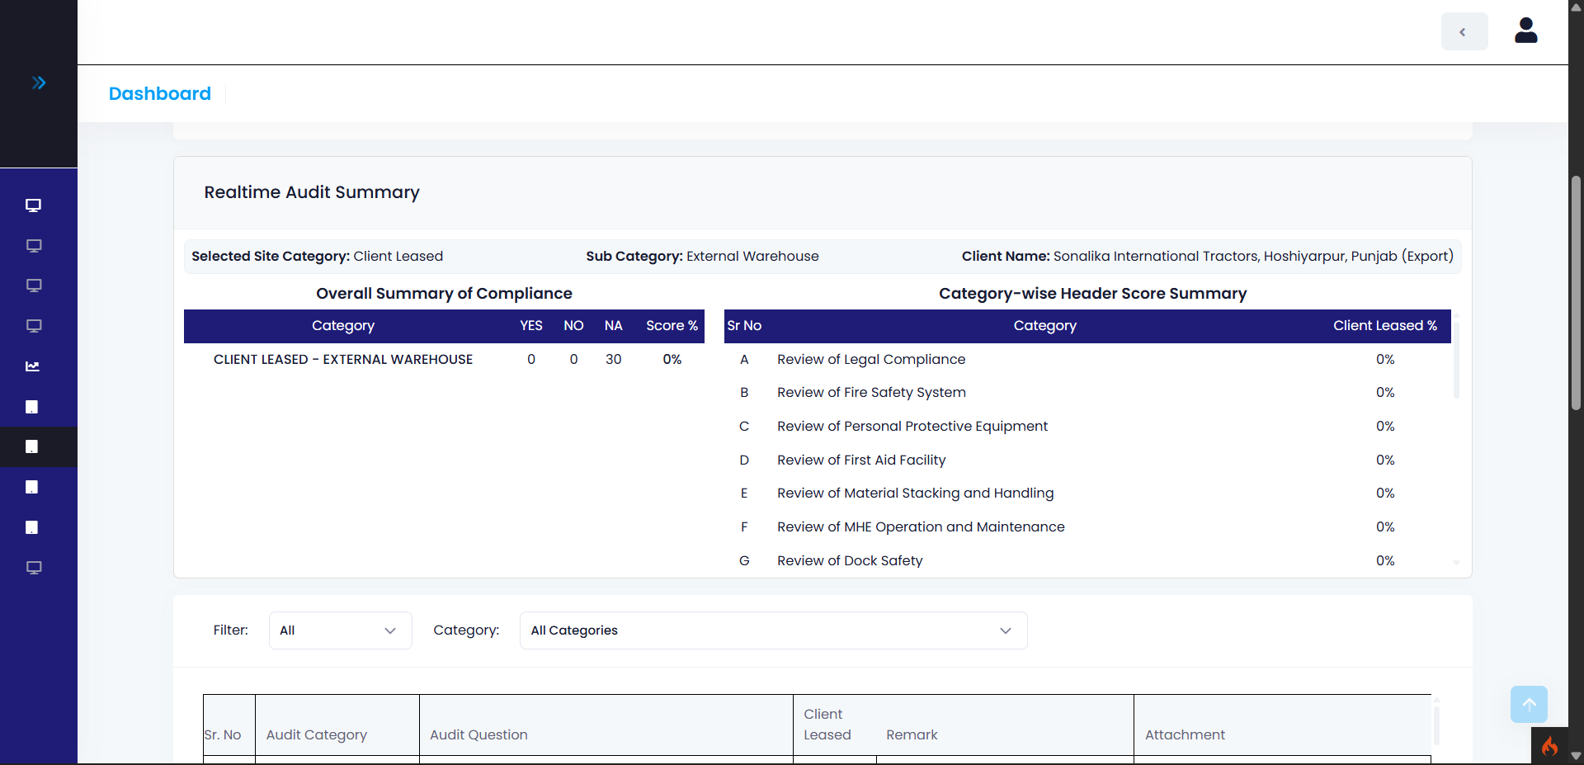
Structure Audit -> Perform Audit Part 2
Client Details
Category wise
summery
Overall Summery
UNITGLO SOLUTIONS PVT LTD | help@unitglo.com

Slide 24
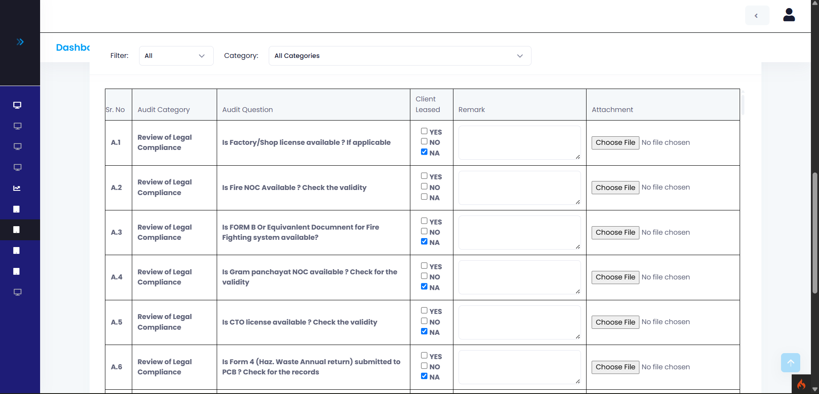
Structure Audit -> Perform Audit Part 3
Category and Selection wise filter
Option to Mark
Yes/No/NA
Audit Category and
Questions
Add attachment
for a point from here
Can add remark here
UNITGLO SOLUTIONS PVT LTD | help@unitglo.com

Slide 25
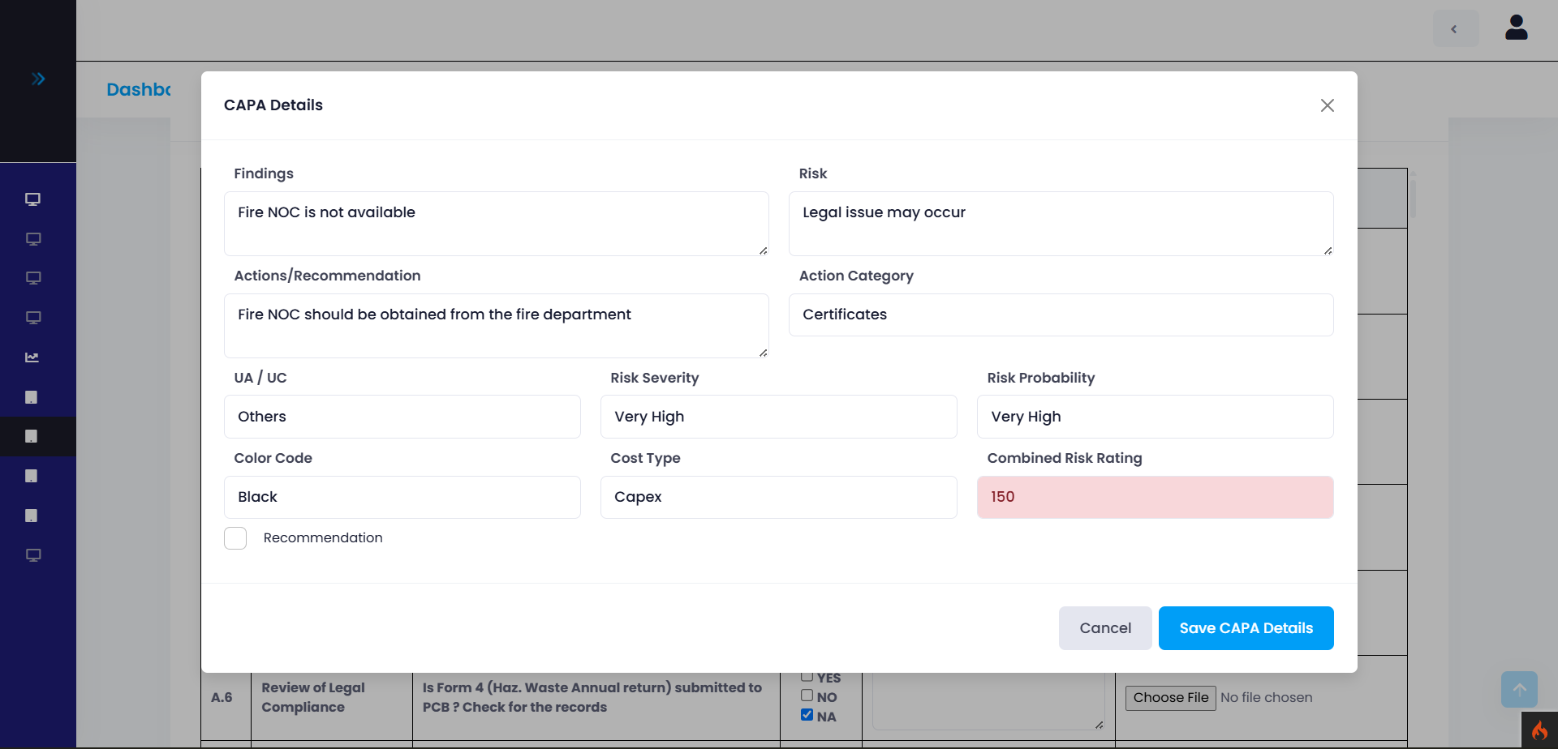
Structure Audit -> Perform Audit Part 4
On click of No for any point, the CAPA information can be edited from here
Can mark as recommendation from here
UNITGLO SOLUTIONS PVT LTD | help@unitglo.com

Slide 26
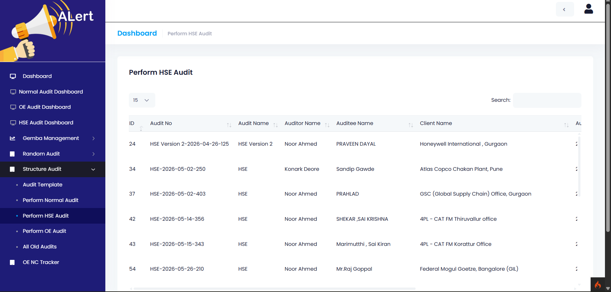
Structure Audit -> HSE Audit 1
In this list only the latest audit will be shown
Order Filter for
each column
OE Audit Data
Search Option
HSE
Audit
UNITGLO SOLUTIONS PVT LTD | help@unitglo.com

Slide 27
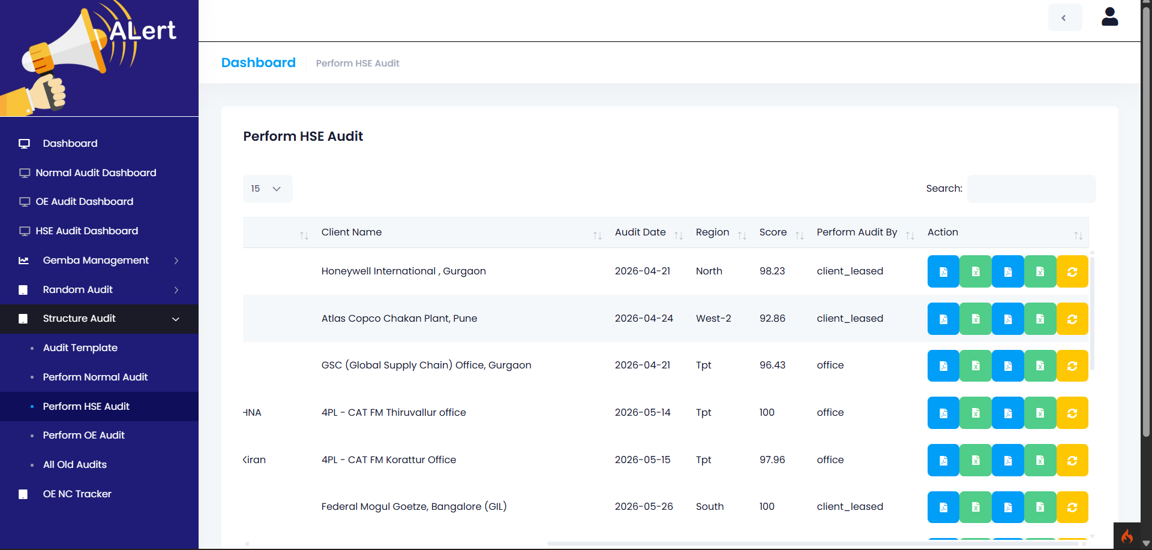
Structure Audit -> HSE Audit 2
Download CAPA report In PDF and excel
HSE Audit Data
Download Normal and
Autogrid In PDF and excel
Perform Reaudit
HSE
Audit
UNITGLO SOLUTIONS PVT LTD | help@unitglo.com

Slide 28
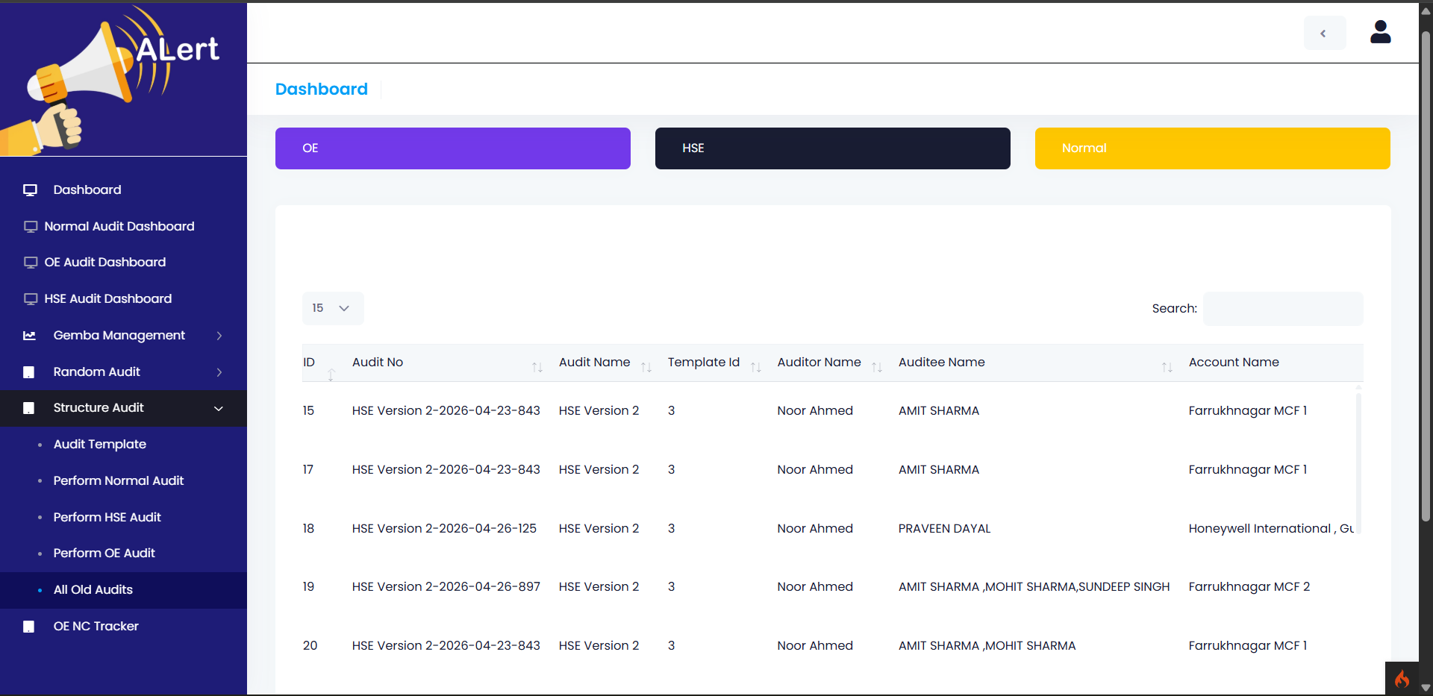
Structure Audit -> Old HSE audit 1
All the old audits will be here
Filter for audit types
HSE Audit Data
Old
Audit
UNITGLO SOLUTIONS PVT LTD | help@unitglo.com

Slide 29
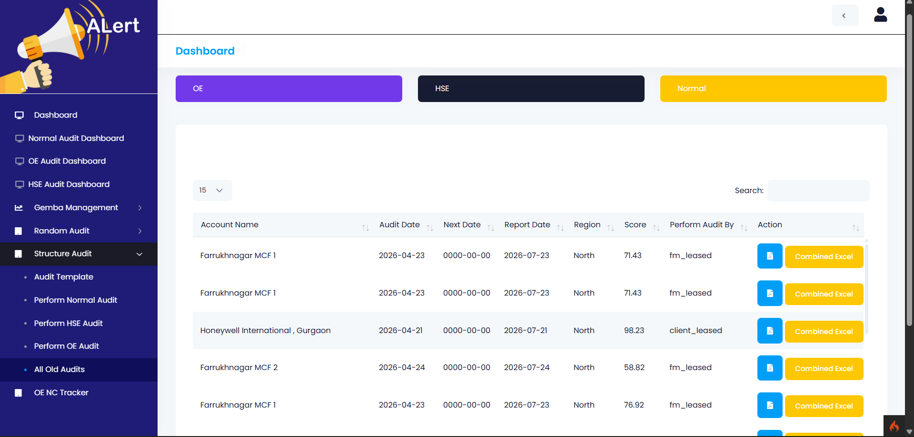
Structure Audit -> All Old HSE audit 2
All the old audits will be here
Filter for audit types
OE Audit Data
Download Combined Report
Excel & PDF
OE
Audit
UNITGLO SOLUTIONS PVT LTD | help@unitglo.com

Slide 30
qHSE NC Tracker

Slide 31
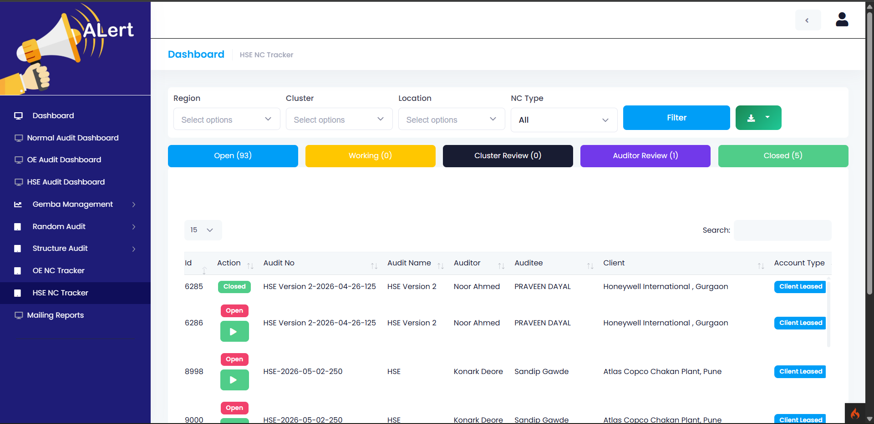
HSE NC Tracker(Open State)
Filters for region, cluster, location with NC type options, you can also choose between Open, Under Review,
working and Close NC’s
Nc current state is shown here
List of all NC’s
OE
Audit
UNITGLO SOLUTIONS PVT LTD | help@unitglo.com

Slide 32
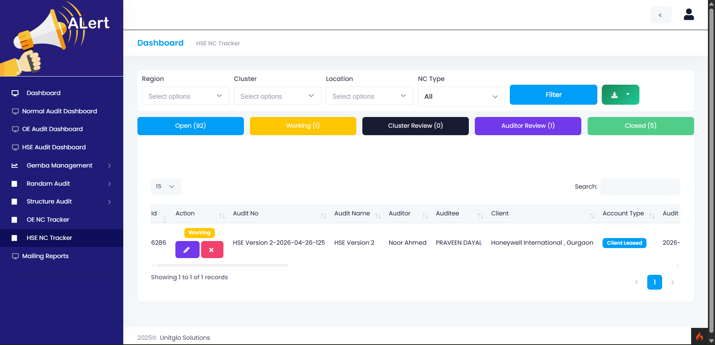
HSE NC Tracker(Working State)
Filters for region, cluster, location with month options, you can also choose between Open, Under Review,
working , Close NC’s
List of all NC’s
Nc current state is shown here
OE
Audit
Click on first icon to move to submit details for NC or reject to move again to open state
UNITGLO SOLUTIONS PVT LTD | help@unitglo.com

Slide 33
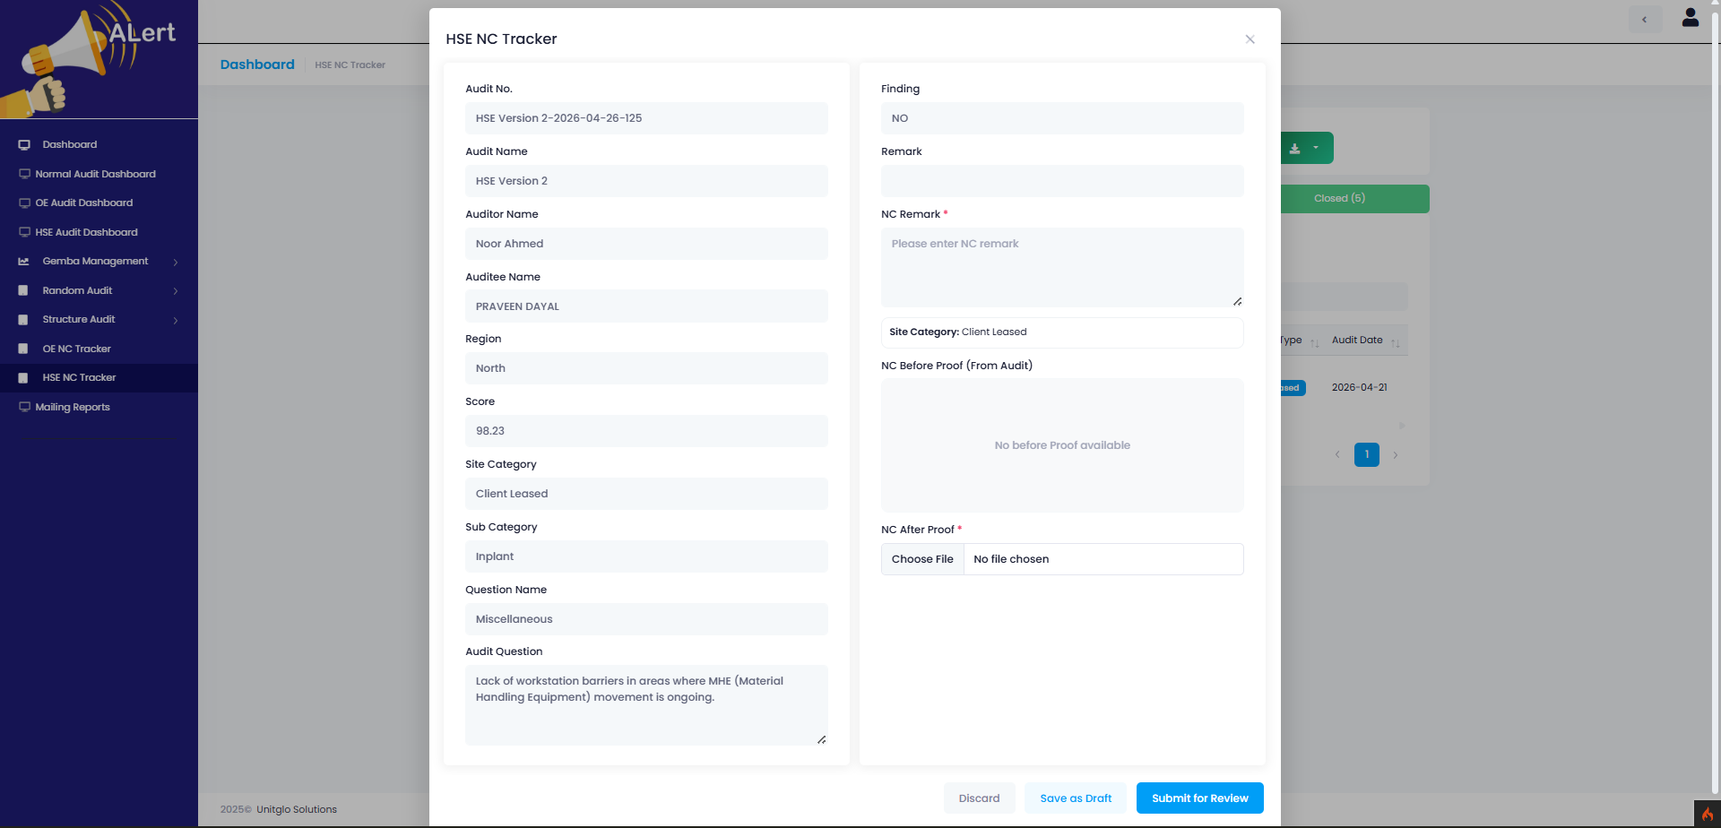
HSE NC Tracker(Submitting Stage)
All the necessary
Data is shown here
There is an option
At bottom to upload
photos
HSE
Audit
Option to discard, Save as Draft and Submit for Review
UNITGLO SOLUTIONS PVT LTD | help@unitglo.com

Slide 34
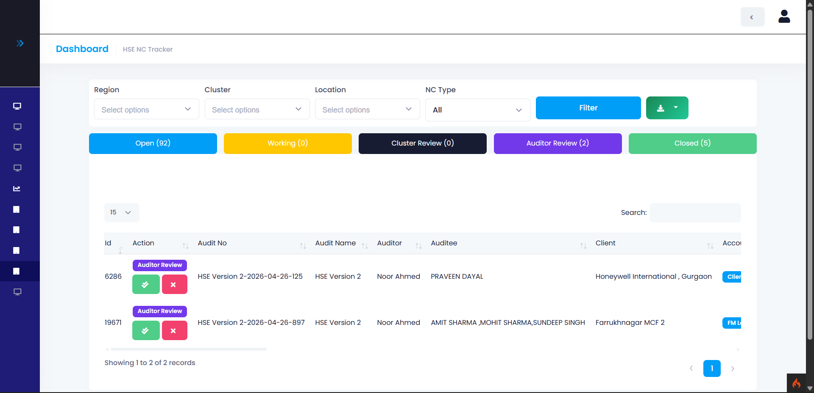
HSE NC Tracker(Review State)
Filters for region, cluster, location with month options, you can also choose between Open, Under Review,
working , Close NC’s
List of all NC’s
Nc current state is shown here
Click on first icon to move close the point (If under cluster review then will go to Auditor review instead of close)for NC or
reject to move again to open state
UNITGLO SOLUTIONS PVT LTD | help@unitglo.com

Slide 35
GEMBA
Screens

Slide 36
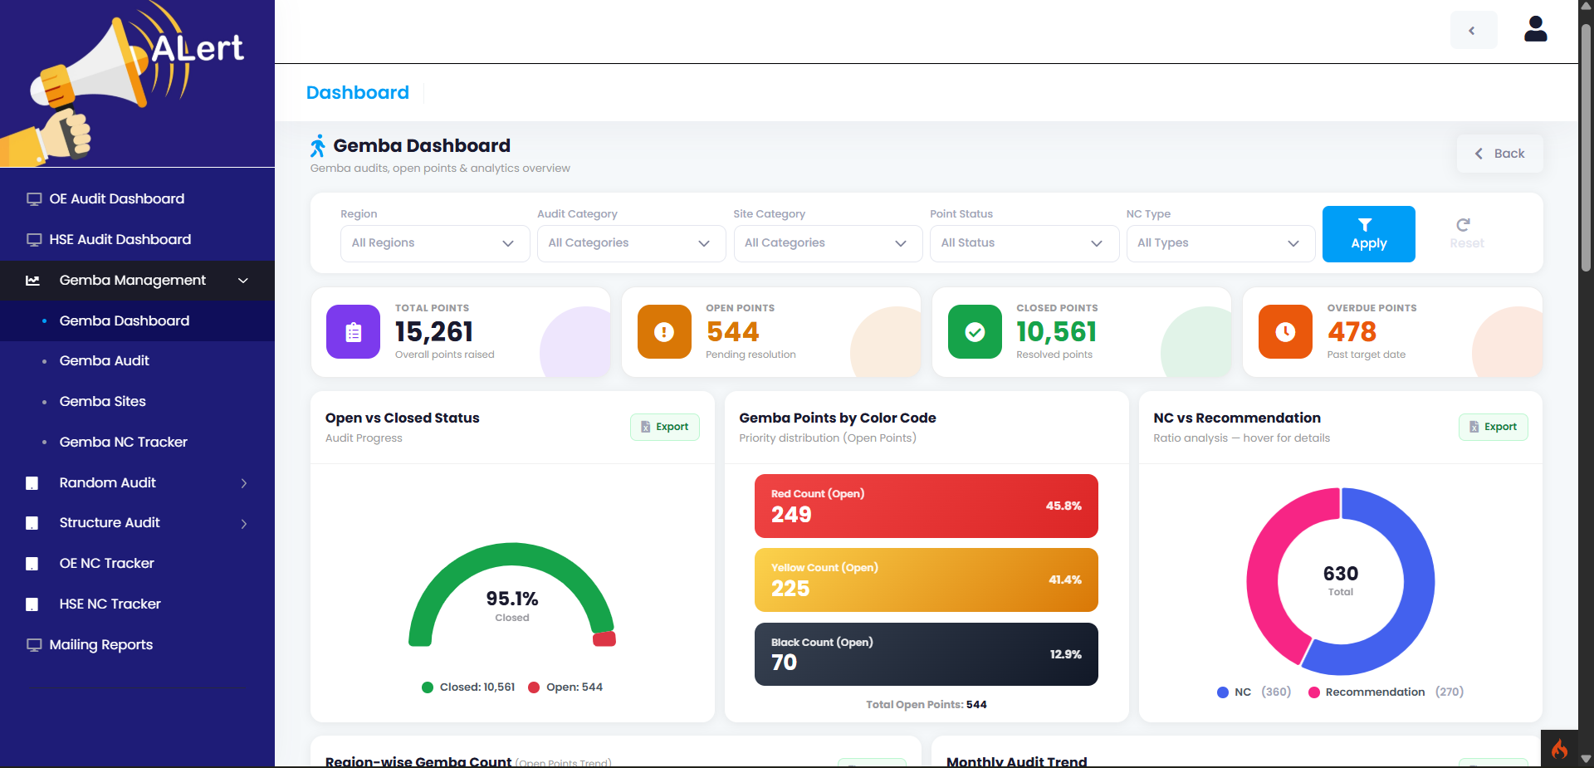
HSE Gemba Dashboard I
Gemba
Dashboard
Overall
Summery
NC vs Recommendation with export option
Open vs close Status with export option
UNITGLO SOLUTIONS PVT LTD | help@unitglo.com

Slide 37
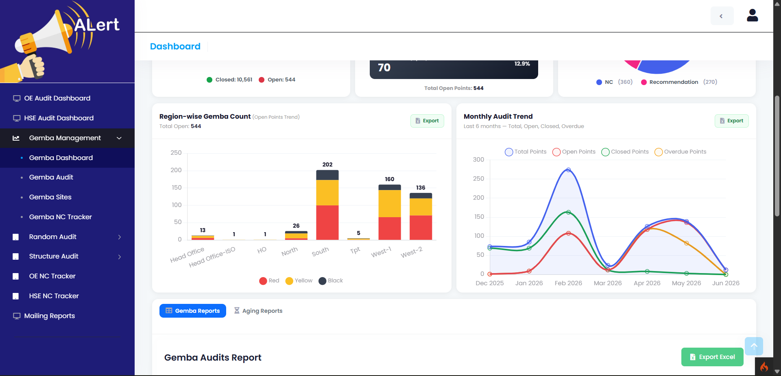
HSE Gemba Dashboard II
Gemba
Dashboard
Region wise Gemba Count with export option
Monthly Audit Line Chart
UNITGLO SOLUTIONS PVT LTD | help@unitglo.com

Slide 38
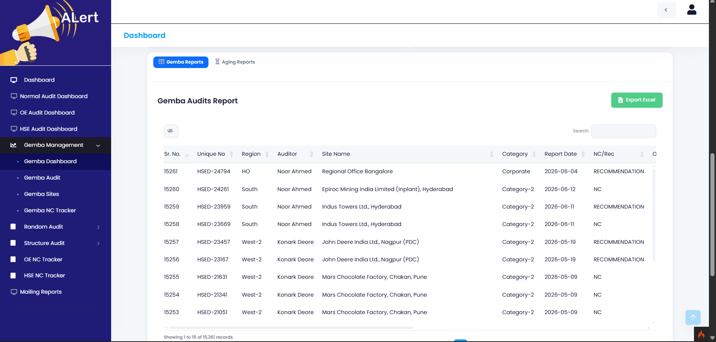
HSE Gemba Dashboard III
Type of report
Gemba Report data
Export Option
Gemba
Dashboard
UNITGLO SOLUTIONS PVT LTD | help@unitglo.com

Slide 39
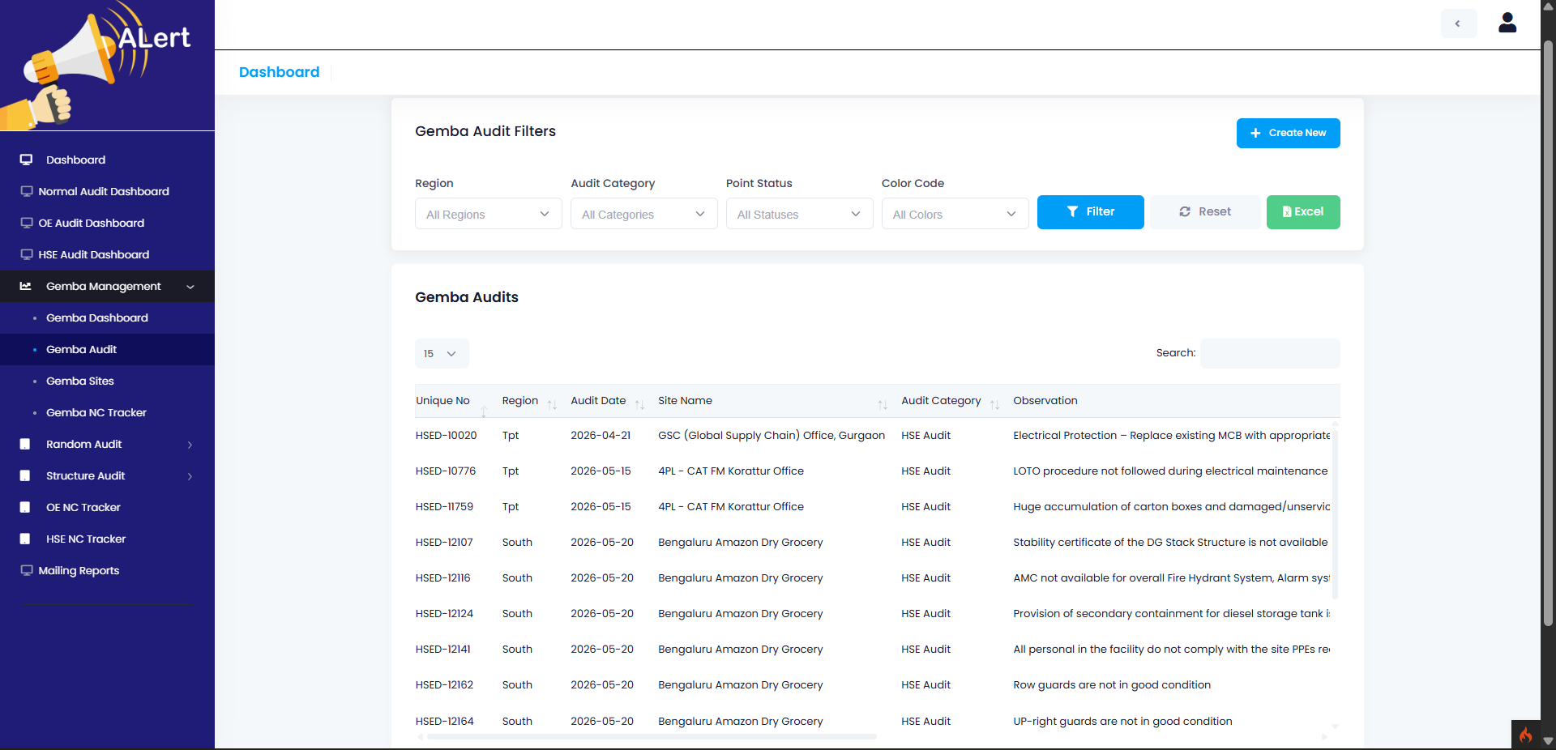
HSE Gemba Audits
Gemba Report data
Create New
Report
Filter
Export
Option
Gemba
Audit
UNITGLO SOLUTIONS PVT LTD | help@unitglo.com

Slide 40
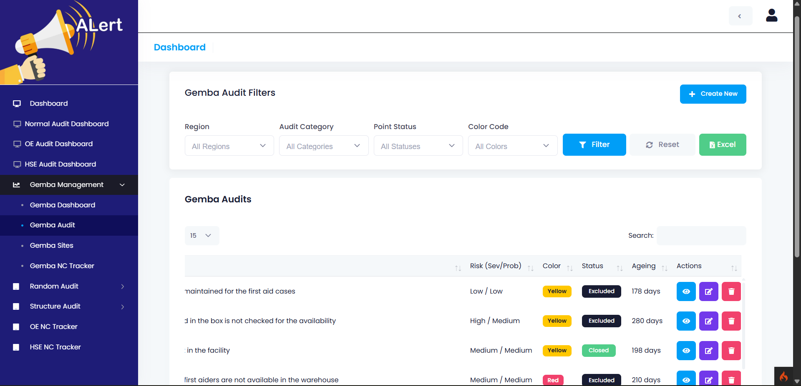
HSE Gemba Audits
Option to View, Edit and Delete the Audit
Gemba
Audit
UNITGLO SOLUTIONS PVT LTD | help@unitglo.com

Slide 41
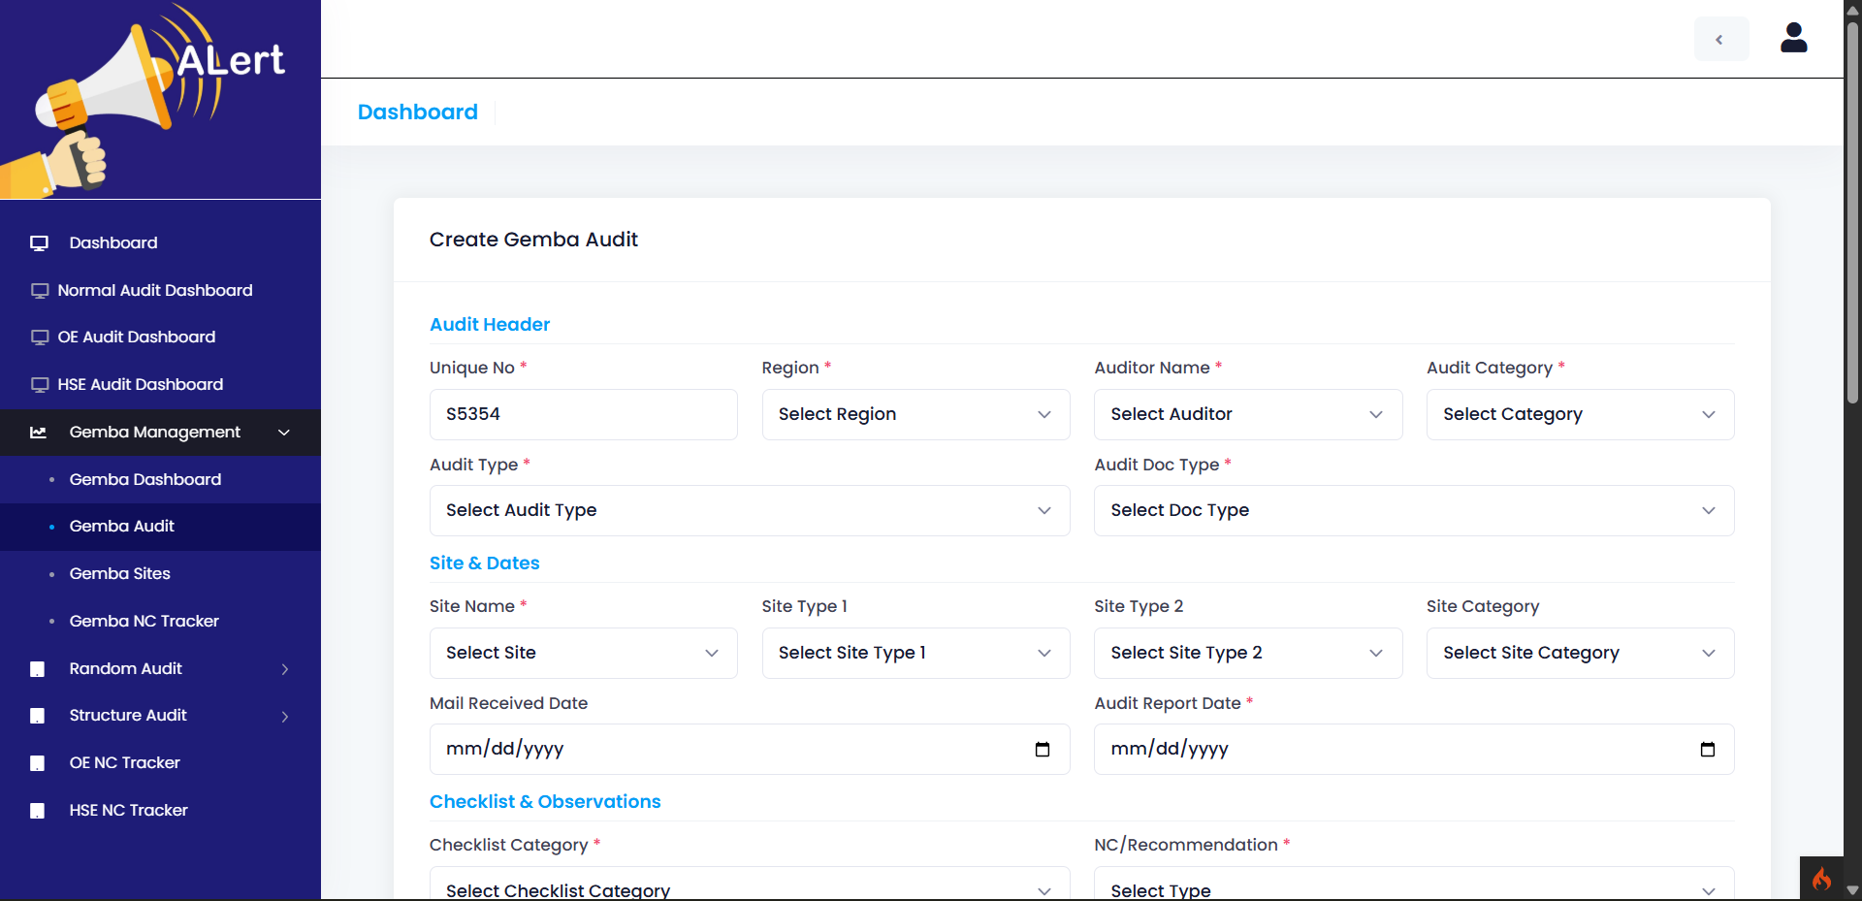
HSE Gemba Audits create audit
Create Gemba Audit
Gemba
Audit
UNITGLO SOLUTIONS PVT LTD | help@unitglo.com

Slide 42
HSE Gemba Audits create audit
Create Gemba Audit
Gemba
Audit
UNITGLO SOLUTIONS PVT LTD | help@unitglo.com

Slide 43
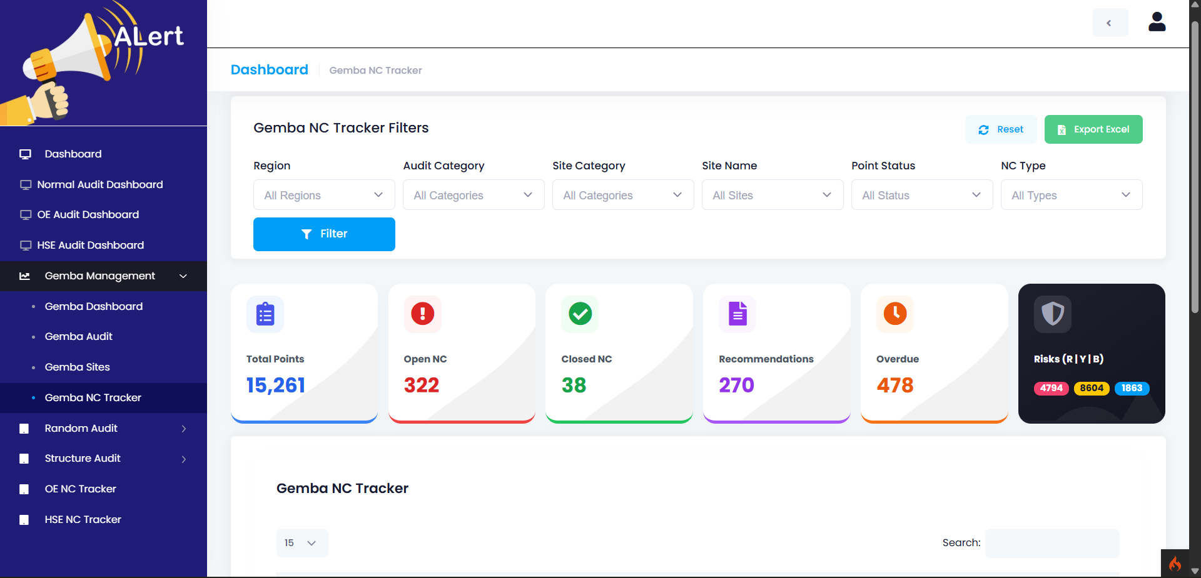
HSE Gemba Audits NC tracker
Filter for NC tracker
Gemba
Audit
Overview of Data
UNITGLO SOLUTIONS PVT LTD | help@unitglo.com

Slide 44
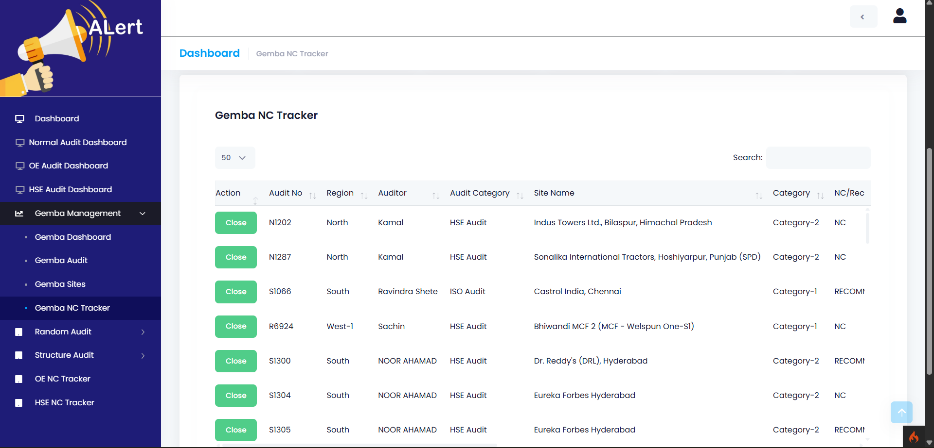
HSE Gemba Audits NC tracker
All Data NC tracker
Click to Close
Gemba
Audit
UNITGLO SOLUTIONS PVT LTD | help@unitglo.com

Slide 45
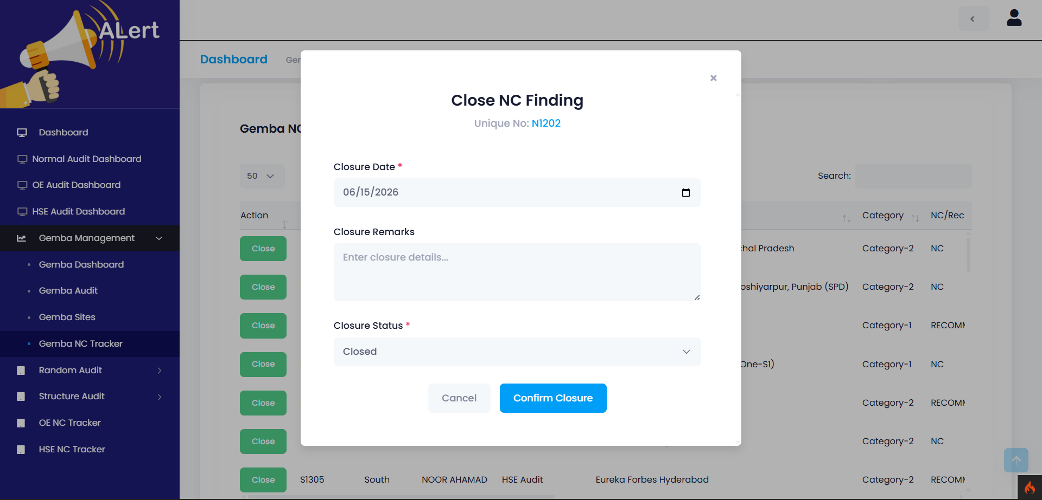
HSE Gemba Audits NC tracker
Closing an NC
Gemba
Audit
UNITGLO SOLUTIONS PVT LTD | help@unitglo.com

Slide 46

UNITGLO SOLUTIONS PVT LTD | help@unitglo.com

