Slide 1
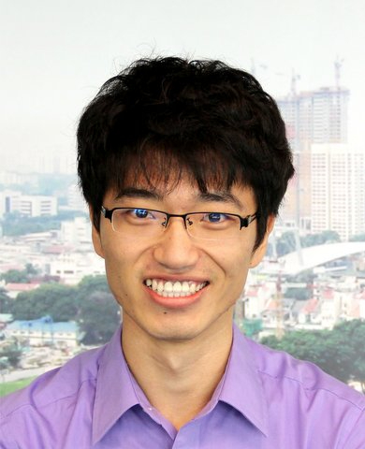
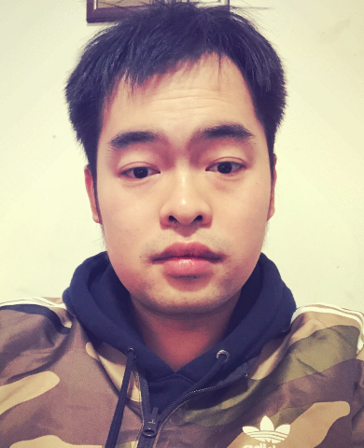
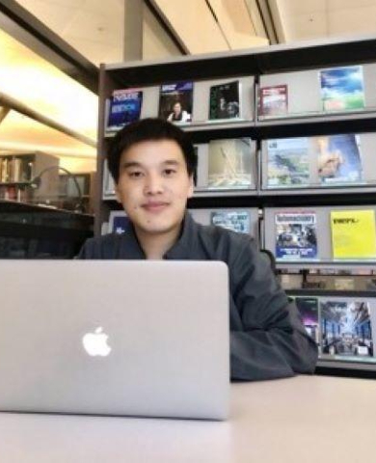
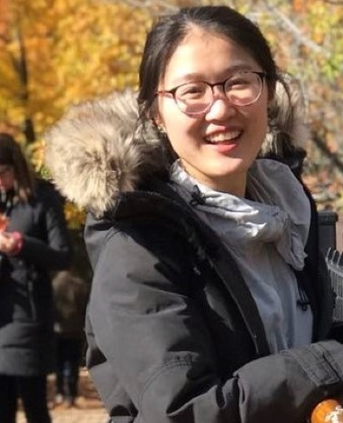
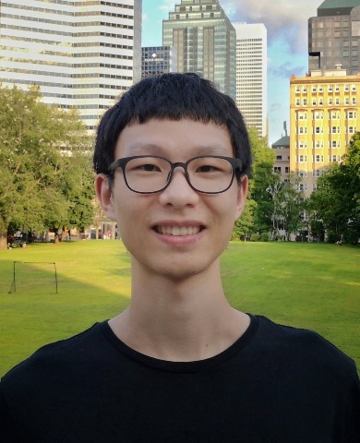
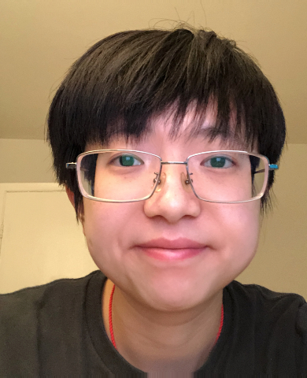
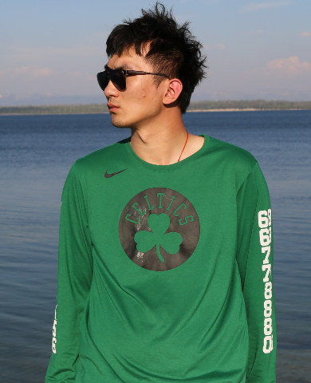
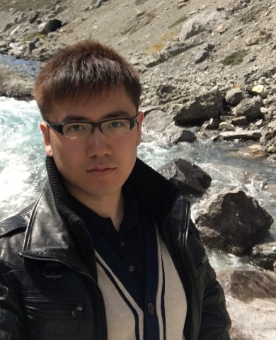
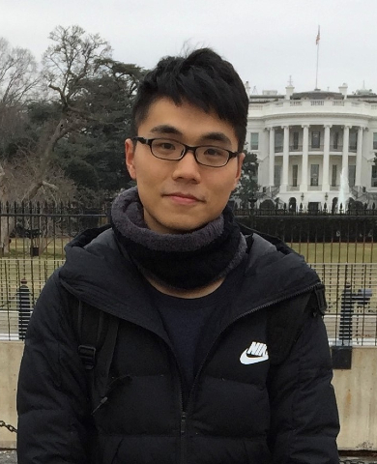
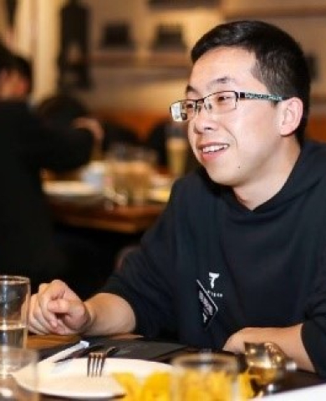
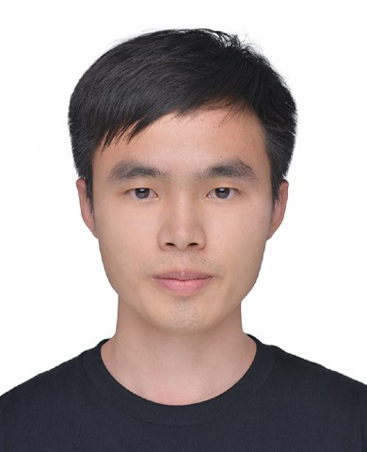
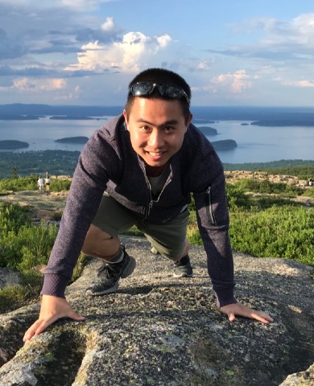
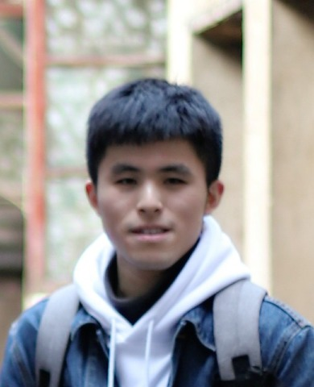
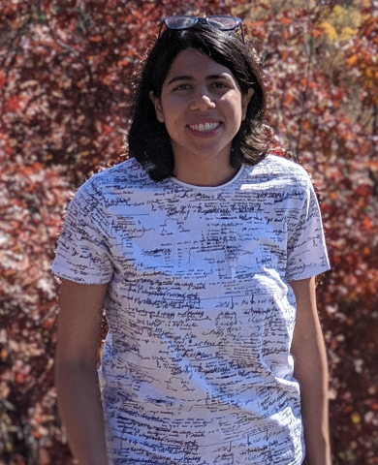
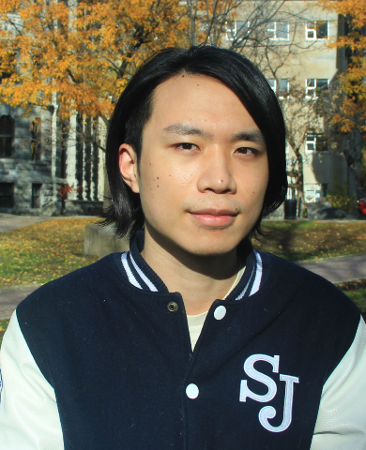
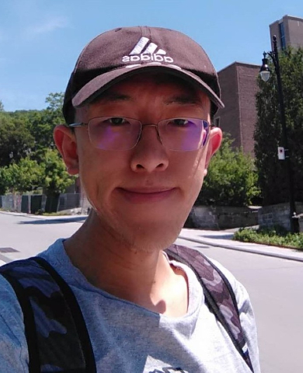
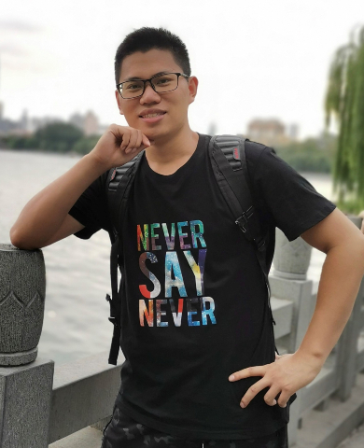
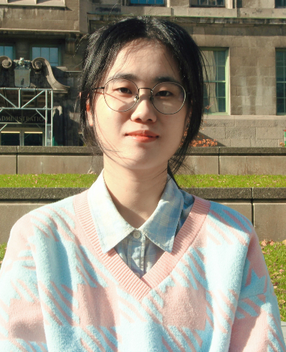
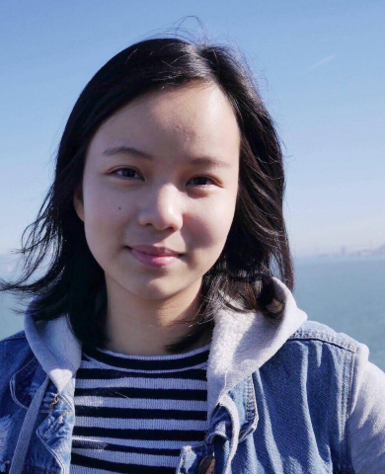
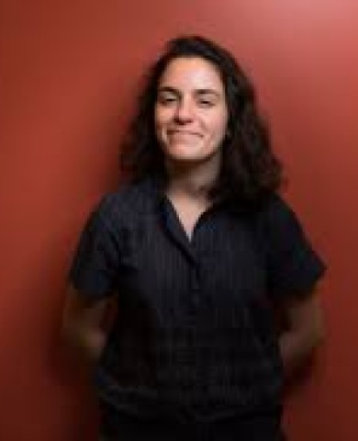
Smart Transportation Lab at McGill
Current members
Prof. Lijun Sun
PI
Yuankai Wu
Postdoc
Wenshuo Wang
Postdoc
Xudong Wang
PhD Candidate
Zhanhong Cheng
PhD Candidate
Mengying Lei
PhD Student
Fuqiang Liu
PhD Student
Jingbo Tian
PhD Student
Jiawei Wang
PhD Student
Xiaoxu Chen
PhD Student
Xinyu Chen
PhD Student
Zhicheng Liu
PhD Student
Zhihao Zheng
PhD Student
Mojdeh Sharafi
Msc Student
Dingyi Zhuang
Msc Student
Tianyu Shi
Msc Student
Chengyuan Zhang
Msc Student
Alumni
Zhenyuan Ma
Msc Student
Lulu Tan
Msc Student
Leila Hawa
Msc Student

