Slide 1

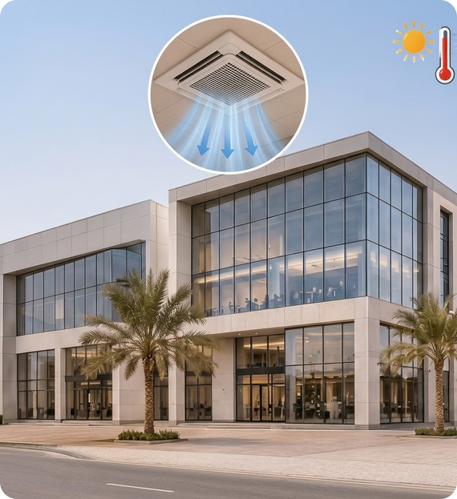

AIR IN
BUILDING SERVICES
CENTRAL
HVAC SYSTEM
Heating, Ventilation & Air Conditioning for large buildings
GROUP MEMBERS
Rawan Ali AlFarsi 1532J233
Zaynab Yaqoob ALMusallami 232j2406
Shrooq Saif Alhashami 1532j2337647
Nusiaba Alnadabi 232s23020
University of Technology and Applied Sciences (UTAS)
Notes:
Welcome. Introduce the group and the topic: the central HVAC system as a core building service.

Slide 2
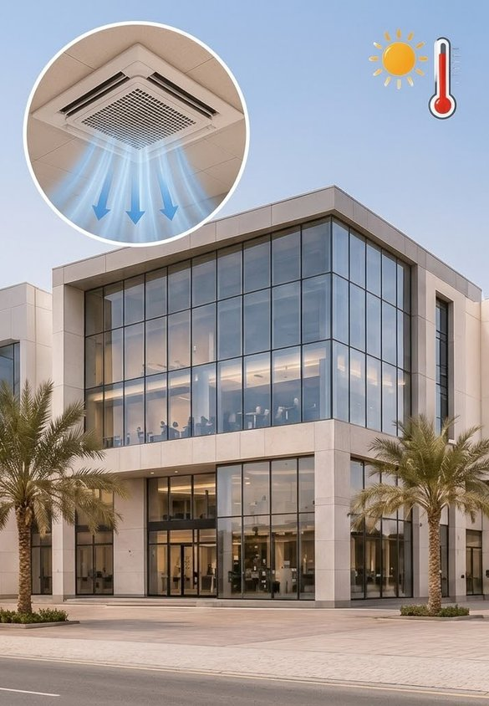



01 · INTRODUCTION
Why HVAC Matters
45°C
Outdoor summer heat in hot climates
HVAC systems are important in hot climates because they keep buildings cool and comfortable.
COMMONLY USED IN
Shops
Hospitals
Large Buildings
Notes:
In hot climates like Oman, outdoor temperatures can reach 45°C. HVAC keeps shops, hospitals and large buildings cool and comfortable.

Slide 3
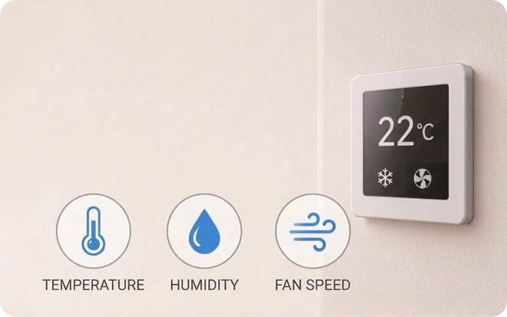



02 · ENGINEERING DEFINITION
What Is Central HVAC?
22°C
Comfort, on demand
A system that controls indoor temperature, humidity and air quality.
Temperature
Humidity
Air Quality
Notes:
Engineering definition: central HVAC controls three things – temperature, humidity and indoor air quality – from one central plant.

Slide 4
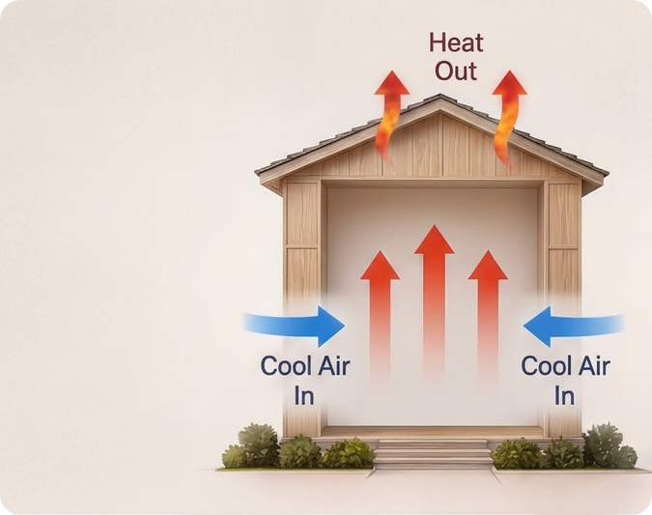


03 · SCIENTIFIC IMPORTANCE
Moving Heat, Not Making Cold
Heat Transfer & Cooling Cycle
It works using heat transfer and the cooling cycle.
Inside → Outside
It removes heat from inside the building and releases it outside.
Notes:
Science: HVAC does not create cold – it moves heat. Heat is absorbed inside and rejected outside through the refrigeration cycle.

Slide 5
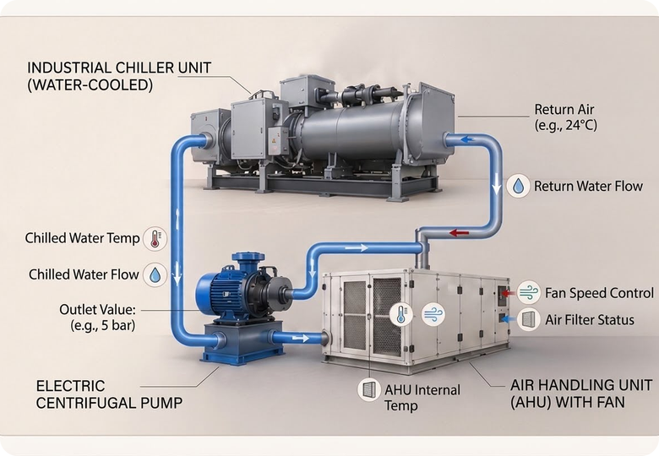


04 · CHILLED WATER CYCLE
The Cold Heart of the System
4–7°C
Chilled water supply temperature
Water Chiller
Cools the water to around 4–7°C.
Pumps & Insulated Pipes
Move cold water to AHUs or FCUs to absorb heat.
Notes:
The chiller cools water to 4–7°C. Pumps push it through insulated pipes to AHUs and FCUs, where it absorbs heat from the air and returns warmer to the chiller.

Slide 6
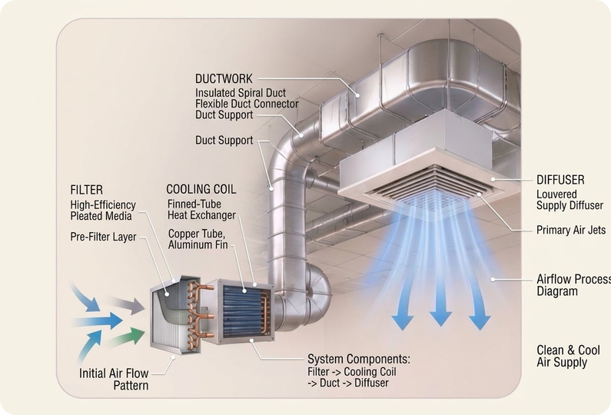


05 · AIR DISTRIBUTION
From Return Air to Fresh Comfort
Return + Fresh Air
Return air mixes with fresh air
Filter
Dust and particles removed
Cool
Air passes the cooling coil
Distribute
Delivered through ducts
Notes:
Return air mixes with fresh air, is filtered, cooled over the coil, then distributed through ducts to every space.

Slide 7
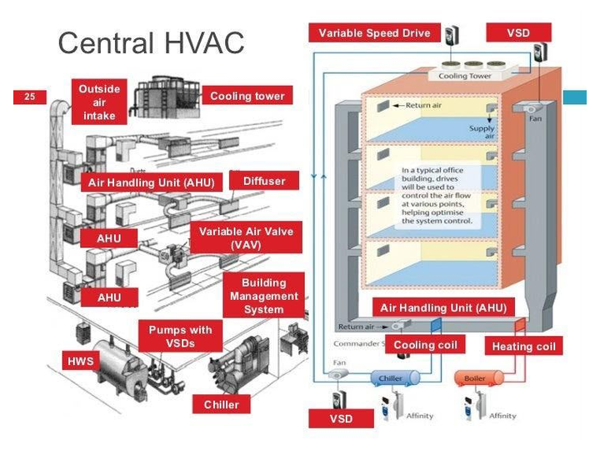


06 · MAJOR EQUIPMENT BREAKDOWN
Two Sides of One System
Central Plant Equipment
Water chillers
Boilers
Pumps
Air-Side Distribution
Air Handling Units (AHUs)
Fan Coil Units (FCUs)
Duct systems
Notes:
The equipment splits into two sides: the central plant (chillers, boilers, pumps) and the air side (AHUs, FCUs and ducts).

Slide 8
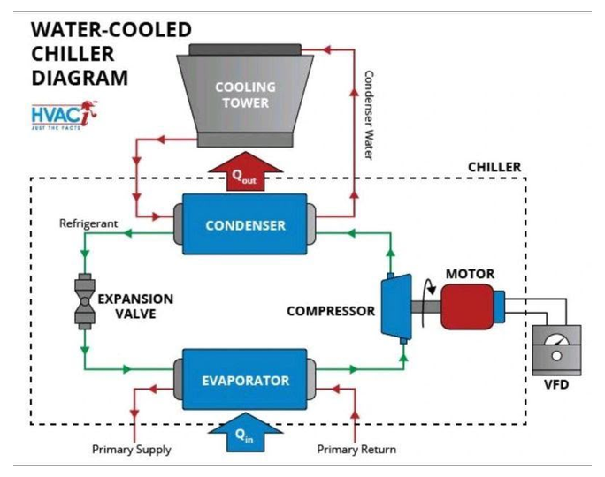


07 · CHILLERS & COMPRESSORS
Inside the Chiller
High-Capacity Compressors
Centrifugal / Screw
Evaporators
Absorb heat from the chilled water
Condensers
Reject heat out of the system
Notes:
Main chiller components: high-capacity centrifugal or screw compressors, the evaporator that chills the water, and the condenser that rejects heat.

Slide 9
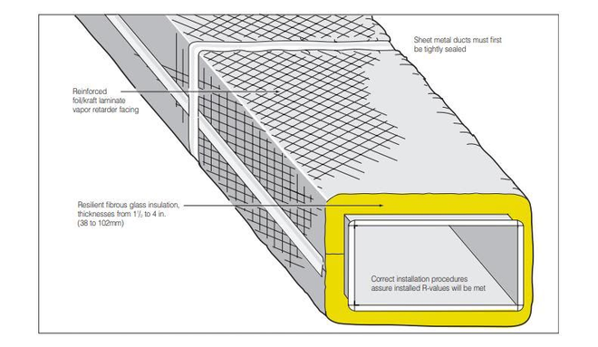



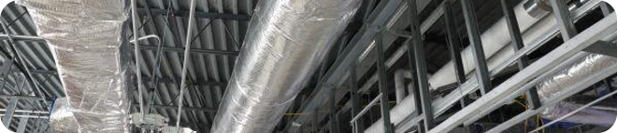
08 · DUCTWORK & INSULATION
Built to Carry Cold Air
Galvanized Steel Sheets
Ducts are mainly constructed from galvanized steel sheets.
THERMAL & ACOUSTIC INSULATION
Fiberglass
Foam Insulation
Notes:
Ducts are made from galvanized steel and wrapped with fiberglass or foam insulation to stop heat gain, condensation and noise.

Slide 10
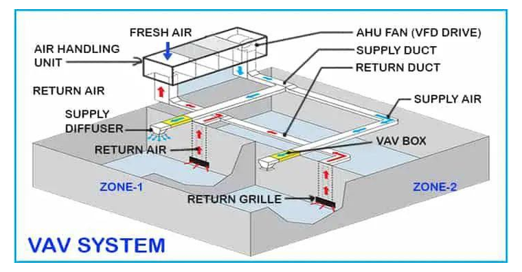



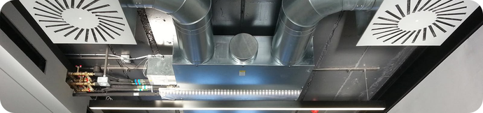
09 · DIFFUSERS & DAMPERS
Where Air Meets the Room
Supply Diffusers
Return Grilles
Distribute conditioned air into indoor spaces
Let air flow back into the HVAC system
VAV Dampers
CAV Dampers
Adjust airflow to room requirements
Maintain a constant airflow rate
Notes:
Supply diffusers push conditioned air into the room, return grilles bring it back. VAV dampers vary airflow per room; CAV dampers keep it constant.

Slide 11
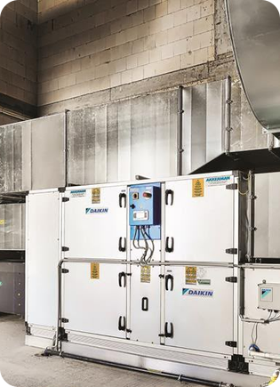
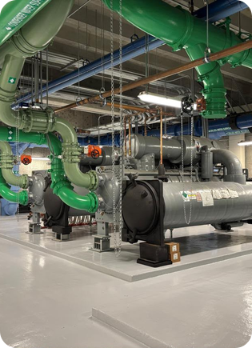
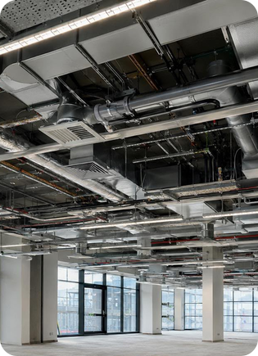
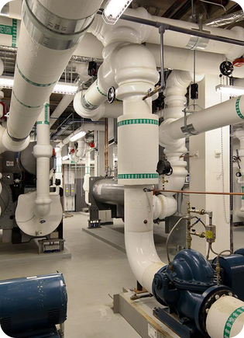

10 · FIELD DOCUMENTATION
Real HVAC Components
Air Handling Units (AHUs)
Chillers
Ductwork
Control Valves & Dampers
Notes:
Photographs of real HVAC components: air handling units, chillers, ductwork, and the valves and dampers that control flow.

Slide 12
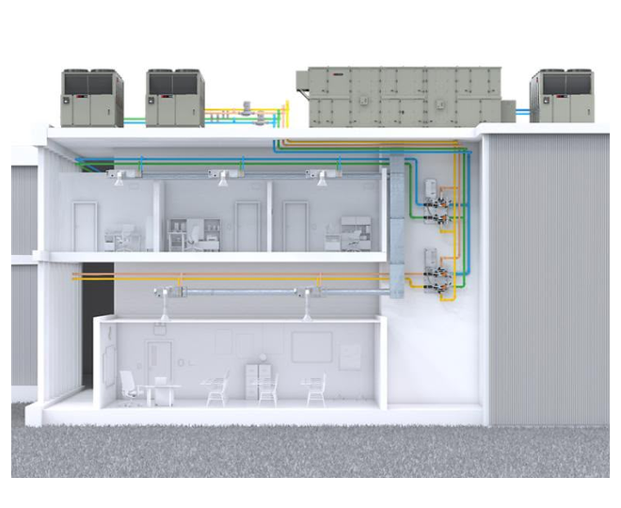

11 · LOCATION OF EQUIPMENT
Where Should HVAC Equipment Go?
Terrace
Equipment Rooms
Ceiling Areas
Areas of Service
Notes:
Ideal placement: terraces/roofs for heat rejection, dedicated equipment rooms, ceiling areas for terminal units, and accessible service areas.

Slide 13
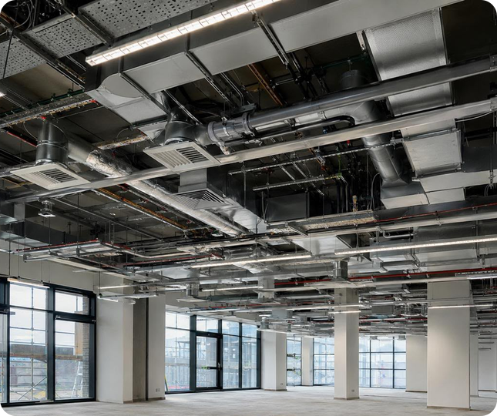


12 · ARCHITECTURE & CEILING DROPS
Hidden Above the Ceiling
HVAC ducts are hidden above dropped ceilings.
Ceiling voids hold ducts, pipes and electrical systems.
Ceiling heights must align with lighting and fire safety systems.
The ceiling design incorporates diffusers and grilles.
Notes:
How HVAC integrates with interior design: ducts and services sit in the ceiling void, coordinated with lighting and fire systems, with diffusers built into the ceiling.

Slide 14




13 · ACCESS OPENINGS
Reaching What's Hidden
Access hatches allow entry to hidden HVAC elements.
Mounted in drop ceilings and service partitions.
Enable inspection of dampers, valves and filters.
Simple to reach and sized for maintenance tasks.
Notes:
Access openings let technicians reach concealed components. They sit in drop ceilings and partitions and must be easy to reach and large enough to work through.

Slide 15
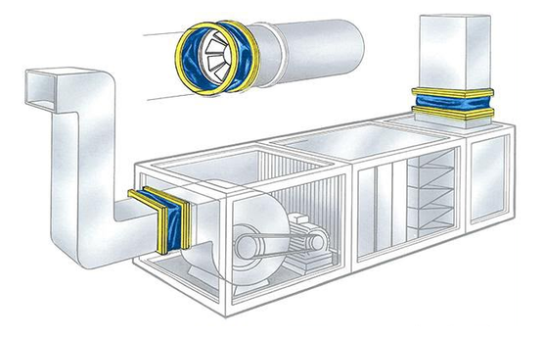

14 · SOUND MANAGEMENT
Quiet Comfort
Minimizing sound and vibration from HVAC systems
Soundproofing
Noise Reduction Devices
Flexible connectors isolate fan vibration from the ductwork.
Vibration Dampers
Adaptable Links
Notes:
Noise and vibration are controlled with soundproofing, noise reduction devices such as silencers, vibration dampers under equipment, and flexible connectors.

Slide 16
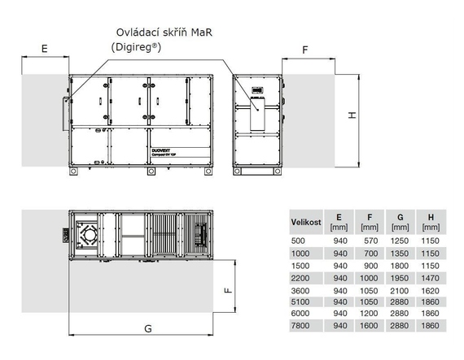

15 · MAINTENANCE CLEARANCES
Room to Work
Sufficient space around HVAC systems.
Clearances let technicians inspect and fix components.
Space needed for filter changes and coil cleaning.
Service doors and removable parts easily accessible.
SERVICE CLEARANCE ZONE
Notes:
Equipment needs clear space around it so technicians can inspect, change filters, clean coils and open service doors.

Slide 17

16 · ADVANTAGES
Why Choose Central HVAC
01
02
03
04
05
Indoor Comfort
Cooling Large Spaces
Air Filtration
Centralized Temperature Control
Flexible Operation
Notes:
Advantages: comfort, cooling of large spaces, filtration, central control of temperature and flexible operation.

Slide 18





17 · LIMITATIONS
What to Plan For
01
02
03
04
05
High Installation Cost
Regular Maintenance
Equipment Space Requirements
Noise and Vibration
Complex Repairs
Notes:
Limitations: high installation cost, regular maintenance, space for equipment, noise and vibration, and more complex repairs.

Slide 19
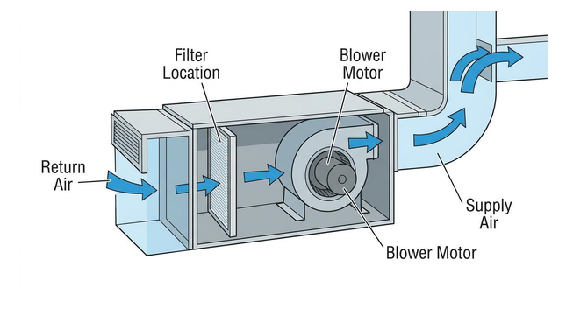





18 · ENERGY EFFICIENCY & MAINTENANCE
Keeping It Efficient
Energy Efficiency
Energy-Efficient Equipment
Temperature Control
Reduced Energy Consumption
Maintenance
Clean Air Filters
Filter location
Filters sit before the blower, so keeping them clean protects airflow and efficiency.
Inspect Pumps and Pipes
Regular System Inspection
Notes:
Efficiency comes from efficient equipment and good temperature control; reliability comes from clean filters, pump and pipe checks and regular inspection.

Slide 20
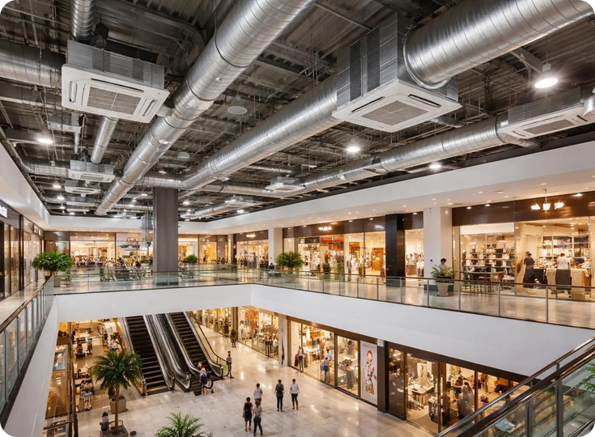



19 · APPLICATIONS
Where You'll Find It
Shopping Malls
Hotels
Hospitals
Office Buildings
Commercial Buildings
Notes:
Central HVAC is used wherever large spaces need reliable cooling: malls, hotels, hospitals, offices and commercial buildings.

Slide 21
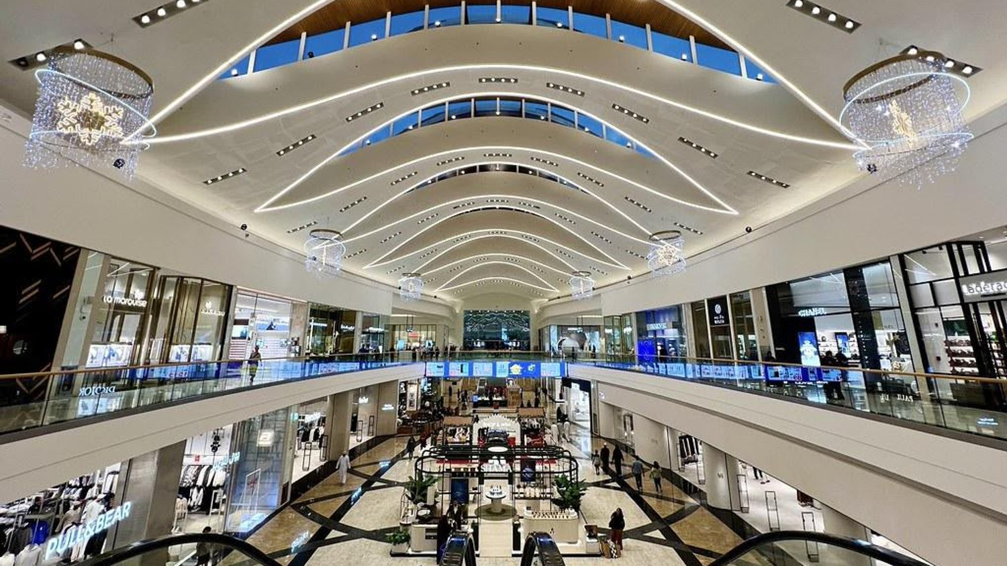

CASE STUDY · MUSCAT, OMAN
Mall of Oman
A large commercial building that uses a central HVAC system to provide cooling for its indoor spaces.
Notes:
Local example: Mall of Oman in Muscat relies on a central HVAC system to cool its vast indoor spaces.

Slide 22

20 · CONCLUSION
Key Takeaways
01
Suitable for Large Buildings
02
Provides Cooling for Multiple Spaces
03
Regular Maintenance Is Important
04
Energy Efficiency Reduces Operating Costs
Notes:
To conclude: central HVAC suits large buildings, cools many spaces from one plant, needs regular maintenance, and good efficiency cuts operating costs.

Slide 23

REFERENCES
Sources
ASHRAE Handbook – HVAC Systems and Equipment
CIBSE Guide A – Environmental Design
Chudley & Greeno – Building Construction Handbook
Bahwan Engineering – Mall of Oman
Notes:
References used in this presentation.

Slide 24


COLD AIR OUT
THANK YOU
Questions?
Rawan · Zaynab · Shrooq · Nusiaba
Building Services · UTAS
Notes:
Thank the audience and invite questions.

