Slide 1

An extension to maintain the safety of the city Joensuu
Made by: Christel, Kasper, Michiel, Pablo and Beau
Team: Eta

Slide 2

Table of contents
Business Canvas Model
SWOT Analysis
Introduction of the new plan
A demo of the extension
A demo for the smart camera’s
Possible extra features
Questionnaire

Slide 3
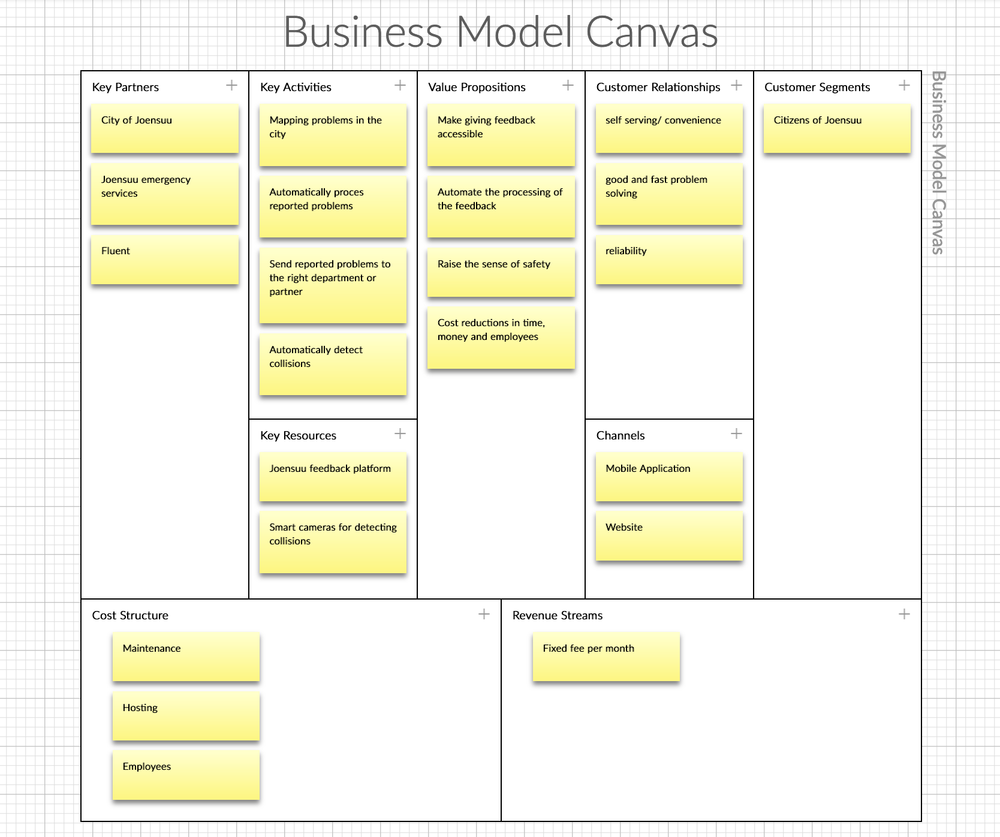
Business Canvas Model

Slide 4
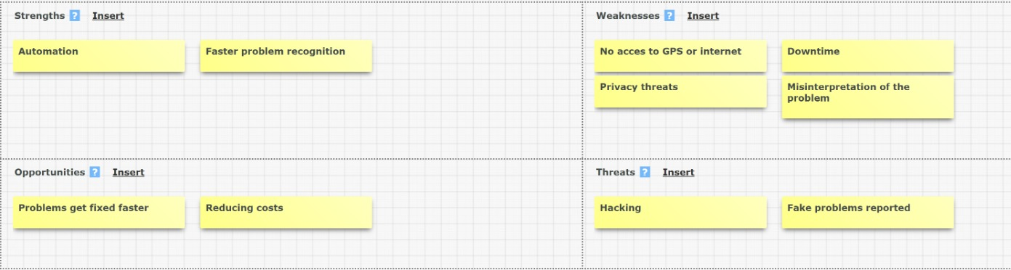
SWOT Analysis

Slide 5
Risk analysis and measures
 | Chance | Impact | Total risk | Measures | Chance | Impact | Total risk
1: Hacking | 6 | 8 | 48 | Partitions in our storage | 2 | 6 | 12
2: Information leak | 5 | 9 | 45 | No phone information | 5 | 5 | 25
3: Insecure connection | 7 | 8 | 56 | Encryption | 1 | 3 | 3
4: Downtime | 6 | 8 | 48 | Back-up server | 2 | 8 | 16
5: Unstable connection | 8 | 8 | 64 | Phone number right department | 3 | 8 | 24

Slide 6
Introduction of the plan
We want to make it easier for the residents of the city of Joensuu to declare an emergency through the application.
Through photo recognition from street cameras and phones, we want to make it easier for the application how to categorise the problem.
We want to use “Digital twins” to notify and help firefighters to evacuate buildings faster and safer.

Slide 7
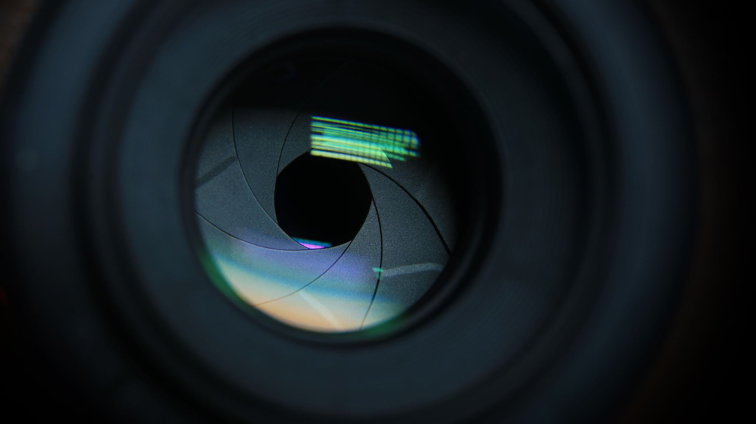
The demo

Slide 8
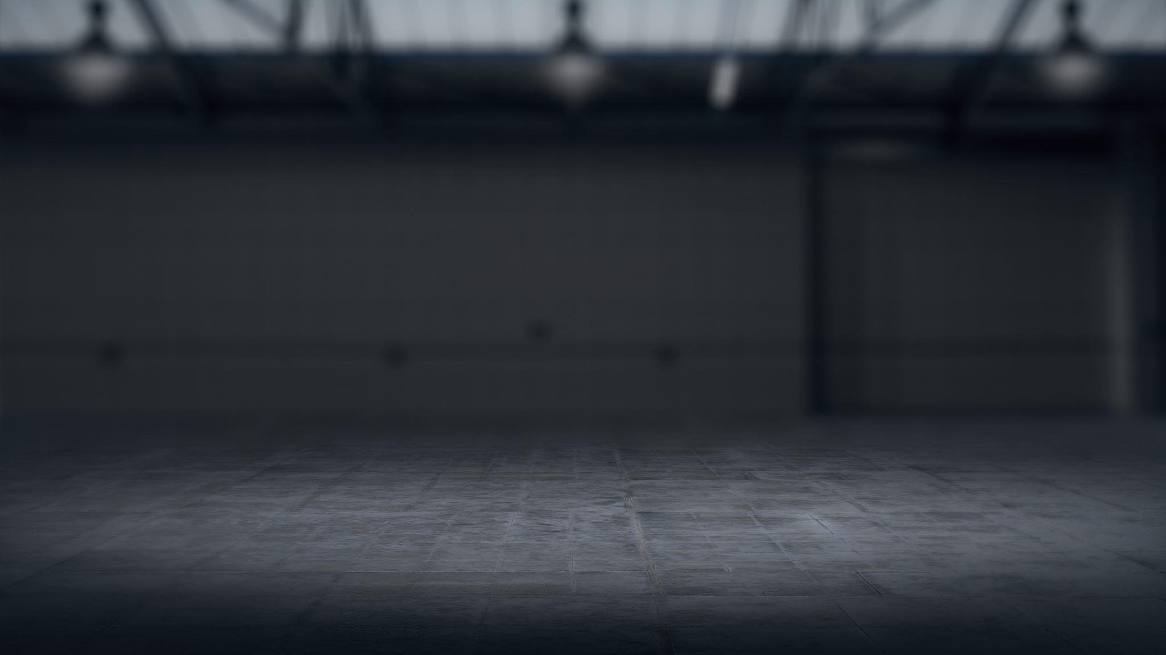
Extra possible features

Slide 9
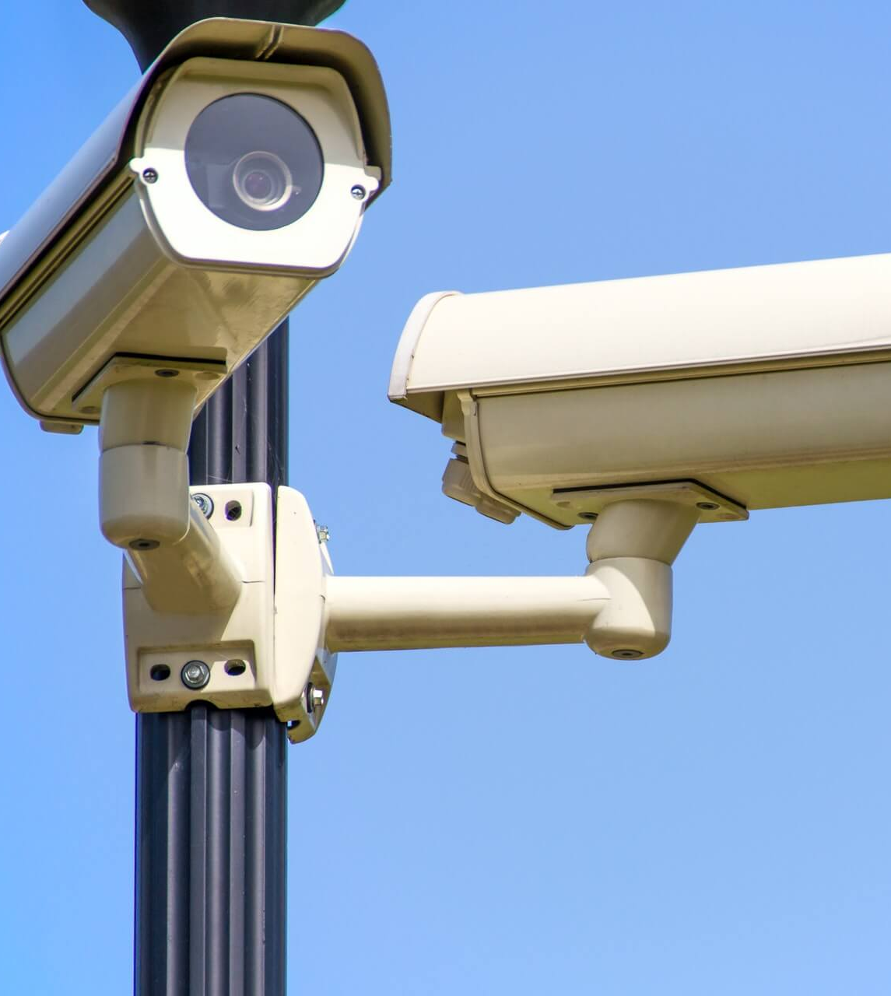
Street cameras addition
Problems can be automatically recognized and reported to the application.
The cameras will need recognize capabilities.

Slide 10
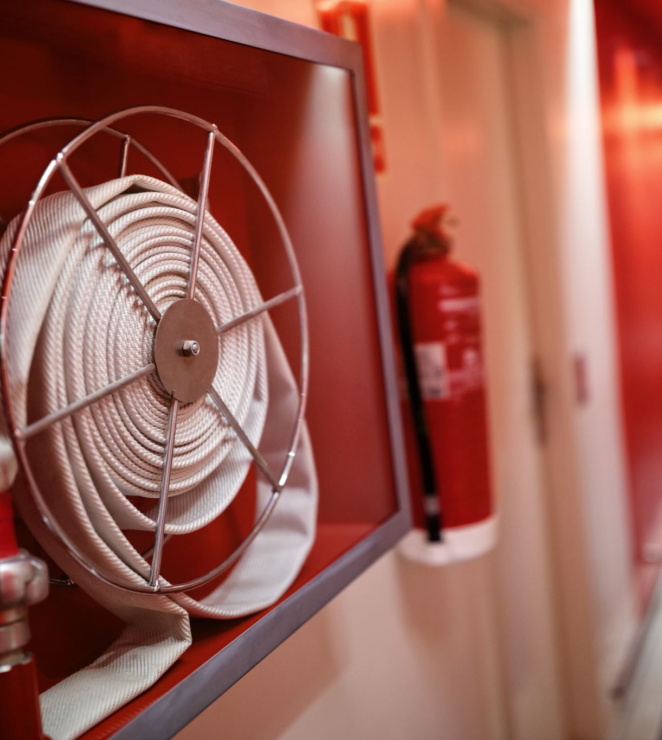
Firefighter support
Use of ”Digital Twins”
IOT devices/sensors
Recognizing the fire and notifying the fire department
Finding the best evacuation route

Slide 11
Questionnaire
After this presentation, does anybody of u have a question?

