Slide 1
Working Memory in LLM
弭元元
清华大学 心理系

Slide 2
An Example: N-back Task Phenomena and Mechanism
Proactive Inference: Research in Psychology and LLM
Serial Dependence: Proceed from Psychology

Slide 3
An Example: N-back Task Phenomena and Mechanism

Slide 4
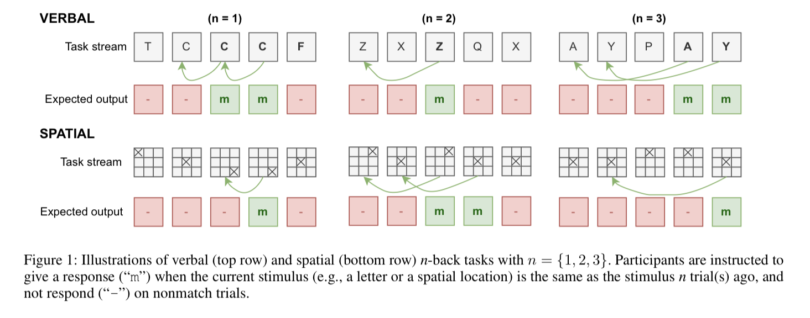
N-back Task
理论依据
Executive attention theory claims that working memory depends on utilizing attention to maintain and suppress information, and the restriction on memory capacity is not specifically about memory storage per se, but more about the capacity for sustained, regulated attention in the presence of interference.
实验范式
(Gong et al., 2024)

Slide 5
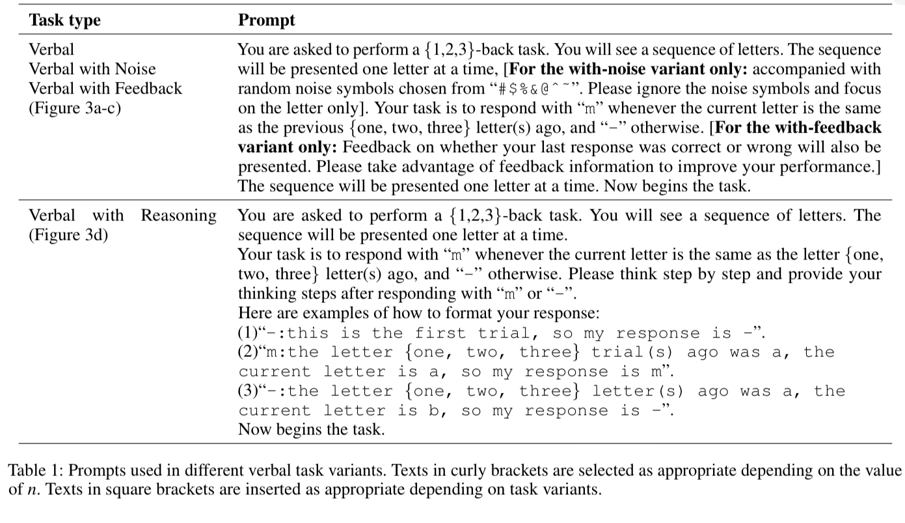
Empirical Study
提示词示例
(Gong et al., 2024)

Slide 6
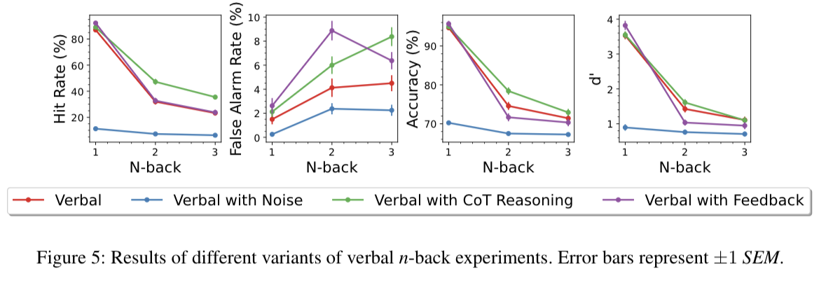
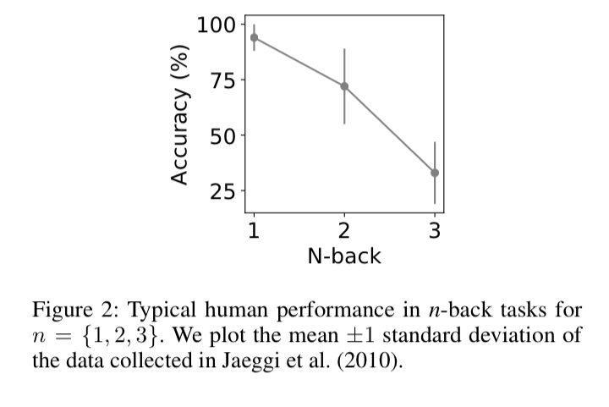
Empirical Study
Result on LLM(GPT 3.5)
Human behavior
(Gong et al., 2024)

Slide 7
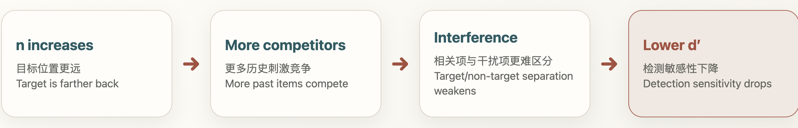
What does this work tell us?
First: LLM context use can be quantitatively measured with cognitive-science tasks.
Second: ChatGPT shows an n-dependent capacity limit in n-back, resembling human working-memory curves.
The authors speculate that the constraint may relate to model architecture, especially self-attention. Hence,the next step is mechanistic: how self-attention, contextual competition, and interference control jointly determine capacity.
(Gong et al., 2024)

Slide 8
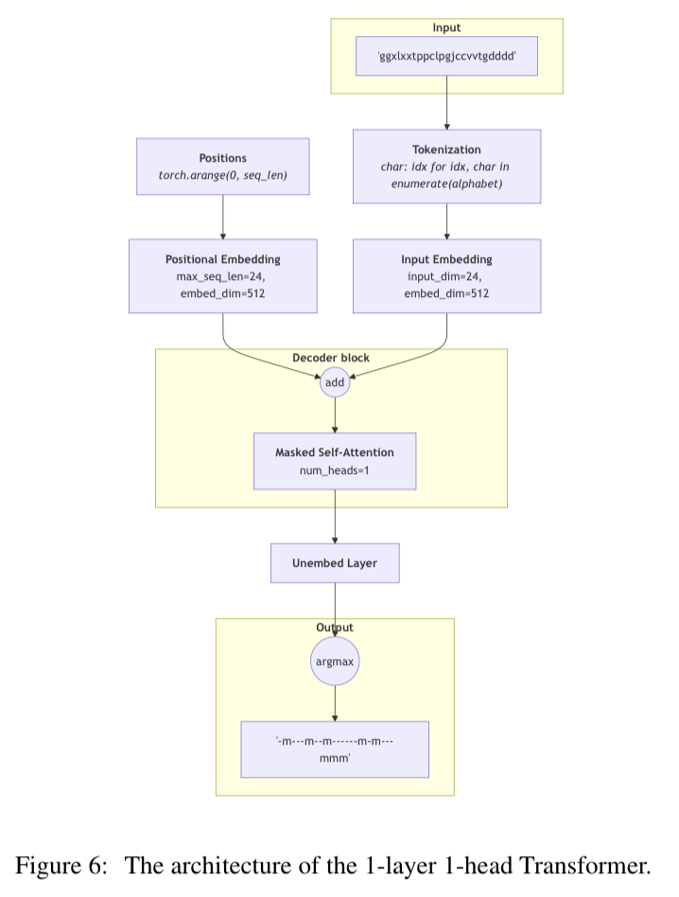
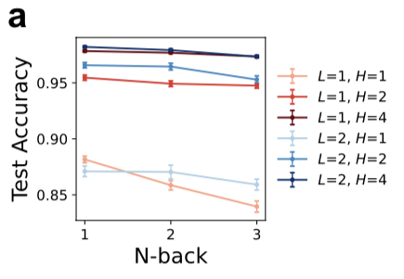
Self-attention: Mechanism
N-back 任务训练结果
(Gong & Zhang., 2024)
简单的可解释 attention 模型架构

Slide 9
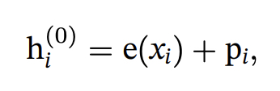
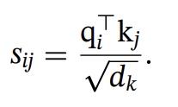
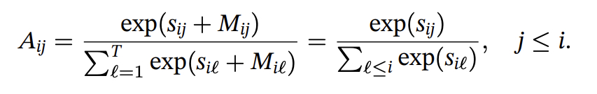
Self-attention: Mechanism
What happened indeed?
Every symbol in sequence will be embedded accompanied with position coding:
And all those token embeddings will be projected into three spaces:
Current position(i) will give a score on history position(j):
Attention weight will be calculated based on masked score:
(Gong & Zhang., 2024)

Slide 10
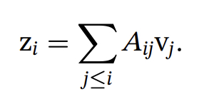
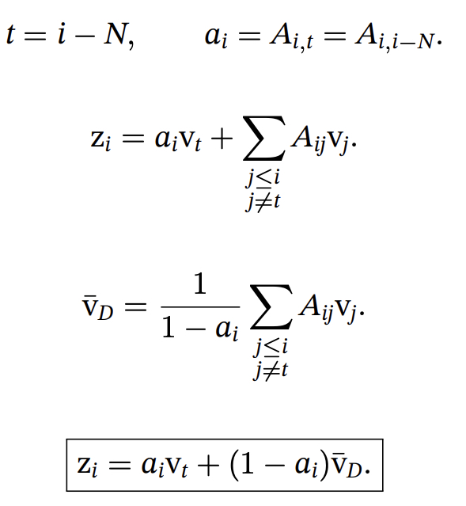
Self-attention: Mechanism
What happened indeed?
Current output will be calculated based on attention weight:
Then, with the assumption that targeted position is t = i-N, we could run the calculation
(Gong & Zhang., 2024)

Slide 11
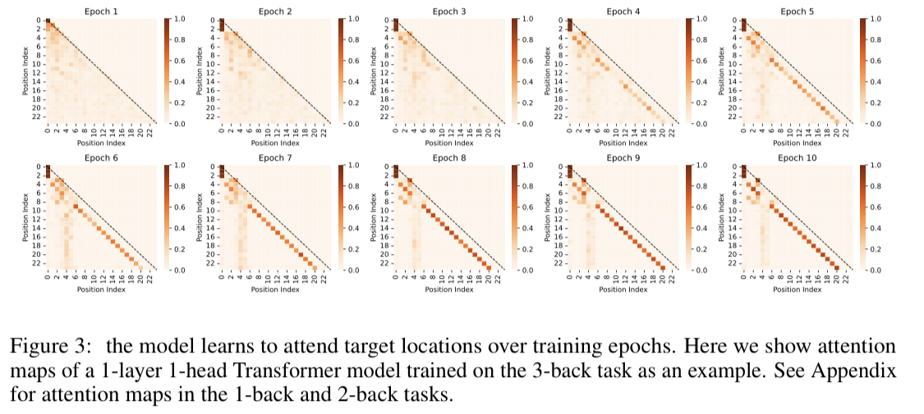
Self-attention: Mechanism
Above calculation implicates that higher a_i will give higher accuracy, hence the model should enhance cetain amplitude
(Gong & Zhang., 2024)

Slide 12
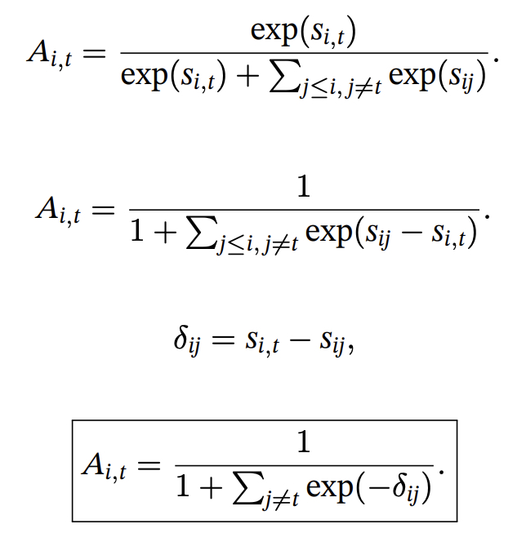
Self-attention: Mechanism
Why more N reduces the amplitude of certain attention weight?
(Gong & Zhang., 2024)

Slide 13
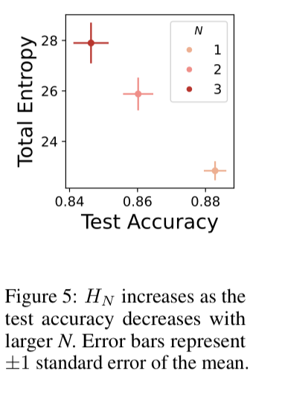
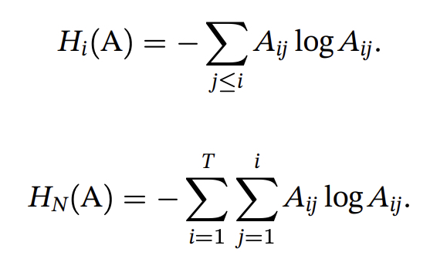
Self-attention: Mechanism
In this paper, author introduces an index, attention entropy:
总熵与准确率的结果图：
N越大，熵越高，准确率越低
(Gong & Zhang., 2024)

Slide 14
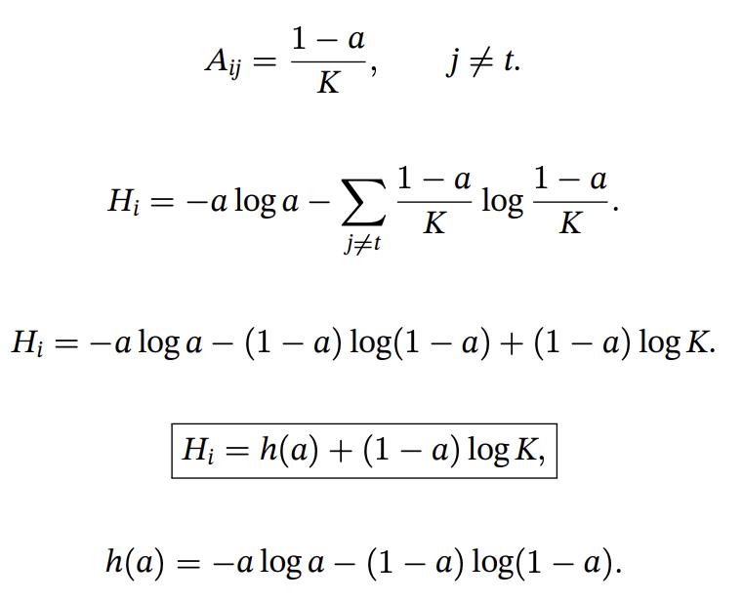
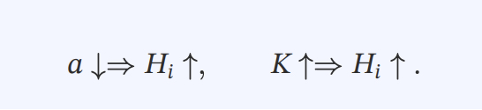
Self-attention: Mechanism
Suppose targeted attention weight is a, and interference shares remaining weight. Total entropy could be calculated as
(Gong & Zhang., 2024)

Slide 15
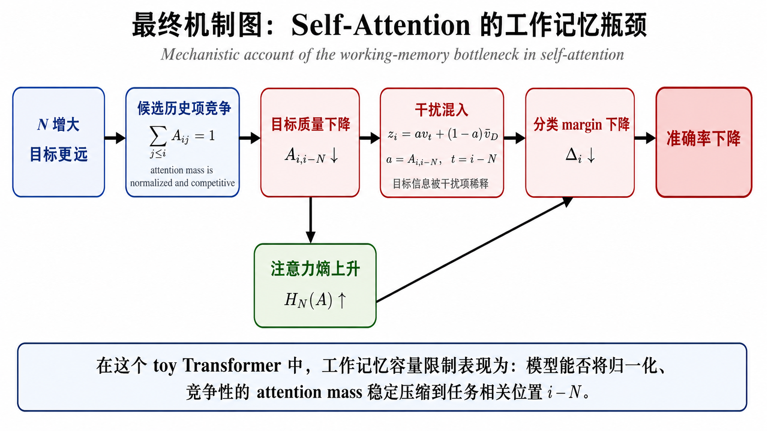
To summarize
(Gong & Zhang., 2024)

Slide 16
Proactive Inference: Research in Psychology and LLM

Slide 17
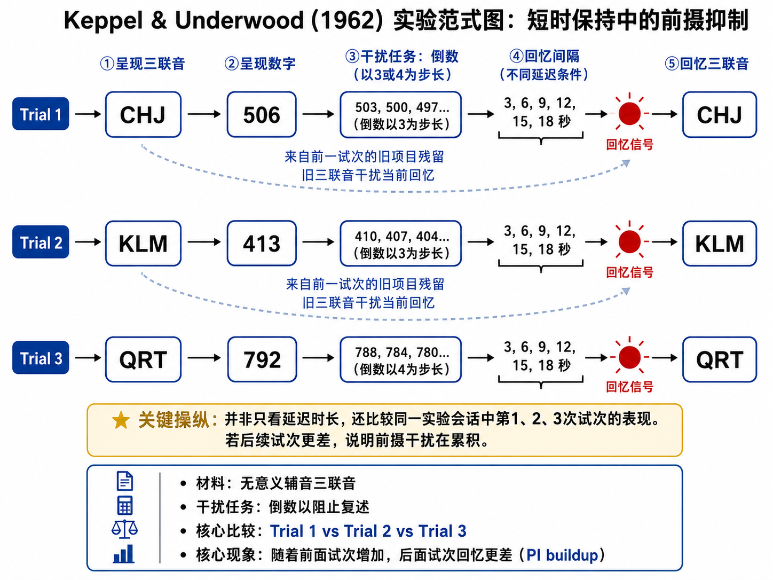
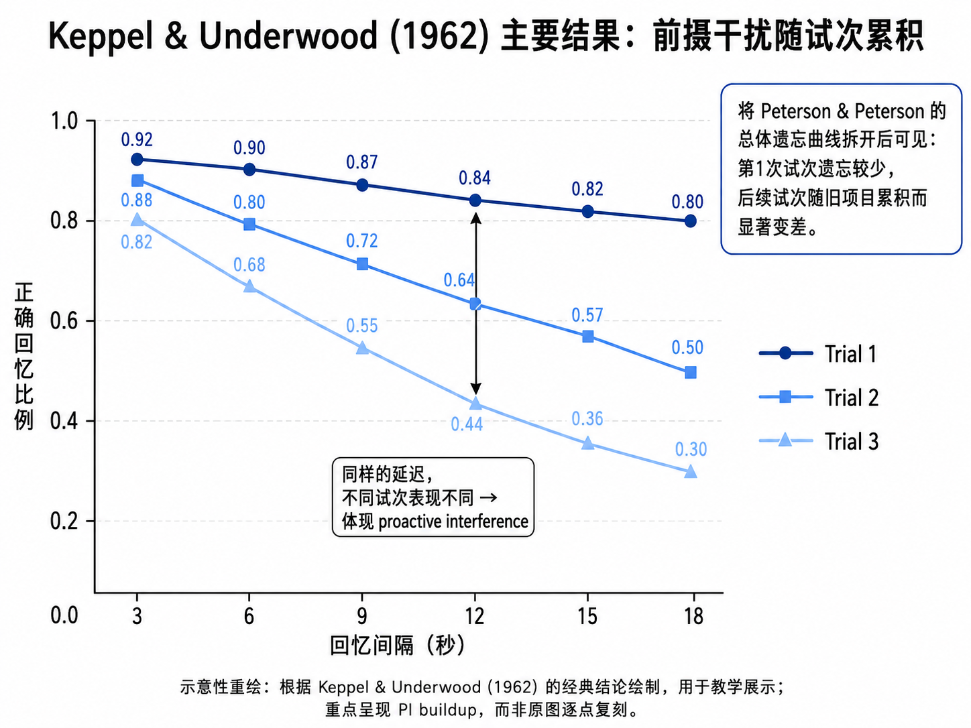
Psychological Research
Classical Results
(Keppel & Underwood, 1962)
Classical Proactive Interference Paradigm

Slide 18
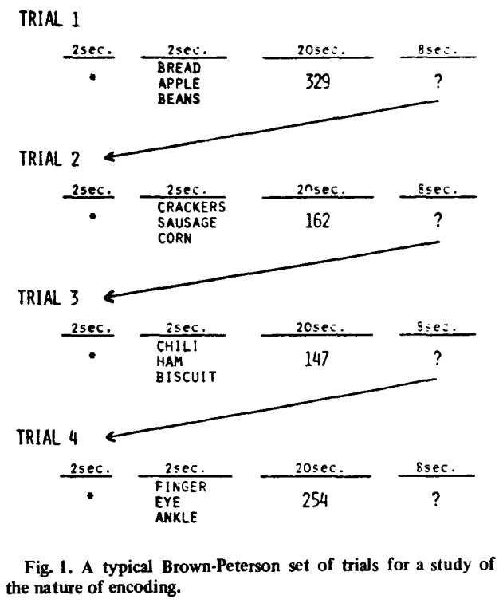
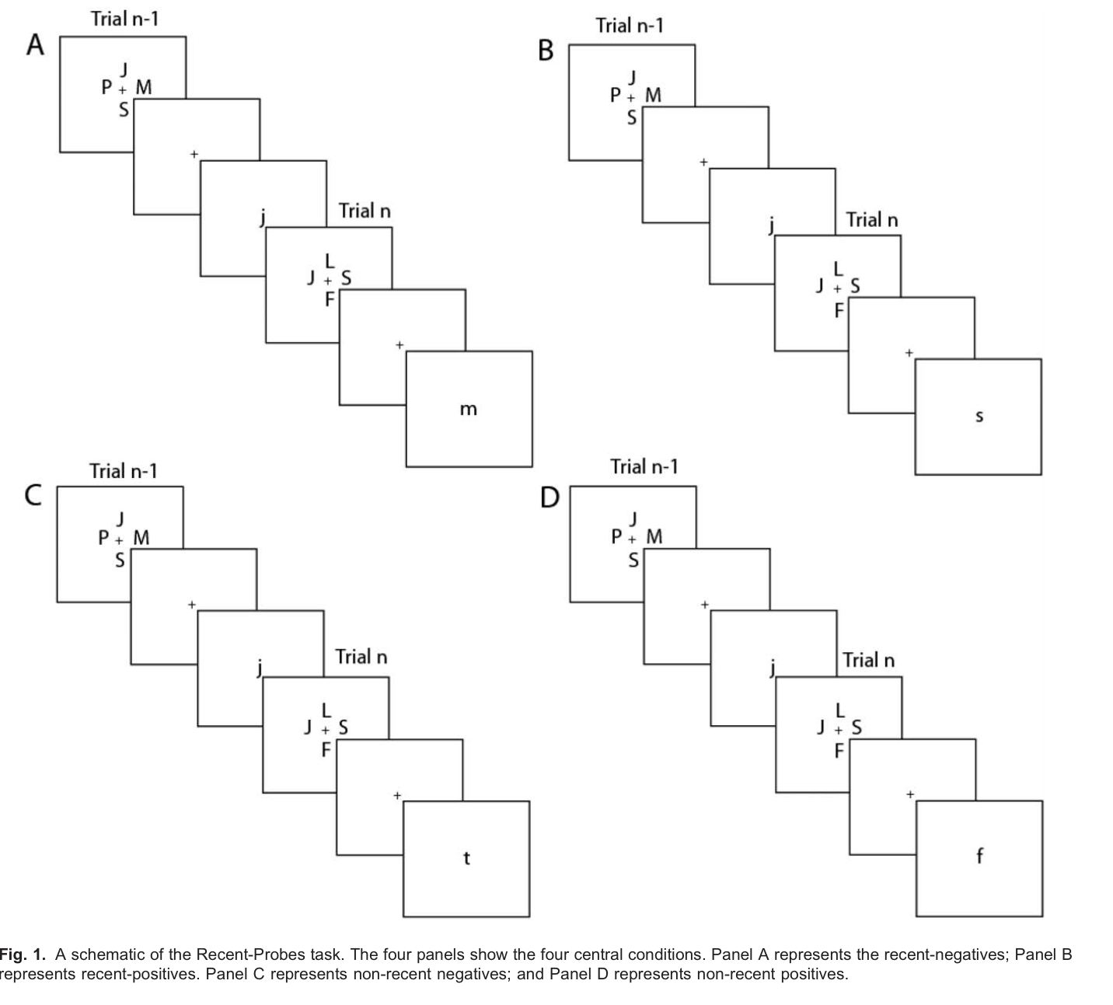
Psychological Research
Other paradigms…
(Wickens, 1973)
(Jonides & Nee, 2006)

Slide 19
Psychological Research
Proactive interference shows that working memory failure is not simply due to passive decay. Instead, recently encoded but currently irrelevant information can remain active and interfere with new information.
First, working memory must continuously update its contents by removing or de-binding outdated item–context associations. When this process fails, old information intrudes into current recall.
Second, interference is stronger when old and new items are similar. Shared perceptual, phonological, semantic, or contextual features increase competition, whereas a category shift can reduce interference and produce release from PI.
Third, forgetting often reflects retrieval competition rather than complete loss of information. The system must distinguish current relevance from mere familiarity, selecting the target while suppressing outdated competitors.

Slide 20
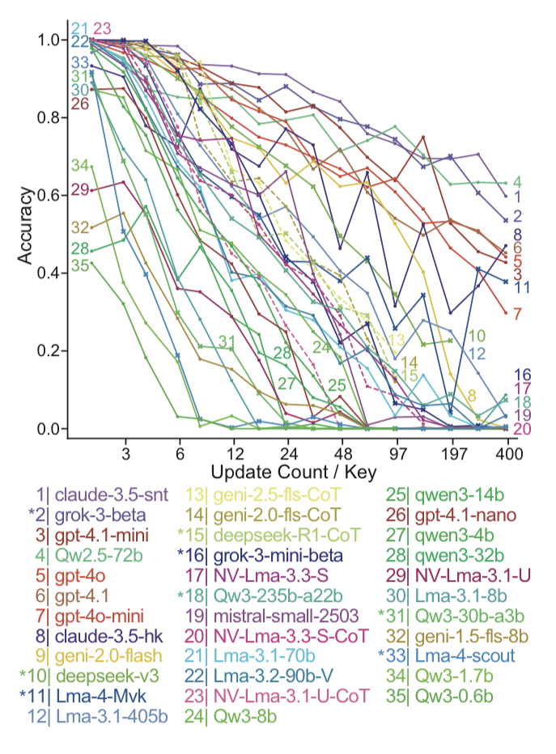
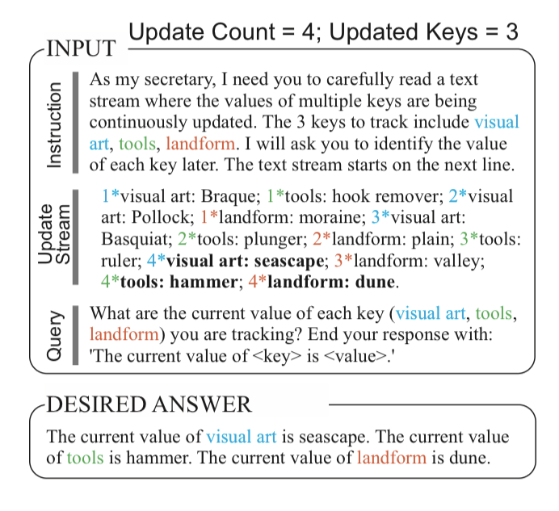
LLM Research
Key-value pairs paradigm in LLM
多模型结果
提示词设计
(Wang & Sun, 2025)

Slide 21
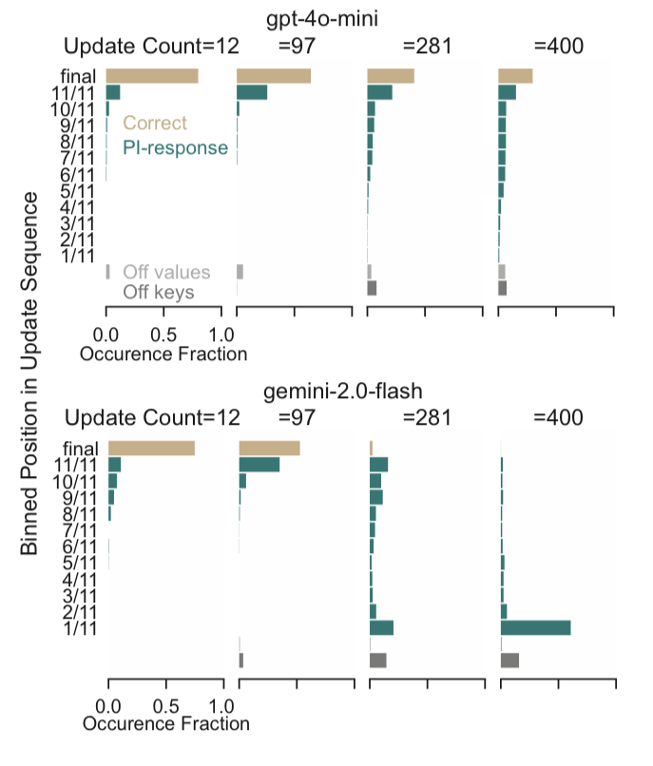
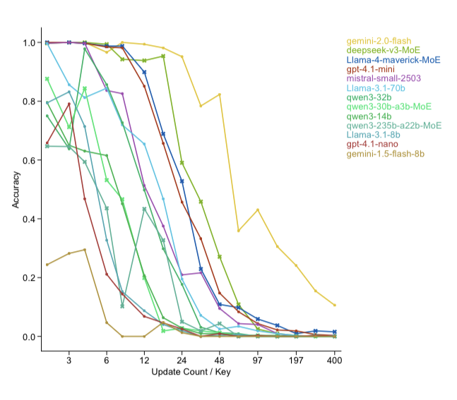
LLM Research
规律施 key-value 变化带来的雪崩效应
错误答案落在哪个区间
(Wang & Sun, 2025)

Slide 22
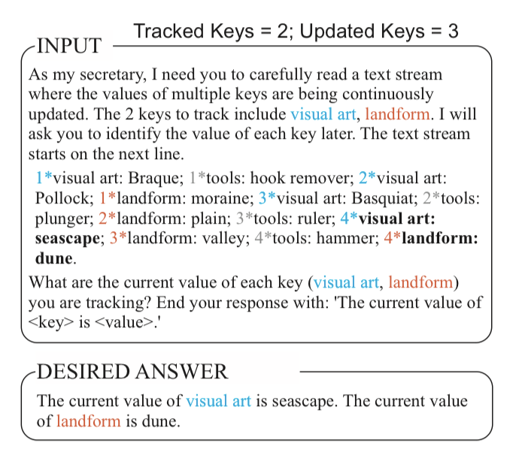
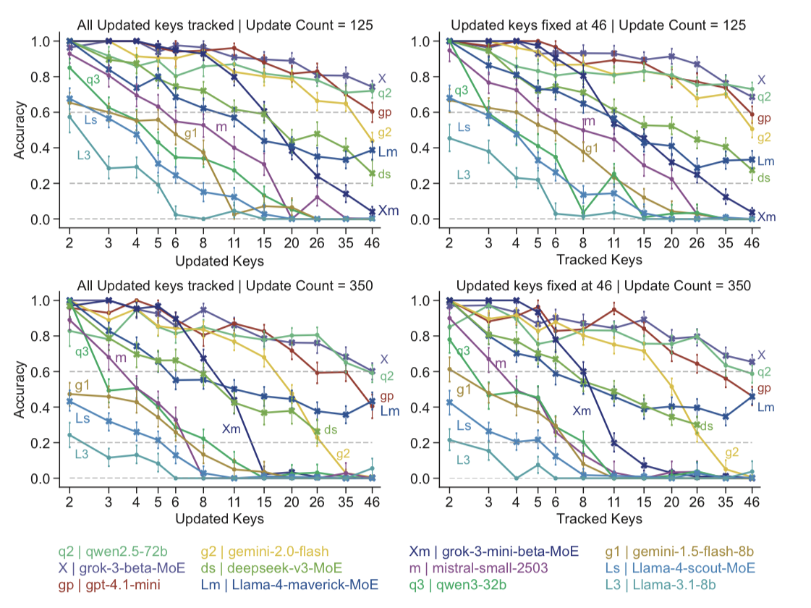
LLM Research
解耦updated key-value和tracked key-value以排除context长度的影响
(Wang & Sun, 2025)

Slide 23
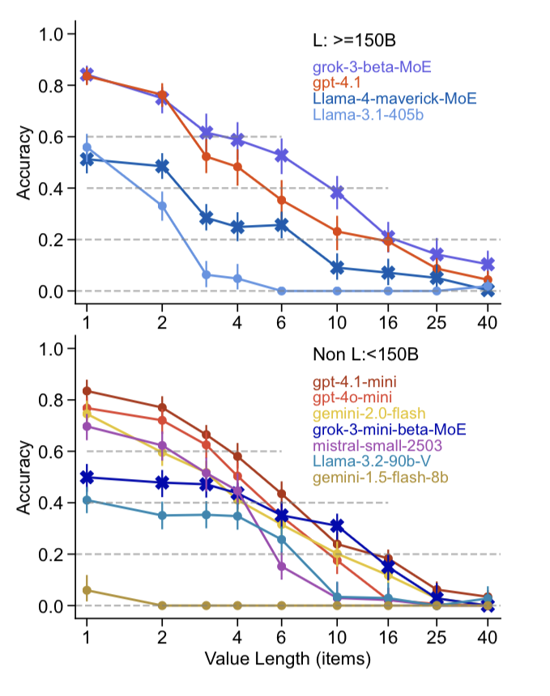
LLM Research
拼接value探究value-length的影响
(Wang & Sun, 2025)

Slide 24
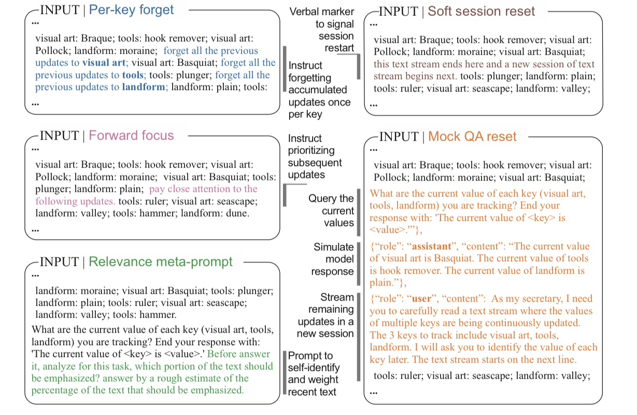
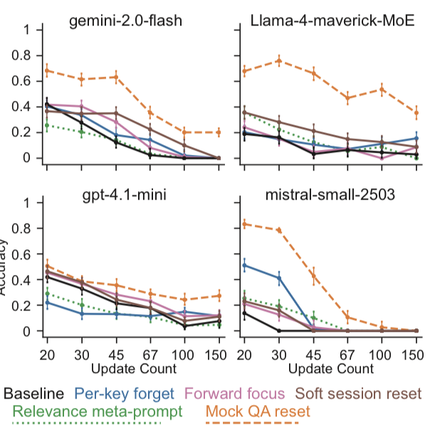
LLM Research
提示词工程
(Wang & Sun, 2025)

Slide 25
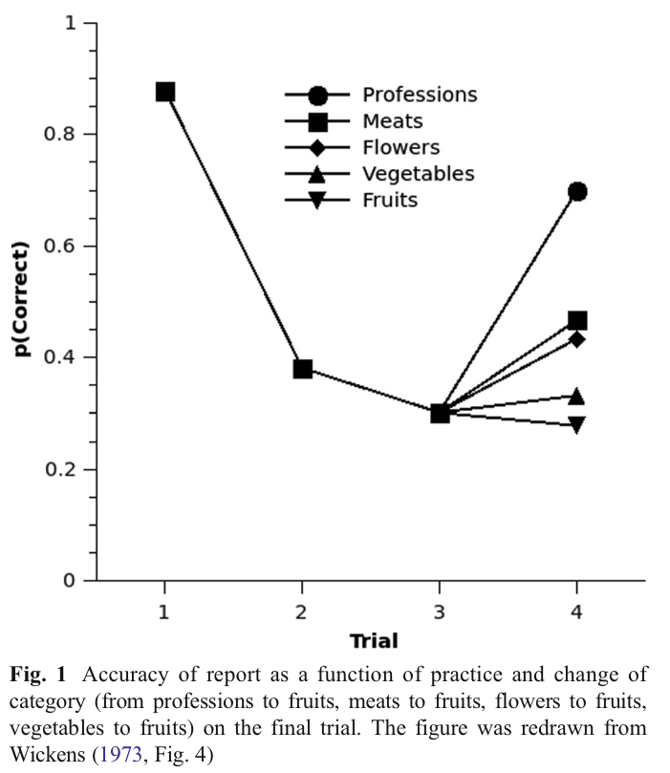
Further Study
Want to investigate whether release from PI also exists in LLM
(Mewhort et al., 2018)

Slide 26
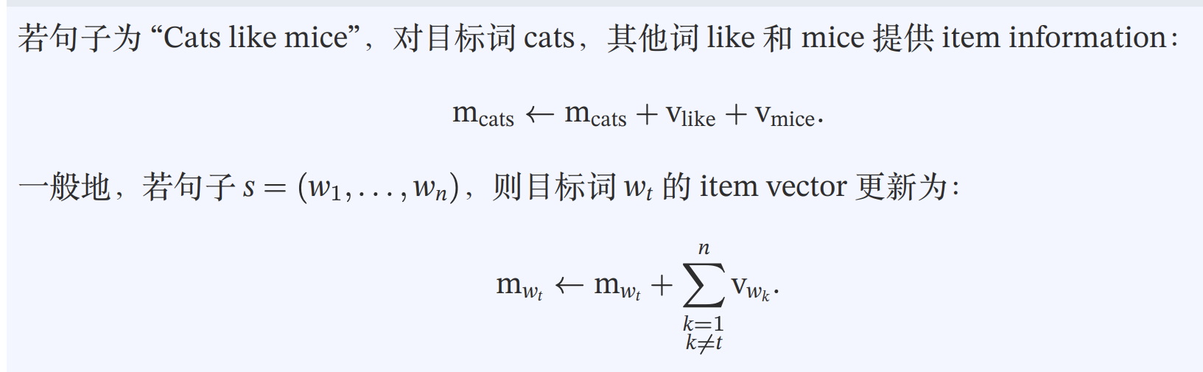
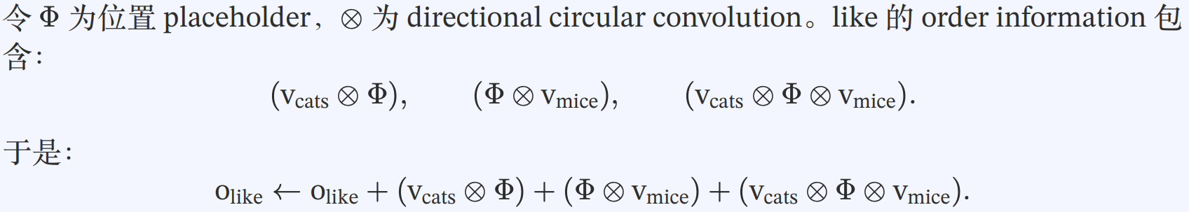
Further Study
Feasible mechanism behind release from PI(RPI)
BEAGLE word vector
Item information
Order information
(Mewhort et al., 2018)

Slide 27
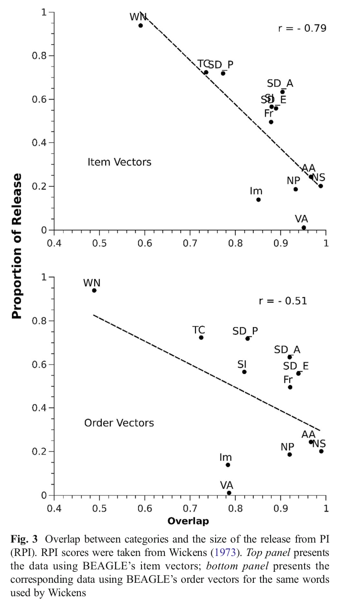
Further Study
(Mewhort et al., 2018)

Slide 28
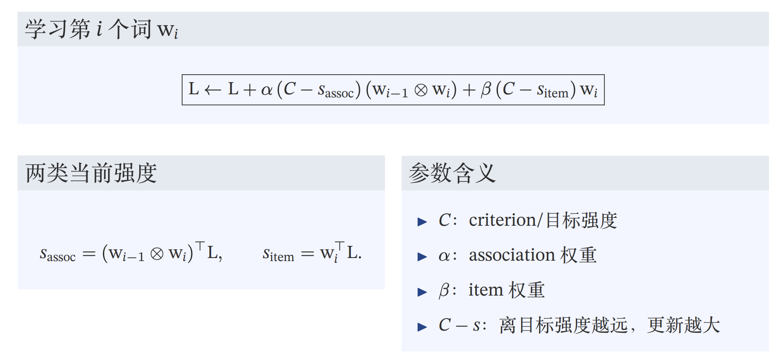
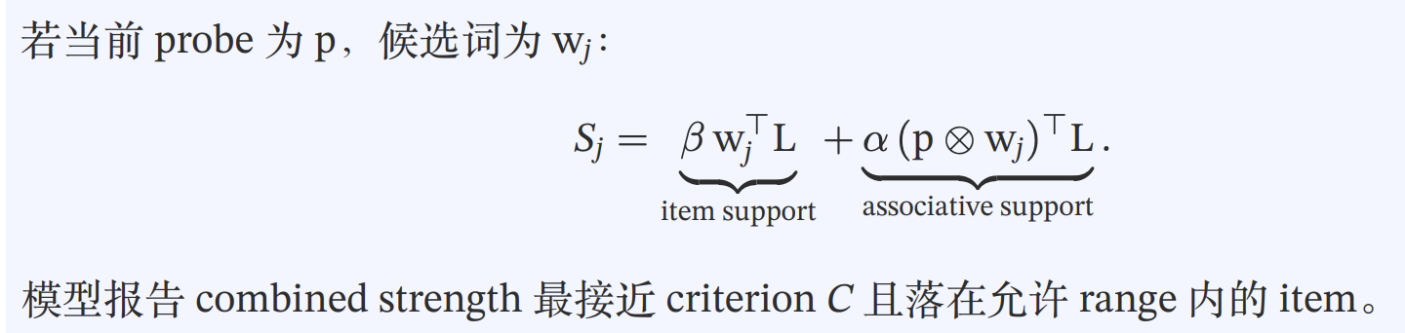
Further Study
A toy model: holographic memory model
(Mewhort et al., 2018)

Slide 29
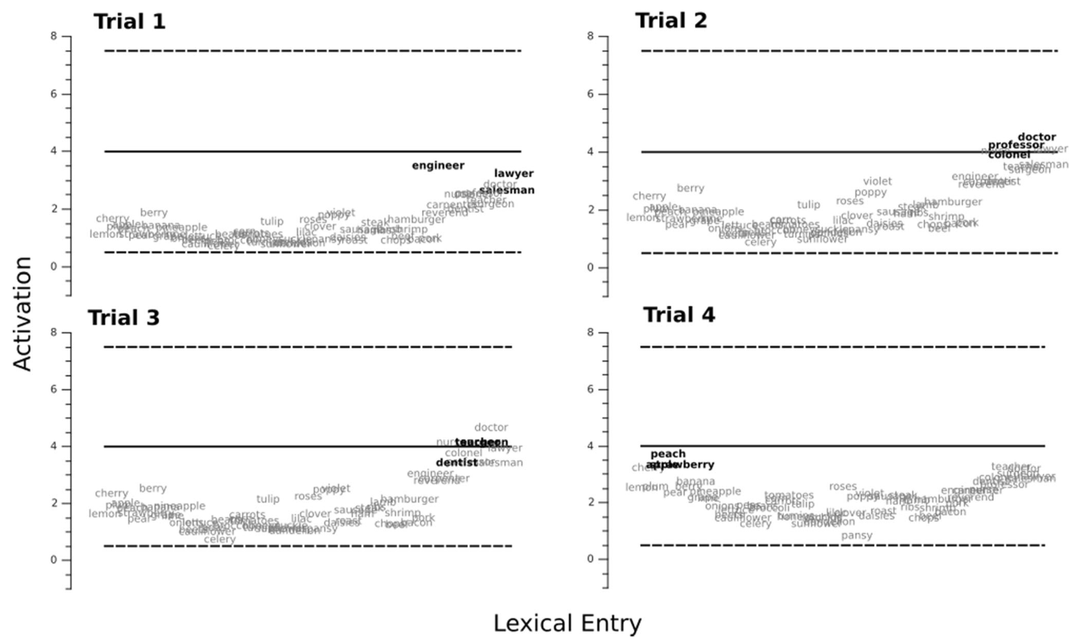
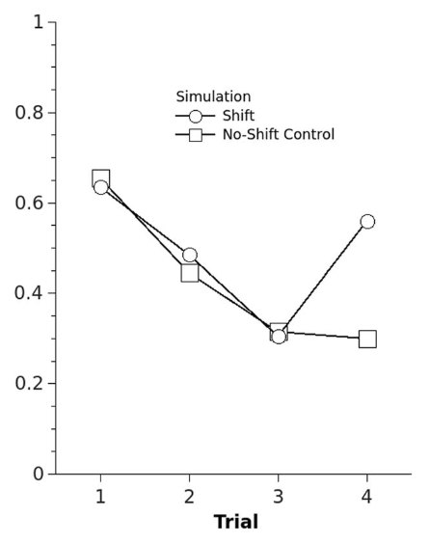
Further Study
(Mewhort et al., 2018)

Slide 30
Further Study
If we aim to study the RPI phenomenon in LLMs, what prompt design strategies should be employed, and what metrics need to be measured?
If some phenomenon is observed in LLM, could we design a toy model to illustrate it also? Or could we track the inner state of such model to elucidate the basic mechanism?
If we understand the underlying principles, can we redesign certain architectures to mitigate this limitation? Furthermore, in doing so, could we draw inspiration from specific mechanisms within the human brain?

Slide 31
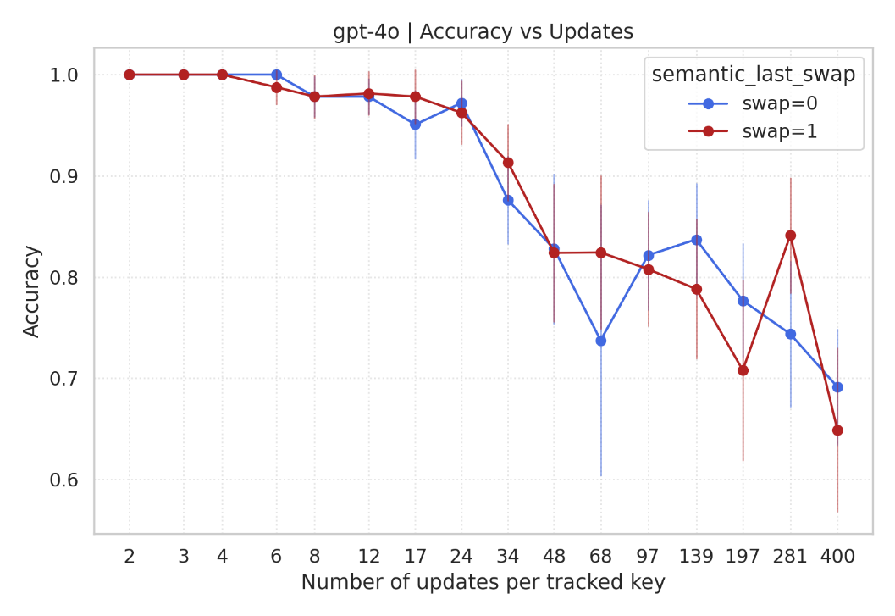
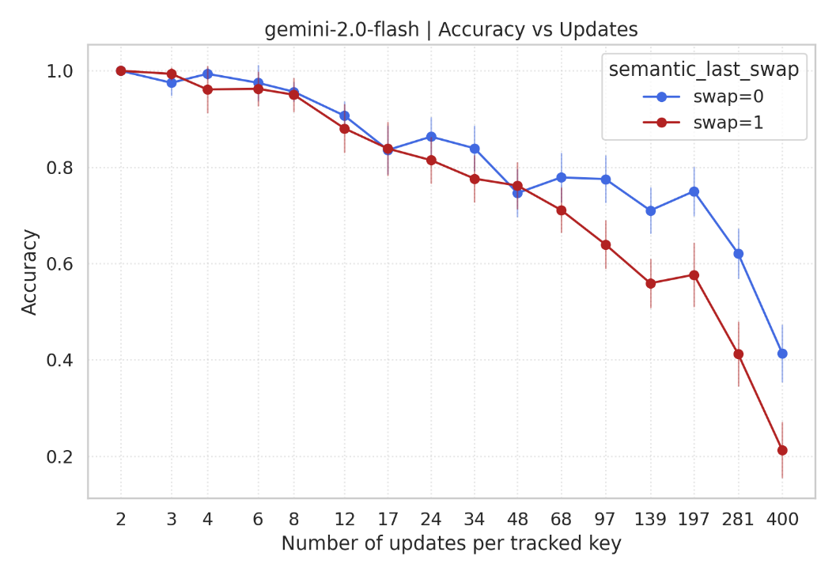
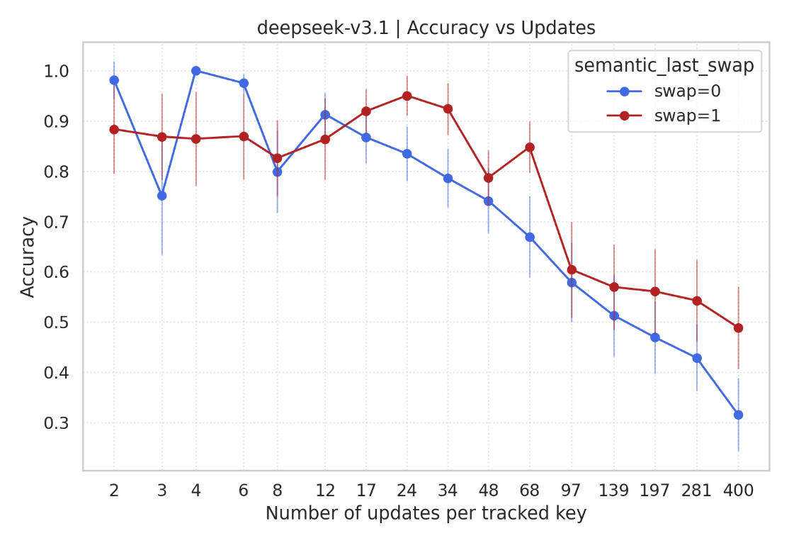
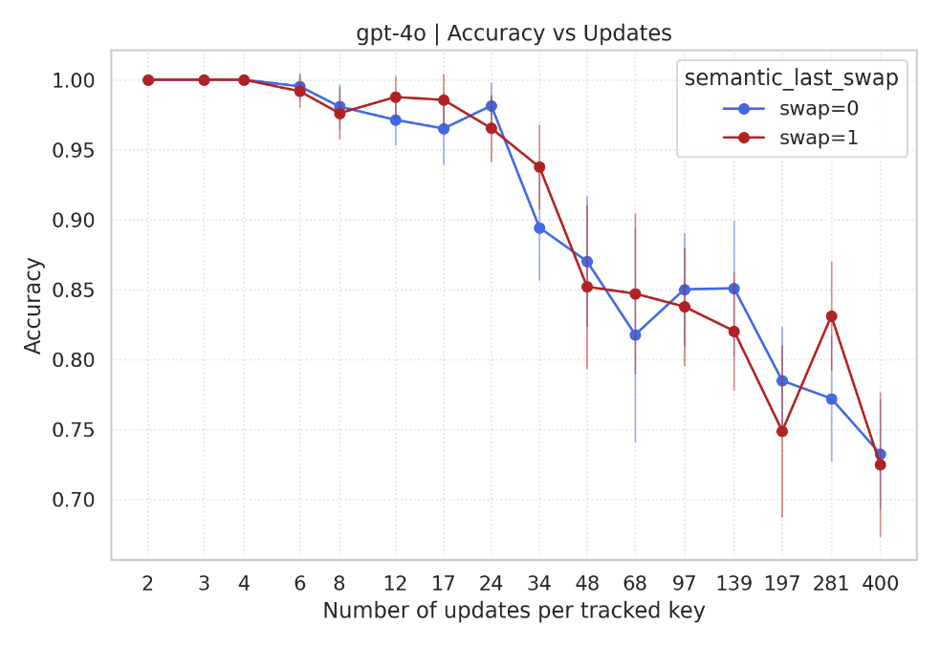
Further Study
Unexpected result:
The semantic change seems to have no influence on the retrieval accuracy.
No obvious difference between two sets.
No consistent result in all models.
31

Slide 32
Serial Dependence: Proceed from Psychology

Slide 33
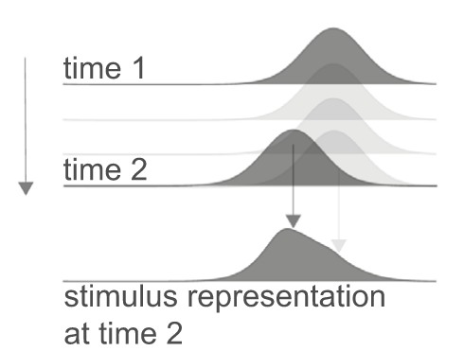
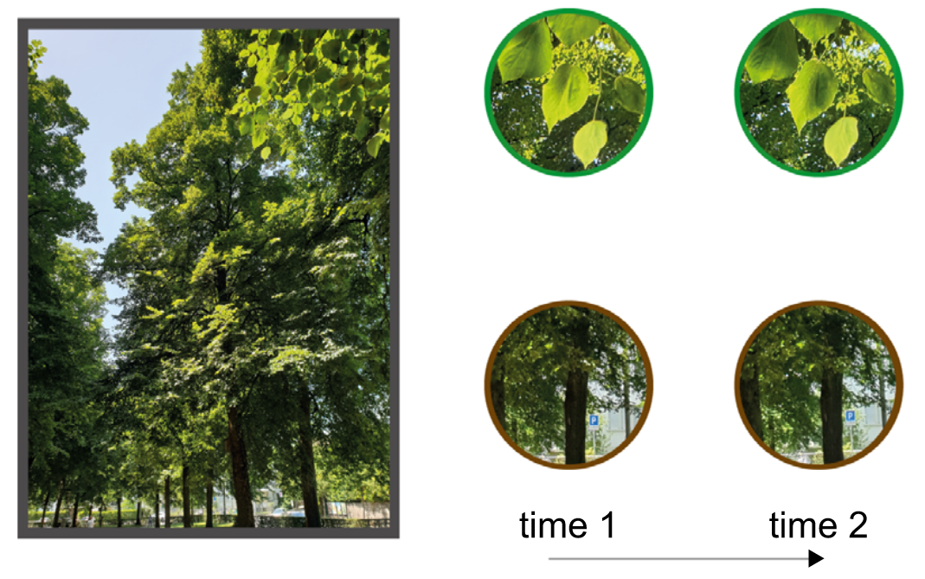
Visual perceptual stability
The visual world casts dynamic images on the retina.
From moment to moment, internal and external noise fluctuates across changes in lighting, occlusion, and viewpoint in the environment.
Yet we perceive coherence and stability in the world.
Serial dependence is an intrinsic mechanism through which our visual system exploits temporal correlations and contextual redundancies by merging similar stimuli that slightly changing over time.
Pascucci et al., Journal of Vision, 2023
Notes:
走在街上时，光线带给我们眼睛的信息是不断变化的。每一次我们移动和转移视线，场景的细节都会发生变化。然而，我们在感知中保持着一种连续感：尽管我们的视野不断被打断和变化，街道旁边的树被视为刚才看到的同一棵树。
大脑如何在变化的世界中保持连续性？最近的许多结果表明，视觉系统利用视觉世界中事件的自相关，利用最近的过去来告知现在的感知。这个观点的核心是序列依赖性。序列依赖性是我们视觉系统的一种内在机制，视觉系统利用时间相关性和情境冗余性，将随时间轻微变化的相似刺激进行整合。这是一种行为偏差，其中当前的视觉决策受到以前看到的刺激历史的影响

Slide 34
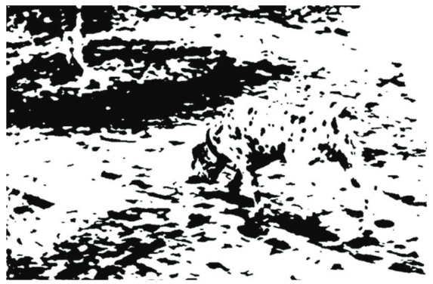

Serial Dependence in Perception
immediate sensory input
current perception
sensory input mapped onto the model
perception
serial dependence
☺
optimizing strategy:
increase signal-to-noise ratios
side effect:
bias responses
contextual information over space and time
past perception
a coherent model
☹

Slide 35
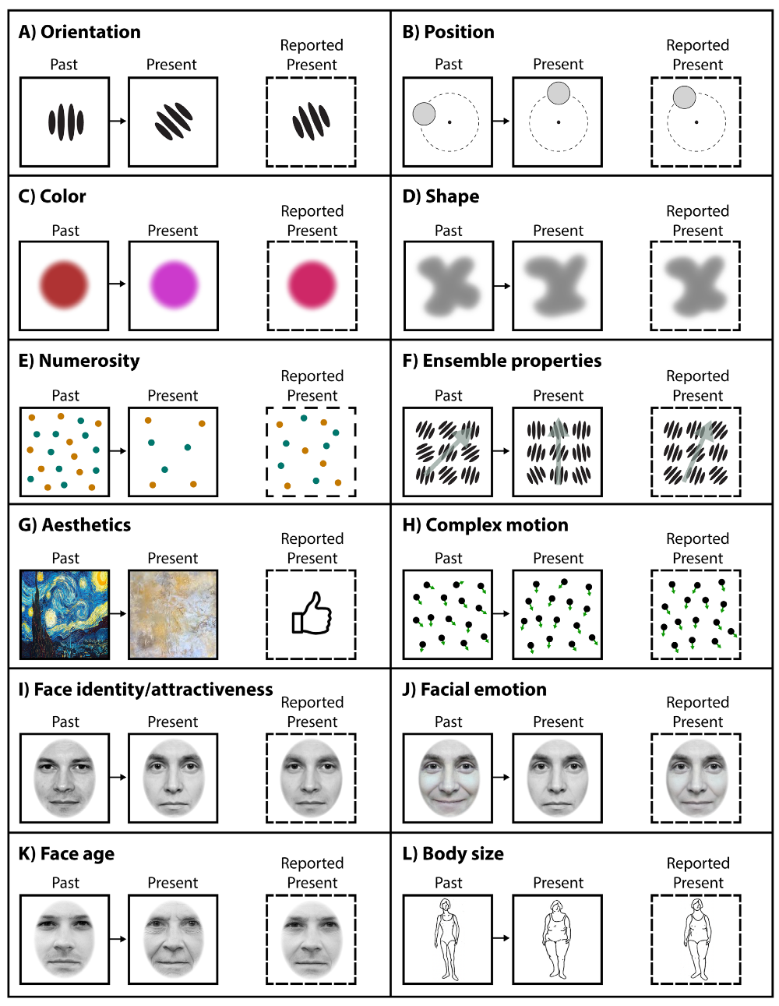
Positive serial dependencies across visual stimuli
The term serial dependence has been used to describe, typically, a positive bias to judge present stimuli as more similar to recent stimuli than they are (i.e., a form of assimilation).
In particular, serial dependence involves a systematic bias in perceptual decisions during psychophysical tasks, which are attracted toward aspects of the stimulus presented one or a few trials before.
For instance, the decision about the orientation of a visual stimulus is biased toward the orientation of the stimulus seen before.
Serial dependence has been investigated with a variety of paradigms, involving different types of stimuli, responses, and analysis.
Manassi, Murai, & Whitney, Journal of Vision, 2023

Slide 36
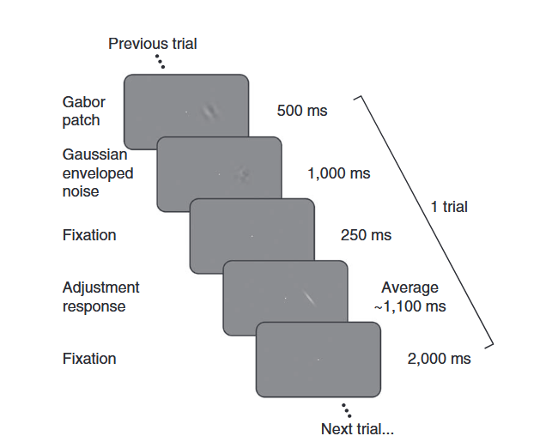



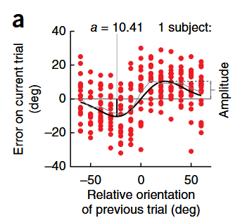


Serial dependence paradigms: Adjustment tasks
In the method of adjustment, a brief stimulus is followed by a response tool that resembles one of the stimulus’ features (e.g., the orientation, size). Participants adjust the tool to match their perception of the feature. This method is also known as a “delayed reproduction task” or simply “reproduction task.”
orientation of Gabor stimuli
attraction
……
Trial N-1
Trial N
Response
On average, adjustment errors (reported minus true orientation) were positively related to the difference in orientation (Δ) between the previous and the present stimulus, showing a bias toward the previous orientation.
$θ_{response}−θ_{N}$
$θ_{N−1}−θ_{N}$
Fischer & Whitney, Nature Neuroscience, 2014
Notes:
Fischer & Whitney (2014) 首先开始定量研究序列依赖性。他们让被试判断一个光栅的方向，在response阶段并调节这条白色bar的角度，来报告他们感知到的方向。就是在这个过程中，他们发现了序列依赖性。举一个例子，比如这是上一个刺激的方向，这是这一试次中刺激的方向，而被试在反应阶段调节出的方向相比于真实的刺激，会稍微的偏向上一个刺激的方向。
如果将很多各式次的结果汇总在一起，它们的平均值就会形成一条这样的曲线，横轴代表上一个刺激的角度与这一个刺激的角度的差异，纵轴代表response报告的角度与实际角度的差异。比如上一个刺激相对于下一个刺激更顺时针，报告出的角度相对于真实刺激也会更顺时针，强烈偏向于先前刺激的方向，体现出吸引性的序列依赖性。随着两个刺激差异增大，效应先增强再减弱，在20度 达到峰值。

Slide 37




Serial dependence paradigms: Forced-choice task
As an example: An inducer stimulus might be presented at one location, and subsequently, two stimuli appear, one at the location of the inducer, the other at a neutral location.
Asking observers to compare a feature of the two stimuli can reveal whether the inducer has changed the perceived features of the stimulus.
Fritsche and colleagues (2017) found that the stimulus at the previous location caused a repulsive bias upon the perceived orientation of the subsequent Gabor, in tasks where forced choices involved both comparative and equality judgments.
two-alternative forced-choice (2AFC) task
point of subjective equality (PSE)
Comparative
(which one is more clockwise?)
Equality judgments
(Is their orientation the same?)
Fritsche, de Lange et al., Current Biology, 2017
Notes:
诱导剂是同时呈现的两个Gabors之一。在典型的调整任务中提出了观察者来重现该Gabor的方向。在每个试验中，调整响应之后是另外两个Gabors的提示，并且观察者被迫选择更逆时针的Gabor。调整后的刺激的方向改变了随后在同一位置出现的Gabor的感知方向，主观平等点发生了显着转移 - 结果与以前的刺激的有吸引力（Fischer＆Whitney，2014年）。然而，使用非常相似的范式，Fritsche及其同事（2017）发现，先前位置的刺激在感知到随后的Gabor的方向上引起了反击的偏见，在此任务中，强制选择涉及比较既涉及比较（例如，哪个是顺时针判断？ Cicchini及其同事（2017）未能复制这种排斥效应，但当诱导剂距离当前刺激5°时，发现有吸引力的偏见（而不是在Fritsche等人，2017年，而不是20°）。
他们的第二条证据设计了一个巧妙的实验，不需要报告刺激的方向，也就是不需要decision-making，而只需要比较两个刺激。首先，他们给了两个inducer让被试对其中一个做反应，然后让他们判断两个新的刺激判断哪一个更顺时针。这条心理物理学曲线的横轴是右边减左边的角度，如果形成了使右边的刺激看起来更顺时针的serial dependence，即更小的角度差异就可以选择右边，那么曲线理应向左偏移。但是，比较inducer不同的两条心理物理学曲线，有利于右边的红色曲线和有利于左边的蓝色曲线比起来，更靠右一些，说明产生的并不是吸引的serial dependence，而是排斥的。
另一个实验也是同样的范式，但判断的不是哪一个更顺时针，而是两个刺激是否看起来相同。没有serial dependence的情况下，应该是以0为中心的高斯分布，而序列依赖性引入的bias会导致波峰位置的移动。横轴代表不存在影响一侧的光栅（unbiased）相对于存在（biased）一侧的角度，如果是右边更顺时针的inducer，需要左边的光栅逆时针旋转来匹配右边的光栅，也就是说，形成了逆时针的影响，即排斥的serial dependence，并且两个实验的PSE是类似的。

Slide 38


Serial dependence paradigms: Postcueing paradigms
In a study by Czoschke and colleagues (2019), participants memorized two consecutively presented clouds of drifting dots and were subsequently cued to report the drift direction of the first or second cloud.
The biases were repulsive from the drift direction memorized within trials but attractive from those memorized on preceding trials. This argued for positive serial dependence across trials and repulsive serial dependence within trials, compatible with repulsive interference between simultaneous working memory representations.
within repulsive; between attractive
serial dependence across trials: the influence of the previous S2 on the current S1
serial dependence within a trial: the influence of the current S1 on the current S2
Czoschke, Bledowski et al., British Journal of Psychology, 2018
Notes:
在Czoschke及其同事（2019年）的一项研究中，参与者记住了两个连续呈现的漂流点的云，随后被提示以报告第一或第二云的漂移方向。这些偏见是从试验中记忆中的漂移方向排斥的，但从先前的试验中记住的偏见是有吸引力的。这是在试验中跨试验和反击序列依赖性的积极序列依赖性，与同时工作记忆表示之间的排斥性干扰兼容。

Slide 39

Further Study
Motivation: to study serial dependence on LLMs
Key idea: human ratings of words along certain semantic dimensions such as concreteness, valence, and arousal can be well predicted from the linear regression of semantic vectors, suggesting that these ratings can serve as one-dimensional, behaviorally meaningful projections of semantic space. (Using large language models to estimate features of multi-word expressions: Concreteness, valence, arousal. Behavior Research Methods)
Task: The model rated each word on a scalar semantic dimension, such as concreteness or valence, across a sequential stream of trials.
For example:

Slide 40


Further Study
Stimulus value: we use
1. Human ratings on the same task (printed human norm data)
2. LLMs’ average rating without conversation history
as the stimulus value of each words
Analysis: first removed stimulus-specific bias, and then analyzed the residual response as a function of the difference between the previous and current stimulus values.
Result: did not find a robust canonical serial-dependence effect in this cleaner one-dimensional setting.

Slide 41


Further Study
Random walk tracking task on pure transformer will arouse serial dependence;
But if dataset for training is shuffled randomly, the effect will fade away. Even if the attention is forced to focus on previous tokens.

Slide 42

Further Study
Further directions:
1. Investigate the mechanism inside transformer to see why there is no serial dependence in LLMs.
2. Better design another experiment to further test whether there is serial dependence in LLMs.
For 2 → Reminder:
1. Should remove artefacts (see Box1 in Continuity fields enhance visual perception through positive serial dependence).
2. Limit the length of conversation history in your input (to save money and to make better control of your experiment).
另一个源自研究过程的提醒: Use Sentence-BERT to map words to vector is a great method to study semantic relationship between words, but when it comes to serial dependence, things get more complex because there are lots of artefacts that we should avoid, and a high-dimensional variable with complex geometry (like semantic vectors in the Sentence-BERT embedding space) will cause artefacts which is hard to remove.

Slide 43
Research Proposal: Discussion

Slide 44
谢 谢 ！

Slide 45
References
Gong, D., & Zhang, H. (2024). Self-Attention Limits Working Memory Capacity of Transformer-Based Models. NeurIPS 2024 Workshop on Behavioral Machine Learning. arXiv:2409.10715v2；
Gong, D., Wan, X., & Wang, D. (2024). Working Memory Capacity of ChatGPT: An Empirical Study. Proceedings of the AAAI Conference on Artificial Intelligence, 38(9), 10048–10056. https://doi.org/10.1609/aaai.v38i9.28868;
Keppel, G., & Underwood, B. J. (1962). Proactive inhibition in short-term retention of single items. Journal of Verbal Learning and Verbal Behavior, 1, 153–161;
Wickens, D. D. (1973). Some characteristics of word encoding. Memory & Cognition, 1, 485–490. https://doi.org/10.3758/BF03208913

Slide 46
References
Wang, C., & Sun, J. V. (2025). Unable to Forget: Proactive Interference Reveals Working Memory Limits in LLMs Beyond Context Length. arXiv preprint arXiv:2506.08184 ;
Mewhort, D. J. K., Shabahang, K. D., & Franklin, D. R. J. (2018). Release from PI: An analysis and a model. Psychonomic Bulletin & Review, 25, 932–950.

