Slide 1
Serial Dependence: Proceed from Psychology

Slide 2
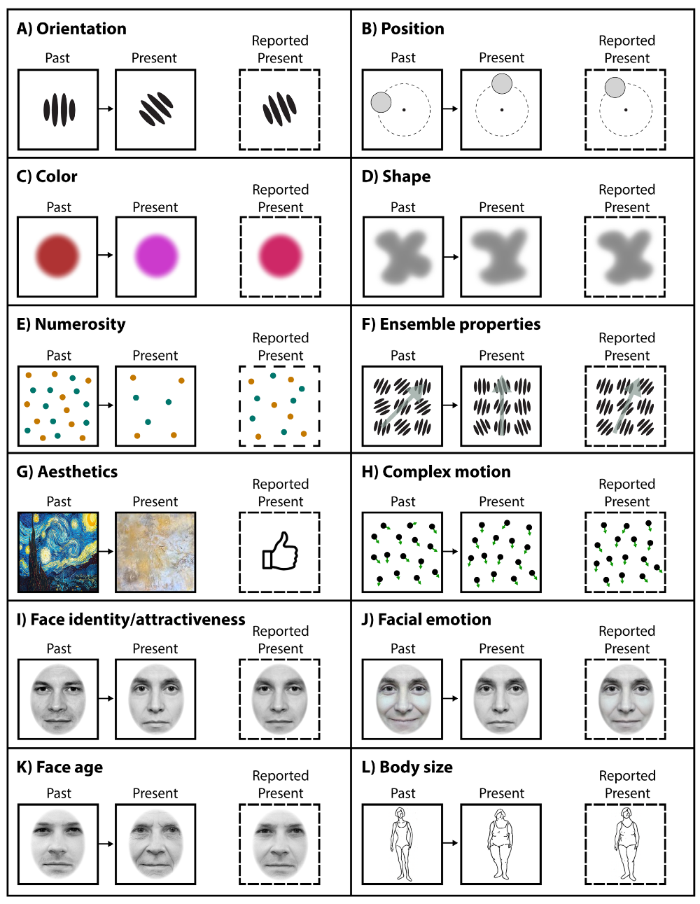
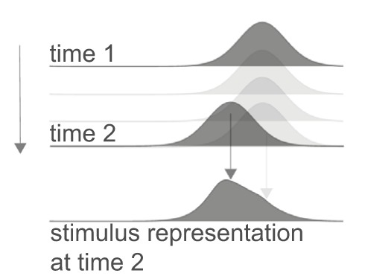
Serial Dependence in humanity

Slide 3
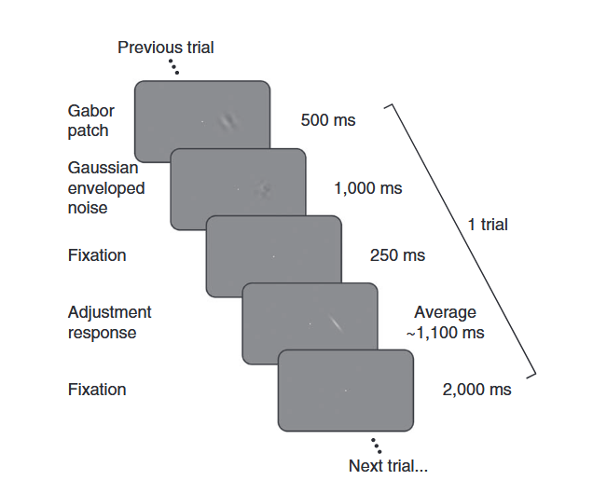



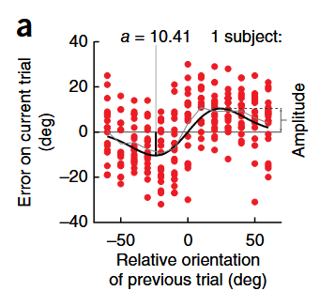


Serial dependence paradigms: Adjustment tasks
In the method of adjustment, a brief stimulus is followed by a response tool that resembles one of the stimulus’ features (e.g., the orientation, size). Participants adjust the tool to match their perception of the feature. This method is also known as a “delayed reproduction task” or simply “reproduction task.”
orientation of Gabor stimuli
attraction
……
Trial N-1
Trial N
Response
On average, adjustment errors (reported minus true orientation) were positively related to the difference in orientation (Δ) between the previous and the present stimulus, showing a bias toward the previous orientation.
$θ_{response}−θ_{N}$
$θ_{N−1}−θ_{N}$
Fischer & Whitney, Nature Neuroscience, 2014
Notes:
Fischer & Whitney (2014) 首先开始定量研究序列依赖性。他们让被试判断一个光栅的方向，在response阶段并调节这条白色bar的角度，来报告他们感知到的方向。就是在这个过程中，他们发现了序列依赖性。举一个例子，比如这是上一个刺激的方向，这是这一试次中刺激的方向，而被试在反应阶段调节出的方向相比于真实的刺激，会稍微的偏向上一个刺激的方向。
如果将很多各式次的结果汇总在一起，它们的平均值就会形成一条这样的曲线，横轴代表上一个刺激的角度与这一个刺激的角度的差异，纵轴代表response报告的角度与实际角度的差异。比如上一个刺激相对于下一个刺激更顺时针，报告出的角度相对于真实刺激也会更顺时针，强烈偏向于先前刺激的方向，体现出吸引性的序列依赖性。随着两个刺激差异增大，效应先增强再减弱，在20度 达到峰值。

Slide 4
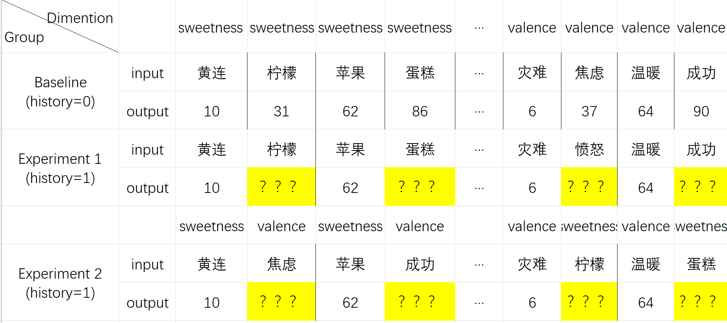
Our Paradigm:
Purpose: In the experiment of testing the serial dependence effect of a large model through vocabulary scoring, the continuity of vocabulary semantics is tested to determine whether it is related to the serial dependence effect

Slide 5
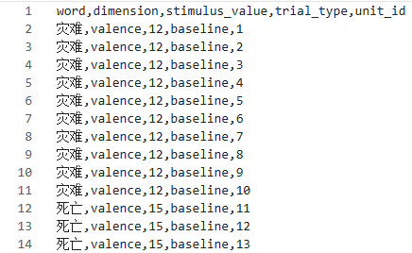
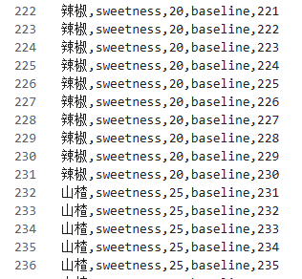
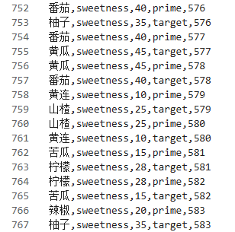
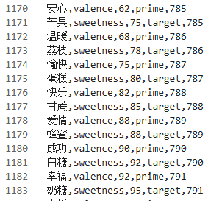
Our Paradigm:
Prompts : 你正在参加一个连续心理判断实验，每个试次会给出一个词语和一个评价维度，请你根据对该词 语意思的整体理解，为这个词语在其维度中进行打分。评分规则：1. 输出1-100之间整数。2. 只 能输出数字，不输出解释。3. 根据当前词语和当前任务自然判断。
评价维度：情绪效价：1 = 极端消极，50 = 中性，100 = 极端积极；味觉甜度：1 = 极苦或无甜味， 50 = 中性，100 = 极甜
Baseline
Same Domain
Cross Domain

Slide 6
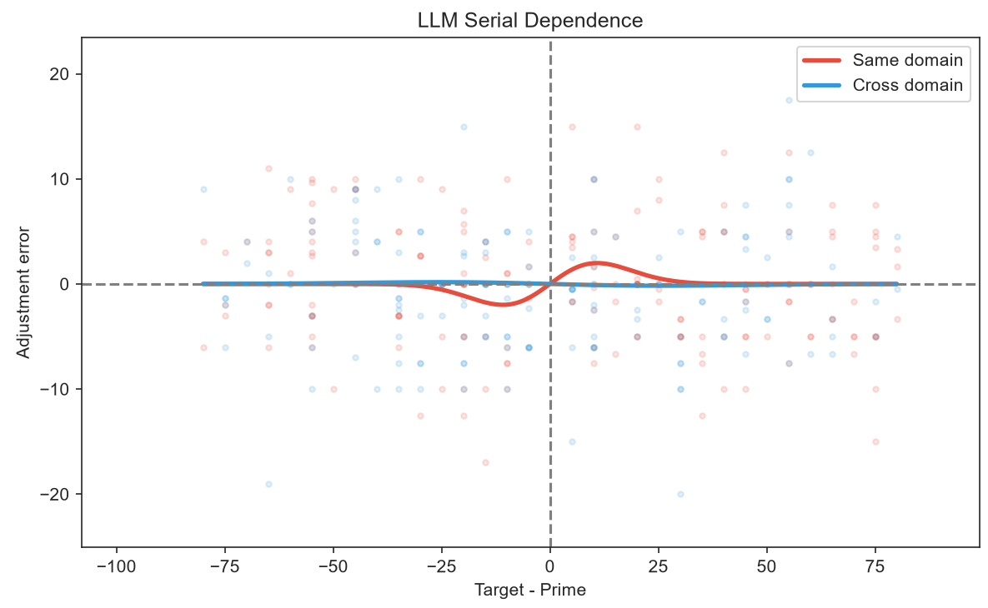
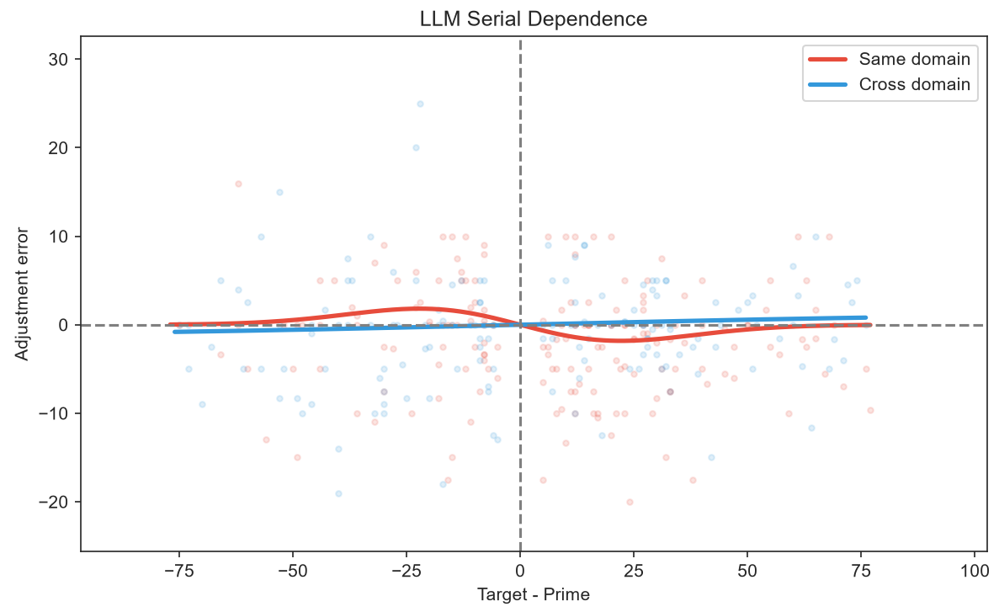
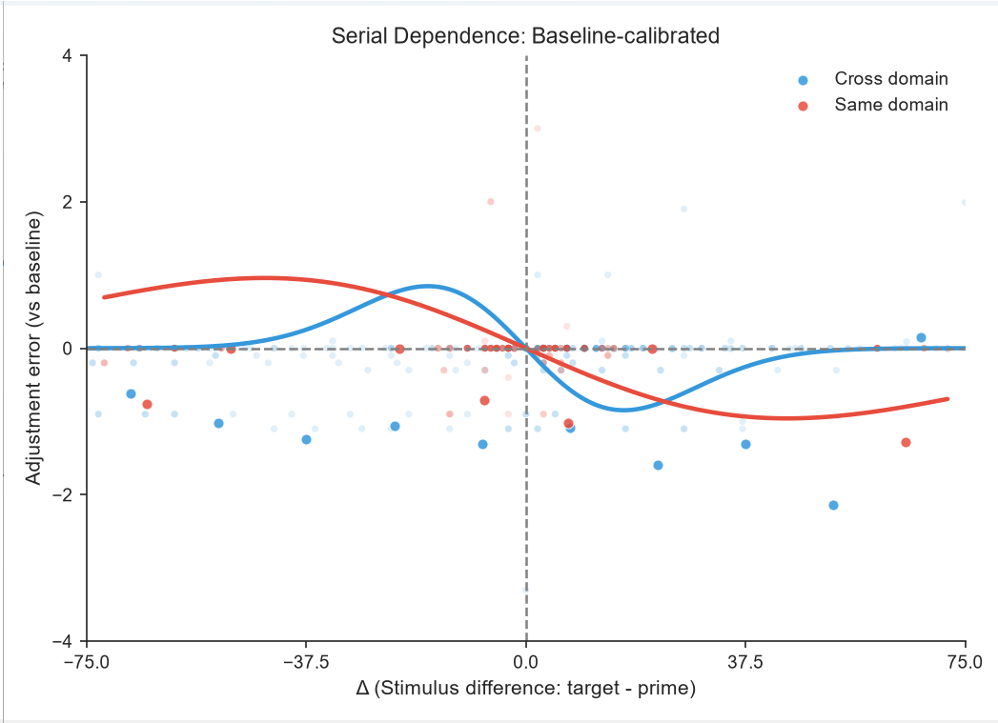
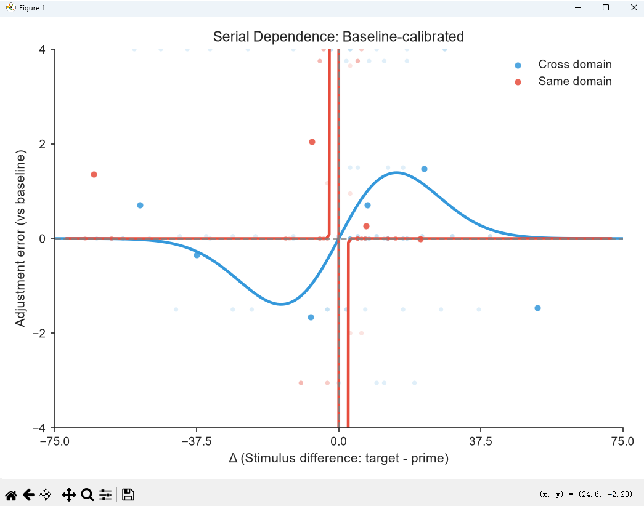
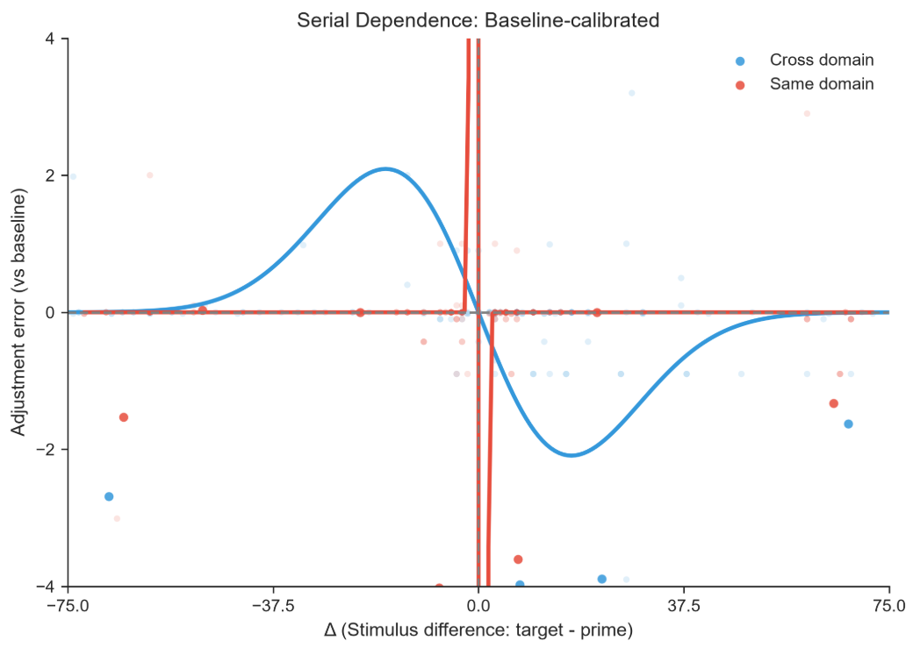
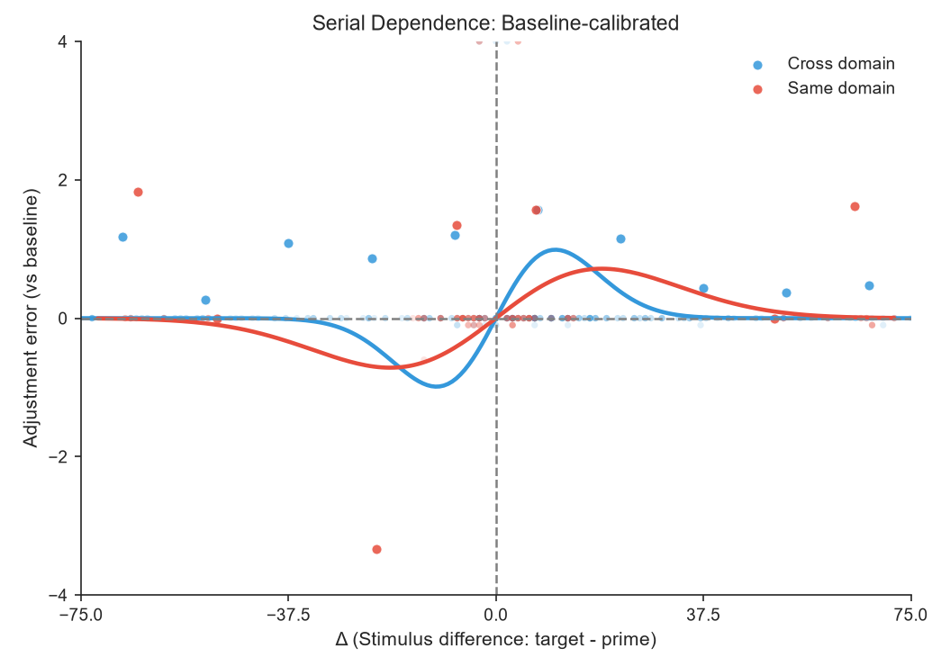
Result：

Slide 7
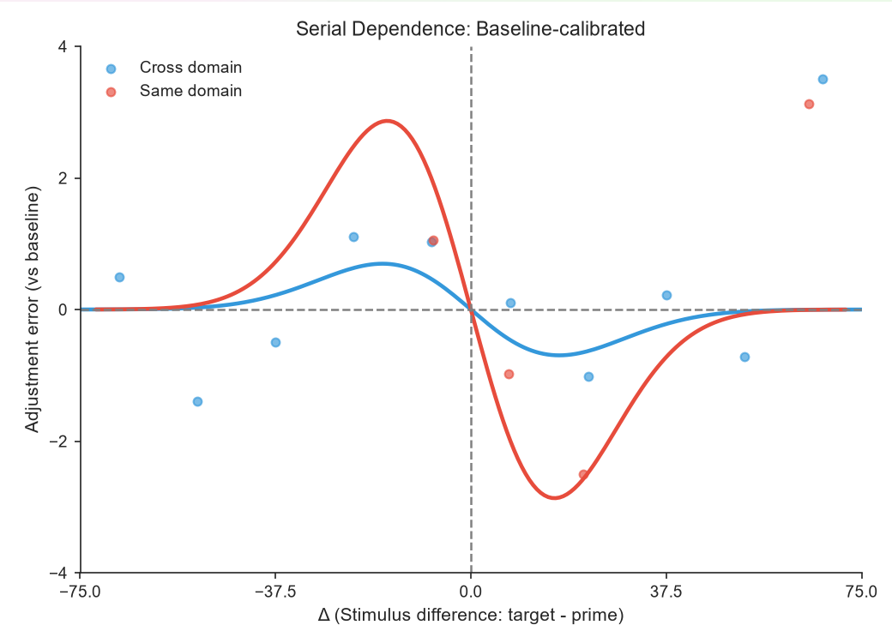
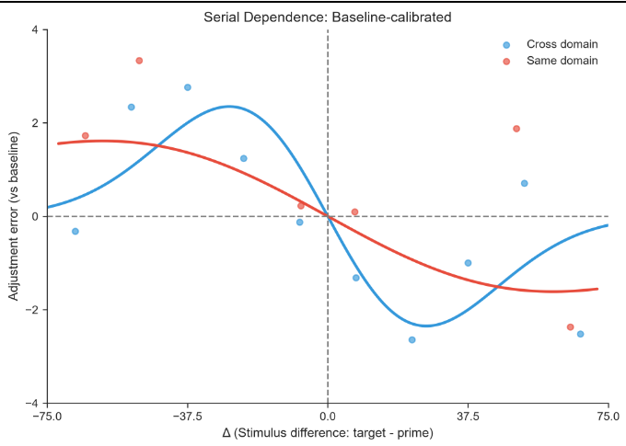
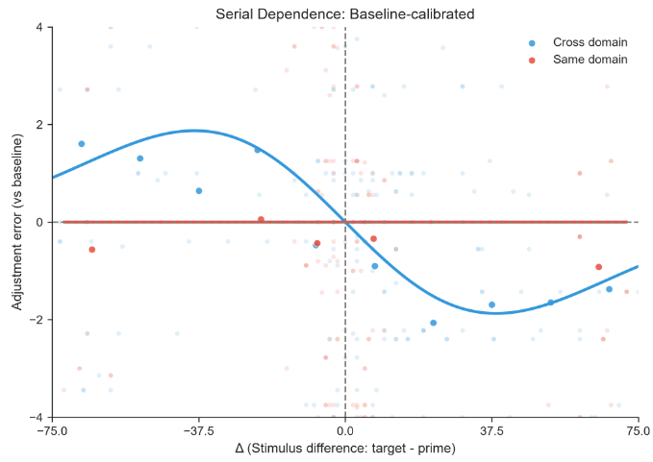
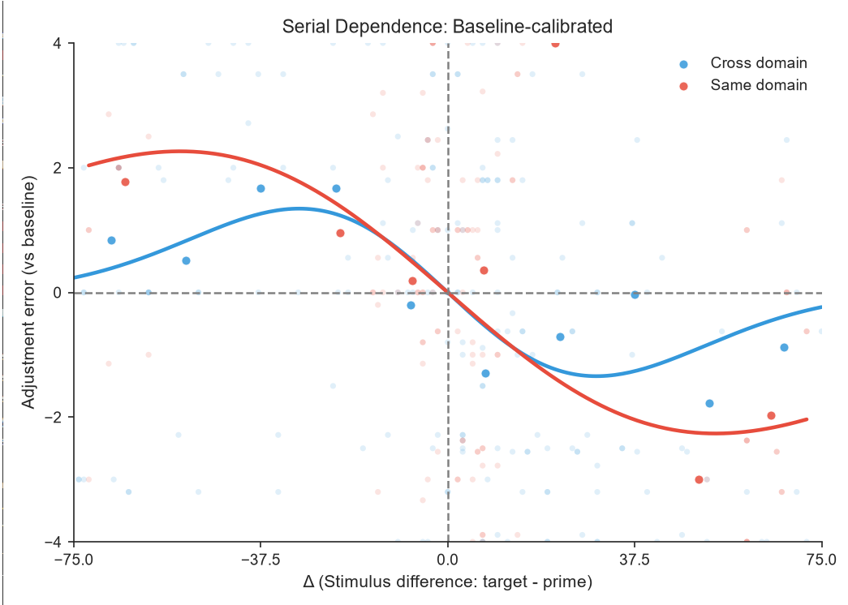
Result：

Slide 8
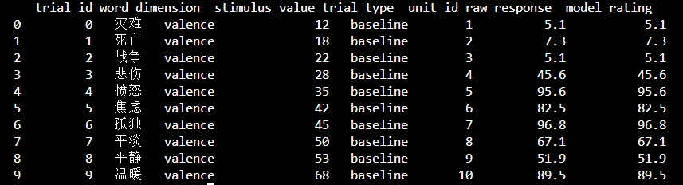
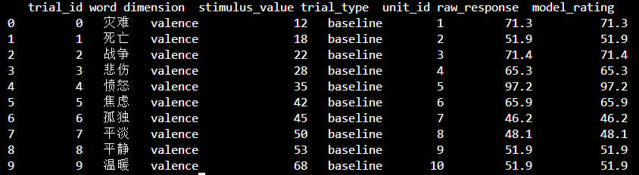
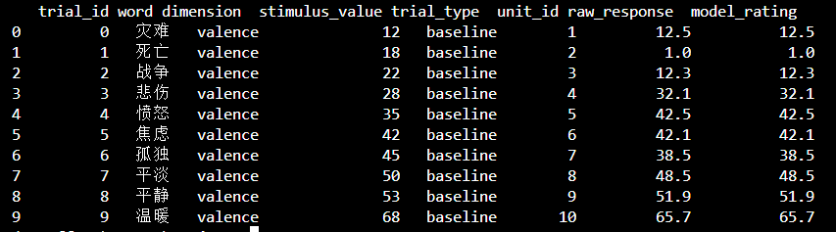
Result：
Qwen3 0.6B-Base
Qwen3 1.7B-Base
Qwen3 4B-Base

Slide 9
Further study
Using servers to validate Qwen3-4B-Base scoring and its serial dependence effects
Combining multiple random number seeds to fit images
Attempt to obtain a stable curve by adjusting parameters
Increasing memory length to observe changes in serial dependence effects
Study the specific mechanism of serial dependence effects within large language models through methods

