Slide 1

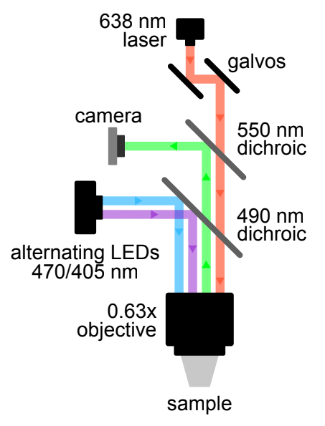

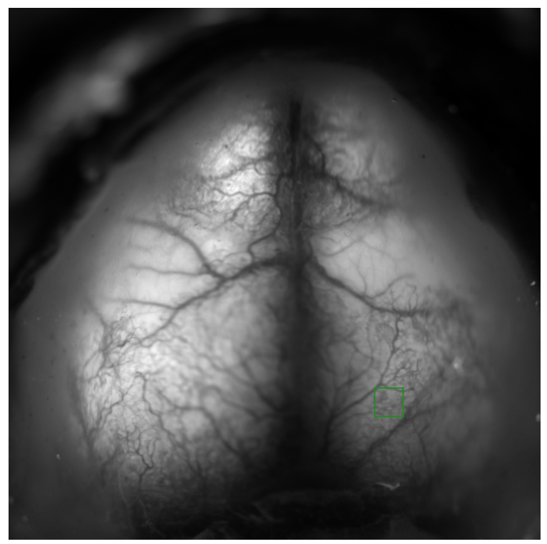
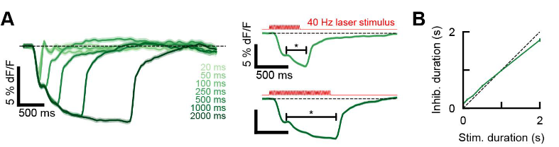
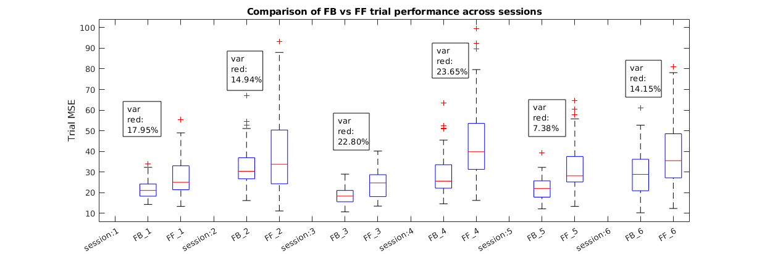
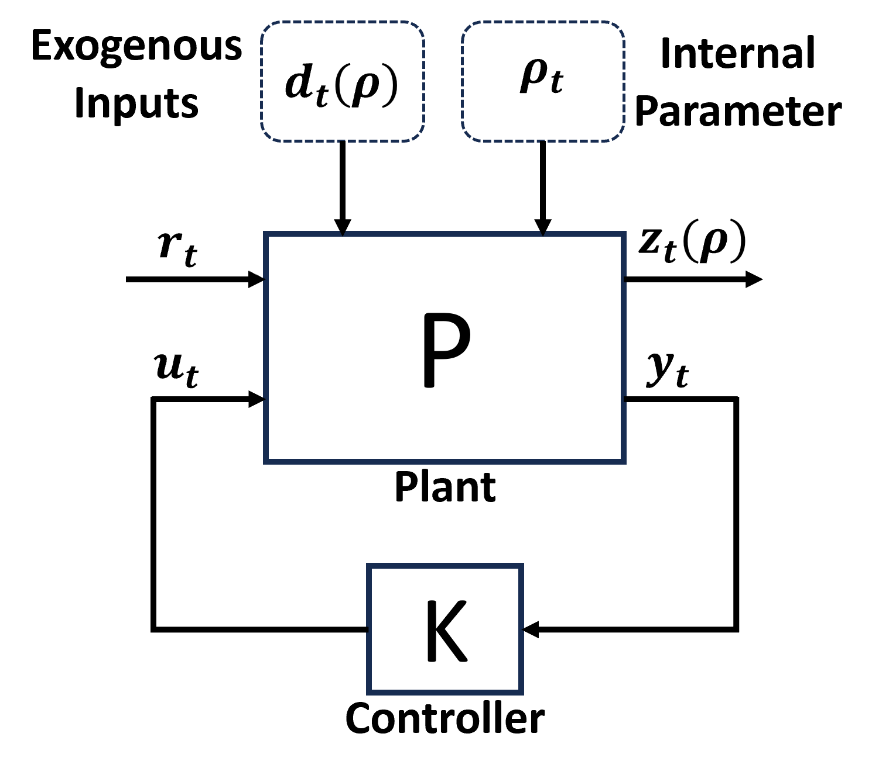
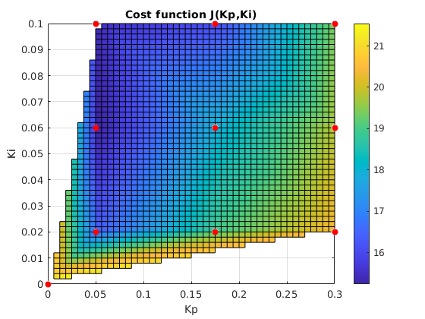
Towards Data Driven Feedback for Cortical Activity
Aditya Deole, Anna Li, Nick Steinmetz, Mehran Mesbahi, Eric Shea-Brown
University of Washington
Preliminary System Analysis
System Design
Results
Optogenetic stimulation and high dimensional WF imaging provides a system level view of the brain.
Using Control Theoretic tools for this system we design a control policy which can statistically show regulariz-ability of cortical dynamics.
We assume a Linear parameter varying model exists for the latent cortical states which approximates the true non-linear dynamics :
Assumptions:
Parameter varying Linear Dynamics
Stationary dynamics explain the trial averaged responses
Exogenous inputs and disturbances are stationary
Objective: Demonstrate signal tracking across trials using the PI controller
Reference signal tracking is improved due to feedback signal begin able to perform disturbance rejection and nonlinear compensation
Local optogenetic stimulation causes cortical inhibition
-Nonlinear response with disturbance and variability across trials
-Monotonic behavior is observed over trial averaged responses
Controller parametrization:
Feedforward Controller:
Assuming monotonic response between input and output we select a linear controller using linear regression:
FeedBack Controller
PI control structure can guarantee stability under feasible gains, if monotonic relationship is valid:
The Averaged Linear System can be represented for latent and integral states as follows:
Experiment
System output is measured at a fixed location on the cortex using spatial average of WF image
Single input to the system is the intensity of the laser applied at a fixed region
Trial is defined as 3sec window where reference signal is –5% dF/F
Controller Evaluation
The controller can be evaluated by computing the approximation of a loss function pertaining to trial averaged tracking error
Data Driven Approach to Controller Optimization
Assuming linear system and stationarity assumptions hold, we use a model free policy optimization approach to select controller gains Kp, Ki based on controller evaluations.
Procedure:
Sample a policy :: K << K + U
Collect data for N trials, compute J(K)
Estimate gradient
Gradient Descent
CONCLUSIONS
Optional section, list as appropriate

