Slide 1


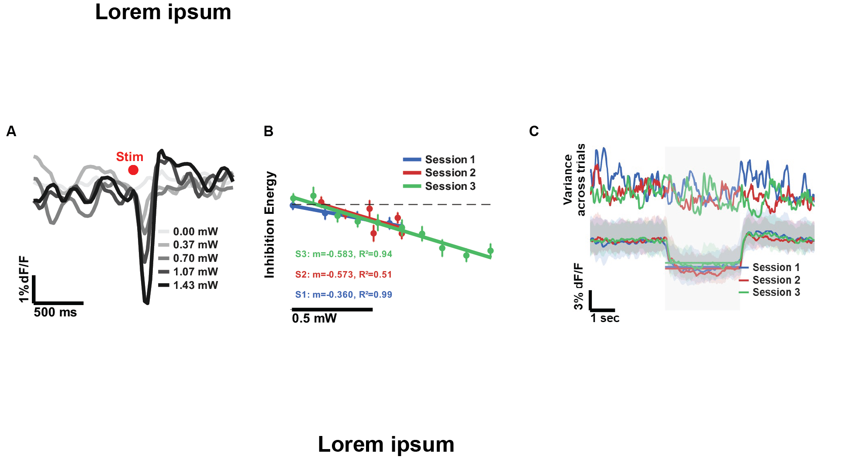
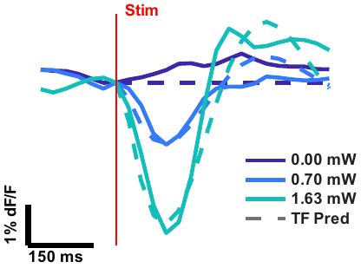
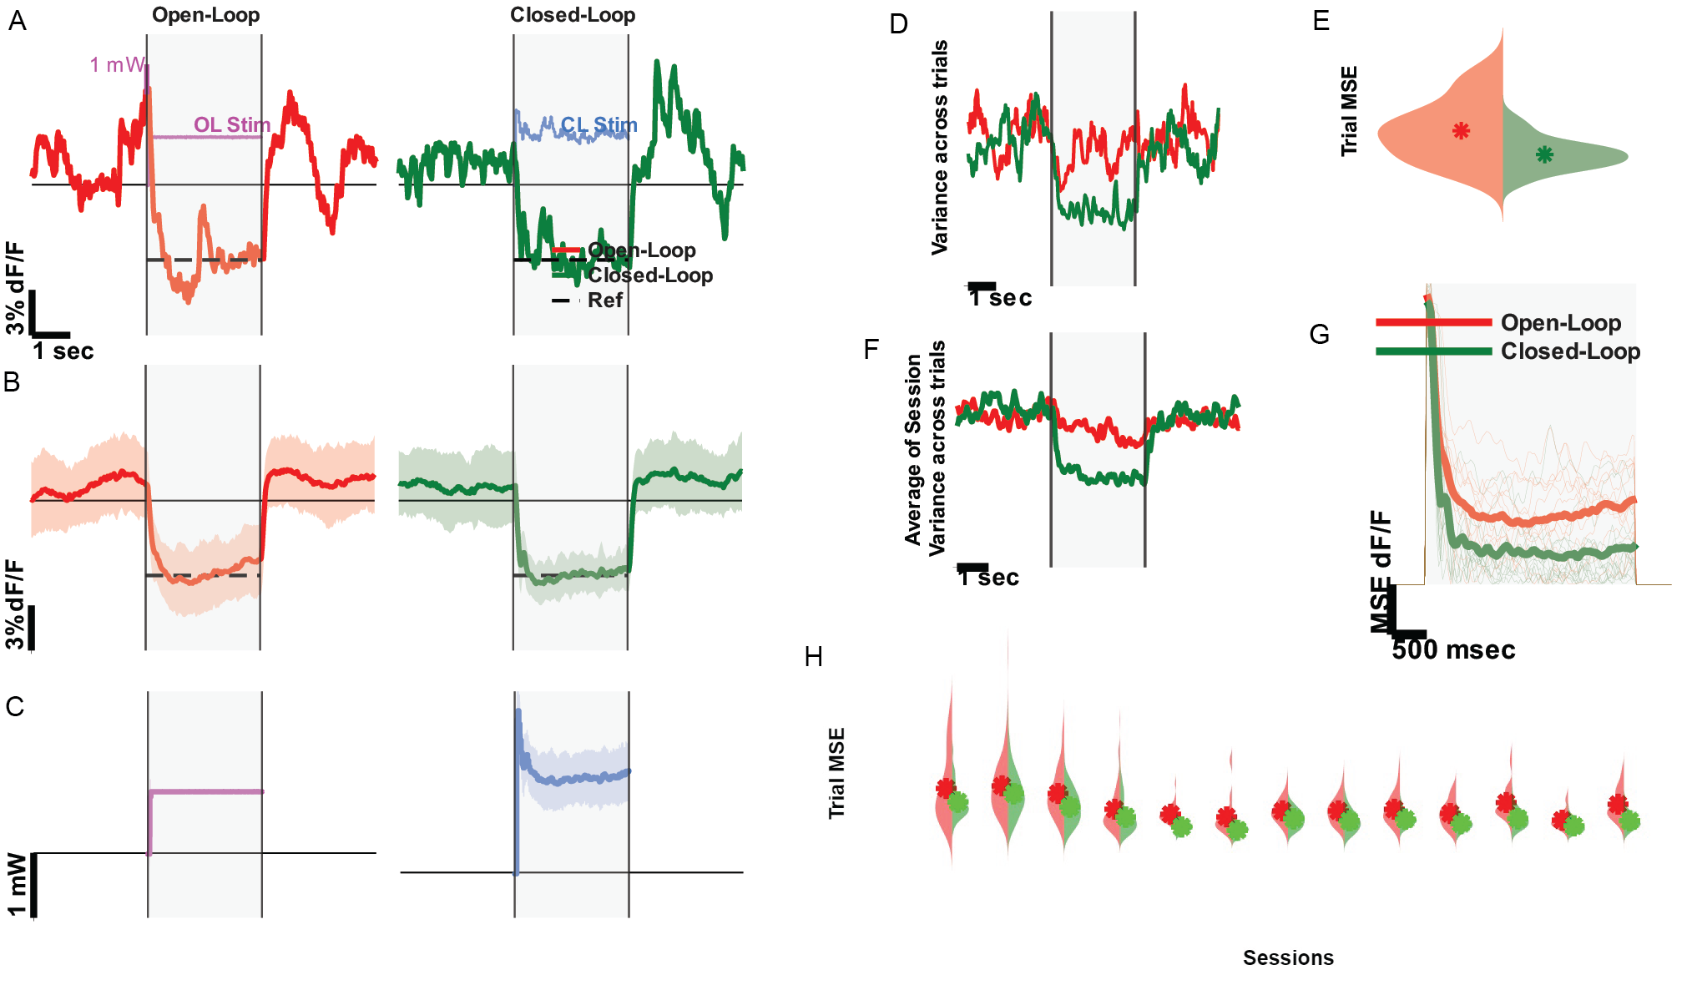
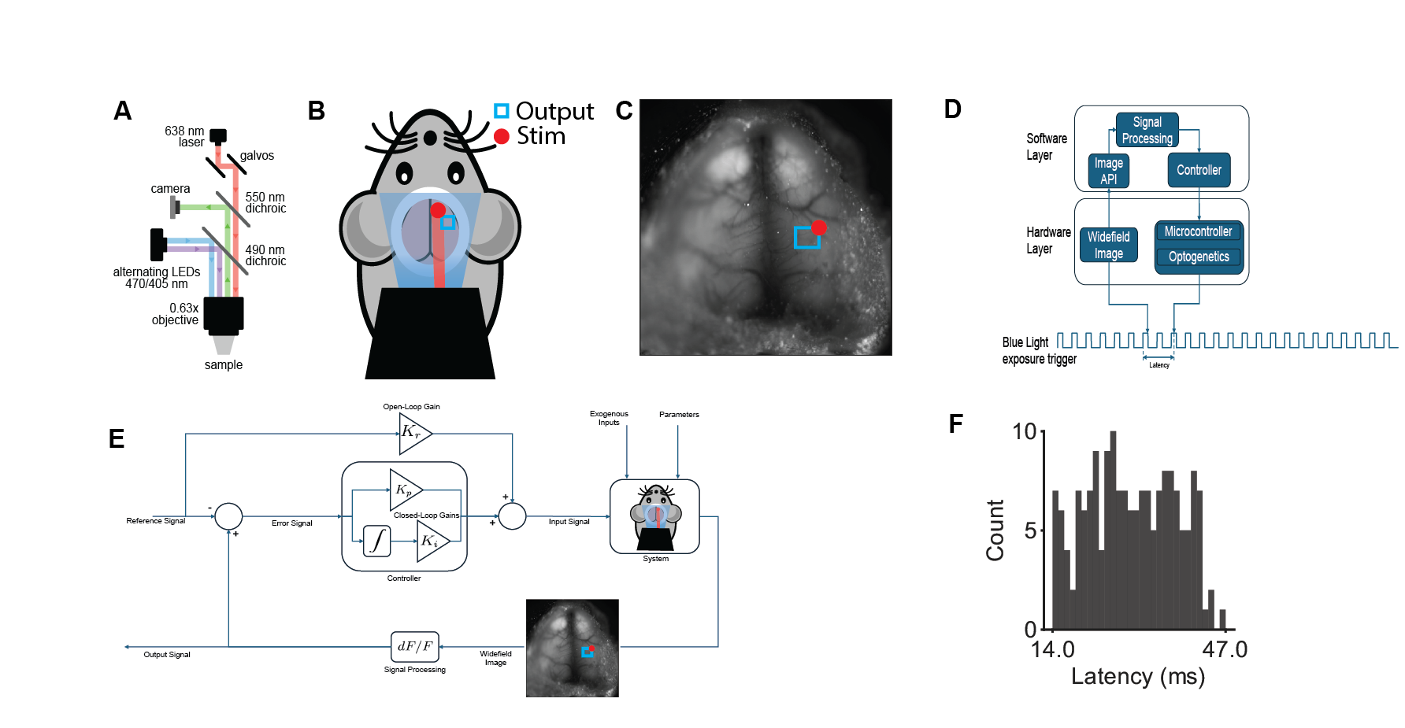
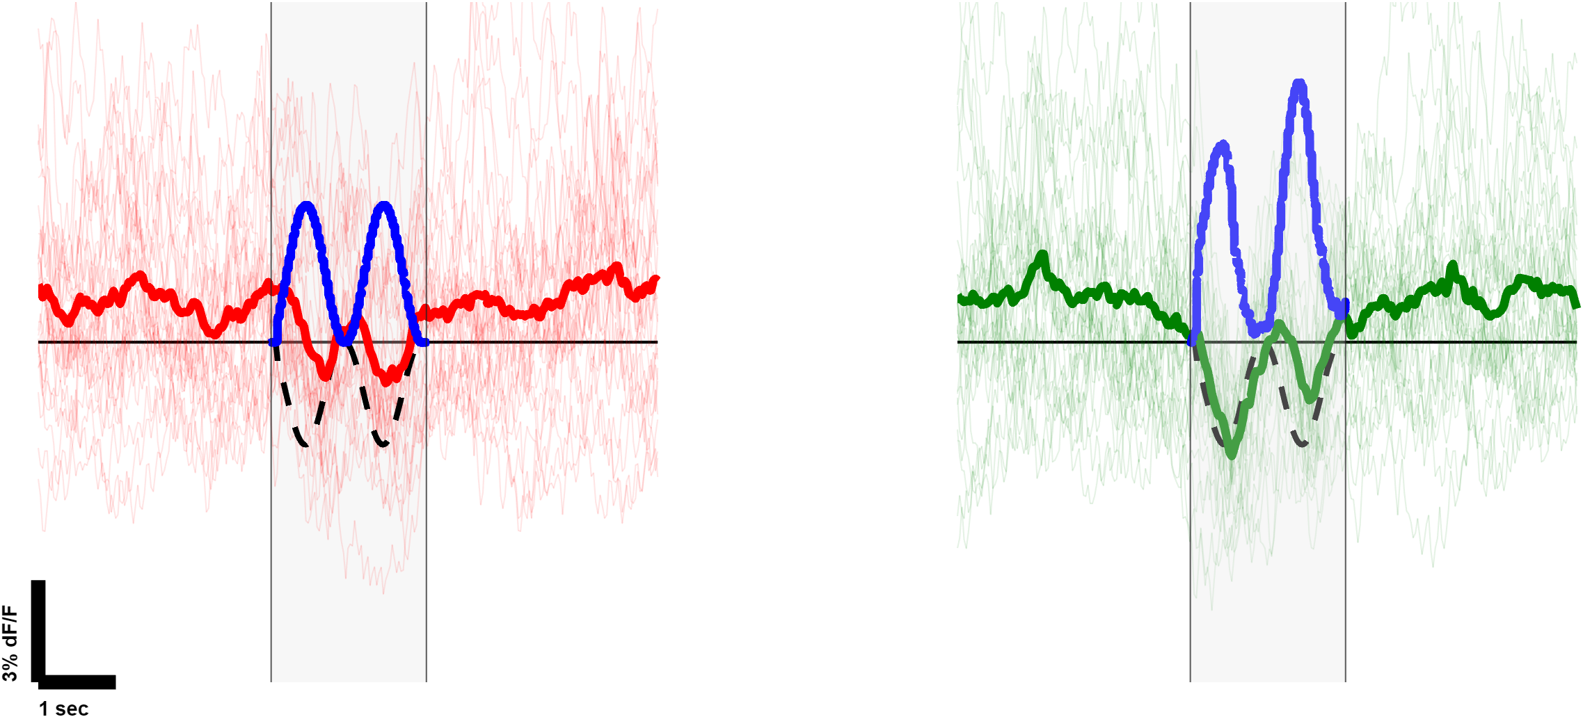
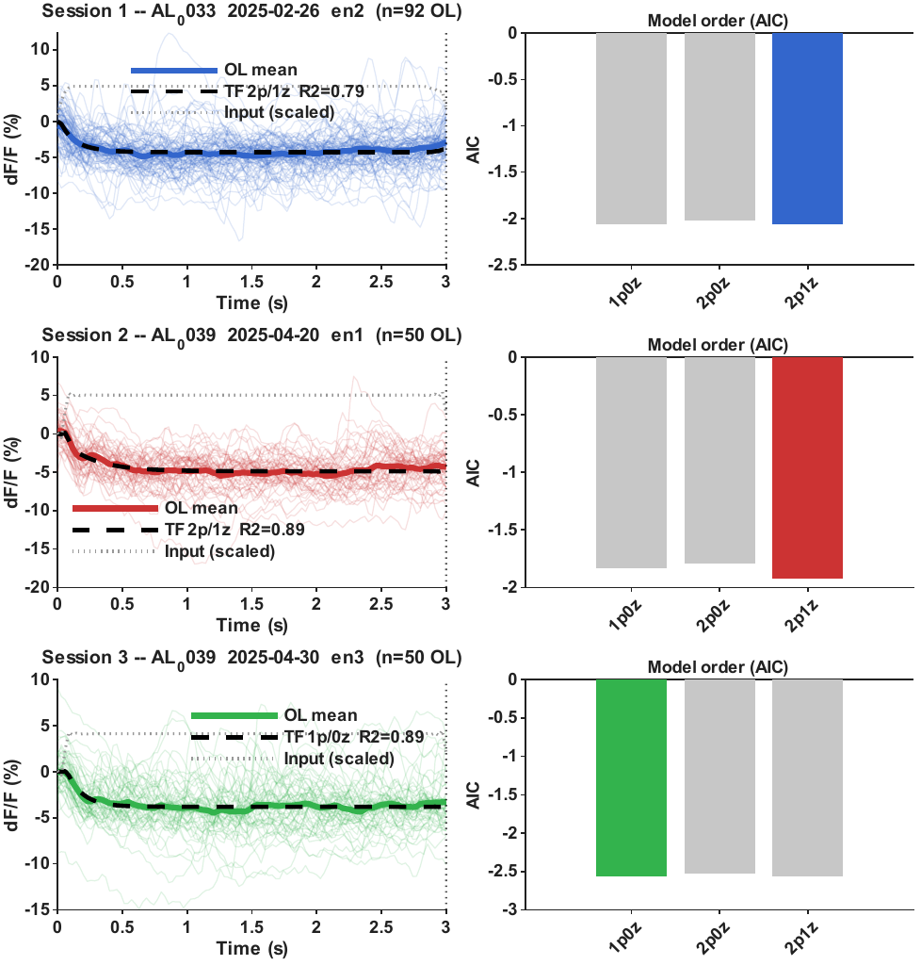
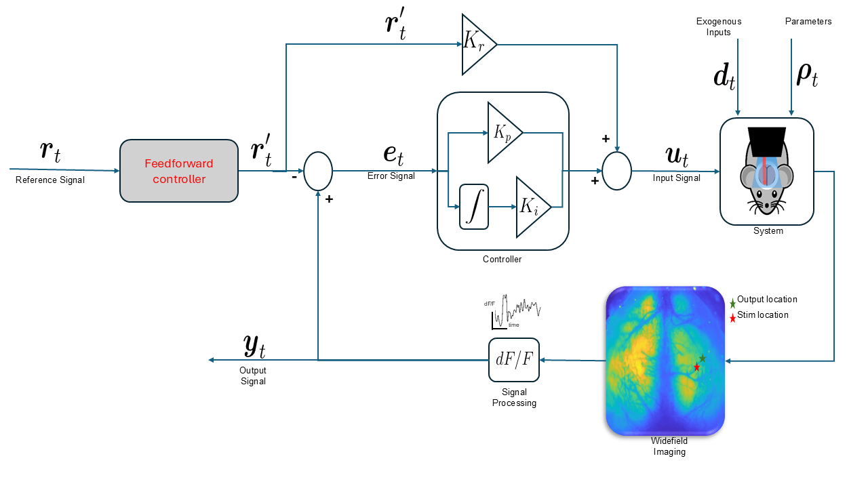
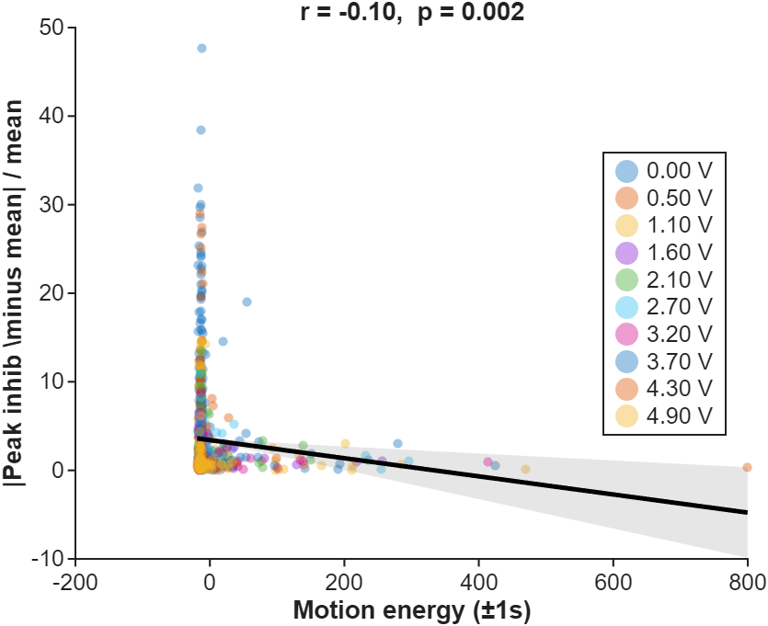
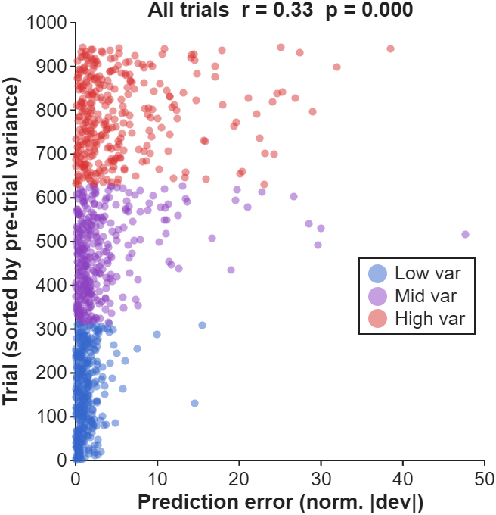
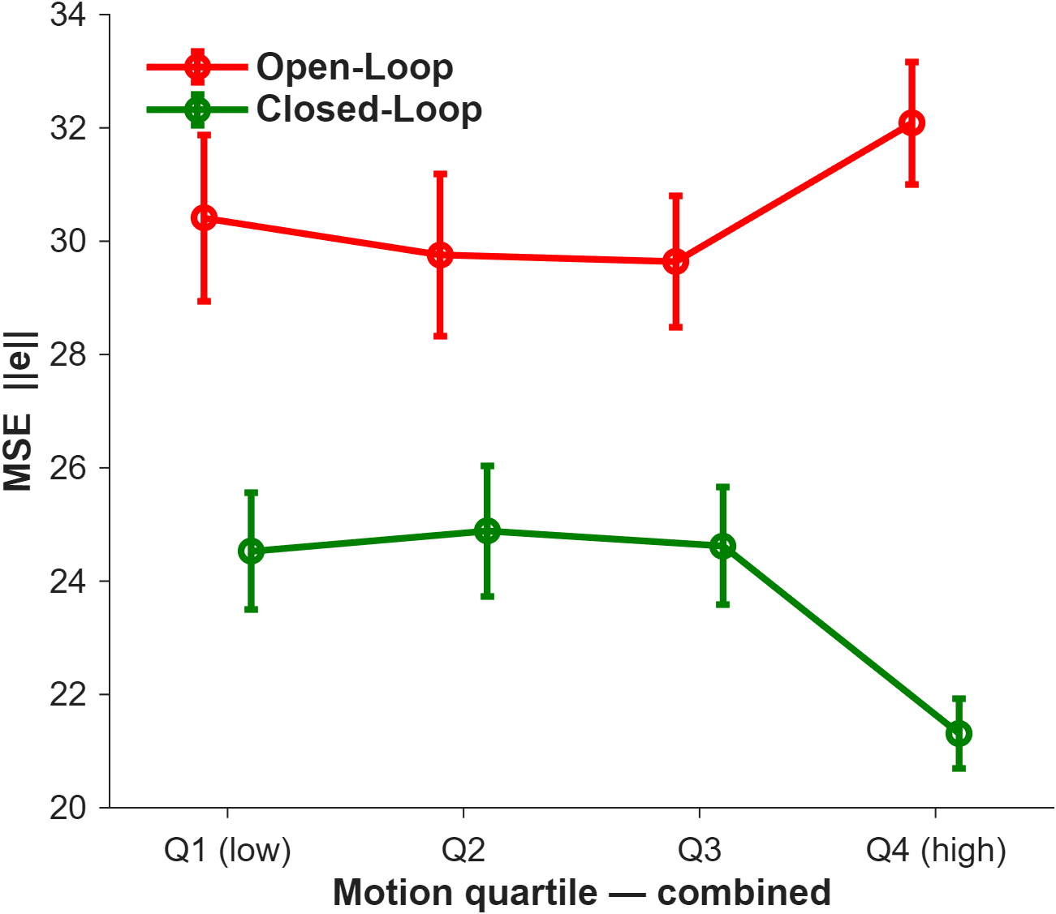
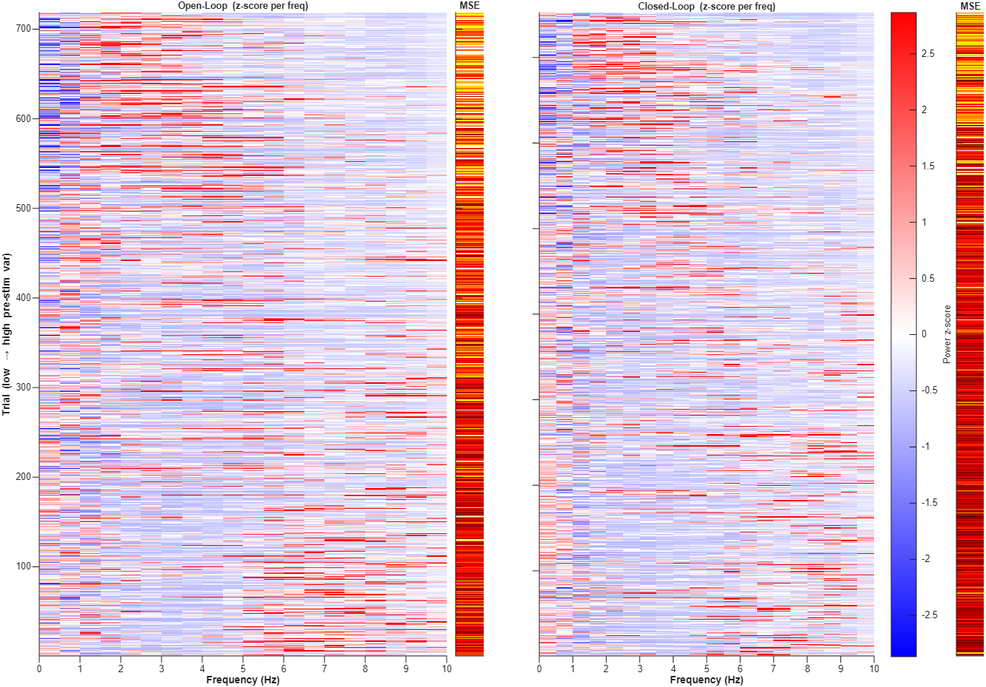
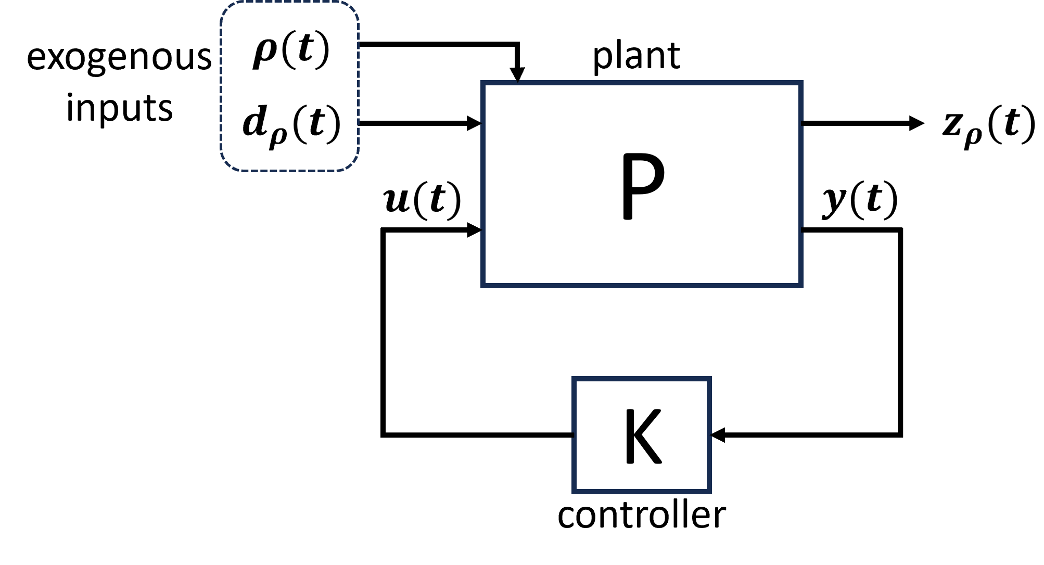
Closed-Loop Widefield Control of Cortical Neural Activity via Optogenetics
A. Deole · A. Li· M Mesbahi· E. Shea-Brown · N. Steinmetz
University of Washington
adityad@uw.edu
Introduction + System
LTI Validation — Impulse + Step
Controller Performance — CL vs OL (11 Sessions)
Motivation
Dose-Response Linearity
Impulse Transfer Function
MSE Reduction and Trial Average Convergence
Variance Suppression
• Spontaneous cortical fluctuations drive trial-to-trial variability
• Pre-stimulus brain state (motion, oscillations) significantly affects response amplitude
• Open-loop stimulation cannot compensate for ongoing neural state and regional interactions
Peak inhibition energy (∫ΔF/F, 0–200 ms) scales linearly with amplitude (R²>0.97, n=3 sessions) — justifies LTI assumption.
Amplitude-normalized response fit with low-order LTI model
Per-session violin (t = +1 → +3 s): CL MSE < OL in every session. Mean trial trace: CL converges toward −5% reference; OL diverges.
CL (green) suppresses trial-to-trial variance vs OL (red) — all sessions.
Goal
Drive cortical ΔF/F to a desired reference using real-time feedback, reducing MSE and trial-to-trial variability.
Proportional Integral Controller
• Discrete-time PI feedback controller
• Feedback: kernel-avg ΔF/F in cortical ROI
• Output: laser power (optogenetic inhibition)
Dataset
3 mice · 13 sessions
OL Step Response — Transfer Function (3 Sessions)
Open-loop step response modelled with the same LTI plant; time constants match impulse TF, validating LTI model across stimulus types.
Variable Reference Tracking — Feed-Forward Controller
Controller tracks a sinusoidal reference waveform. Trial-average ΔF/F follows target with low residual error.
Impulse — Brain State Dependence
Controller — Brain State Dependence
Conclusions
Motion: Inhibition by Tertile
Pre-trial variance (Spectral Power 2-4Hz)
Motion: MSE by Quartile
Frequency: Spectral Heatmap (variance -sorted)
Key Findings
Low / mid / high trials: high motion reduces inhibition depth and increases inter-trial variability.
Pre-stimulus variance which mostly attributes to 2–4 Hz power relates to predictability of inhibition depth.
High-motion trials have elevated MSE in OL; CL reduces this dependence — closed-loop partially compensates for motion.
Trials sorted by pre-stim variance, high-variance trials show elevated 2–4 Hz pre-stim power and higher tracking error.
✓ Cortical response is LTI: inhibition energy scales linearly with amplitude (R²>0.97)
✓ LTI dynamics hold for trial-averaged dynamics, a key assumption in controller design
✓ PI controller reduces MSE and variance in all experimental sessions
✓ CL trials can be used to assess trial state (motion, synchronicity) based on tracking performance
✓ Feedforward Controller adequately tracks variable reference waveforms
-- Validation of parameter varying modelling approach
Future Work
→ Multimodal controller synthesis
→ MPC-optimal control
→ Regularizability analysis
Acknowledgments
Steinmetz lab, Dept of NBIO, University of Washington.
All experiments conducted under approved IACUC protocols.
Department of Cooputational Neuroscience · University of Washington · Seattle, WA 98195

