Slide 1
TP-GDAR on IOS Reach
The task, its spectrum by phase, the math, and a control example

Slide 2
The task: a 4-target center-out reach
Trial timeline
Single trial
target on
go cue
touch
A6
B2
B9
50 µV
hold
target on
go cue
touch
-500
0
500
Trial average
400 ms
408 ms
target on
go cue
touch
A6
B2
B9
50 µV
-500
0
500
ms from go cue
Monkeys reach with the right hand to 1 of 4 targets, 80 mm from center
This deck: H 2021-11-12, no stim, 320 trials, 22 channels, LFP at 333 Hz
Notes:
Head-fixed, in a dark rig. The middle finger is tracked by motion capture; targets are 25 mm across on a monitor within reach, and a tone is the go cue. Juice reward. Noah's curated set: H 10 days, 3,865 trials; L 6 days, 5,116 trials. The papers analyse more trials than the curated set: Nat Commun H 4,522 over 8 sessions, L 11,101 over 13; EMBC H 3,904, L 8,588.

Slide 3
The setup: record and shine light through one window
LED array: 4 × 4, red light
25 mm window over left posterior parietal cortex (PPC), stable for years
Jaws, an inhibitory opsin, covers 92 mm² area
Light: 900 ms from target on, on a random half of stim-day trials
The window stays clear for 10 to 14 weeks, then tissue is removed
Air gap and cover glass
light
See-through ECoG: 32 electrodes
LFP, 1 kHz
Cortex: left PPC, Jaws in part of it
Griggs, Stanis et al., Nat Commun 2026. Stanis et al., EMBC 2025.
Notes:
Monkeys H and L: adult male rhesus macaques. Jaws covers 92 mm2 in H and 76 mm2 in L. Areas 7a and 7b near the intraparietal sulcus (IPS). Vector AAV8-hSyn-Jaws-GFP by convection-enhanced delivery, up to 50 uL per site. Red LEDs 634 nm, cortical temperature change under 1 C. Expression faded after about 2 years, and reinjection restored the response. The two papers give different numbers for light intensity (about 12 mW/mm2 vs 1.2 mW/cm2) and spacing (EMBC: 800 um pitch, while 32 electrodes over 314 mm2 would average about 3 mm), so they're left off the slide. Worth asking Noah.

Slide 4
What the papers found on this task
Behaviour
Light slows reaches by tens of ms, most clearly downward. Paths look similar
Planning
Theta power rises near the IPS and in areas 7a and 7b
Light
ECoG power goes up, not down, and more over Jaws cortex
Controls
No such effect in an untreated monkey, with blue light, or once expression fades
Likely why
Upper layers are inhibited, which releases layer 5. A simulation agrees
Network
Over Jaws cortex, gamma coherence and theta-gamma coupling fall
Griggs, Stanis et al., Nat Commun 2026. Stanis et al., EMBC 2025.
Notes:
Reach time, stim vs no stim: H p = 0.04, L p = 0.009. Downward: H p = 0.03, L p = 0.0001. Path length is longer overall in L (p = 4.2e-6). Controls: untreated Monkey C p = 0.53; blue light and tissue growth show no Jaws vs no-Jaws difference (p = 0.90, 0.47); H after about 2 years p = 0.76. Theta here is 4-10 Hz, planning vs the 500 ms before the target. Coherence and coupling come from one electrode per region (EMBC). Check on our no-stim days, 4-10 Hz, plan vs hold: the all-channel mean is flat (+0.11 dB on 11-12, -0.25 on 08-23), but channels split. On 11-12, 8 rise (A6 +2.1, A5 +1.5 dB) and 7 fall; on 08-23, 5 rise (B2 +1.9) and 8 fall. A local rise fits the papers, but we can't place these channels without the channel map.

Slide 5
A trial has four phases
target on
go cue
touch
hold
plan
move
post
400 ms
median 400 ms
median 408 ms
500 ms
end of a 1 s hold at center
target shown, waiting for go
go cue to touch, reaction included
after the touch
The delay is random: 50 to 700 ms in the task, 245 to 610 ms on this day
On stim days the light runs 900 ms from target on, through plan and most reaches
Notes:
Medians over 320 trials on 2021-11-12; move runs 95 to 1768 ms. Timing from Nat Commun 2026, Fig. 7. The segment file has no separate reaction time, and the papers' reach time is the same go-to-touch interval. Each segment starts 500 ms before the target, so hold here means the last 400 ms of the 1 s hold.

Slide 6
Spectrum by phase: low frequencies fall in movement
Power in each phase
Change from hold
hold
plan
move
post
plan
move
post
20
5
10
0
power (dB)
dB re hold
0
-5
-10
-20
-10
5
10
20
50
100
5
10
20
50
100
frequency (Hz)
frequency (Hz)
Move vs hold: alpha −7.9 dB, beta −5.5 dB, high gamma +1.2 dB. 200 ms Hann windows, evoked response left in.
Notes:
Bands: theta 4-8, alpha 8-13, beta 13-30, gamma 30-60, high gamma 65-115 Hz. Evoked response left in. 200 ms Hann windows every 50 ms inside each phase, demeaned; per channel the trial-mean power, then dB, then the mean over channels. Resolution about 10 Hz. 23 trials have a move shorter than 200 ms and add nothing to move; 18 add nothing to post. Bootstrap 95% over trials, move vs hold: alpha -8.37 to -7.55, beta -5.84 to -5.23, high gamma +1.00 to +1.46. Plan vs hold: beta -1.04. Raw lfp gives the same picture: change from hold differs by under 0.7 dB everywhere from 3 to 100 Hz. The high gamma band runs to 115 Hz, past the plot. The dip near 60 Hz is the notch filter: EMBC 2025 lists notches at 60, 120 and 180 Hz, and both lfp and noart dip about 9 dB at 60 Hz. Log: cache/spectra_run.log.

Slide 7
Another no-stim day shows the same pattern
Power in each phase
Change from hold
hold
plan
move
post
plan
move
post
30
5
20
0
power (dB)
dB re hold
10
-5
0
-10
-10
-15
5
10
20
50
100
5
10
20
50
100
frequency (Hz)
frequency (Hz)
H 2021-08-23, 404 trials, 16 channels. Move vs hold: alpha −8.2 dB, beta −7.1 dB, high gamma +1.8 dB.

Slide 8
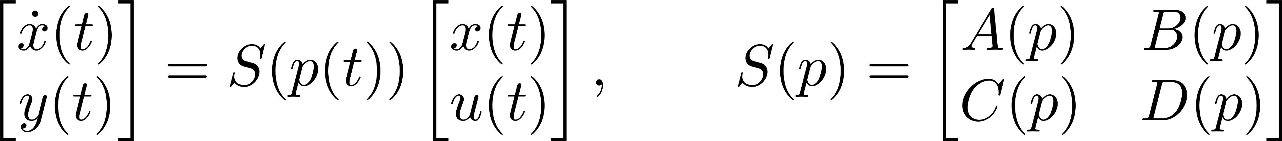
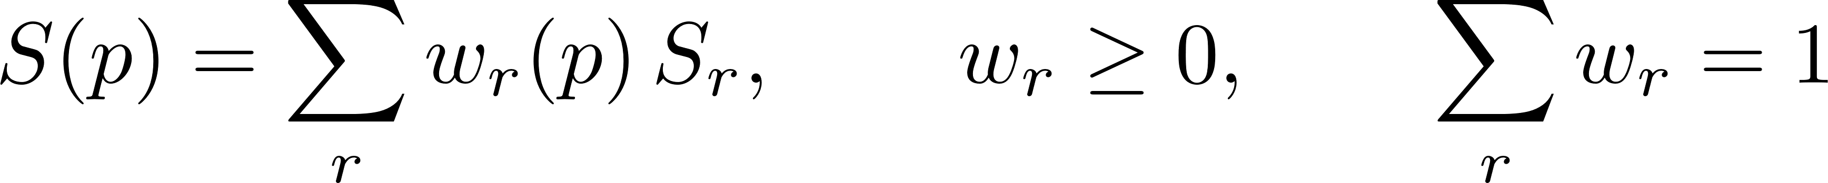
The TP paper: from a known model to a polytope
State space
Polytope
Known model
Sample on a grid
HOSVD
Drop small singular values
Make weights convex
Baranyi 2004, Method 4. It rewrites a model you obtain from sysID, so LMI design can use it.
Notes:
State-space form and S(p): the paper's eqs. 1 and 2. For a discrete-time system the left side reads x(t+1) instead of the time derivative.

Slide 9
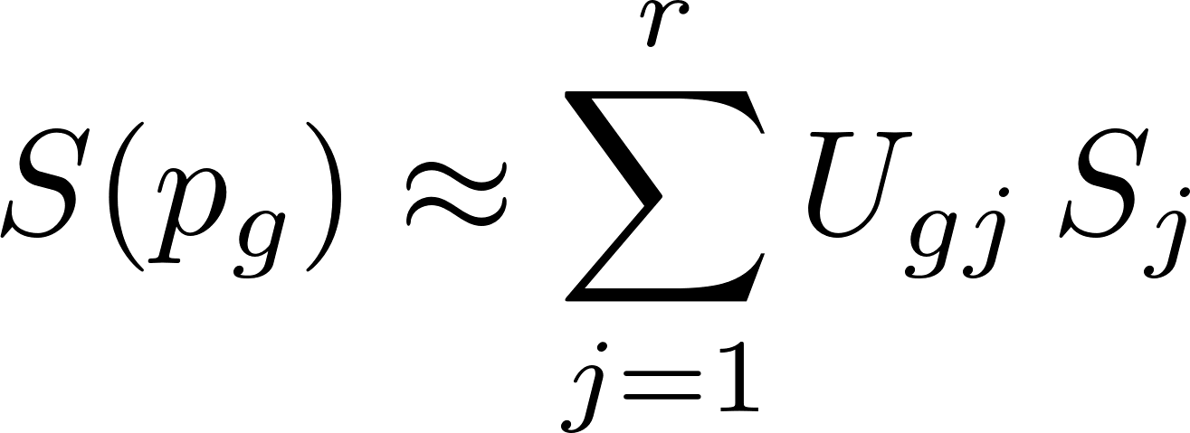
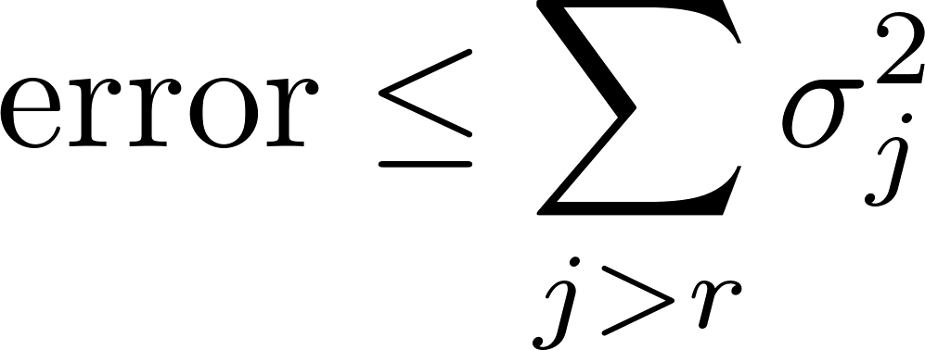
The paper, steps 1 and 2: sample, then HOSVD
1 Sample
2 HOSVD
Keep r
Error
Each kept column is one weight function on the grid, joined by straight lines
Rank is read from singular values that are exactly zero
Notes:
With several parameters, HOSVD runs on each parameter dimension and the vertex counts multiply; the system matrix dimensions aren't compressed. With one parameter it is this one SVD. Error bound: the paper's eq. 37.

Slide 10
The paper, step 3: make the weights convex
Free choice
1 Sum to one
Transformation 1. It may add one weight column; here it doesn't
2 Nonnegative
Transformation 2. Shrink all weights toward uniform
SVD weights
1: sum to one
2: nonnegative
Tightest
0.4
1.5
0.8
1
weight
0
-0.4
-0.5
0
1
2
1
2
1
2
1
2
p
p
p
p
Valid but loose: after step 2 no weight passes 0.61, and the vertices' triangle has about 300 times the tightest area.
Notes:
The worked example is mine, not the paper's. S_0, S_1, S_2 are orthonormal, on 41 points of p. Singular values relative to the first: 1, 0.121, 0.0066, then zero, so rank 3. The constant is in the span of the weights, so Transformation 1 adds no column; U' = U diag(U'1). After it the weights run from -0.44 to 1.42. As printed, the paper's Z in Transformation 2 doesn't normalise, so I used Z = (bI + 11')/(n + b), with b = 1 unless the most negative entry is below -1. Here b = 1. Weights then run from 0.14 to 0.61. All steps reconstruct S(p) exactly. Tightest is the smallest enclosing triangle, the same code as the real fits: weights reach 0.75, 0.93, 0.93. Triangle area in vertex space: 59.2 after step 2, 0.19 tightest. A loose polytope makes the LMI harder to solve, because it must hold at every vertex.

Slide 11
p is trial phase, warped per trial
hold
plan
move
post
1/4
2/4
3/4
4/4
1/4
2/4
3/4
4/4
1/4
2/4
3/4
4/4
1/4
2/4
3/4
4/4
-400 ms
target on
go cue
touch
touch + 500 ms
16 bins: each phase is cut into 4 equal parts of its own length on that trial
Go and touch are known only afterwards, so this p can't be used online

Slide 12
An electrode array is a graph
Electrodes and neighbours
Adjacency A
One number per electrode. Edges join neighbours.

Slide 13
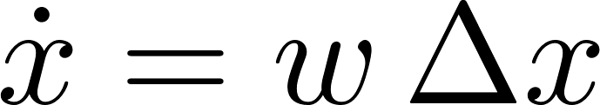
Activity spreads along edges: graph diffusion
Heat diffusion
Eq. 3
On the graph
Eq. 4
t = 0
t = 1
t = 3
t = 8
Schwock et al., bioRxiv 2024, doi 10.1101/2024.02.26.582177.
Notes:
Their notation: s for activity, p for model order, u for noise. Here x, K and e, because p is trial phase and u is the input in this deck. B is the node-to-edge incidence matrix, so L is the graph Laplacian; the continuous Laplacian is approximated by minus L.

Slide 14
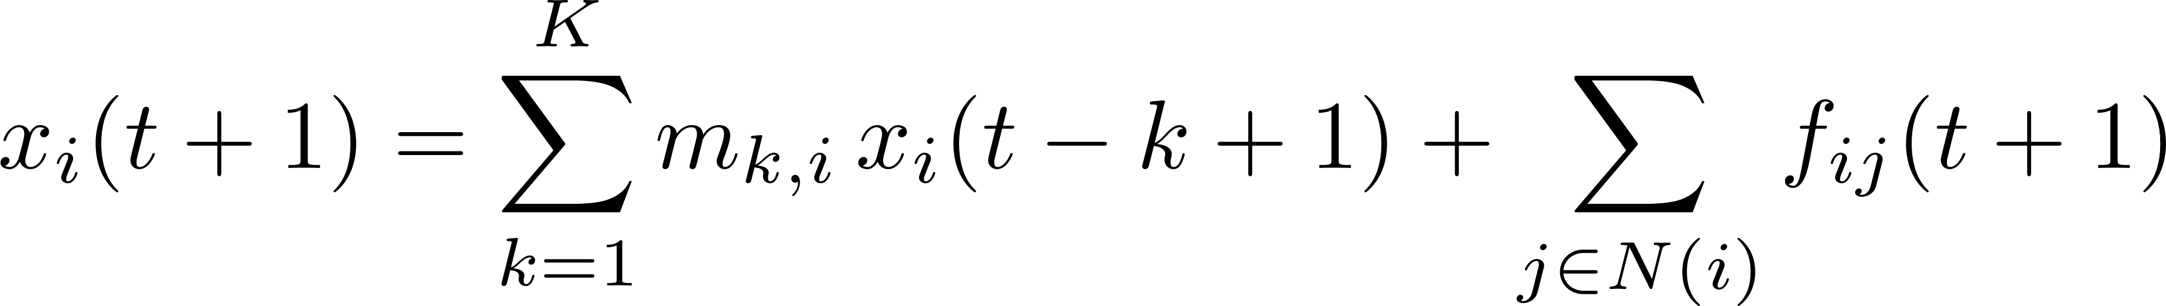
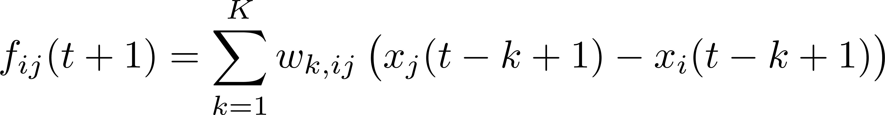
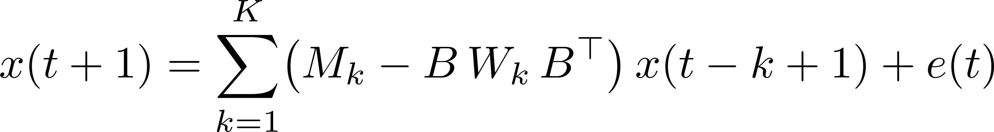
Felix's GDAR: diffusion with learned weights and memory
At node i
Eq. 1
Flow on edge ij
Eq. 2
All nodes
Eq. 5
As a VAR
Eq. 7
Voltage difference × conductivity = flow on each edge. Net flow into a node changes its activity
Fit: least squares on the free numbers in closed form (Eq. 8 to 11)
Schwock et al., bioRxiv 2024, doi 10.1101/2024.02.26.582177. Their s, p, u are our x, K, e.
Notes:
M_k = diag(m_k) holds the node terms and W_k = diag(w_k) the edge terms, at lag k. A_k off-diagonal equals the edge weight, and the diagonal is the node term minus the sum of the neighbours' A_k entries. The GDAR flow is f(t+1) = sum_k W_k B' x(t-k+1), their eq. 6. Fit: they first solve least squares without the noise covariance (eq. 10), estimate the covariance from its residual (eq. 11), and then solve generalized least squares (eq. 9).

Slide 15
One GDAR fitted to this day
−
+
edge weight
A₁
Edges, all lags
Here (22 nodes + 50 edges) × 16 lags = 1,152 numbers, one operator for the whole day.

Slide 16
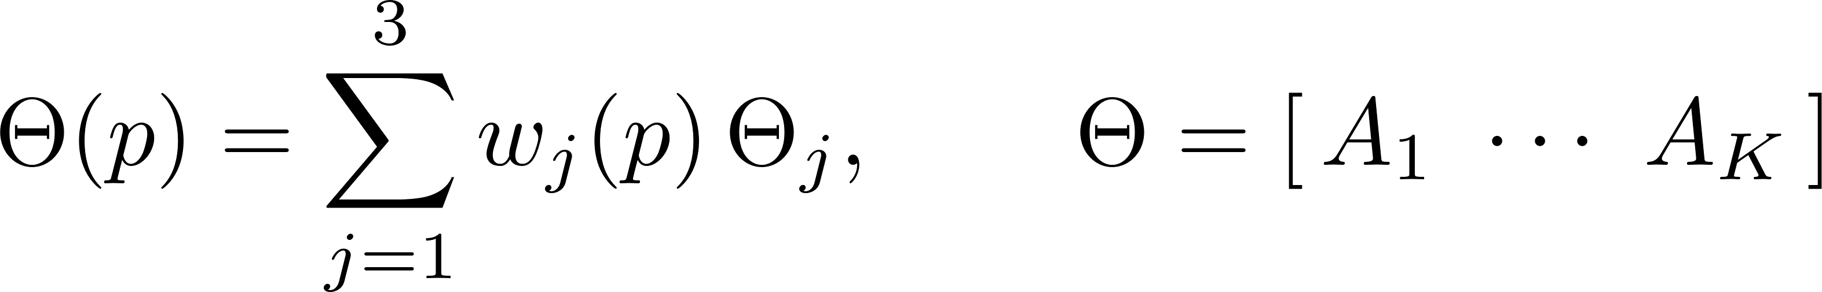
TP-GDAR: three GDARs, mixed across the trial
−
+
edge weight
Vertex 1
Vertex 2
Vertex 3
Weights
Vertex 1
Vertex 3
1
0.75
Vertex 2
0.5
0.25
0
hold
plan
move
post
Rank 3: 3,495 numbers. 16 separate fits: 18,432. Evoked response left in.
Notes:
3,495 = 3 x 1,152 operator numbers plus the free weights, 16 x 3 less 9. The corners of the triangle are one choice of coordinates. Vertex 2 lies 1.01 of the data's spread from the nearest bin, so the data never reach it.

Slide 17
From data to vertices: what we add to the paper
Known model
Sample on a grid
HOSVD
Convex weights
TP paper
Recordings
GDAR fit in each bin
HOSVD
Convex weights
Data, HOSVD
Recordings
Statistics in each bin
Joint fit
Convex weights
Data, joint fit
Shaded: taken from the paper. White: what data needs
The fit in each bin plays the part of sampling the model, but with noise
Notes:
The data step is ours, using Felix's GDAR model and estimator in each bin. The joint fit keeps the paper's model form and its idea of convex weights, but it replaces both the per-bin fits and HOSVD.

Slide 18
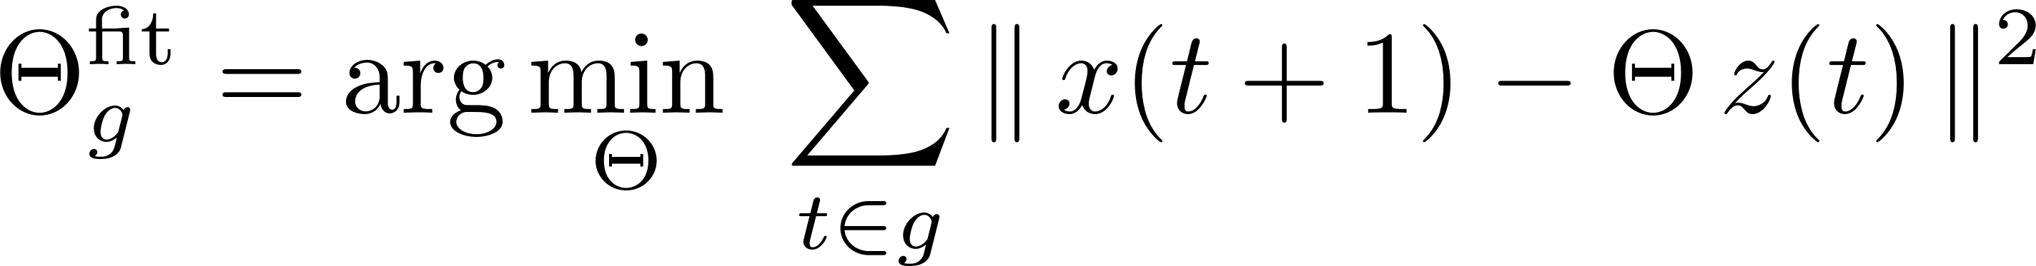
Data step: a GDAR in each bin
Model in bin g
Regressor
Objective
Constraint
Each lag operator is symmetric and zero off the graph, as in GDAR
The same fit as Felix's GDAR, run once per bin. About 10,800 samples per bin on this day.
Notes:
Left off the slide to keep it simple: the norm in the real fit is weighted by the inverse noise covariance, Sigma from one pooled fit, then fixed (Felix's generalized least squares, his eq. 9). The pooled fit matches CVARModel.fit_gdar to 1e-11. The weighted form is written out on the joint-fit slide, which needs it.

Slide 19
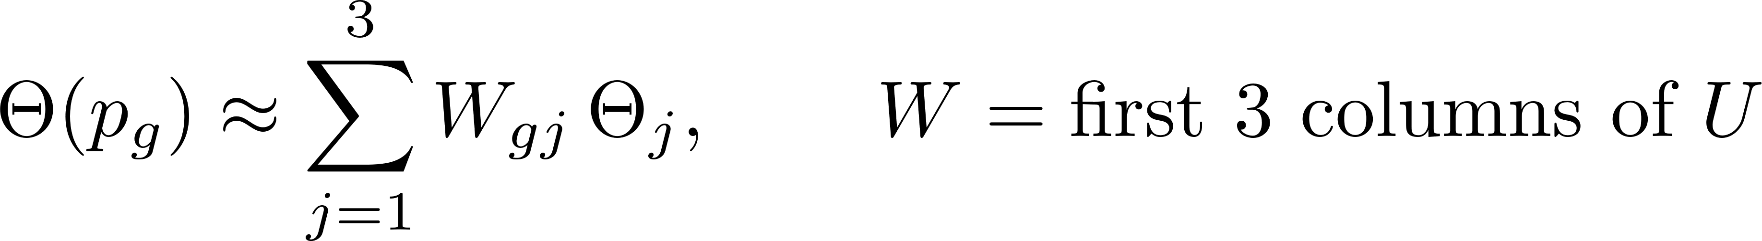
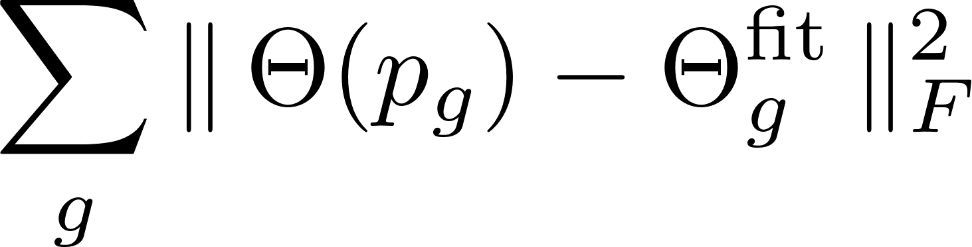
HOSVD on the fits: every coefficient counts the same
Stack the fits
Keep 3
It minimises
Exact samples make this the right loss. With noisy fits it treats a badly estimated coefficient like a good one
No exact zeros to read a rank from: singular values 1, 0.018, 0.011, 0.010, ...

Slide 20
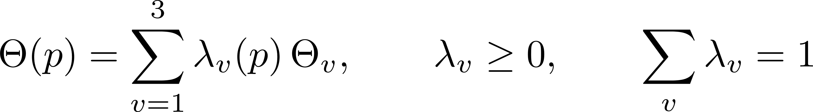
From rank 3 weights to convex weights
Sum to one
Data metric
Vertices
The smallest triangle that encloses the weights of all bins
Result
Same freedom as the paper, a different transform. No added vertex
The metric says how well all the data pin down each direction
We ran this on the joint fit, which comes next. Sum-to-one misses by 0.017 to 0.019; the likelihood cost of that isn't measured
Corners needn't be visited by the data. Only the mix is unique, not the vertices
Notes:
Phi stacks the 3 operators in free numbers. H_pool is the metric H_g of the joint-fit slide, summed over bins. This step refits nothing. Held-out gains are measured before it, so they're unaffected, but the vertex maps and weight plots aren't exact. Nearest bins, as a fraction of the spread: evoked left in 0, 1.01, 0.16; evoked removed 0.12, 0, 0.35. The step needs only rank 3 weights and a metric; it has been run on the joint fit, not on the HOSVD weights.

Slide 21
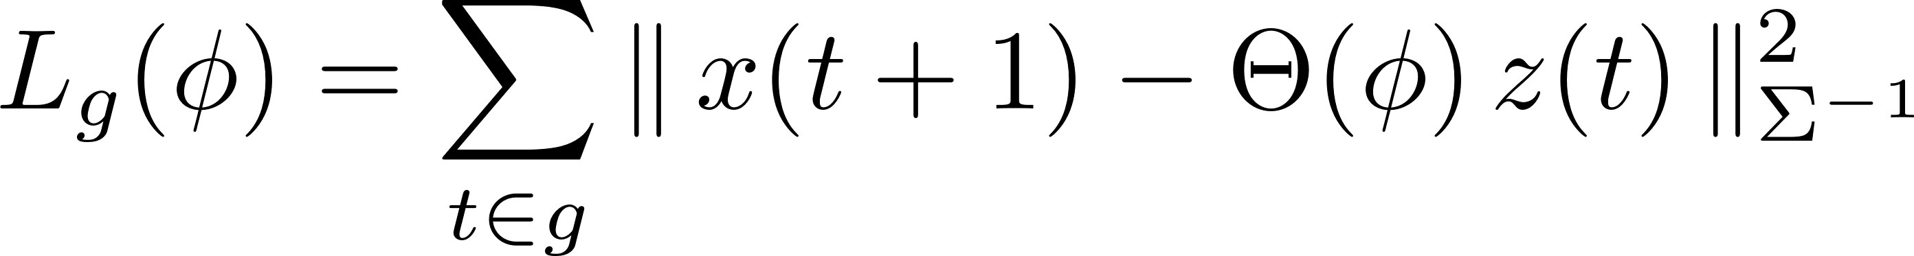
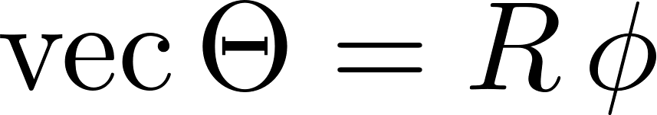
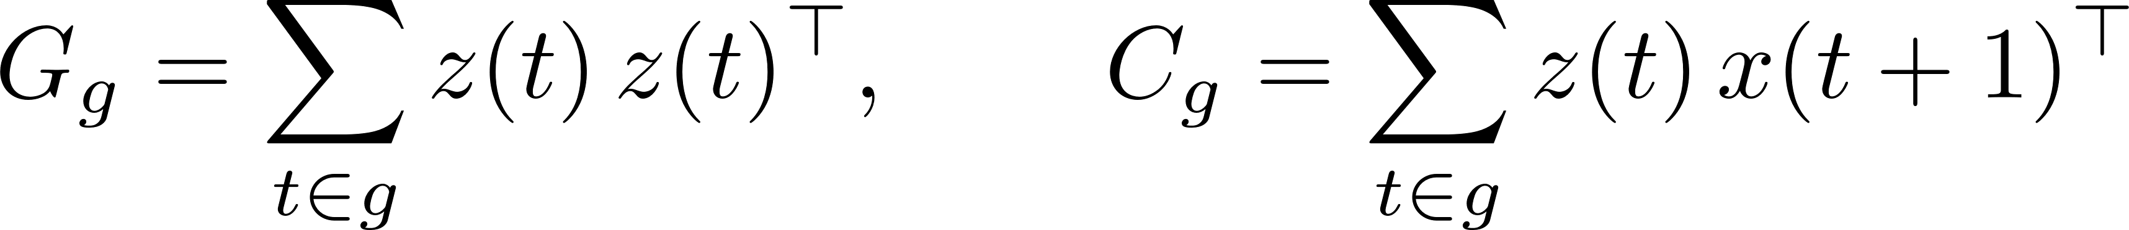
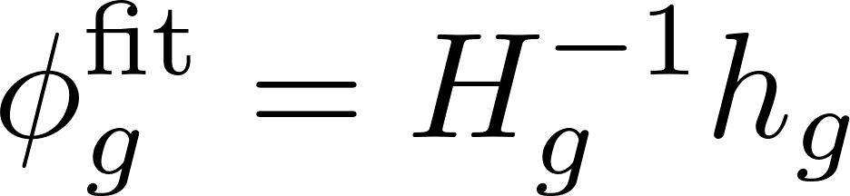
Joint fit: score each bin on its own data
Loss in bin g
Noise
Free numbers
Statistics
Metric
Fit in bin g
Notes:
R maps the free numbers to the full coefficient matrix: symmetric, zero off the graph. The pooled fit with G and C summed over bins is Felix's estimator; it matches CVARModel.fit_gdar to 1e-11. H_pool on the convex-weights slide is H_g summed over bins.

Slide 22
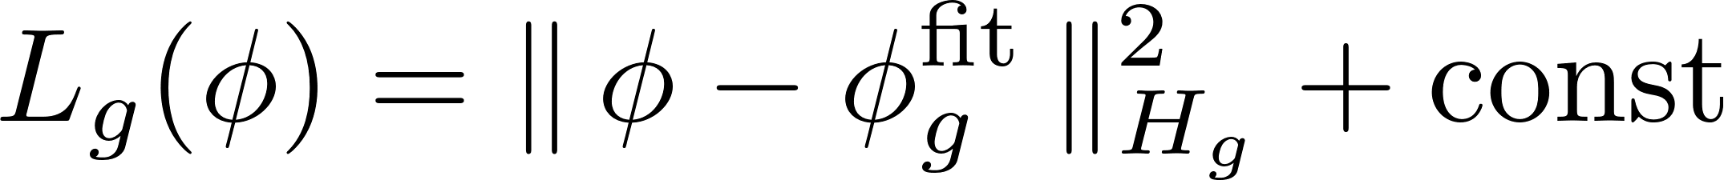
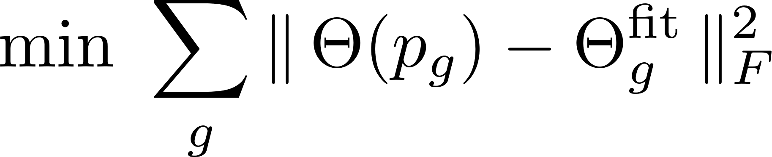
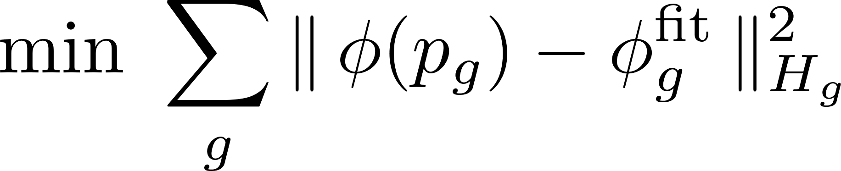
Joint vs HOSVD: same low-rank form, different metric
Loss, rewritten
HOSVD
Joint
Directions that a bin's data pin down count more, because the metric is the inverse covariance of that bin's fit.
Notes:
Cov of phi-hat is the inverse of H_g given the regressors, with Gaussian noise and known Sigma. So the joint fit is the maximum-likelihood low-rank fit for that fixed Sigma. HOSVD would be the same only if every H_g were proportional to the identity. This is my derivation, not the paper's. Held-out gain over GDAR at rank 3, nats per sample, 5-fold, 16 bins, H 2021-11-12, script 12d: evoked left in HOSVD +0.123, SVD in the pooled metric +0.212, joint +0.222, separate fits +0.211; evoked removed +0.239, +0.304, +0.323, +0.392. So the metric does most of the work. One day only, with the target-onset step unmasked.

Slide 23
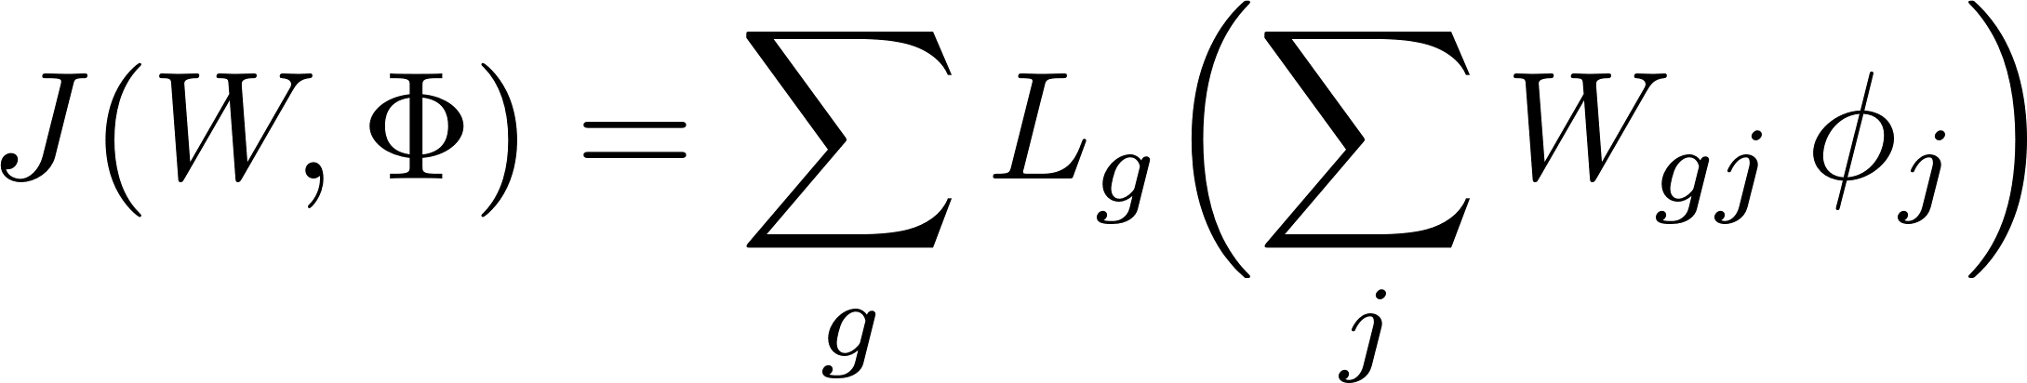
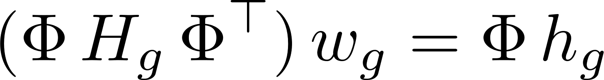
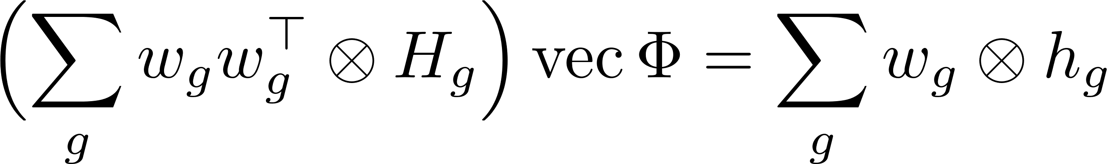
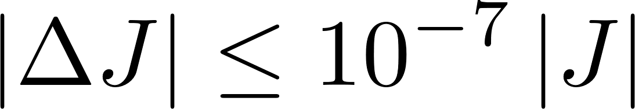
Joint fit: alternate two exact solves
Objective
Start
Weight step
Operator step
Stop
The objective never rises, and these fits took 5 to 6 sweeps. No closed form: it finds a local optimum. Then the same convex step.
Notes:
Start: the other operators come from an SVD of the per-bin fits around the pooled fit, in the pooled data metric. After each sweep the weights are rescaled so each column has norm sqrt(P), which changes nothing in the model. Limits: 25 sweeps in folds, 40 on the full day. Jitter 1e-10.

Slide 24
TP beats one GDAR on held-out trials and unseen task times
4 phases
12 time bins
Task time left out
evoked removed
0.3
0.3
0.3
0.2
0.2
0.2
0.1
evoked left in
0.1
0.1
gain over GDAR (nats/sample)
0
0
0
TP rank 3
fit on that bin
-0.1
fit on neighbour
-0.1
-0.1
-200
0
200
400
600
GDAR
rank 3
separate
GDAR
rank 3
separate
ms from go
Gain = held-out one-step likelihood over GDAR, 5-fold. Separate fits match or beat rank 3, except on 12 bins with evoked left in.
Notes:
Each model gets its own noise covariance when scored, Sigma = 0.99 Sigma-hat + 0.01 diag(Sigma-hat), so the fit doesn't quite optimise the score. Script 12. 4 phases: evoked left in rank 3 +0.167, separate +0.180; evoked removed +0.259, +0.297. 12 time bins: left in +0.137, +0.098; removed +0.168, +0.173. Fold SE 0.008 to 0.013. Numbers on 12 bins: GDAR 1,152, rank 3 3,483, separate 13,824. Task time left out (evoked left in): each inner bin is left out of the fit in turn. Rank 3 reads its weights off its neighbours; 'fit on neighbour' is a separate fit on the nearest bin; 'fit on that bin' is a separate fit that did see that bin. All are scored with GDAR's noise covariance, since a left-out bin has no residuals of its own. Over those bins, evoked left in / removed: rank 3 +0.122 / +0.110, neighbour +0.044 / +0.004, that bin +0.077 / +0.121; rank 3 minus neighbour, per trial, +0.079 +/- 0.007 / +0.105 +/- 0.008. Given its own bin's covariance, which the others don't get, the neighbour fit reaches +0.089 / +0.082: below zero before go, +0.23 / +0.27 after it. Corrected 2026-11-05 (L-2026-11-05-d): before, each fit had its own covariance and the neighbour fit looked worse than GDAR. One monkey. No light in these fits, so they say nothing about the Jaws effects. The cleaned LFP has steps at 0 and 900 ms, not masked here; masking moved the gains little. They likely come from the artefact cleaning, which rejoins epochs at light on and off even on no-stim trials. On 11-12 the median jump is 23.5 uV at 0 ms and 13.9 at 900 ms in noart, against 2.5 typical, and raw lfp has none. To confirm with Noah.

Slide 25
Rank 3, evoked removed: hold, plan, move
−
+
edge weight
Vertex 1
Vertex 2
Vertex 3
Weights
Vertex 1
Vertex 2
Vertex 3
1
0.75
0.5
0.25
0
hold
plan
move
post
Notes:
Vertex 1 leads through hold (0.67 to 0.94). Vertex 2 leads from plan 1/4 to 3/4 (1.00, 0.79, 0.49), and again at post 3/4 and 4/4 (0.65, 0.72). Vertex 3 leads from plan 4/4 to post 2/4 (0.54 to 0.81). So post heads back toward the early-plan vertex, not the hold one. Weights: jackknife band over the 5 training splits. Corners are one choice of coordinates: nearest bins are 0.12, 0 and 0.35 of the spread away.

Slide 26
Rank 3 fit vs data: similar shape, weaker in plan and move
hold
plan
move
post
data
model
data
model
data
model
data
model
4
4
4
4
2
2
2
2
0
0
0
0
dB re mean of phases
-2
-2
-2
-2
-4
-4
-4
-4
-6
-6
-6
-6
5
10
20
50
100
5
10
20
50
100
5
10
20
50
100
5
10
20
50
100
frequency (Hz)
frequency (Hz)
frequency (Hz)
frequency (Hz)
Correlation with the data, 3 to 100 Hz: r = 0.88 to 0.98. Beta (13-30 Hz) in move: data −3.6 dB, model −1.9 dB. In post the sign differs: +0.7 vs −0.1 dB.
Notes:
Model: the rank 3 fit with evoked left in, its AR spectrum frozen at each of the 16 bins, averaged in dB within a phase, with the same 200 ms window applied in frequency. Data and model are each shown relative to the mean of their four phases. A frozen spectrum isn't the true spectrum of a changing system, and the model doesn't include the evoked response as an input. No model was fitted for this slide. Beta, data vs model: hold +1.9, +1.6 dB; plan +0.9, +0.5 dB. High gamma (65-115 Hz) agrees within 0.25 dB in every phase. Log: cache/spectra_run.log.

Slide 27

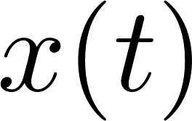

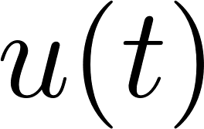

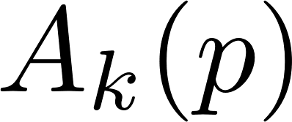
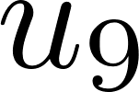

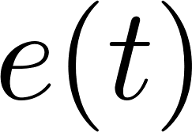
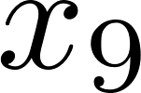
Control example: the system
Activity at 9 nodes on a 3 × 3 grid, joined by 12 edges
9 inputs, one per node, like stimulation at each site
Input gain at each node, fixed, 0.5 to 1.5
How activity spreads over the last 2 steps
Moves from 0 to 1 and back. The controller never sees it
Noise at each node, standard deviation 0.3
Synthetic, so the truth is known. Without control activity grows: largest eigenvalue 1.03 at the unstable end
Goal: keep the network stable for every p, then drive all 9 nodes to one target
Notes:
Numbers per operator: 2 x (9 + 12) + 9 = 51. 20 random plants in each of two designed cases: p = 0 stable (0.90) and p = 1 mildly unstable (1.03), or both ends at 1.03. The instability is by design and says nothing about cortex. The truth is a mix of two operators, so this example has 2 vertices. It is the one place in the deck with 2.

Slide 28
Polytopic control: the math
Feedback
At each vertex
As an LMI
If it holds at the vertices it holds at every mix of them: every p, and p moving at any speed
The rate sets a guaranteed decay. The fitted certificate needs a margin to hold on the true plant
The loop is closed on the true plant, never on the fitted model
Notes:
At rate 1 the fitted certificate held on the true plant in 0 of 20 plants, because the solution sits on the LMI's boundary. At rate 0.9 it held in 20 of 20, in both cases. A_v here is the companion form of vertex v and B_c the input matrix in that form.

Slide 29
Consensus: all 9 nodes follow one target
Target
Running error
Input
All 9 nodes get an input at every step, each worked out from all nodes' recent activity and error
Consensus needs that: with fewer inputs, only that many nodes can be held at a chosen value
The same LMI on the fitted vertices gives one fixed gain. It doesn't see p, which keeps moving
The loop runs on the true plant, here with both ends of p unstable
Notes:
State xi and error z together still form a polytope, so the same LMI applies, at rate 0.95. Script 17.

Slide 30
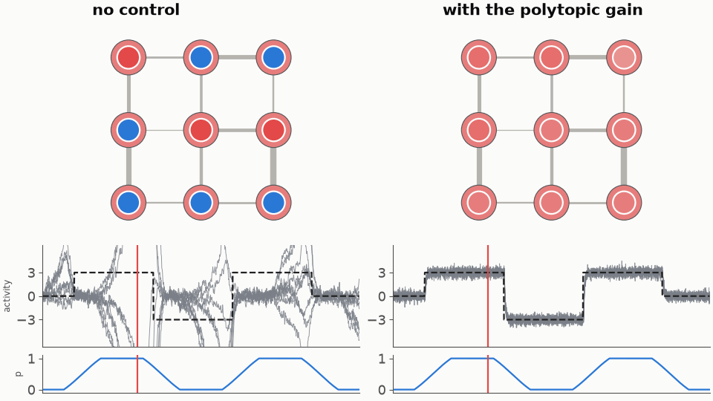
Consensus: the movie
Dot = node activity. Ring = target. Line width = edge strength at that moment's p. Traces: all 9 nodes, target dashed, p below
Left, no inputs: activity runs away. Right, one fixed gain: every node reaches the target. Held error about 0.33, set by the noise
Notes:
One plant with both ends unstable, polytopic gain. Medians over 20 plants in the held windows: no control, stable at all p in 0 of 20, rms error 24.5. Polytopic, 20 of 20, rms error 0.338, rms input 1.97. Pooled LQR does this too, 20 of 20, rms error 0.333, rms input 1.94.

