Slide 1
MPC replay and TP-GDAR
Part 1: model-predictive control, brain paper
Part 2: TP-GDAR vs Felix Schwock's GDAR, Hydrogen, IOS Reach
Part 3: polytopic control on a synthetic 9-node example

Slide 2
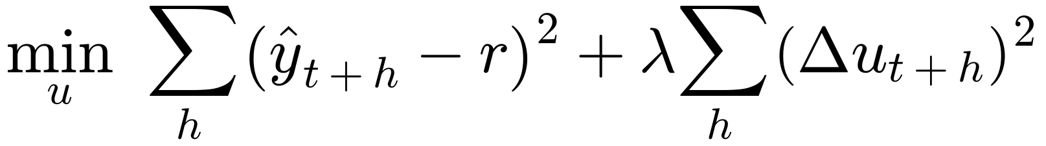
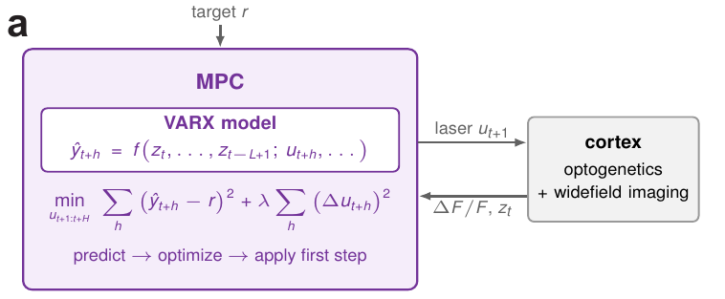
The MPC: predict, plan the laser, apply the first step
Every frame: plan the laser over the next 1 s, apply the first command, replan
Model: a VARX on the past second of the controlled site, 100 cortical sites and the laser
Held-out 200 ms prediction R²: VARX 0.41, site + laser 0.37, last value 0.10
A replay, not a live experiment: a VARX of the whole session stands in for cortex, driven by each trial's recorded residuals, and the MPC's own model never saw closed-loop trials

Slide 3
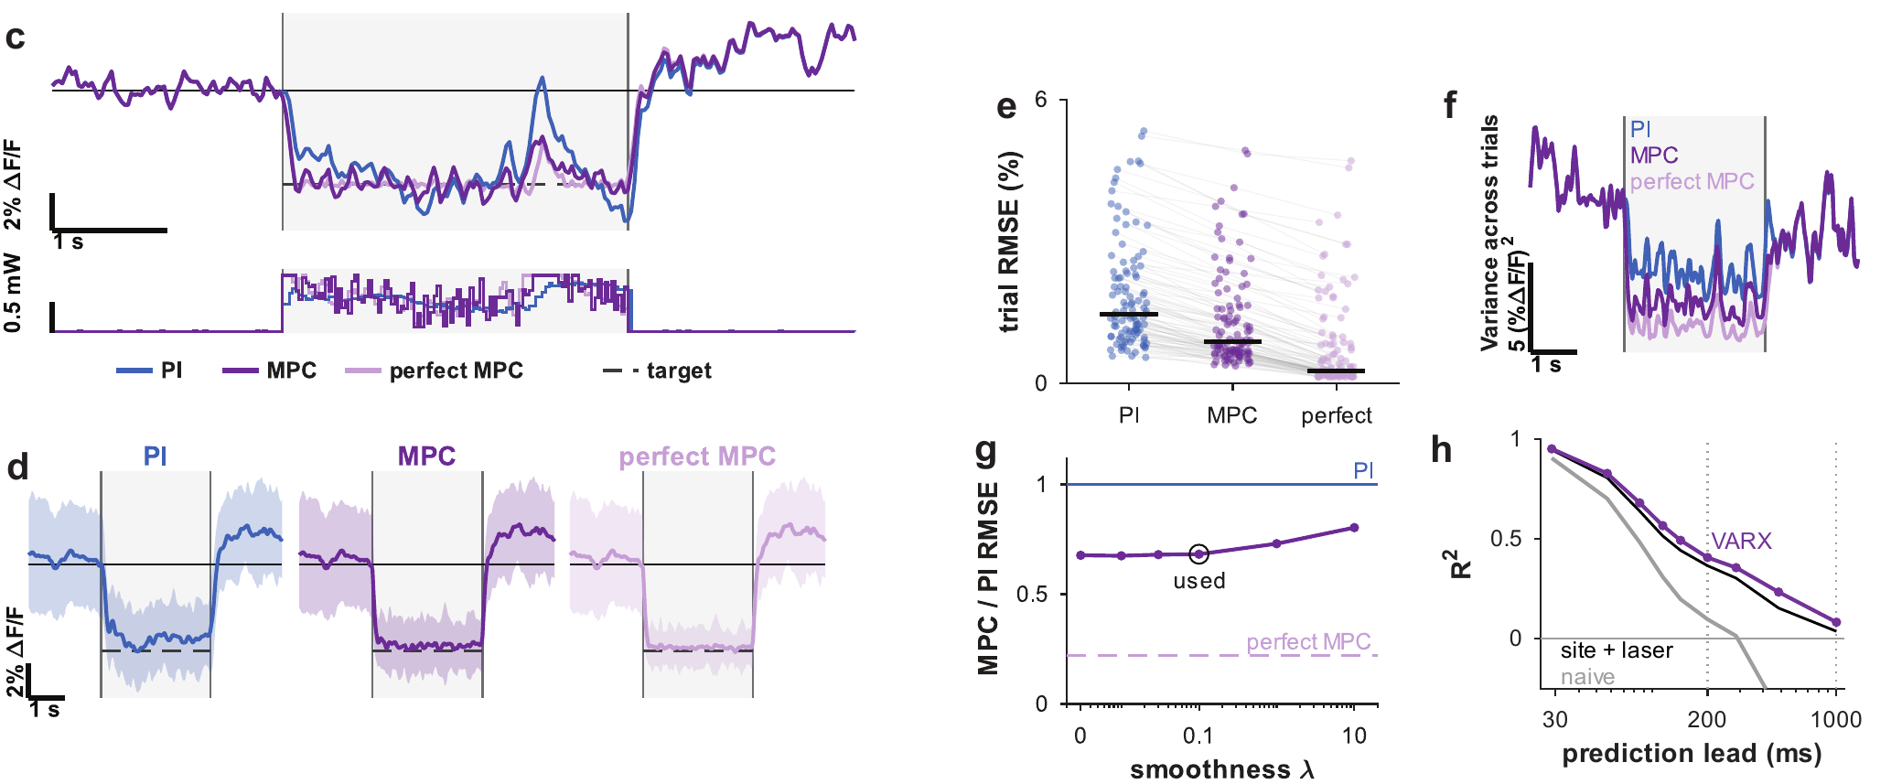
Constant target: MPC lowers the error PI leaves
Median RMSE, %ΔF/F: recorded PI 1.46, MPC 0.88, perfect prediction 0.27 (Mouse 1e, steady-state window 1-3 s)
Lower than PI on 107 of 108 trials; across-trial variance down 37%

Slide 4
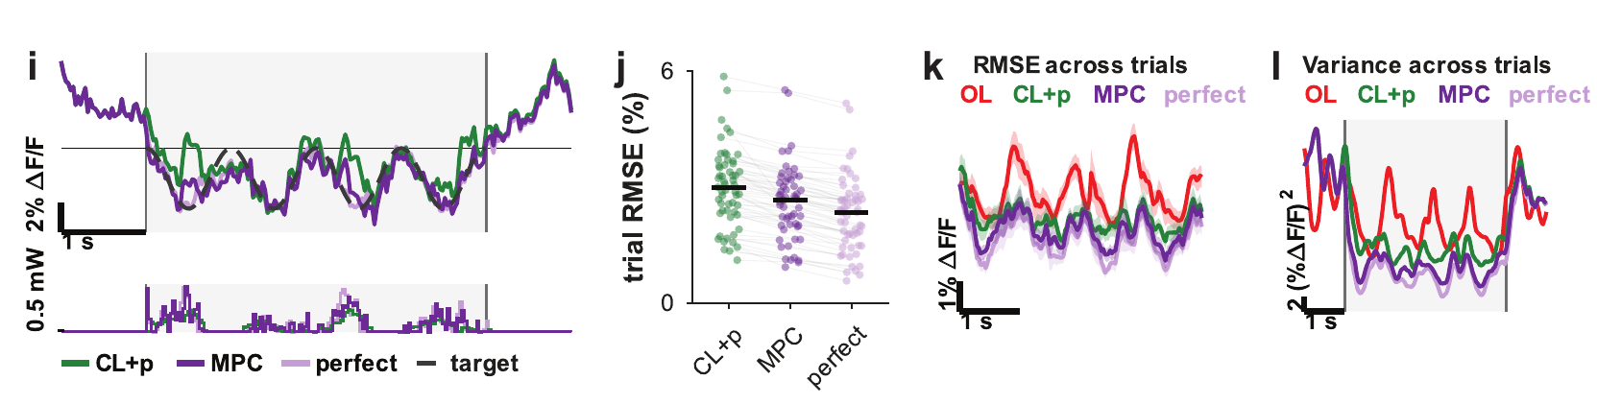
Sinusoidal target: a smaller gain over feedback with preview
Median RMSE, %ΔF/F
Recorded CL+p | 3.00
MPC | 2.67
Perfect prediction | 2.35
Lower than CL+p on 56 of 57 trials
Across-trial variance 0.71 times that of CL+p
Mouse 3b, 4 s window; open loop lags by 71°, CL+p and MPC stay near zero

Slide 5
What the MPC replay says, and how far it goes
Predicting activity lowers the error and the variability that feedback leaves
Constant target: error down about 40% with a fitted model, about 80% with perfect prediction (ratios of medians; the median per-trial MPC/PI ratio is 0.68)
Most remaining error is prediction error, except on the worst quarter of trials (n = 27): with perfect prediction their median RMSE stays at 1.97 (0.21 for the rest), and 89% of that squared error occurs with the command at a limit
Descriptive simulation on recorded data, not a live test and no statistical tests
One session per target type (Mouse 1e, Mouse 3b)

Slide 6
Part 2: TP-GDAR
The model, how it is trained, and what it finds on IOS Reach

Slide 7
Felix's GDAR: one operator for the whole day
Each lag matrix is symmetric and non-zero only on graph edges and the diagonal
Here N = 22 channels, E = 50 edges and K = 16 lags (48 ms), so 1,152 free numbers
R is a fixed sparse matrix that copies each edge coefficient into (i, j) and (j, i)

Slide 8
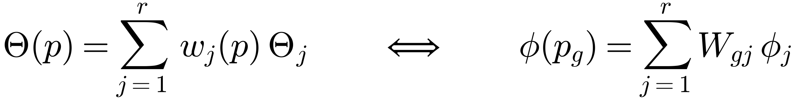
The TP structure: a low-rank mix over p
Each Θⱼ is a complete symmetric GDAR operator with all 16 lags
Only the p direction is compressed; channels and lags are not
The weights W are free per bin, so nothing forces them to be smooth
W and the Θⱼ can trade an invertible r × r matrix, so they are not unique: only Θ(p) is
Model | Parameters
Felix's GDAR | 1,152
TP-GDAR rank 2 | 2,332
TP-GDAR rank 3 | 3,495
16 separate fits | 18,432

Slide 9
p is trial phase, warped per trial
hold
plan
move
post
1/4
2/4
3/4
4/4
1/4
2/4
3/4
4/4
1/4
2/4
3/4
4/4
1/4
2/4
3/4
4/4
-400 ms
target on
go cue
touch
touch + 500 ms (max 1400 ms)
Each phase is cut by its own duration on that trial, so all trials line up on P = 16 bins
A sample belongs to the bin of its target x(t+1); its lags can reach into the previous bin
Go and touch times are known only afterwards, so this warped p cannot be used online

Slide 10
Training 1: statistics per bin, then the baseline
Summed within trials, never across a trial boundary. The rest of the fit uses only these sums.
1. Symmetric OLS on all bins pooled
2. Σ from its residuals, then fixed
3. Refit weighted by Σ⁻¹: gives φ₀
This is Felix's estimator; on one trial it matches Felix's fit_gdar to a relative difference of 1e-11
Preprocessing first: decimate by 3 to 333 Hz, demean each trial, optionally remove evoked kernels

Slide 11
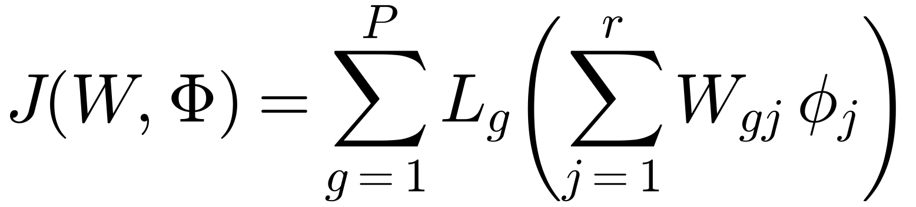
Training 2: the objective is the data loss
For one bin the GLS loss is quadratic in φ:
The whole model minimises the loss summed over bins:
Data decide the metric: well-excited directions count more. An unweighted SVD of per-bin fits, the older two-stage route, treats all coefficients equally.

Slide 12
Training 3: initialise, then alternate
Start from the pooled model plus the leading per-bin deviations:
Each sweep solves one block exactly, so J can never increase:
After each sweep, rescale weight columns to unit RMS; operators take the inverse scale
Stop at a relative change in J below 1e-7, or 40 sweeps (25 on training splits); real fits took 5 to 7
No penalty beyond numerical jitter of 1e-10, matching Felix's unpenalised fit

Slide 13
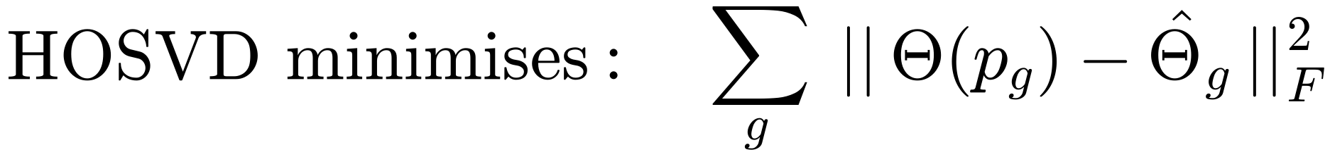
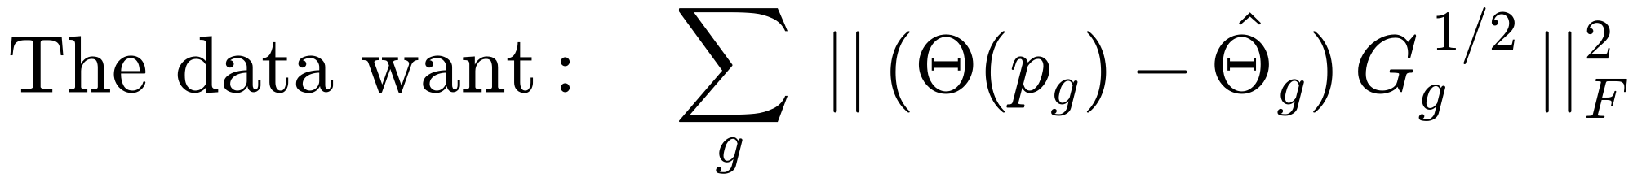
HOSVD vs the joint fit: same vectors, different metric
Felix's GDAR has no HOSVD: it fits one operator. HOSVD comes from TP model transformation, and was our first route
Each 22 × 352 operator is flattened along p (M is 16 × 7,744) and reshaped back, so lags, channels and support survive
The SVD treats all entries alike, so rank goes to poorly determined coefficients
Real OS-Pulse, held-out trials: HOSVD -45 to -7.5 nats/sample, joint fit -0.11 to +0.52
HOSVD was not run on IOS Reach; these fits use the joint route

Slide 14
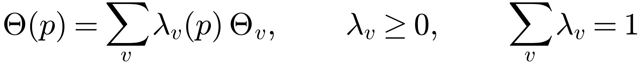
From components to vertices
Find a with Wa ≈ 1 and project W onto that plane (worst error 0.033 to 0.037 at rank 2, about 0.02 at rank 3)
Rank 2 vertices: the two extreme bins, in the pooled data metric
Rank 3 vertices: the smallest triangle on convex-hull edges that encloses all bins; corners need not be visited by the data
λ comes from non-negative least squares
Sum-to-one makes the companion form, which the LMI controller needs, mix linearly across vertices
This is post-processing: the held-out gains come from the fitted W and Φ

Slide 15
Evaluation: held-out one-step likelihood
5-fold over trials, stratified by reach direction, refitting everything on each training split
Each model m has one Σ, from its own training residuals, with 1% shrinkage toward the diagonal
Weight uncertainty: express each split's fit in the full-data vertices and take the jackknife SE
K = 16 was picked on the baseline only; the Felix likelihood is still rising at K = 32

Slide 16
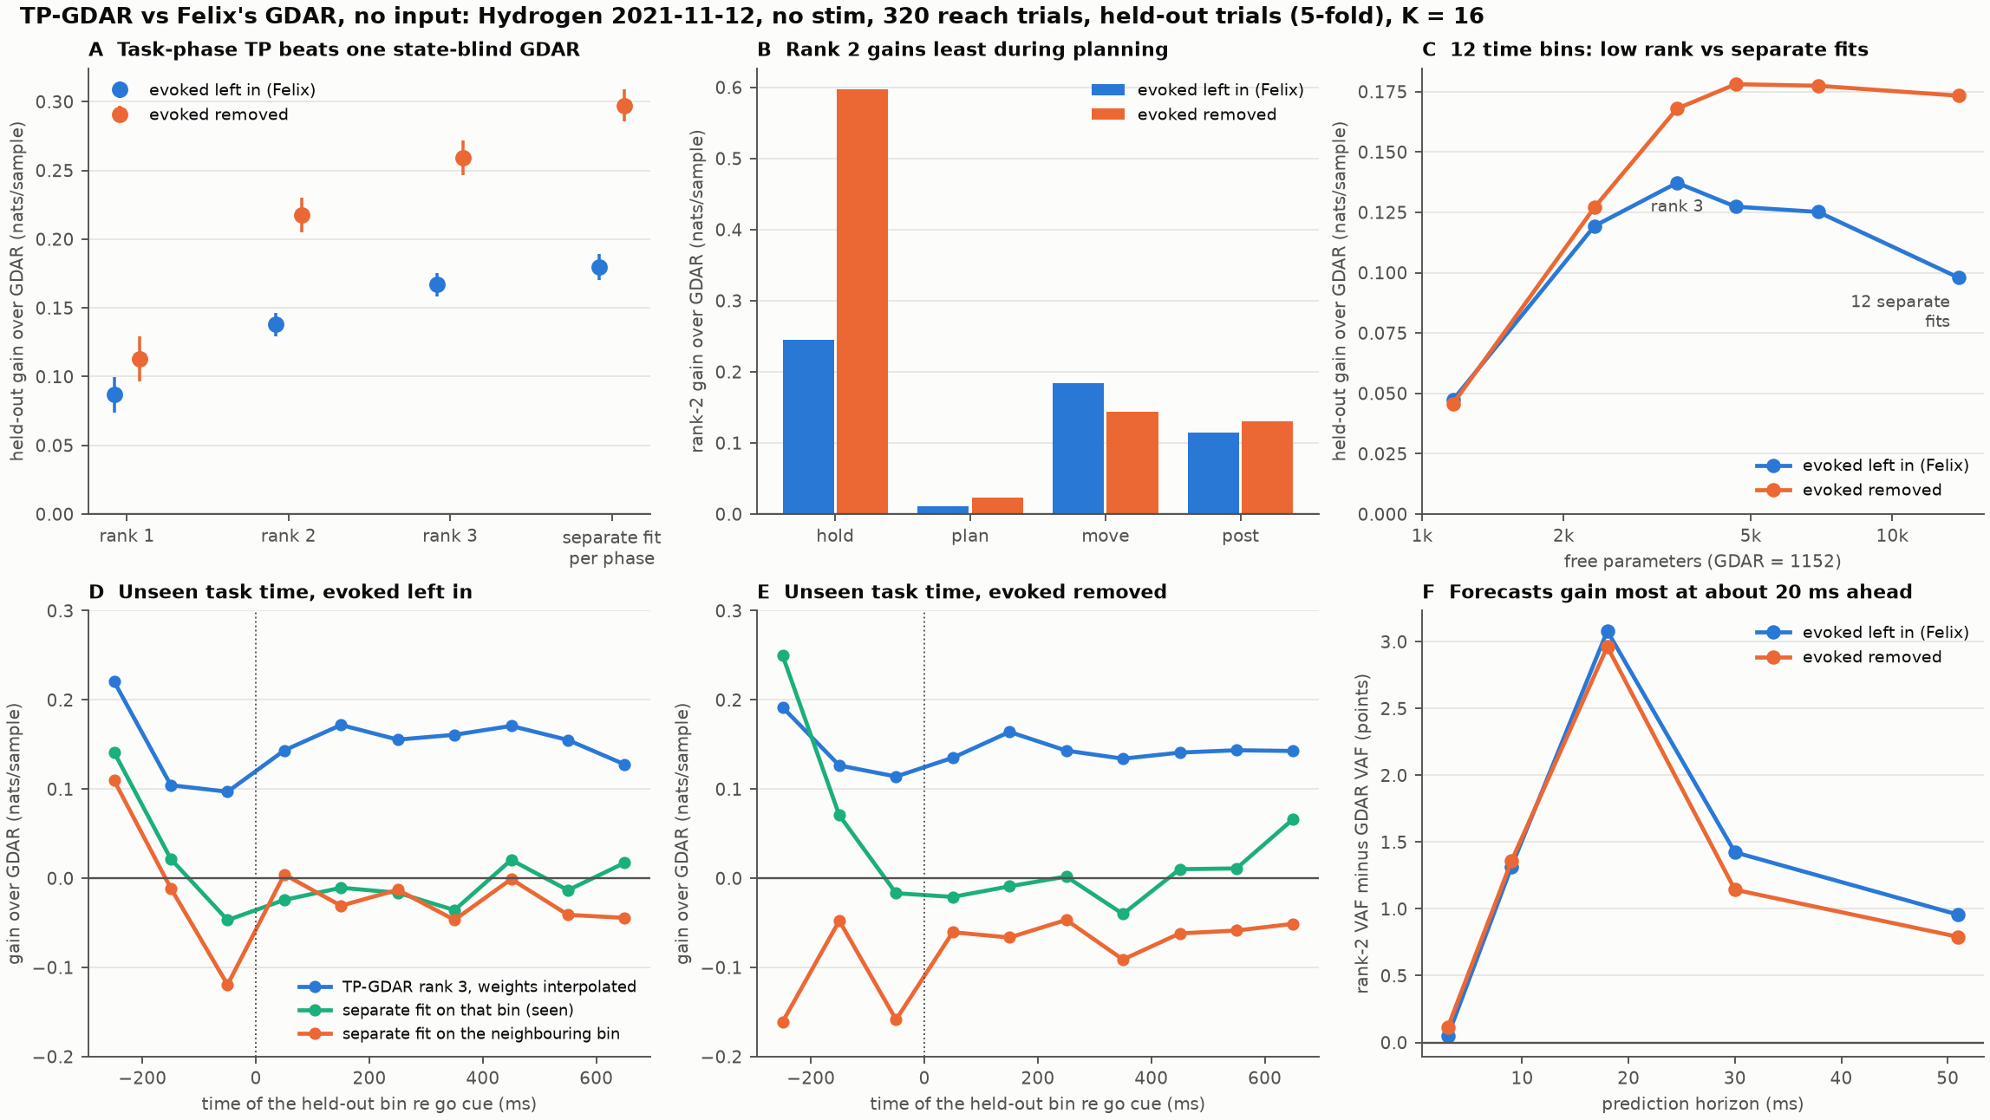
TP beats one GDAR on held-out trials and unseen task times

Slide 17
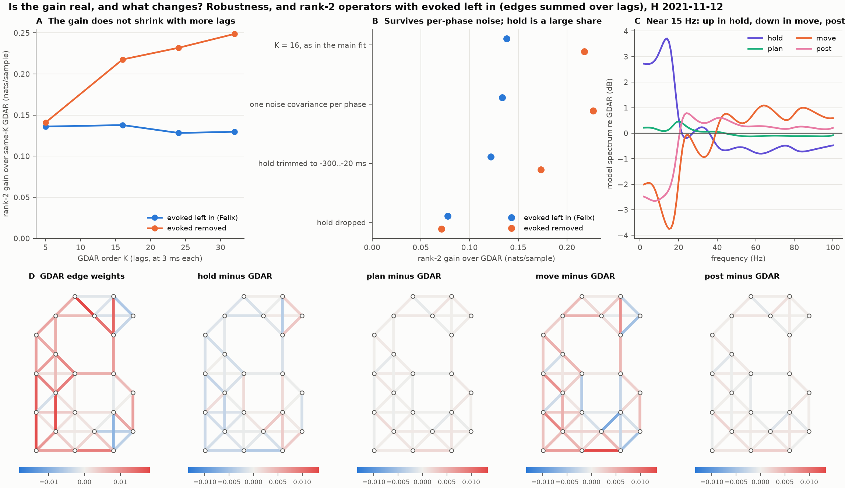
The gain holds with more lags; hold is a large share

Slide 18
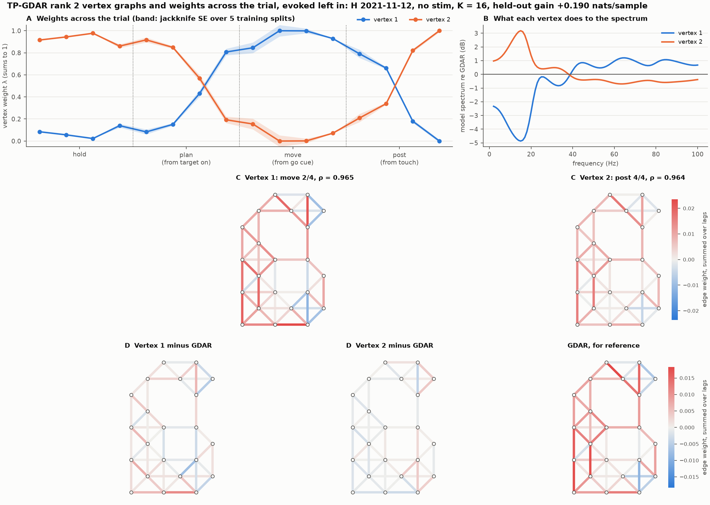
Rank 2, evoked left in: a switch before the go cue
Held-out gain +0.190 nats/sample; 16 separate fits +0.211
One vertex through hold and early plan, the other from late plan through move and early post
Vertices differ by about 8 dB near 15 Hz in the model, not yet checked against data

Slide 19
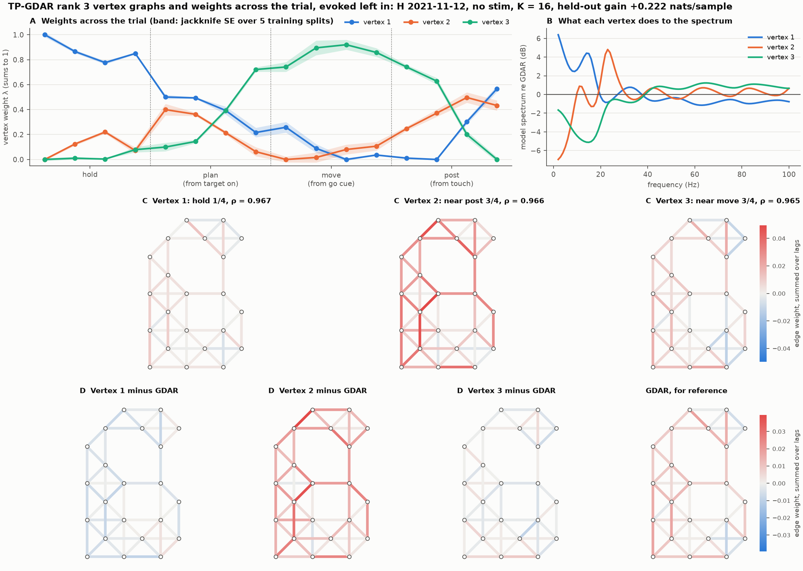
Rank 3, evoked left in: vertex 2 is an extrapolation
Held-out gain +0.222 nats/sample, above the 16 separate fits
The triangle encloses all bins, so corners need not be visited by the data
Vertex 2 is a full spread from any bin: don't read its strong coupling as a real state

Slide 20
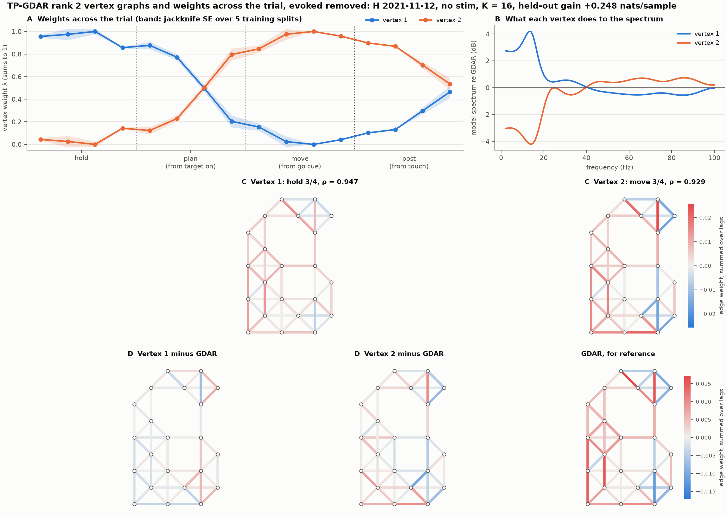
Rank 2, evoked removed: the switch returns only part way
Held-out gain +0.248 nats/sample; 16 separate fits +0.392
Same switch in late plan, about half way back after touch
Hold vertex is slower: spectral radius 0.947 vs 0.929

Slide 21
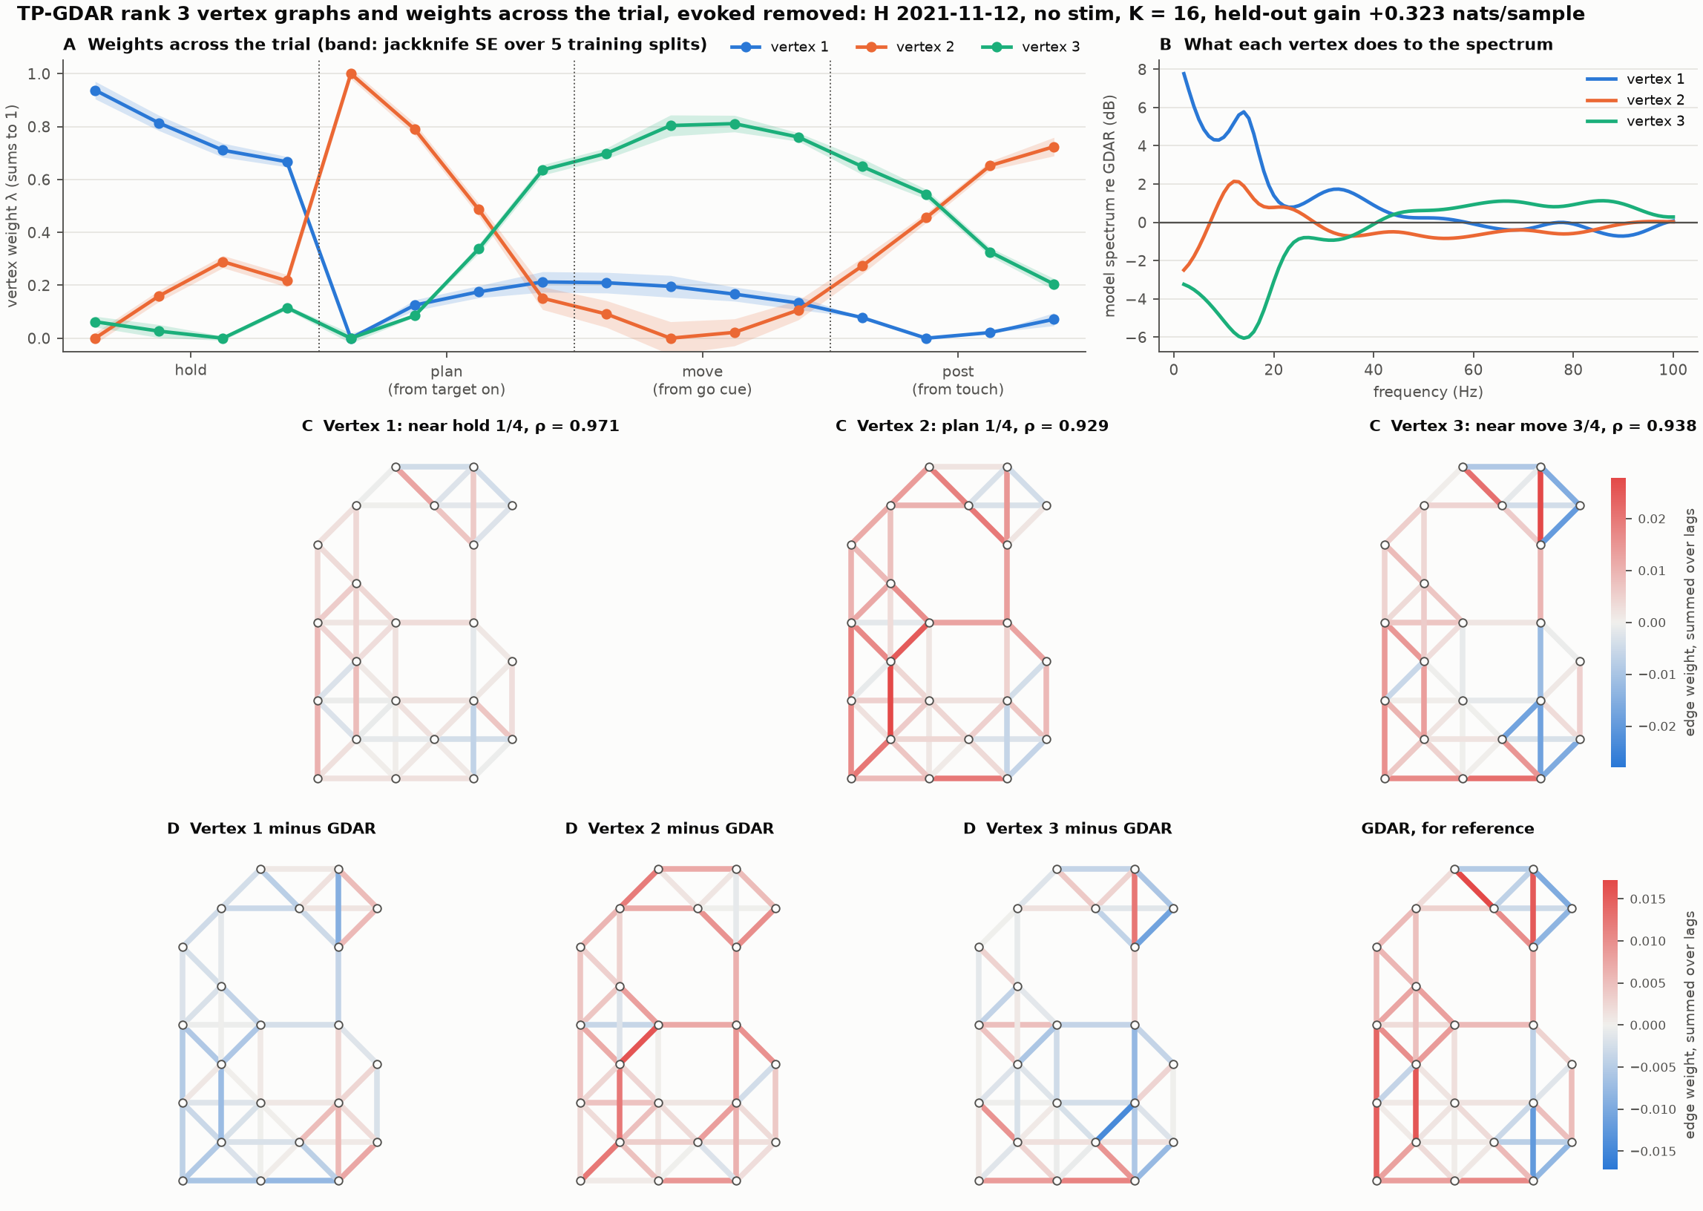
Rank 3, evoked removed: plan 1/4 is an unexplained jump
Held-out gain +0.323 nats/sample; separate fits still win at +0.392
Weights jump right after target onset, and that bin becomes a vertex
This could be left-over evoked response; not investigated yet

Slide 22
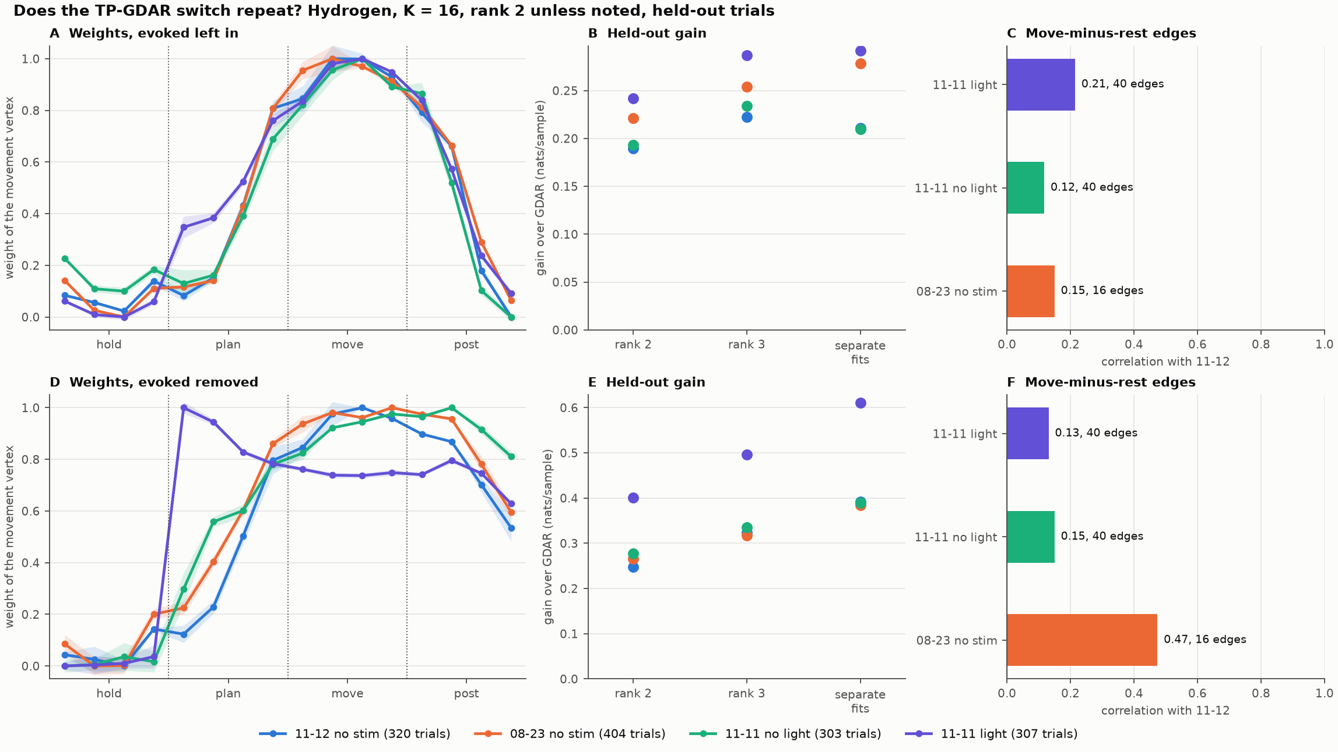
Other days: timing repeats, edge maps mostly don't

Slide 23
Same gain on other days, different edges
Hydrogen, day | Trials | Rank 2 | Separate fits | Edges, r with 11-12
11-12 no stim | 320 | +0.190 / +0.248 | +0.211 / +0.392 | reference
08-23 no stim | 404 | +0.221 / +0.266 | +0.278 / +0.384 | 0.15 / 0.47 (16 edges)
11-11 no light | 303 | +0.193 / +0.277 | +0.210 / +0.389 | 0.12 / 0.15 (40 edges)
11-11 light | 307 | +0.242 / +0.400 | +0.292 / +0.610 | 0.21 / 0.13 (40 edges)
Held-out gain over GDAR, nats/sample. Each cell: evoked left in / evoked removed.
The gain and the timing of the weights repeat across days
Move-minus-rest edge maps mostly do not repeat, so don't read one day's map as a fixed anatomy of the switch
Weights run 0 to 1 by the choice of extreme bins, so overlap in range is partly by construction
Lit trials: the model has no input term, so these vertices can absorb the light (the jump in panel D)

Slide 24
Limitations of the procedure
Phase is not known in real time: bins use go and touch times, and the model does not infer phase from neural activity
Weights describe the average trial; they depend only on the bin, not on trial-to-trial state
Bins can only be interpolated if they are ordered; the 4-phase grid has nothing to interpolate
Σ is shared and fixed during the alternation, so this is not a full maximum-likelihood fit
Vertices are one choice of coordinates for the fitted family
One monkey, three days: the timing of the weights repeats, but the edge maps mostly do not. Noah has not confirmed the channel map

Slide 25
Part 3: a control example
A sparse 9-node graph learned with TP-GDAR, an input at each node, one polytopic gain

Slide 26
The example: 9 nodes, known truth, an input at each node
3 × 3 grid, 12 edges, 2 lags, symmetric: 51 numbers per operator, of which 9 are input gains
Data: 30 trials of 200 samples at each of 7 values of p, with random input at every node
20 random plants in each of two cases. One unstable: spectral radius 0.90 at p = 0, 1.03 at p = 1. Two unstable: 1.03 at both
The second case was added after seeing the first, as a stress test
Instability is put in by design so a controller has something to fix. This says nothing about cortex

Slide 27
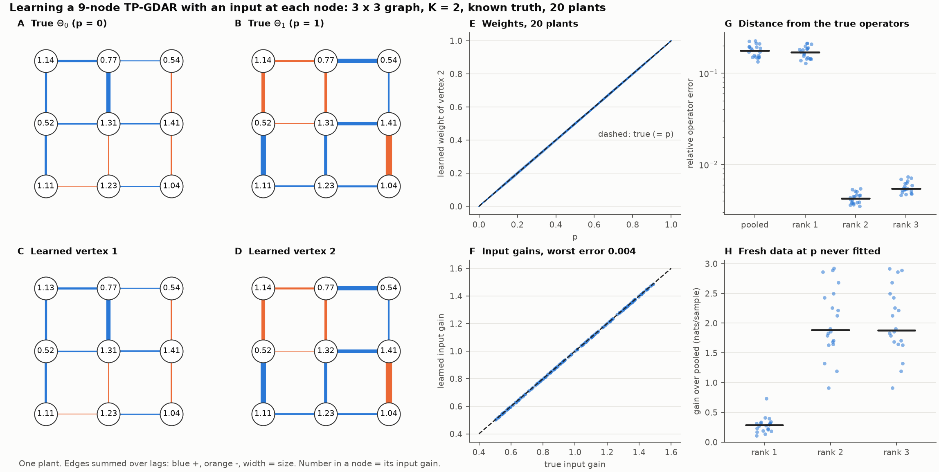
TP-GDAR recovers the operators and the input gains

Slide 28
Polytopic control: one gain, checked at the vertices
If it holds at the vertices it holds at every mix of them: every p, and p moving at any speed
The gain does not need to know p, only the fitted vertices and B
α sets a guaranteed decay rate. At α = 1 the fitted certificate held on the true plant in 0 of 20 plants, because the solution sits on the LMI's boundary. At α = 0.9 it held in 20 of 20, in both cases
The loop is closed on the true plant, never on the fitted model

Slide 29
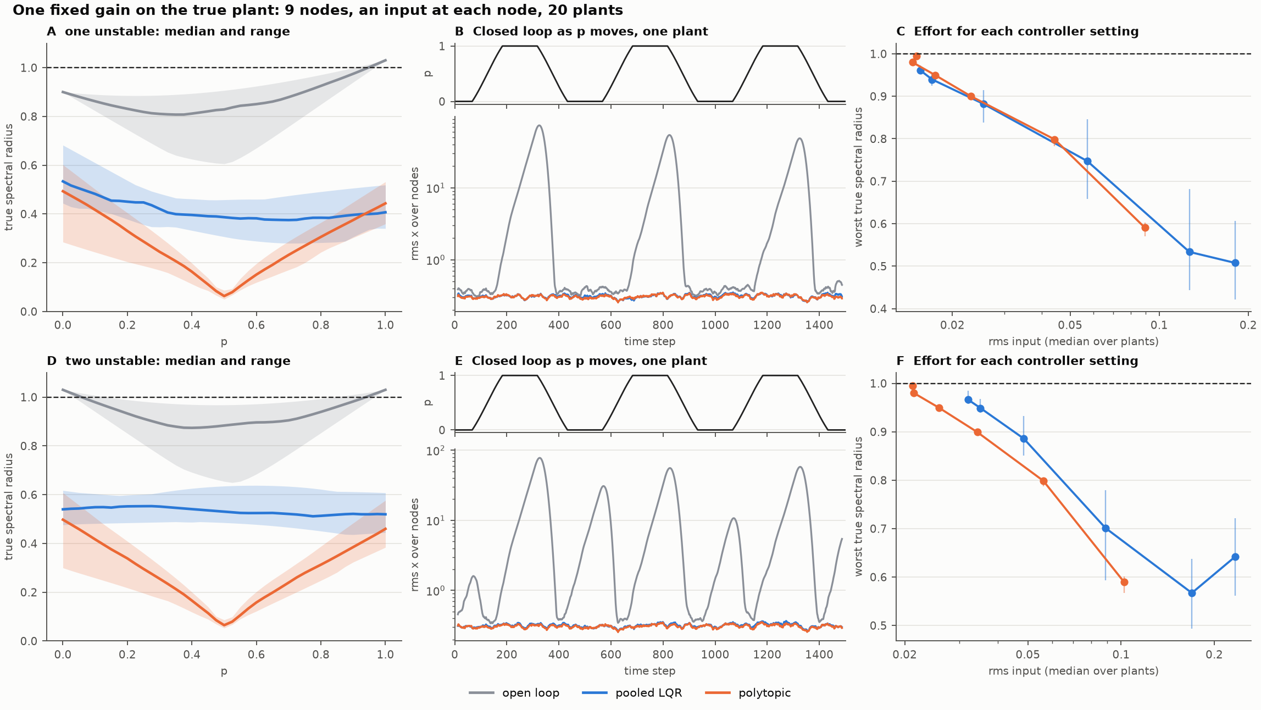
Both gains stabilise every plant

Slide 30
Here the vertices matter more than the LMI
Median over 20 plants | Stable at all p | Worst true ρ | rms x | rms input
One unstable: open loop | 0 / 20 | 1.030 | 9.76 | 0
Pooled LQR, R = 1 | 20 / 20 | 0.534 | 0.311 | 0.126
Polytopic, α = 0.9 | 20 / 20 | 0.501 | 0.307 | 0.171
Two unstable: open loop | 0 / 20 | 1.030 | 14.2 | 0
Pooled LQR, R = 1 | 20 / 20 | 0.567 | 0.314 | 0.169
Polytopic, α = 0.9 | 20 / 20 | 0.506 | 0.308 | 0.184
Pooled LQR stabilises every plant too: with an input at every node the gain can nearly cancel the mean operator
With the LMI set to minimise the gain (panels C, F), the same worst-case ρ takes less input: 15 to 35% less with two unstable ends; with one, even down to ρ = 0.8 and 10 to 17% less below that
Noise suppression, rms x per unit of input, is about even
The fitted vertices can certify either gain: pooled LQR passes at rates 0.9 and 0.8 (19 or 20 of 20 on the true plant). A rate-0.6 certificate exists for it in only 10 and 0 of 20; the LMI reaches 0.6 in all 40
Synthetic, linear, full state, no delay or actuator limits. A few inputs on real data is the real test

