Slide 1
GDAR-TP · PRELIMINARY RESULTS · SIMULATED DATA
Modeling — and steering —
how brain areas talk to each other
A network model whose wiring changes with brain state, compressed to a few simple pieces — plus a stimulation controller that is guaranteed steady across every state.
Graph Diffusion AutoRegression · Tensor-Product decomposition

Slide 2
THE IDEA IN ONE PICTURE
Brain areas sit on a fixed map — and nudge their neighbours
A
We record activity from a grid of sensors on the brain — one number per channel, many times a second.
B
Each channel is pushed around mostly by its close neighbours on the grid, not by everything at once.
C
One slow “state knob” — arousal, or how hard we stimulate — changes how strongly neighbours push each other.
A channel and its neighbours
2

Slide 3
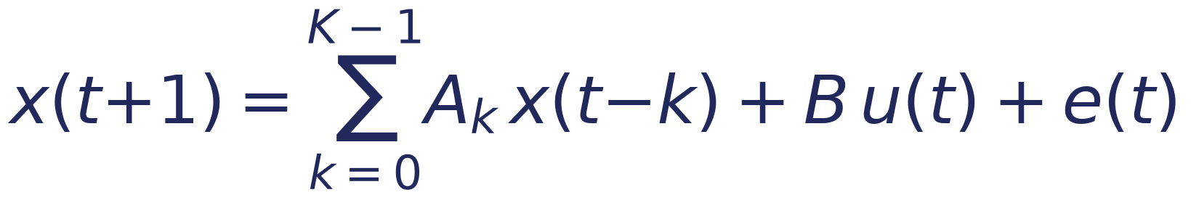
THE MODEL
Predict each channel from its recent past, its neighbours, and the stimulation
x(t+1)
Aₖ x(t−k)
next activity at every channel
how strongly channels pushed each other, k steps ago
B u(t)
e(t)
the effect of the stimulation we apply
everything left over — noise
3

Slide 4
CONSTRAINT 1 — KEEP IT HONEST
Only neighbours are allowed a direct link
We forbid direct arrows between far-apart channels. Each channel is only nudged by the average of its neighbours — written with the grid’s Laplacian L. Two numbers per time-lag do the whole grid.
“keep only neighbour + self links” “a little of itself, minus a diffusion across the grid”
4
2,592
same fit
numbers describe the whole grid’s coupling
numbers a free model would need
far fewer knobs, no accuracy lost
4

Slide 5
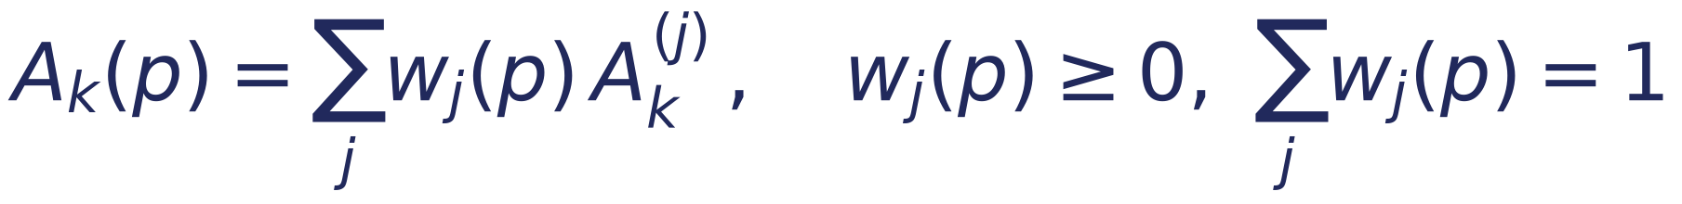
CONSTRAINT 2 — ONE KNOB, FEW PIECES
Blend a handful of fixed “corner” models
Instead of a different model at every knob setting, we keep a few fixed corner models and blend them with weights that add up to 1. The knob just slides the blend; a standard decomposition (HOSVD) tells us how many corners are really needed.
the model at knob value p = a weighted blend of fixed corner models
✓
Interpretable
✓
Compact
✓
Controllable
each corner is one clean spatial pattern of communication
the whole knob-sweep is a few pieces plus a blend curve
a controller only has to handle the corners, not every setting
5

Slide 6
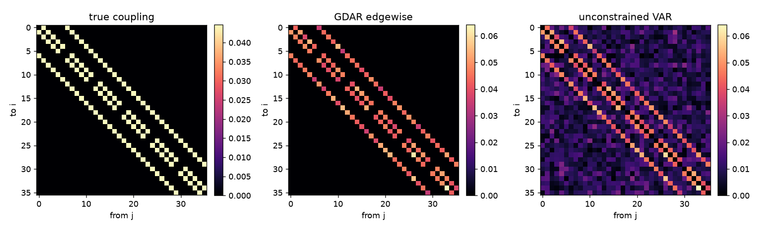
RESULT 1
It recovers the true wiring — a plain model does not
True channel-to-channel coupling (left) vs. our graph model (middle) vs. an unconstrained model (right).
0.99
0.90
4 vs 2,592
our model’s match to the true wiring
the free model’s match — noisier
knobs used to get there
6

Slide 7
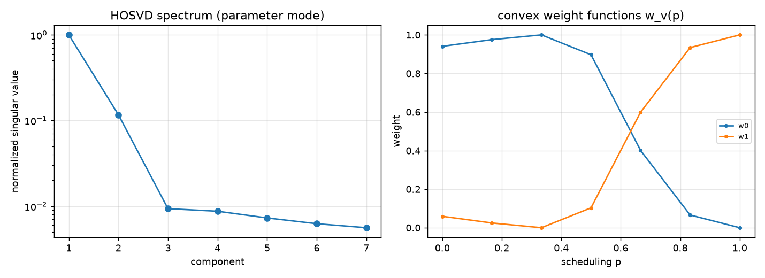
RESULT 2
The knob’s whole effect collapses to just two corners
Left: importance of each corner drops off a cliff after two. Right: the two blend weights slide smoothly as the knob turns.
7×
then flat
held-out
error drop going from one corner to two
a third corner adds essentially nothing
predicts unseen knob settings as well as a custom fit
7

Slide 8
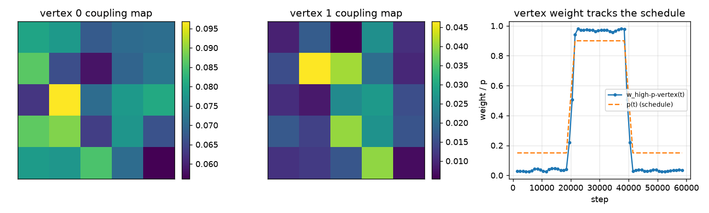
RESULT 3
The corners are readable, and the blend tracks the state
Two corner models as spatial coupling maps (left, middle); the recovered blend weight follows the true state schedule over time (right).
0.997
two maps
match between the recovered blend and the real state schedule
each corner is one distinct, interpretable communication pattern
8

Slide 9
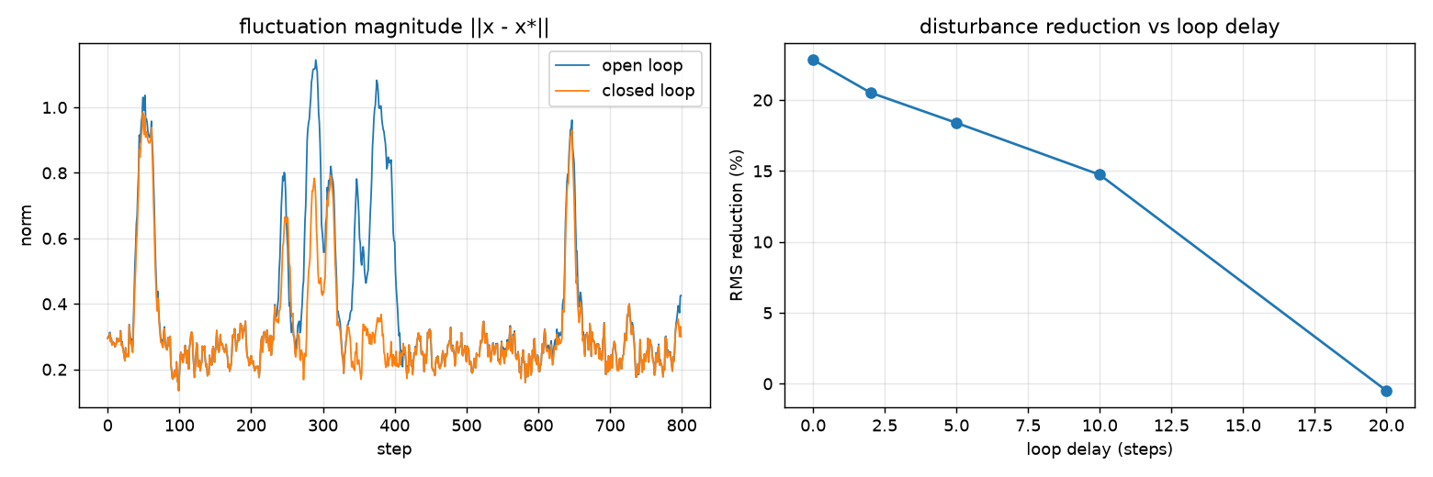
RESULT 4 — CLOSING THE LOOP
One controller, provably steady across every state
Run on the true nonlinear network with sensor noise, loop delay and a cap on stimulation. Left: closed loop (orange) vs. no control. Right: benefit fades gracefully as delay grows.
~23%
graceful
one gain, guaranteed stable for every blend
less unwanted fluctuation
degrades slowly with delay
9

Slide 10
Where this stands
The full pipeline — model → compress → interpret → control — works end to end on a simulated brain network, with 27 automated tests. Real recordings are the next step.
Recovers wiring
Compresses cleanly
graph model beats a free model with a tiny fraction of the knobs
the state-dependence needs only two corner models
Stays interpretable
Controls stably
corners are spatial maps; the blend tracks the real state
one guaranteed-stable gain cuts fluctuations on the true network
NEXT
Wire in real recordings (monkey ECoG / Utah array) — this is the concrete home for the grant’s “GDAR model fits” (Aim 3).
Decide the coefficient form (strict diffusion vs. free edge weights) against real-data residuals.

