Slide 1
TP-GDAR: the model and how it is trained
Symmetric TP-GDAR compared with Felix Schwock's GDAR
Worked example: Hydrogen 2021-11-12, IOS Reach, no stim

Slide 2
Felix's GDAR: one operator for the whole day
Each lag matrix is symmetric and non-zero only on graph edges and the diagonal
Here N = 22 channels, E = 50 edges and K = 16 lags (48 ms), so 1,152 free numbers
R is a fixed sparse matrix that copies each edge coefficient into (i, j) and (j, i)

Slide 3
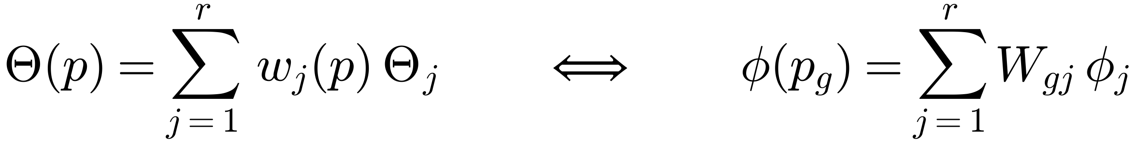
The TP structure: a low-rank mix over p
Each Θⱼ is a complete symmetric GDAR operator with all 16 lags
Only the p direction is compressed; channels and lags are not
The weights W are free per bin, so nothing forces them to be smooth
W and the Θⱼ can trade an invertible r × r matrix, so they are not unique: only Θ(p) is
Model | Parameters
Felix's GDAR | 1,152
TP-GDAR rank 2 | 2,332
TP-GDAR rank 3 | 3,495
16 separate fits | 18,432

Slide 4
p is trial phase, warped per trial
hold
plan
move
post
1/4
2/4
3/4
4/4
1/4
2/4
3/4
4/4
1/4
2/4
3/4
4/4
1/4
2/4
3/4
4/4
-400 ms
target on
go cue
touch
touch + 500 ms (max 1400 ms)
Each phase is cut by its own duration on that trial, so all trials line up on P = 16 bins
A sample belongs to the bin of its target x(t+1); its lags can reach into the previous bin
Go and touch times are known only afterwards, so this warped p cannot be used online

Slide 5
Training 1: statistics per bin, then the baseline
Summed within trials, never across a trial boundary. The rest of the fit uses only these sums.
1. Symmetric OLS on all bins pooled
2. Σ from its residuals, then fixed
3. Refit weighted by Σ⁻¹: gives φ₀
This is Felix's estimator; on one trial it matches Felix's fit_gdar to a relative difference of 1e-11
Preprocessing first: decimate by 3 to 333 Hz, demean each trial, optionally remove evoked kernels

Slide 6
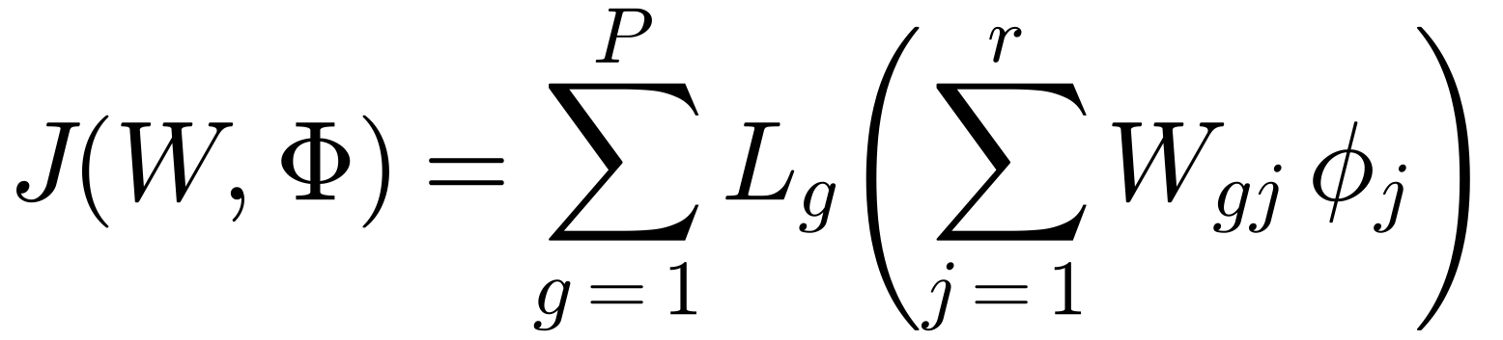
Training 2: the objective is the data loss
For one bin the GLS loss is quadratic in φ:
The whole model minimises the loss summed over bins:
Data decide the metric: well-excited directions count more. An unweighted SVD of per-bin fits, the older two-stage route, treats all coefficients equally.

Slide 7
Training 3: initialise, then alternate
Start from the pooled model plus the leading per-bin deviations:
Each sweep solves one block exactly, so J can never increase:
After each sweep, rescale weight columns to unit RMS; operators take the inverse scale
Stop at a relative change in J below 1e-7, or 40 sweeps (25 on training splits); real fits took 5 to 7
No penalty beyond numerical jitter of 1e-10, matching Felix's unpenalised fit

Slide 8
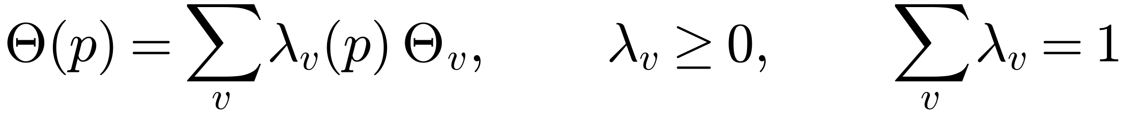
From components to vertices
Find a with Wa ≈ 1 and project W onto that plane (worst error 0.033 to 0.037 at rank 2, about 0.02 at rank 3)
Rank 2 vertices: the two extreme bins, in the pooled data metric
Rank 3 vertices: the smallest triangle on convex-hull edges that encloses all bins; corners need not be visited by the data
λ comes from non-negative least squares
Sum-to-one makes the companion form, which the LMI controller needs, mix linearly across vertices
This is post-processing: the held-out gains come from the fitted W and Φ

Slide 9
Evaluation: held-out one-step likelihood
5-fold over trials, stratified by reach direction, refitting everything on each training split
Each model m has one Σ, from its own training residuals, with 1% shrinkage toward the diagonal
Weight uncertainty: express each split's fit in the full-data vertices and take the jackknife SE
K = 16 was picked on the baseline only; the Felix likelihood is still rising at K = 32

Slide 10
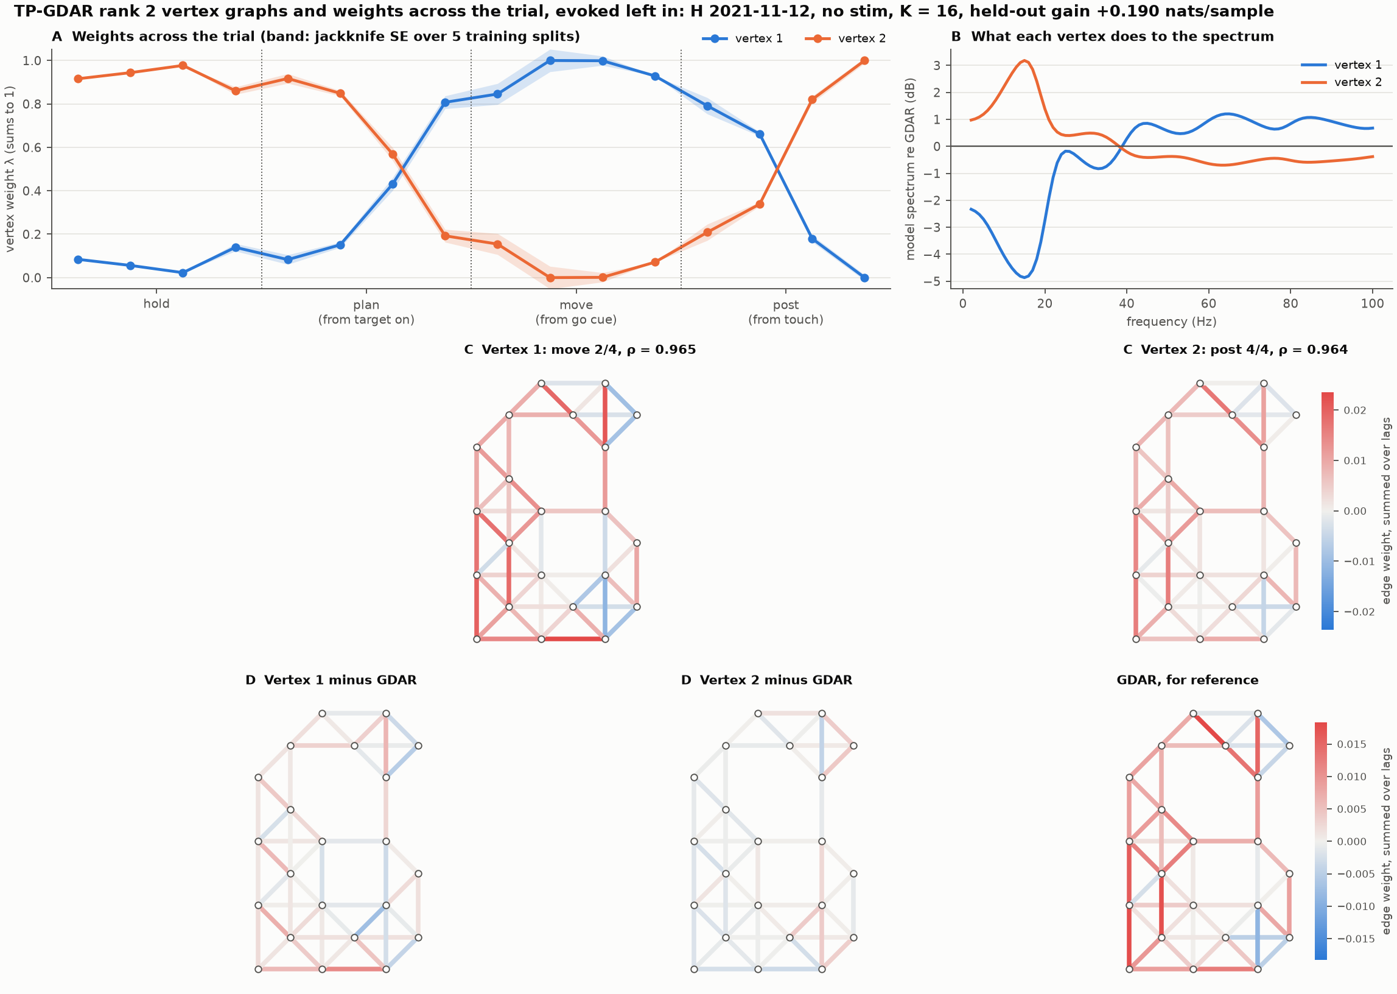
Result: rank 2 acts as a switch across the trial
Gain over GDAR | Evoked in | Removed
Rank 2 | +0.190 | +0.248
Rank 3 | +0.222 | +0.323
16 separate fits | +0.211 | +0.392
Nats/sample on held-out trials, K = 16
Figure: rank 2, evoked left in
One vertex through hold and early plan, the other from late plan through move and early post

Slide 11
Limitations of the procedure
Phase is not known in real time: bins use go and touch times, and the model does not infer phase from neural activity
Weights describe the average trial; they depend only on the bin, not on trial-to-trial state
Bins can only be interpolated if they are ordered; the 4-phase grid has nothing to interpolate
Σ is shared and fixed during the alternation, so this is not a full maximum-likelihood fit
Vertices are one choice of coordinates for the fitted family
One monkey, three days: the timing of the weights repeats, but the edge maps mostly do not. Noah has not confirmed the channel map

