Slide 1
VSphere without the GUI
Configuration, Troubleshooting and everything else.

Slide 2
Introduction
ESXCLI
VM Operations with VIM-CMD
Troubleshooting with ESXTOP
miscellaneous Tools
Notes:
For most of our administration, we use the GUI based tools, but sometimes those tools aren’t available. So as administrator we need to carry many tools on our bets and today I am going to be going over some of the tools which I know of and have used here and there
Just about everything that can be done on a GUI is readily available via the CLI. Though I must admit the GUI is easier for doing some tasks. The only thing that you obviously cant do is open a console windows.
Today I will be going over ESXCLI , VM Operations with VIM-CMD, Troubleshooting with ESXTOP, miscellaneous Tools
This is going to be a high level view of this tools, but the idea is just to show some of the available tools that can come in handy

Slide 3
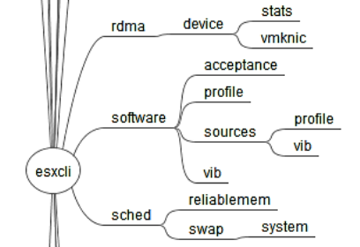
ESXCLI
ESXCLI is command line interface for managing many aspect of vSphere. ESXCLI is organized into functional namespaces such as storage, network, and compute.
ESXCLI replace most of the esxcfg-* commands, such as esxcfg-nics, esxcfg-snmp, etc.
Notes:
http://www.virten.net/2014/02/howto-use-esxcli-in-powercli/
The ESXCLI command is new tool that replaces most of the esxcfg- commands that was present in ESX before the introduction of the ESXi.
The ESXCFG- commands are still available, but vmware encourages the use of ESXCLI as they will be deprecating he ESXCFG commands.
ESXCLI is organized into name spaces, such as storage, network, and so on.
There are somethings which you can do through ESXCLI that you can’t on the GUI, such as having a claimes rule within your ESX host that forces all a particular type of storage array to use a specific loadbalancing – MRU, FXED, RR
Login to a host and demo.

Slide 4
VIM-CMD
The VIM-CMD command is used to perform low level VM related operations on a VM.
The VIM-CMD commands are normally used when all other means to manage a VM fails.
Use case | Command
Register a VM | vim-cmd solo/registervmpath_to_vmx_file
Unregister a VM | vim-cmd vmsvc/unregister vmid
Get the current power state of a VM | vim-cmd vmsvc/power.getstate vmid
Display the IP address of a VM | vim-cmd vmsvc/get.guest vmid |grep -m 1 "ipAddress = \""
Notes:
http://www.doublecloud.org/2013/11/vmware-esxi-vim-cmd-command-a-quick-tutorial/

Slide 5
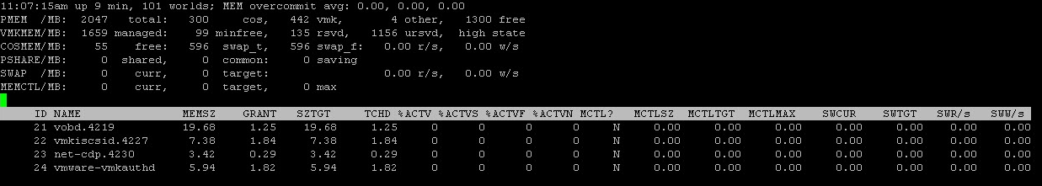
ESXTOP
ESXTOP allows you to view real time performance information of a host
C – CPU View (default screen when you typed esxtop) | u – Disk device view
m – Memory view | v – Virtual Disk View
d – Disk adapter view | n – Network View
h – Help screen for esxtop | y – Power Management
f – add or remove the fields in the respective view. | q – quit the esxtop

Slide 6
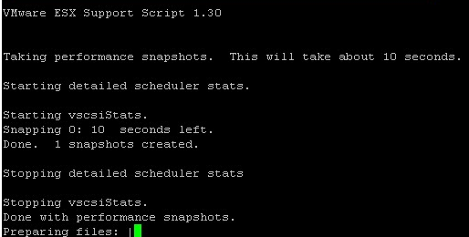
ESXTOP cont…
ESXTOP allows you to capture data at predefined intervals and duration and the replay the captured data.
This is good for capturing low level performance information of the environment
Example: vm-support -s –i 5 -d 10

Slide 7
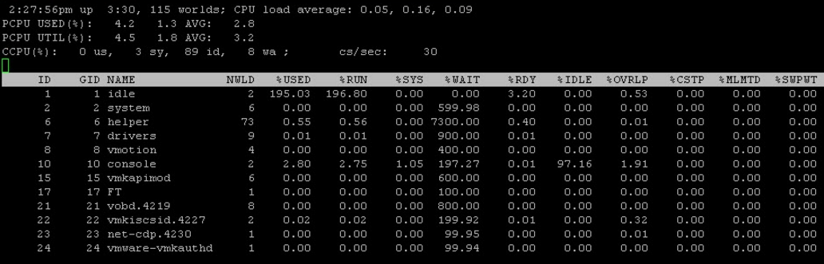
ESXTOP cont…
To replay the captured performance data
Untar the file: tar -xzf esx-2015-12-08–13.51.29993.tgz
Run “esxtop -r vm-support-esx-2015-12-08–13.51.29993” on the extracted file

Slide 8
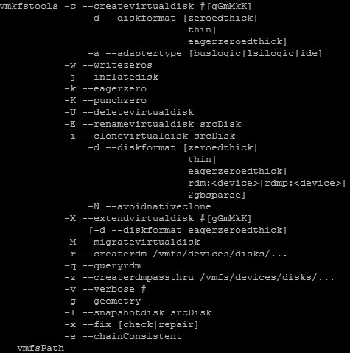
VMKFSTOOLS
vmkfstools is a vSphere cli tool for managing VMFS volumes. It allows you to perform operations against both the file system and the virtual disk files
vmkfstools <conn_options> -C vmfs3 -b 1m -S Test naa.600601604d521c002732ff0dc122dd11:3 | Create a datastore
vmkfstools <conn_options> -s '[storage1] rh6.2.vmdk' | Shrink a VMDK
test2.vmdk test2clone.vmdk -d thin | Clone a VMDK
vmkfstools –activehosts /vmfs/volumes/VNX-20 | Show hosts that actively using a volume
Notes:
http://buildvirtual.net/vmkfstools-examples-working-with-virtual-disks/

Slide 9
Miscellaneous Tools
VOMA
Use VMware Ondisk Metadata Analyser (VOMA) when you experience problems with your VMFS datastore and need to check metadata consistency of VMFS or logical volume backing the VMFS volume.
VOMA is used in cases where a VMFS datastore becomes corrupted, inaccessible or entries in the vmkernel log indicating a metadata errors..

Slide 10
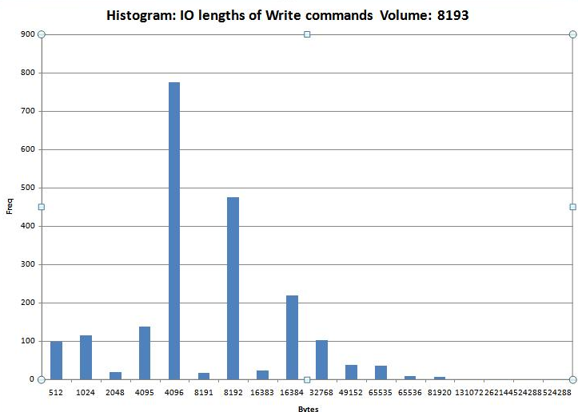
Miscellaneous Tools con…
vscsiStats
vscsiStats is a tool with allows you to capture SCSI performance counters per VM at the vmkernel level. i.e. How much IO is your VM pushing, what size are the IO, Latency, etc. The command produces a histogram data which can be graphed in excel
vscsiStats -s -w 2847194
vscsiStats -w 2847194 -p all -c
vscsiStats -w 2847194 -p all -c /tmp/vco_vscsi_results.csv

Slide 11
?

