Slide 1





Database
MQTT-Broker
Analyst
IoT
http
P2P
smart-Thermometer
ESP32
smart-RGB-Photometer
smart-IR-Turbidimeter
P2P
P2P
smart-pH-Meter
ESP32
ESP32
ESP32
P2P
P2P
smart-Colorimeter
P2P
P2P
smart-EC-Meter
ESP32
ESP32
smart-UV-Photometer
smart-ORP-Meter
ESP32
ESP32
ESPEasy P2P Networking

Slide 2
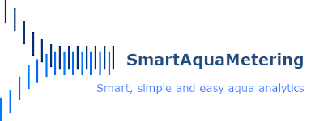
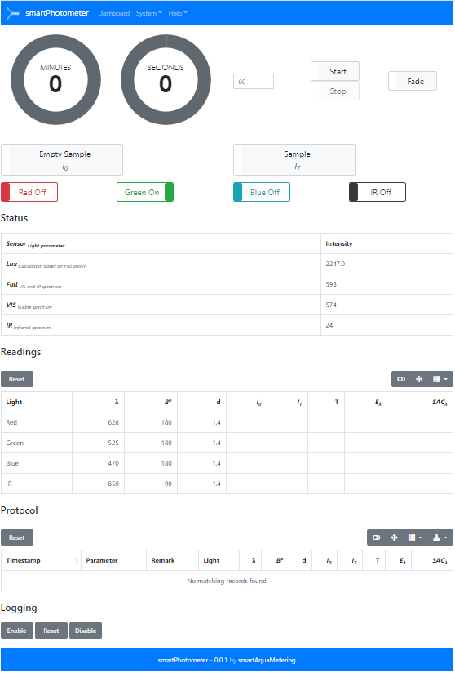
Database
Analyst
MQTT-Broker
mqtt
http
smart-RGB-Photometer
http
ESP32
MQTT
subscribe
publish
smart-UV-Photometer
ESP32
IoT
smart-pH-Meter
ESPEasy
P2P network
ESP32
smart-IR-Turbidimeter
ESP32
ESP32
smart-EC-Meter
smart-Colorimeter
ESP32
ESP32
ESP32
smart-ORP-Meter
smart-Thermometer

Slide 3
Colored solution
0.664
I₀
ε_{λ} , c
I_{T}
Radiation
Source
LED(s)
Monochromatic light of an defined range of wavelengths
λ
Absorbance of complementary
Colors
Light sensor(s)
Display and processing unit(s)
E_{λ}
´SAC_{λ}
c
d
Cuvette

Slide 4
Transmission
Absorption
Scattering

