Slide 1





Database
MQTT-Broker
Analyst
IoT
http
P2P
smart-Thermometer
ESP32
smart-RGB-Photometer
smart-IR-Turbidimeter
P2P
P2P
smart-pH-Meter
ESP32
ESP32
ESP32
P2P
P2P
smart-Colorimeter
P2P
P2P
smart-EC-Meter
ESP32
ESP32
smart-UV-Photometer
smart-ORP-Meter
ESP32
ESP32
ESPEasy P2P Networking

Slide 2
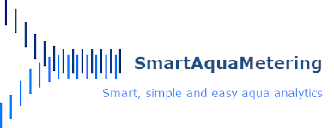
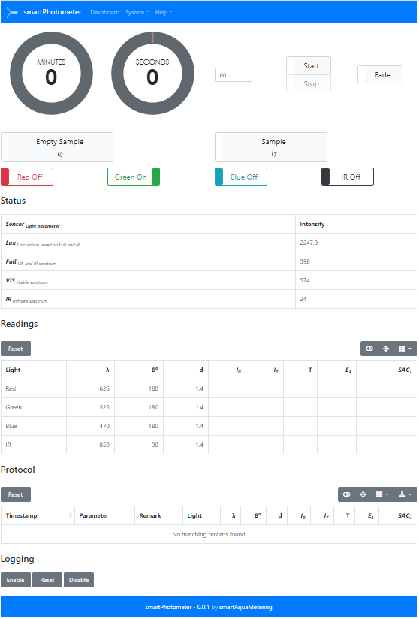
Database
Analyst
MQTT-Broker
mqtt
http
smart-RGB-Photometer
http
ESP32
MQTT
subscribe
publish
smart-UV-Photometer
ESP32
IoT
smart-pH-Meter
ESPEasy
P2P network
ESP32
smart-IR-Turbidimeter
ESP32
ESP32
smart-EC-Meter
smart-Colorimeter
ESP32
ESP32
ESP32
smart-ORP-Meter
smart-Thermometer

Slide 3
Empty Sample
λ
I₀
Beam angle
180 ⁰
Transmitted light measurement
0.66484
Sample
Colored solution
T, E_{λ}, SAC_{λ}, c
λ
ε_{λ} , c
I_{T}
d
Radiation
Source
Monochromatic light of an defined range of wavelengths
Absorbance of complementary
Colors
Light sensor
Display and processing units
Cuvette

Slide 4
Transmission
Absorption
Scattering

Slide 5
Absorbance
Transmitted light measurement
180 ⁰
1.25678
Nephelometric turbidity
Scattered light measurement
Beam angle
90 ⁰

Slide 6
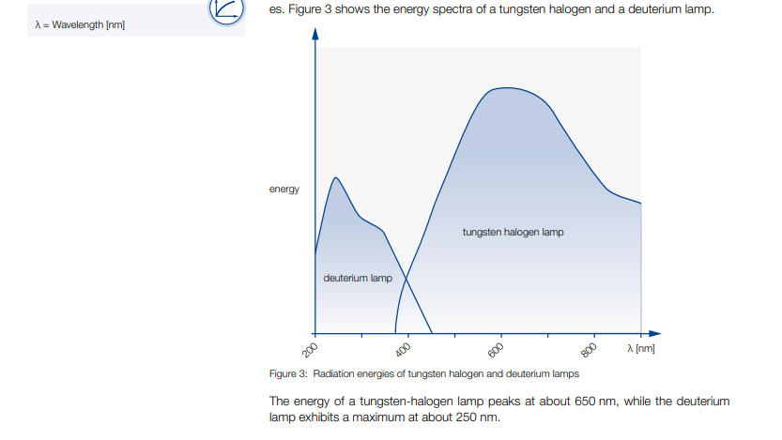

Slide 7
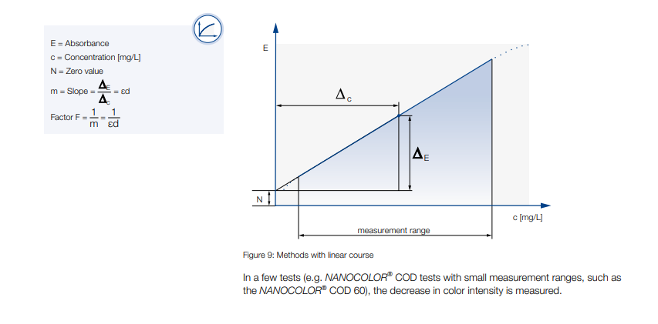

Slide 8
375
470
525
626
850
UVA
Blue
Green
Red
IR
Intensity
Wavelength [nm]

Slide 9
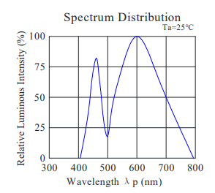
Warm White LED

