Slide 1





Database
MQTT-Broker
Analyst
IoT
http
P2P
smart-Thermometer
ESP32
smart-RGB-Photometer
smart-IR-Turbidimeter
P2P
P2P
smart-pH-Meter
ESP32
ESP32
ESP32
P2P
P2P
smart-Colorimeter
P2P
P2P
smart-EC-Meter
ESP32
ESP32
smart-UV-Photometer
smart-ORP-Meter
ESP32
ESP32
ESPEasy P2P Networking

Slide 2
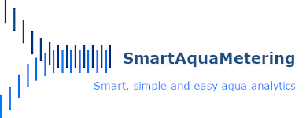
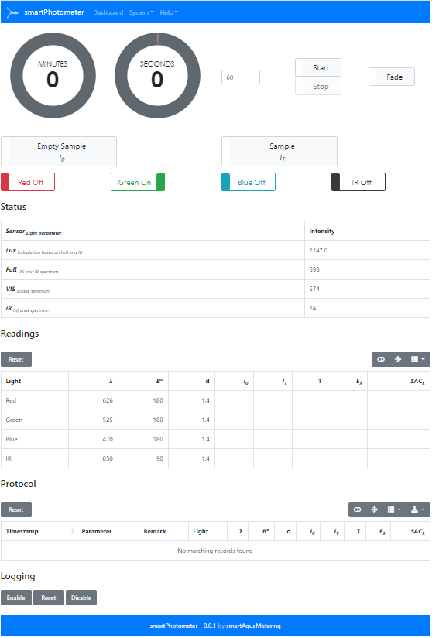
Database
Analyst
MQTT-Broker
mqtt
http
smart-RGB-Photometer
http
ESP32
MQTT
subscribe
publish
smart-UV-Photometer
ESP32
IoT
smart-pH-Meter
ESPEasy
P2P network
ESP32
smart-IR-Turbidimeter
ESP32
ESP32
smart-EC-Meter
smart-Colorimeter
ESP32
ESP32
ESP32
smart-ORP-Meter
smart-Thermometer

Slide 3
Empty Sample
λ
I₀
Beam angle
180 ⁰
Transmitted light measurement
0.66484
Sample
Colored solution
λ
ε_{λ} , c
I_{T}
T_{λ}, E_{λ}, SAC_{λ}, c
d
Radiation
Source
Monochromatic light of an defined range of wavelengths
Absorbance of complementary
colors
Display and processing units
Cuvette
Light sensor

Slide 4
Empty Sample
λ
I₀
Gaussian bandpass filter
Beam angle
180 ⁰
Transmitted light measurement
X: 0.4980
Y: 0.3774
Z: 0.0759
Sample
Colored solution
λ
ε_{λ} , c
I_{T}
T_{λ}, E_{λ}, SAC_{λ}, c
d
Radiation
Source
Absorbance of complementary
colors
RGB sensor
Display and processing units
Polychromatic light
Cuvette

Slide 5
Empty Sample
λ
I₀
Gaussian bandpass filter
Beam angle
180 ⁰
Transmitted light measurement
410: 0.66484
435: 0.62345
460: 0.39876
485: 0.16654 …
Sample
Colored solution
λ
ε_{λ} , c
I_{T}
T_{λ}, E_{λ}, SAC_{λ}, c
d
18 channel
spectral sensor
Radiation
Source
Absorbance of complementary
colors
Display and processing units
Polychromatic light
Cuvette

Slide 6
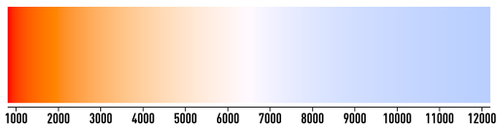
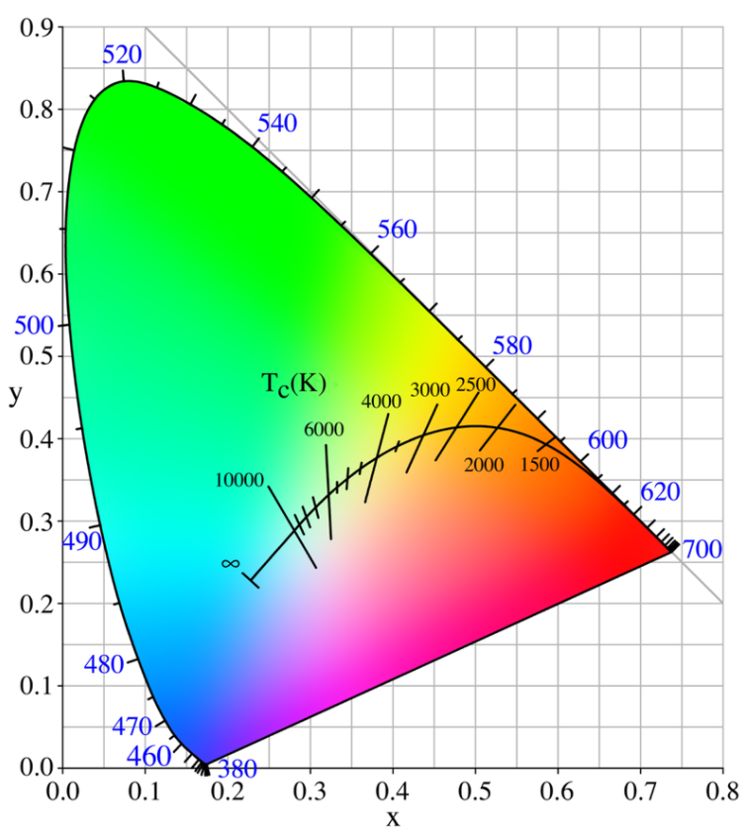
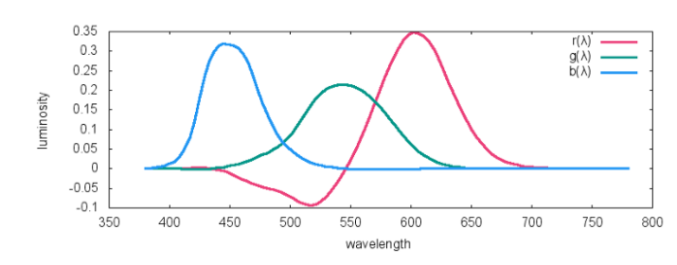
Color temperature (in K)

Slide 7
Transmission
Absorption
Scattering
Reflexion

Slide 8
Transmission
Absorption
Scattering
Reflexion

Slide 9
Reflexion
Transmission
Scattering

Slide 10
Absorbance
Transmitted light measurement
180 ⁰
1.25678
Nephelometric turbidity
Scattered light measurement
Beam angle
90 ⁰

Slide 11
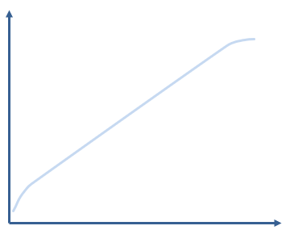
E
Δc
ΔE_{λ}
N
c
Measurement range

Slide 12
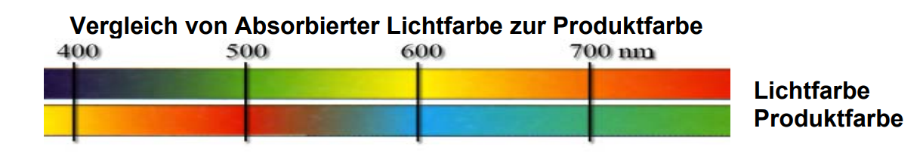

Slide 16
375
470
525
626
850
Light sensor
VEML6070
TSL2591
Relative luminous intensity / spectral response
Spectrum half width (Δλ)
9
26
40
20
45
Light source (LED)
UVA
Blue
Green
Red
IR
λ [nm]

Slide 17
465
525
615
RGB sensor
TCS34725
Relative luminous intensity / spectral response
Spectrum half width (Δλ)
Light source (Warm White LED)
λ [nm]

Slide 18
410
435
460
485
510
535
560
585
610
645
680
705
730
760
810
860
900
940
Spectral sensor
AS7265x
Relative luminous intensity / spectral response
Spectrum half width (Δλ)
Light source (Warm White LED)
λ [nm]

Slide 19
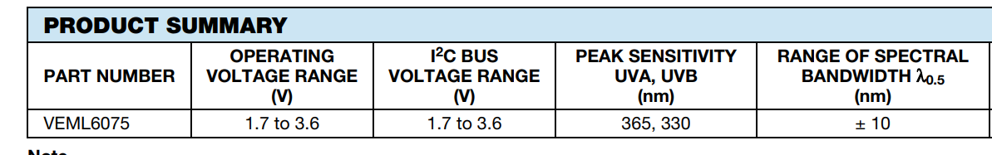
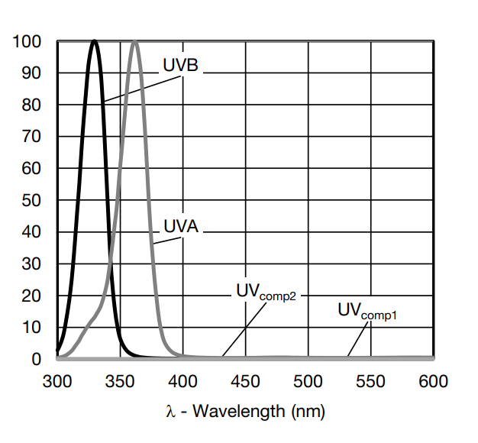

Slide 20
