Slide 1
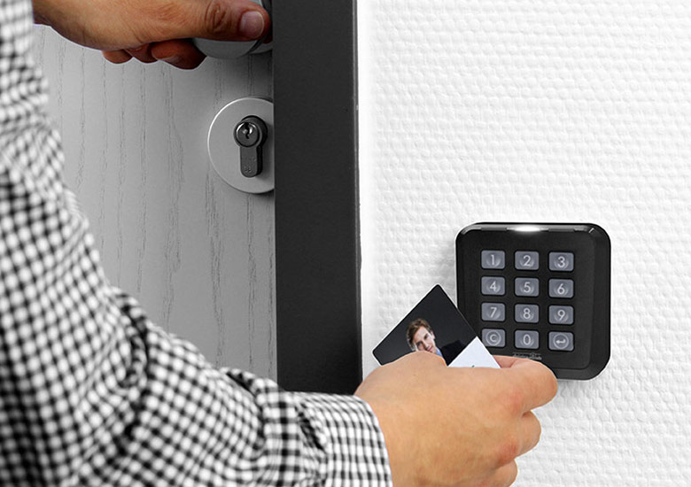
Project NAME :
INTELLIGENT DOOR ACCESS MANAGEMENT SYSTEM
TEAM NAME:
KEANU
AARON AKASH
ABHIJEET.M.RAO
ADITHYA AVINASH.E

Slide 2
introduction
Wouldn’t it be nice to be able to push a button to open or close a door?
Wouldn’t it be better to open the door immediately every time someone Is at the door instead of making them wait?
The proposed system just does that and also captures who is in front of the door.
You have the choice of letting a person in and out.

Slide 3

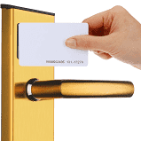

Existing systems
One common door access system is the rFID card based system.
The other is the Biometric scanner.

Slide 4
Proposed system
A “push” button in front of the door is kept in front of the door.
A person in front of the door pushes the button and gets captured by the camera.
A notification is sent to the user’s mobile which Indicates that someone is at the door.
The photo appears in the application used by the user.
The user then has the choice of opening and closing the door when required.

Slide 5
FLOW DIAGRAM
Door Control
Push Button
Raspberry Pi
Camera
Cloud
Mobile Application

Slide 6
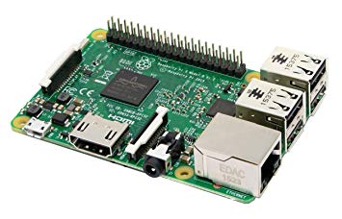
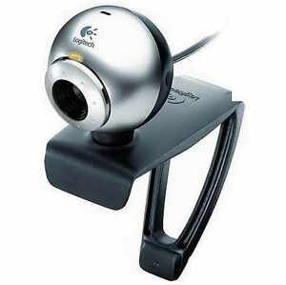


Technology aspects
HARDWARE
PUSH BUTTON
RASPBERRY PI
LOGITECH CAMERA
SOFTWARE
PYTHON IDLE
ANDROID STUDIO
GOOGLE FIREBASE CLOUD

Slide 7
ADVANTAGES
COST EFFICIENT
USER HAS CONTROL OF THE SYSTEM
HISTORY OF PEOPLE VISITING CAN BE VIEWED.
disadvantages
COMPLETE DEPENDENCY ON THE USER
NO OTHER SAFETY CHECKS

Slide 8
SCOPE OF IMPROVEMENT
In order to enhance security we can implement face recognition which can detect intruders.
THIS SYSTEM CAN BE MODIFIED TO ALLOW USERS TO USE THE APP AFTER AUTHORISATION WITH SPECIFIC ID’S.
THE SAME SYSTEM CAN ALSO BE INTEGRATED WITH BURGLAR ALARM SYSTEMS IN ORDER TO DETECT A BREAK IN AND AUTOMATICALLY SEND A NOTIFICATION WITH A PHOTO OF THE INTRUDER TO THE CONCERNED AUTHORITIES.

Slide 9
Thank you

