Slide 1
Twitter Topic Based Sentiment Analysis Using Deep Learning
TEAM-3
Submitted By
R.M.N. Preethi
V.S.Vineela Reddy
Md. Sheena
P. Manisha
V. Keerthi

Slide 2
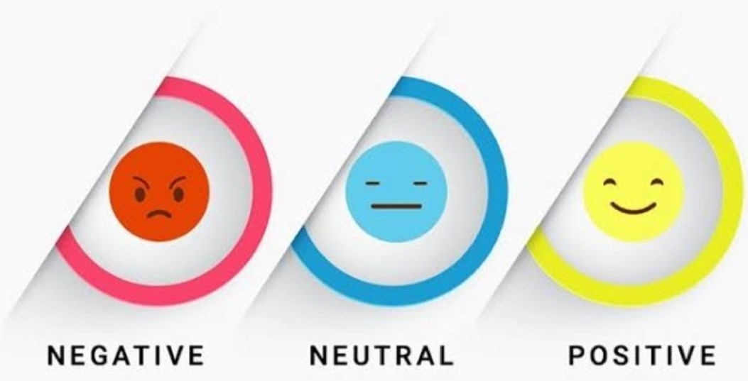
Sentiment Analysis
Sentiment Analysis is a process of determining whether a piece of writing is positive ,negative or neutral.
It is also known as OPINION MINING.

Slide 3

Twitter
Twitter is the best Application through which we can communicate with people all over the world

Slide 4
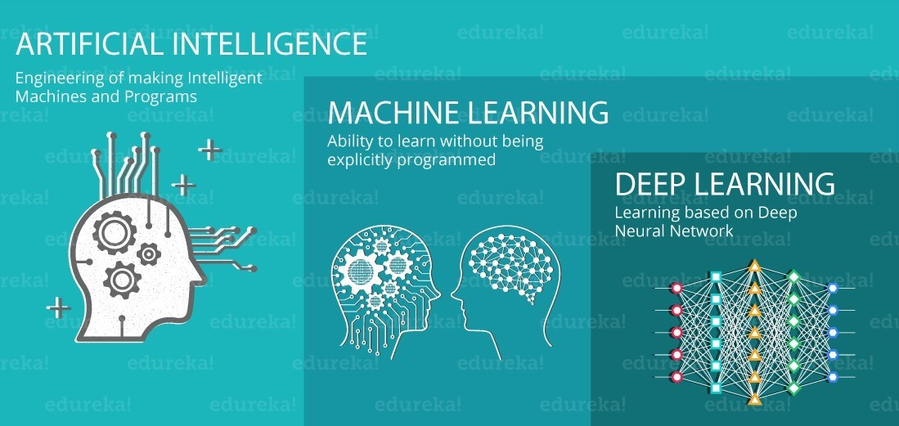
Deep Learning
Deep Learning is a part broader family of Machine learning methods based on artificial neural networks.
Deep Learning is an AI function that initiates the working of human brain in processing data and creating patterns for use in decision making

Slide 5
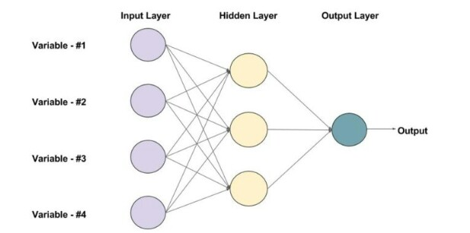
The algorithm that we use to implement this use case are:
1.NLP
2.ANN
Some of the libraries are:
1.Twitter
2.JSON
3.NLTK
4.CSV

Slide 6
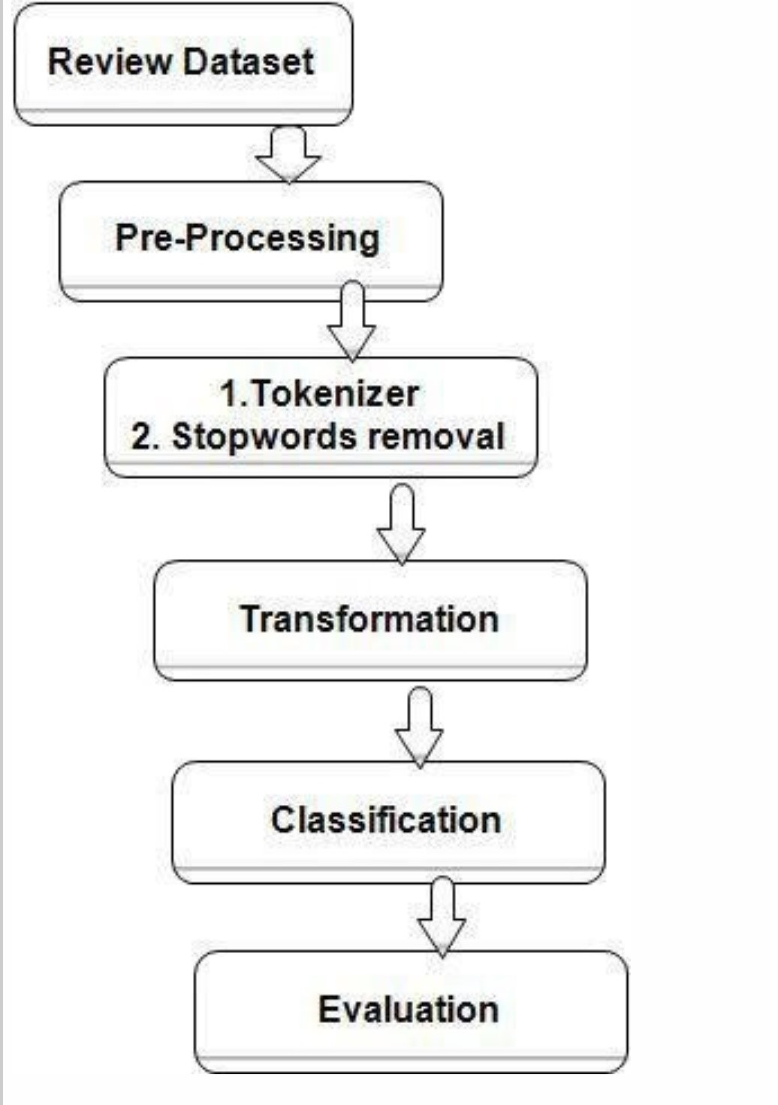
These are the steps that we use to implement our project

Slide 7
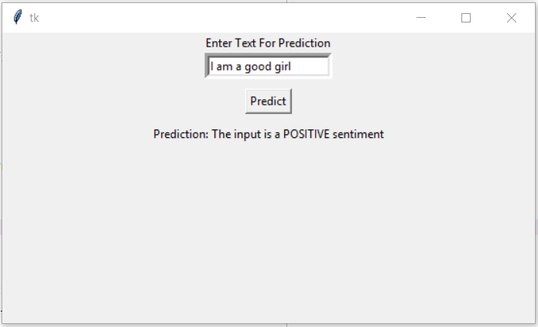
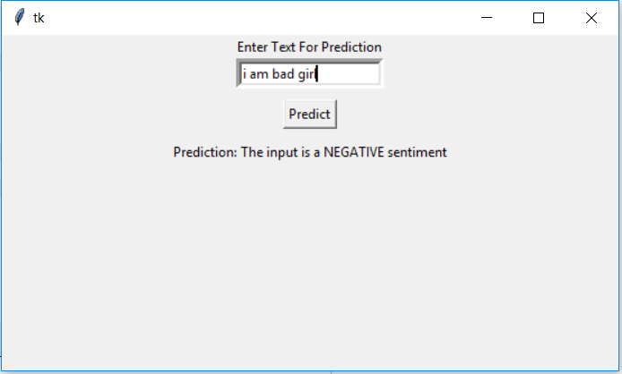
Sample Outputs of the project

Slide 8
Conclusion
Twitter sentiment analysis comes under the category of text and opinion mining.
It comprises of steps like data collection, text pre-processing, sentiment detection, sentiment classification, training and testing the model.
Hence sentiment analysis has a very bright scope of development in future.

Slide 9


