Slide 1

COMPANY TuRNOVER PREDICTOR
Team Members:
M. Issac
Md. Yaser Ali Tariq
Akhilesh C.M
Y. Uday Sai Simha

Slide 2

CONTENTS
INTRODUCTION
DATA PREPROCESSING
GENERATION OF PREDICTED OUTPUT
USER INTERFACE
CONCLUSIONS

Slide 3
iNTRODUCTION
In computer science, artificial intelligence (AI), sometimes called machine intelligence, is intelligence demonstrated by machines, in contrast to the natural intelligence displayed by humans and animals.
AI can learn through data, teach itself, respond in real time, achieves accuracy, organise data to get most of it.
Artificial intelligence can be achieved by training the neural networks. It can be done using a programming language called Python.
Python is an object-oriented, high-level programming language with integrated dynamic semantics primarily for web and app development.

Slide 4

REGRESSION
Linear regression is a linear model wherein a model that assumes a linear relationship between the input variables (x) and the single output variable (y).
Here the y can be calculated from a linear combination of the input variables (x). When there is a single input regression.
When there are multiple input variables, the procedure is referred as multiple linear regression variable (x), the method is called a simple linear.
Simple linear regression is useful in financial portfolio predictions and salary forecasting.

Slide 5
Data preprocessing and prediction
The methods used in this model are :
Data Collection
Data Selection
3. Constructing ANN
4. Training the Neural Network
Building a UI
Data Collection is a method where data is searched and collected from various sites and suitable is selected for the project.
Data Selection is a method where the unwanted parameters in a dataset are not considered and only those parameters which are useful are considered.
Constructing a ANN is a method where a artificial neural network is built which is further used to make predictions based on the dataset.
ANN is a a computing system made up of a number of simple, highly interconnected processing elements, which process information by their dynamic state response to external inputs.

Slide 6
User interface
User Interface is built, so that the clients can use the model at ease, without the backend program being exposed, and can predict their companies turnover.
User Interface is designed using node-red and IBM Watson Studio.
The desired inputs and outputs can be placed according to the requirement of the client.

Slide 7
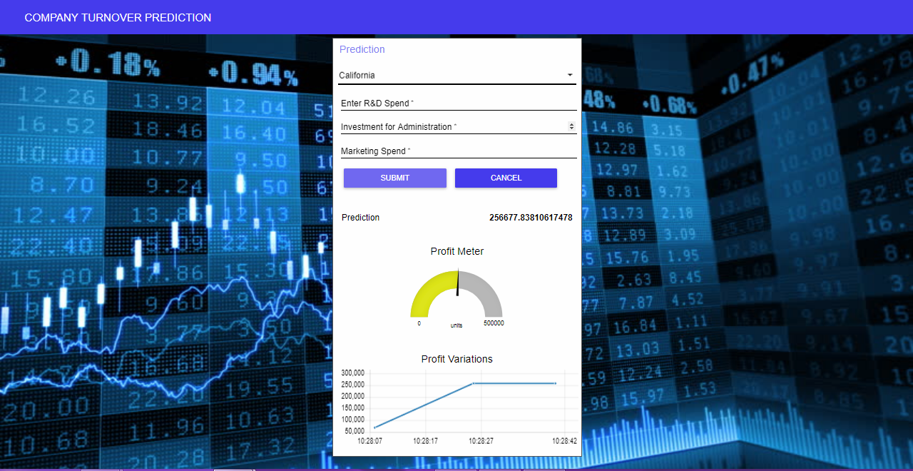
UI AFter deployment

Slide 8
conclusion
This model helps and facilitates many companies to predict their profits.

Slide 9

Thank you

