Slide 1
Smart Home Assistant with Cloud Integration
A . Prem Kumar
K . Vivek
K . Jayanth

Slide 2
PROBLEM STATEMENT :
A home automation project can be made possible by giving voice commands through Alexa.
Alexa is capable of voice interaction, setting alarms, streaming podcasts, playing audio books, and providing weather, traffic, and other real time information. In this project we are configuring Raspberry pi as Voice assistant using Aws alexa services.
We can make a User interface in Adafruit IO and control the switches of that UI through Voice commands and through this voice commands the devices will be turned on and off.

Slide 3
Objective:
Here in this project we sorted out our daily activities in much simpler way by using voice commands.we can control various devices using selected voice commands.we can also get replies to various general questions like time,date etc.

Slide 4
HARDWARE
Raspberrypi
Basic sheild
Usb microphone

Slide 5
SOFTWARE
ALEXA
PYTHON
RASPBIAN
IFTTT(ONLINE)
PUBNUB(ONLINE)

Slide 6
Proposed system :
1. Login into your amazon account.
2. Create a new amazon alexa product and make of note of the product credentials.
3. Connect raspberrypi and download the json file of your amazon product and keep it in the home.
4. Follow the steps as mentioned in the following link to install Alexa in raspberrypi.
https://developer.amazon.com/docs/alexa-voice-service/set-up-raspberry-pi.html

Slide 7
5. After installing alexa in your raspberrypi connect USB microphone to your raspberrypi and go to menu >> preferences >> audio >> select the option with usb microphone.
6. Now connect a 3.3mm jack speaker and test the alexa by saying “ALEXA……”.
7. Login to https://admin.pubnub.com/#/login (PUBNUB) and save the publish and subscribe keys for further use.
8. Follow the steps by logging into your IFTTT .
https://circuitdigest.com/microcontroller-projects/voice-controlled-home-automation-using-amazon-alexa-and-raspberry-pi
9. Run the python code in python2 as python3 doesnot support many features.
10. Open python2 by typing the command “idle python2” in the terminal.
11. Finally make your home smart by using Alexa!!!!

Slide 8
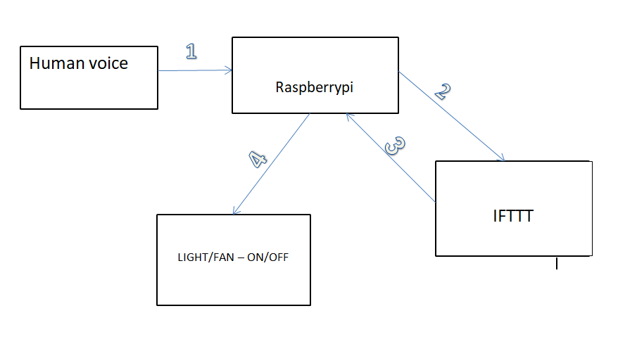

Slide 9
FUTURE SCOPE :
IOT trends the growth perspects ,with the exponential growth in internet usage the next big thing in the queue of technology advancements is ‘INTERNET OF THINGS’. The entire world is migrating towards IOT which will have a huge impacts on lives in the coming five years.We can control various devices using simple commands from different locations which really reduces our work and saves our time

Slide 10
CONCLUSION:
IOT plays a major role in our day to day life ,in which it is very useful in not only getting basic information but also control many devices.Hence we finally able to control devices using raspberryPi and Alexa.

