Slide 1
INTELLIGENT door ACCESS MANAGEMENT SYSTEM

Slide 2
SOLUTION
The solution to intelligent access management system is to create the application that can recognize the motion of the objects and can detect the face .After the picture of the if detected and sent it the cloud .
The sensors we used in this project are:
→DHT11 Sensor ---- the measure the temperature and humidity
→Smoke Sensor---- to detect the smoke in the room or house

Slide 3
→Flame Sensor ---- to detect the flame or any fire senses
→Motor Sensor ---- to rotate the motor …..,in case to open the door
by using the intelligent assistants (ie..,Alexa )
→USB Camera---- to take the snap shots of the object or the face
detected person

Slide 4
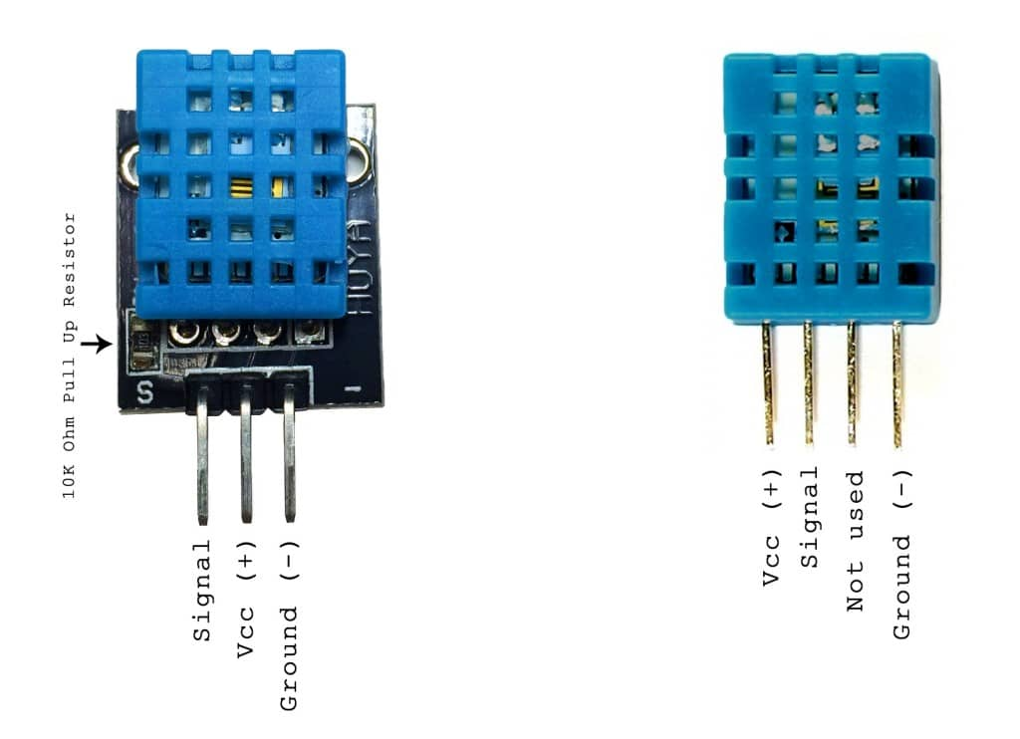
EACH SENSOR USAGE AND CONNECTION
DHT11 Sensor::::
There are two variants of the DHT11 you’re likely to come
across. One is a three pin PCB mounted module and the other is
a four pin stand-alone module. The pinout is different for each
one, so connect the DHT11 according to which one you have:
Here we are using the three pin DHT11 sensor:

Slide 5
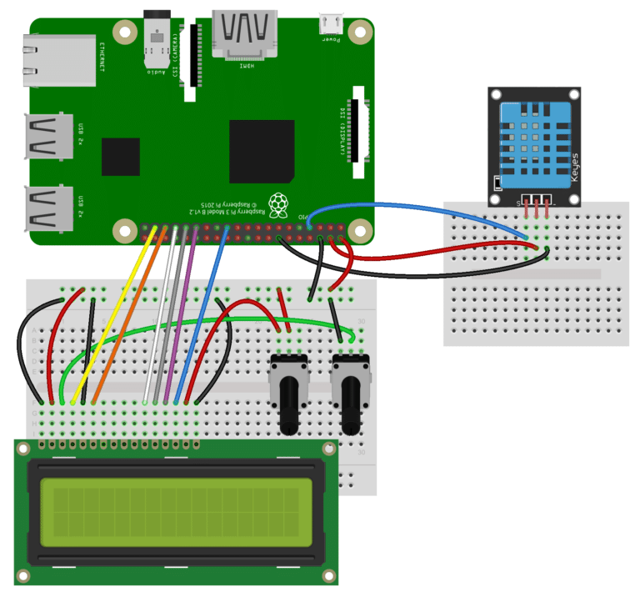
The modules have three pins and are easy to connect directly to the Pi’s GPIO header.
Humidity : 20-80% (5% accuracy)
Temperature : 0-50°C (±2°C accuracy)
The 3 pins should be connected to the Pi as shown in the table below :
DHT11 pin | Signals | Pi pins
1 | 3.3v | 1
2 | Data/Out | 11 (GPIO17)
3 | Ground | 6 or 9

Slide 6
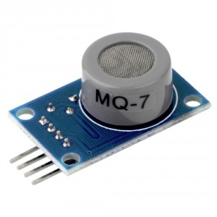
Smoke sensor::::
Sensitive material of MQ-7 gas sensor is SnO2, which with lower conductivity in clean air. It make detection by method of cycle high and low temperature, and detect CO when low temperature (heated by 1.5V). The sensor's conductivity is more higher along with the gas concentration rising.
Character :
Good sensitivity to
Combustible gas in wide range
High sensitivity to Natural gas
Long life and low cost
Simple drive circuit

Slide 7
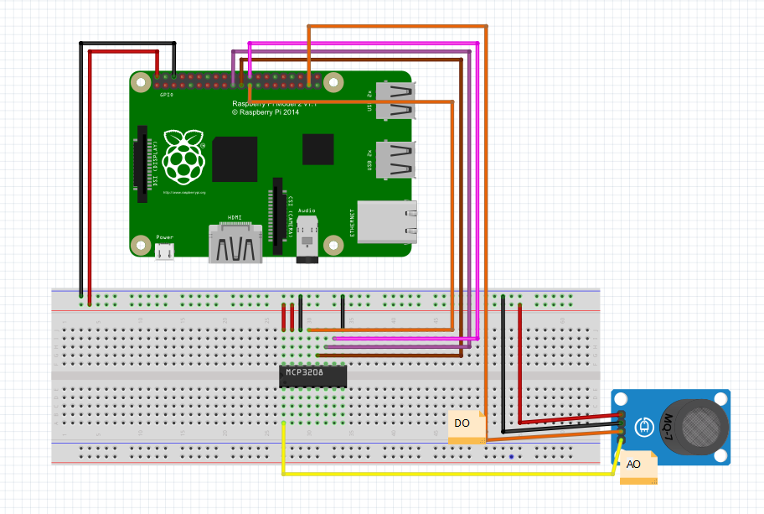
Application:
* Domestic gas leakage detector
* Industrial CO detector
* Portable gas detector

Slide 8
Pin No. | Symbol | Descriptions
1 | DOUT | Digital output
2 | AOUT | Analog output
3 | GND | Power ground
4 | VCC | Positive power supply (2.5V-5.0V)

Slide 9
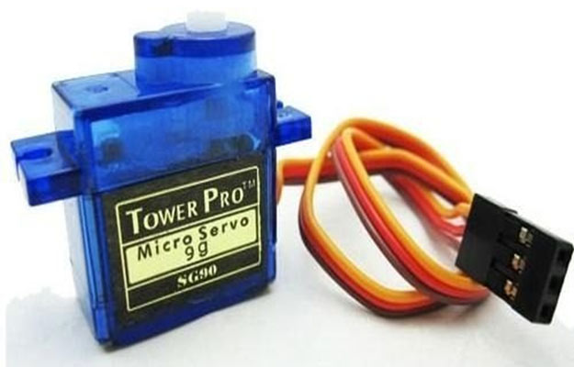
SERVO MOTOR:
It’s small size, low inertia and almost noise and frictionless operation makes the a.c. servomotor particularly attractive in aircraft and spacecraft applications.
Setup(CONNECTIONS)::
In most cases, the colors of the servo are as follows and are connected to the Pi:
Black – comes to GND (pin 6) from the Pi
Red – comes to 3V3 (pin 1) from the Pi
Yellow/Orange – to a free GPIO pin (e.g., GPIO17, pin 11)

Slide 10
Advantages and disadvantages::
Advantages::
Some of the advantages of servo motors over stepper motors are as follows:
High intermittent torque
High torque to inertia ratio
High speeds
Work well for velocity control
Available in all sizes
Quiet
Disadvantages::
More expensive than stepper motors

Slide 11
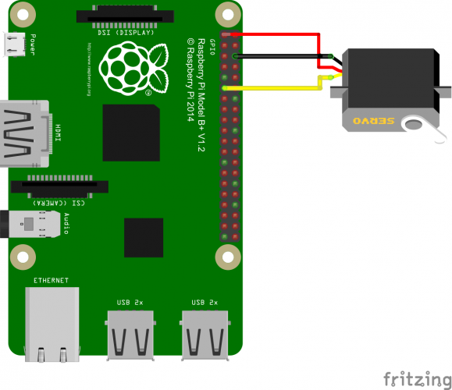
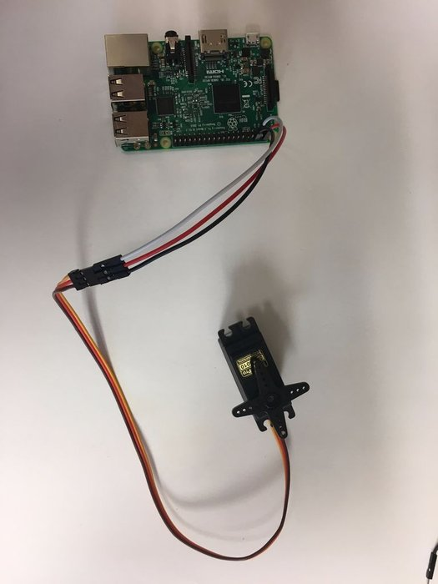
Cannot work open loop - feedback is required
Require tuning of control loop parameters
More maintenance due to brushes on brushed DC motors

Slide 12
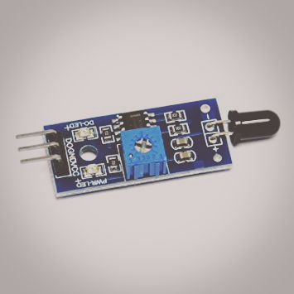
Flame sensor::
This Flame Sensor can be used to detect fire source or other light sources of the wave length in the range of 760nm - 1100 nm.
Features:
High Photo Sensitivity
Fast Response Time
Sensitivity adjustable

Slide 13
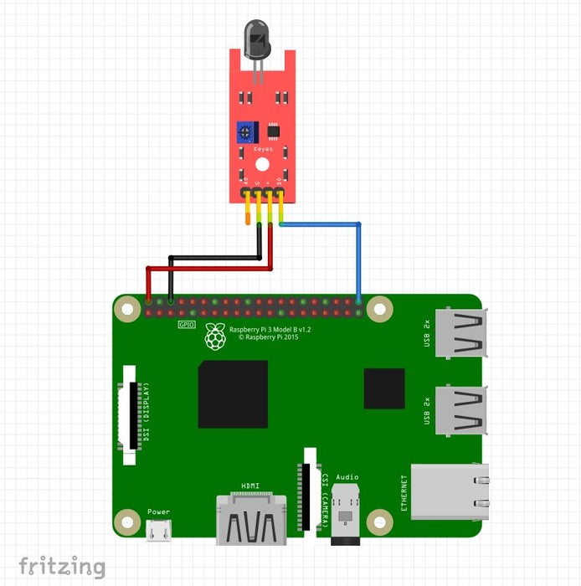
Specification:
Woriking voltage: 3.3v - 5v
Detect range: 60 degrees
Digital/Analog output
On-board LM393 chip

Slide 14
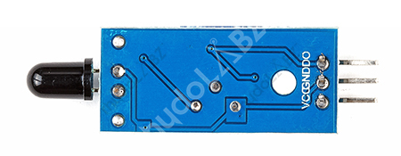
DHT11 sensor | Raspberry pi
VCC | 5V
GND | GND
DO | GPIO 21

Slide 15
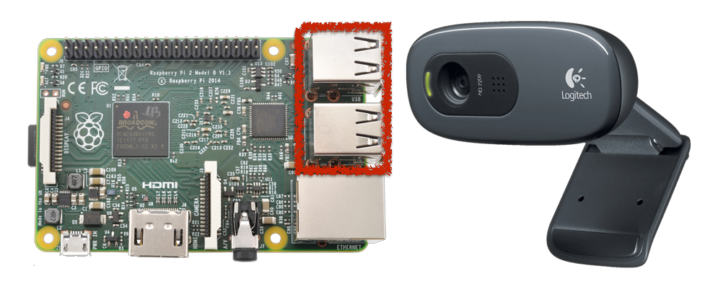
USB CAMERA :::
Starting from small houses to huge industries, surveillance plays very vital role to fulfill our safety aspects as Burglary and theft have always been a problem. In big industries personal security means monitoring the people’s changing information like activities, behavior for the purpose of protecting, managing and influencing confidential details.

Slide 16
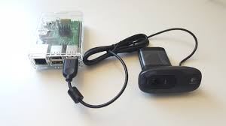
Project Implementation::
Step 1: Setting up Raspberry Pi
Step 2: Operating raspberry pi without monitor display, keyboard and mouse
Step 3: Installing VNC server on Raspberry Pi
Step 4: Client Side (Laptop)
Step 5: Running VNC server at start up in
Raspberry Pi
for some web camera’s we should have install
Open CV installation work with it in python using
Raspberry pi

Slide 17
This is all about our project problem and requirement's according to our solution
Thank You

